Slide 1
Evening Drawing
Week 8: Surface Anatomy
Helena Lukášová, Hana Pokojná

Slide 2
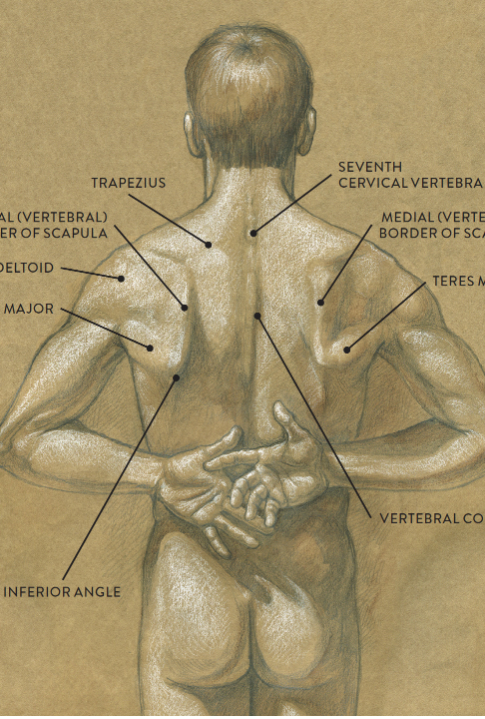
Surface Anatomy
The physiology of the body that we can see on the surface
Muscles
Bones
Glands (sometimes)

Slide 3
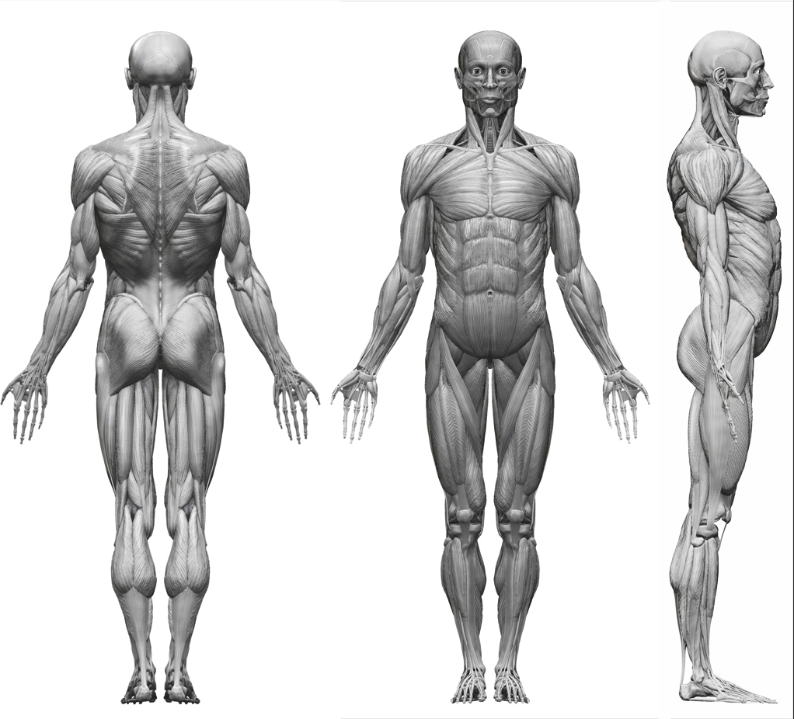
Muscles
The anatomy you can see on the surface, protruding muscles and muscle groups
More obvious on people with higher muscle density, for example, weight lifters
More obvious on men because of biology
http://archive.zbrushcentral.com/printthread.php?t=84848&pp=40

Slide 4
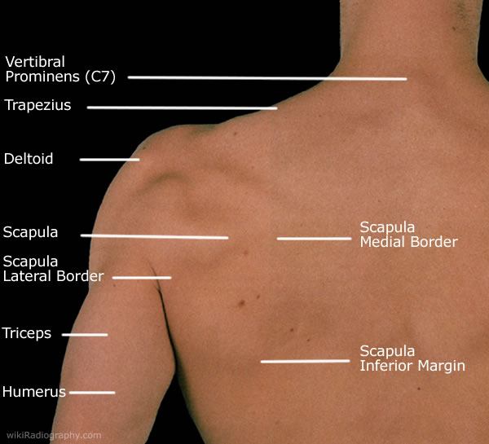
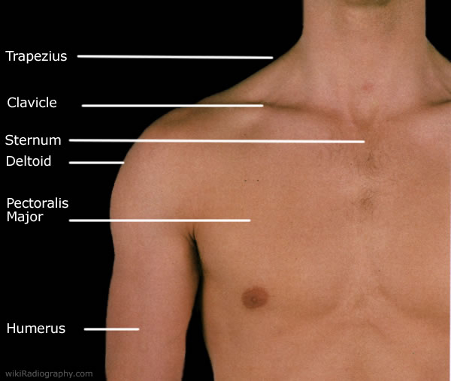
Upper Body
http://www.wikiradiography.net/page/Shoulder

Slide 5
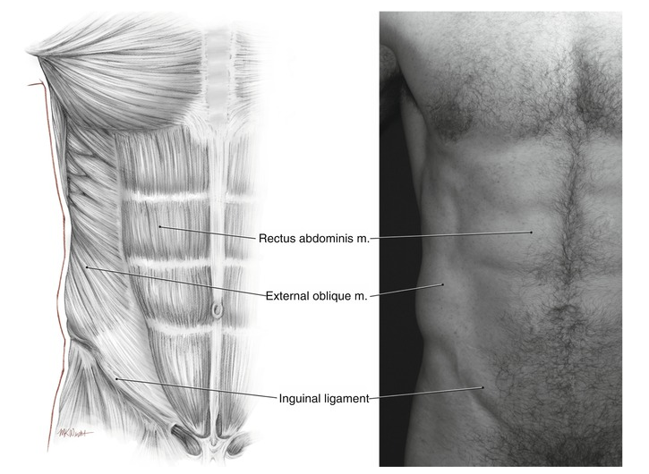
Abdomen
https://plasticsurgerykey.com/muscular-and-surface-anatomy/

Slide 6
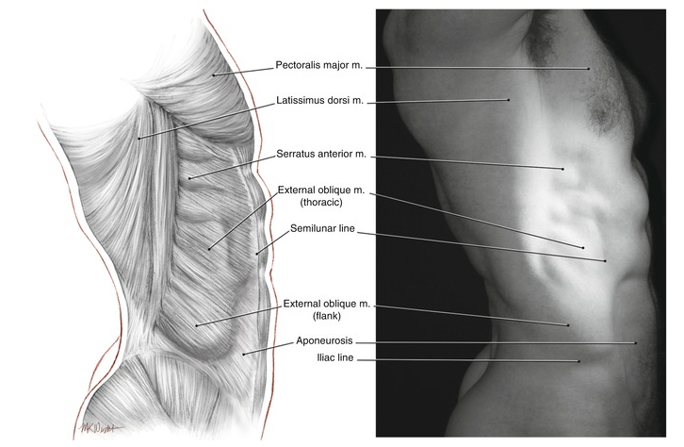
Torso
https://plasticsurgerykey.com/muscular-and-surface-anatomy/

Slide 7
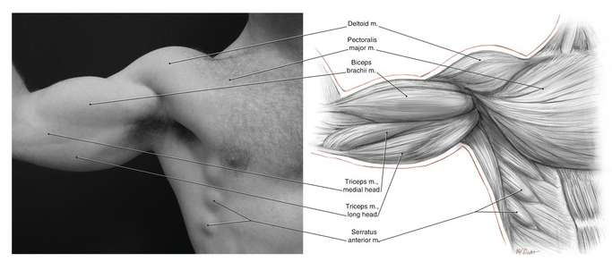
Arm
https://plasticsurgerykey.com/muscular-and-surface-anatomy/

Slide 8
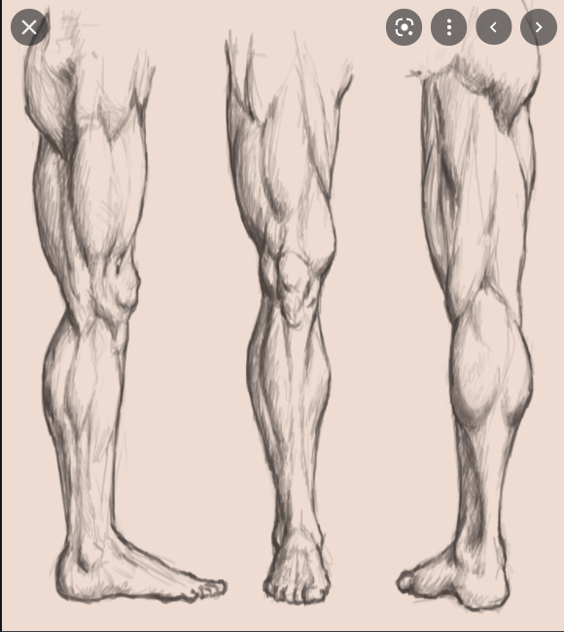
Leg
https://funnyjunk.com/art/75362

Slide 9
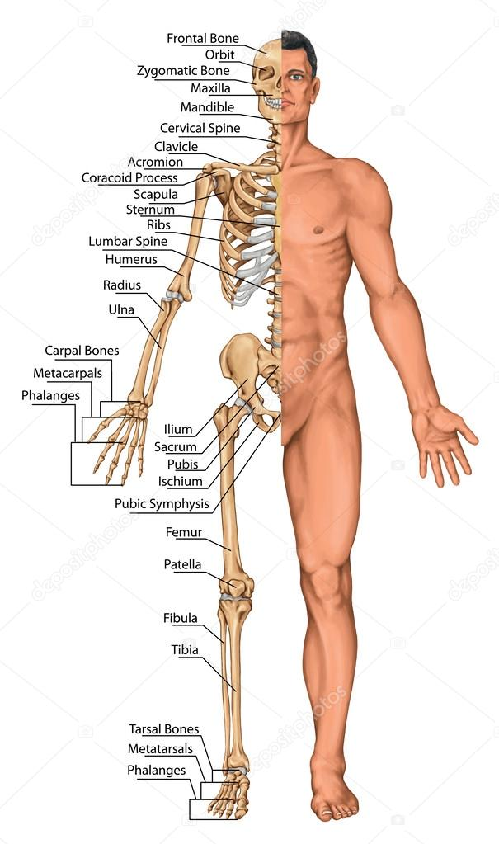
Bones
The anatomy you can see on the surface, protruding bones
More obvious on people with lower fat percentage
https://depositphotos.com/60919253/stock-photo-anatomical-board-anatomical-body-human.html

Slide 10
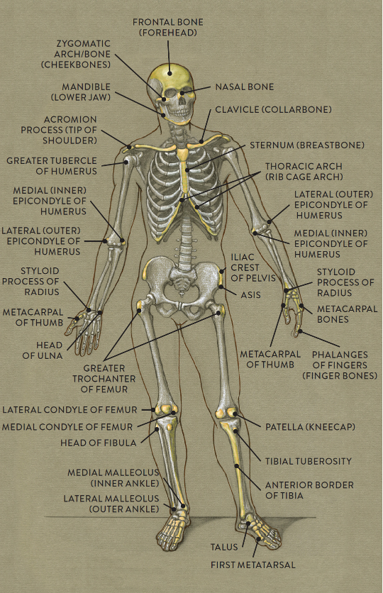
Whole body front
https://schoolbag.info/biology/anatomy/1.html

Slide 11
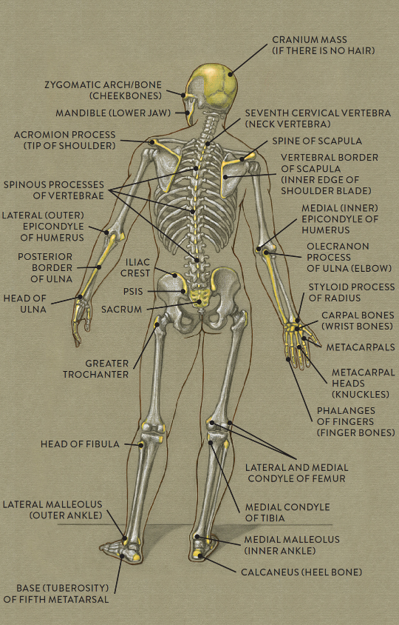
Whole body back
https://schoolbag.info/biology/anatomy/1.html

Slide 12
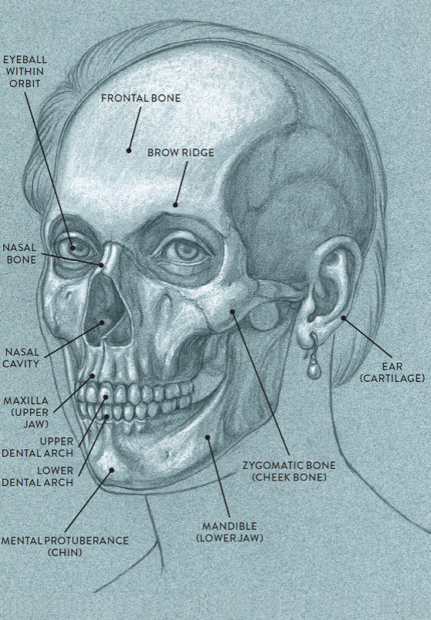
Face
https://schoolbag.info/biology/anatomy/1.html

Slide 13
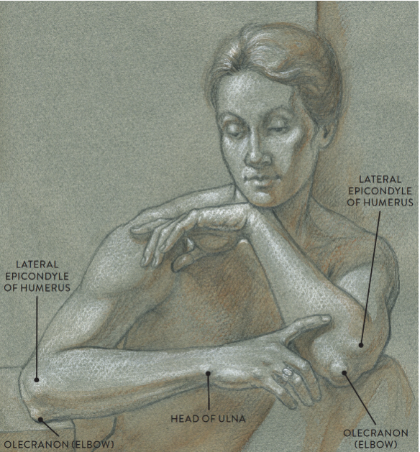
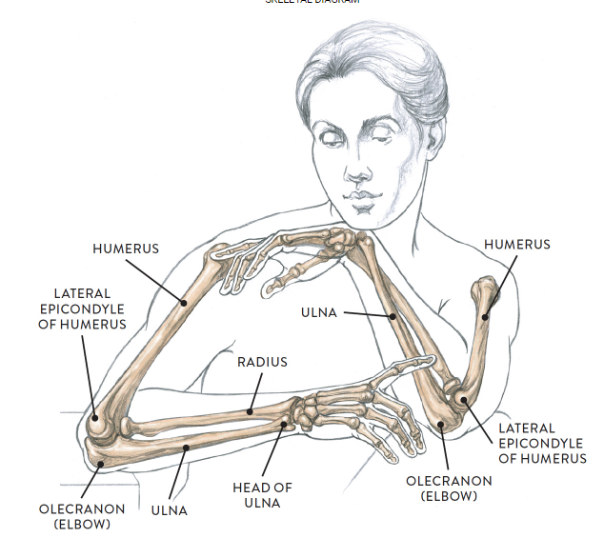
Comparison
https://schoolbag.info/biology/anatomy/1.html

Slide 14
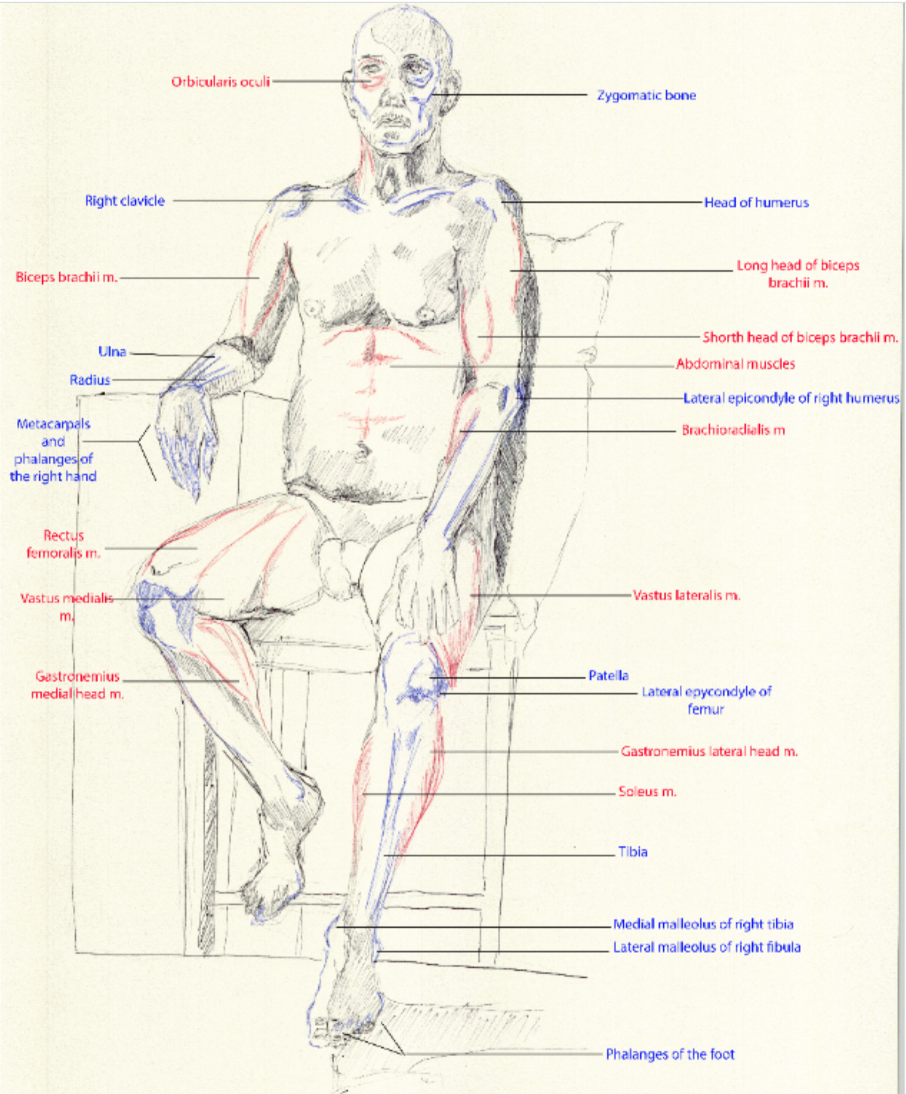
An example showing soft general structures (black), bones (blue) and soft tissue muscles (red).

