Slide 1
Analytical Class Diagram
PB007 Software Engineering I
Lukáš Daubner daubner@mail.muni.cz

Slide 2
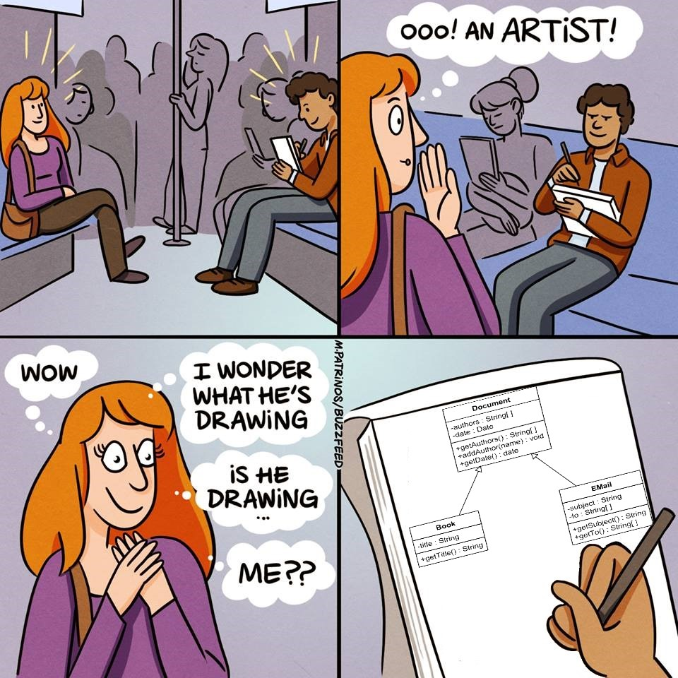
Class Diagram
In general
Static view
Modelling of:
Classes
Attributes
Operations
Relationships

Slide 3
Analytical Class Diagram
Depicts concepts, abstractions, not pieces of code
Relationships
Attributes
It helps us to grasp the domain, make a sense of it
Specify terminology, relationships, dependances, …
ADVANCED: Patterns (Analysis Patterns)
Reusable models – solution to a concrete repeating problems
See this book: Martin Fowler: Analysis Patterns - Reusable Object Models

Slide 4
Analytical Class Diagram
Do not delve into implementation details. Forget about programming
Types
Constructors
Boilerplate methods and classes
Properties (getters, setters)
Language-specific constructs
Etc.

Slide 5
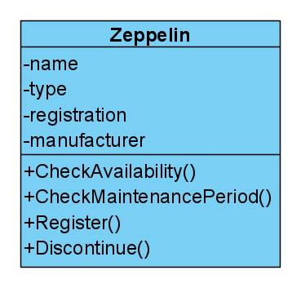
Analytical Class Diagram
How should it look like?
Representative name
Small number of responsibilities (operations)
~3-5
It is not isolated – A part of a system
Low coupling – No spaghetti classes
High cohesion
Operations have MUCH in common
Zeppelin class has operations related to its operation:
CheckAvailability()
CheckMaintenacePeriod()
Discontinue()
Register()

Slide 6
Analytical Class Diagram
Do’s and Dont’s
Be carefull about
Lots of small classes
Few big classes
Service/managers/builders/boilerplate classes
Implementational details, not important for the concept
Complex inheritance hierarchy
Functoids
Classes representing a function or procedure
Try not to think so much about how would you code it
We are not there yet
No interfaces
Again, implementational details

Slide 7
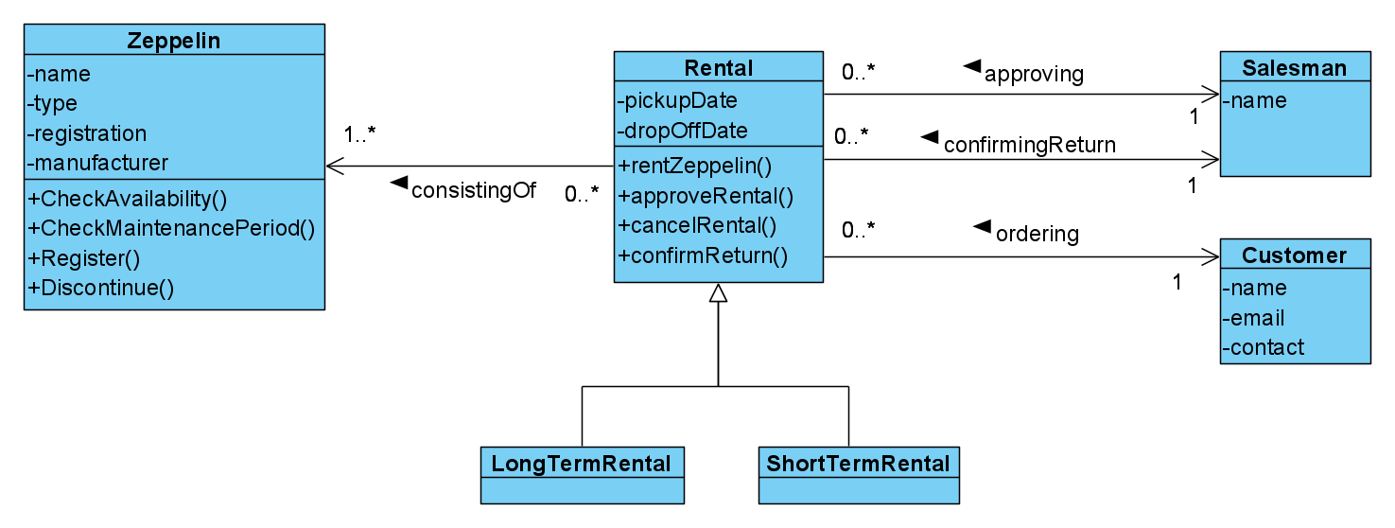
Analytical Class Diagram – Example

Slide 8
How to find analytical classes
For example…
Textual analysis
Use specification, use cases, or any other material available to you
Nouns (Podstaná jména) are often classes or attributes
Verbs (Slovesa) are often relationships or operations
Watch out for “hidden” classes – only implied in the text
Brainstorming
Records candidate classes on sticky notes
Write down their responsibilities
Search for collaborations between them

Slide 9
Relationships between classes
Association
Semantic relationship – from domain
It implies an attribute in one (or both) of the classes – usually
Long-term relationship
It contains:
Name, or name or roles
Multiplicity
Navigability
Multiplicity
How many “partners” can the class have (1:1, 1:N, M:N)
Navigability
Can we effectively “get” from one class to another

Slide 10
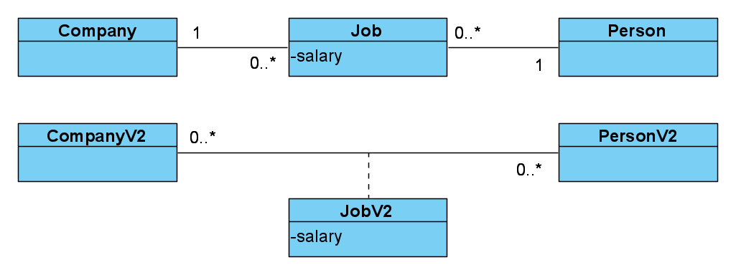
Relationships between classes
Association M:N
All fine in analytical class diagram, it is decomposed later in design class diagram
But, if the relationship is complex, you need to decompose it now
Or use association class, there is at most one relationship between two instances
These two diagrams are not equivalent
Person p can have multiple Jobs in a Company c
Person p can have only one Job in a Company c

Slide 11
Relationships between classes
Multiple associations
Different relationships
Reflexive association

Slide 12
Relationships between classes
Dependency
„Weak association“
Represents a relationship where a change on one class might affect the other
One class somehow depends on the other
The exact meaning is specified by stereotypes
The most common is «use», meaning that some operation uses the other object as attribute or return value. But it does not have it as attribute.

Slide 13
Task for this week
You gotta do what you gotta do
Process the feedback
Model entities, their attributes and associations
Don’t forget inheritance and multiplicity
BONUS: Navigability
You will have to do it someday

Slide 14
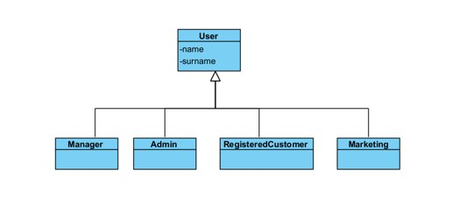
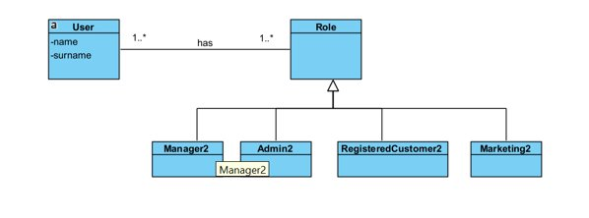
User roles
How can we deal with accounts in our project? Do we need unregistered customers?

Slide 15
Task for next week
You gotta do what you gotta do
Process the feedback
Finish diagram – methods, …
Update the Use Case Diagram. They must describe the same system.
Consider the interaction between objects when fulfilling use cases. Are they represented by your Analytical Class Diagram?

