Slide 1
Effective scheduling, not getting overwhelmed
PV236 – Time Management & Effectiveness
Josef Spurný

Slide 2
Why do we get overwhelmed…?

Slide 3
Why do we get overwhelmed…?
Procrastination
Poor planning → Feeling of “lack of control”
“Wrong” time management
Using TM techniques to fill-in all available time with work AND/OR Forgetting about leisure activities
Being high performer, but losing “the big picture”
Do I really need to do these tasks to achieve what I aspire for?
“Anti-Time Management” by Richie Norton

Slide 4
Why is it better to make plans?
Better control
Think about your hardiness level
More efficient prioritization
Saving time
Avoiding “constant firefighting”
Lower risk of making mistakes
Less anxiety & procrastination

Slide 5
More complex project need more time planning

Slide 6
Golden rules of planning
Plan with deadlines
Record things down in writing
Know your strengths & weaknesses
Merge similar activities into blocks
Plan only for 60 % of time, the rest goes for
Time buffer
Unexpected tasks
Time eaters/disturbances/etc.

Slide 7
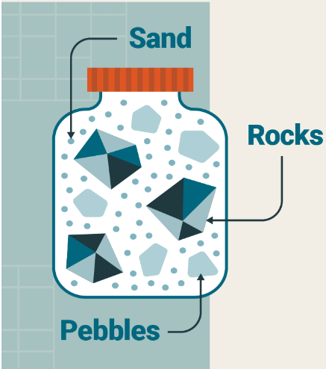
Pickle Jar Theory
Rocks – most important task(s) of the day – place them into jar first
Pebbles – everyday agenda, non-critical tasks – second
Sand – communication overhead, procrastination, unplanned disruptions
“Plan only for 60 % of time”

Slide 8
Inspiration from Project Management
Plan consecutive tasks to save time
Think about activities that can happen simultaneously
A
B
B
A

Slide 9
Inspiration from Project Management – Diploma Thesis Preparation
Work Breakdown Structure
Introduction 2D
Theory 14D
Conceptual Framework 5D
Description of existing approaches 5D
Review of most used tools 3D
Choosing best tool 1D
Case study 28D
Company overview 3D
Organizational structure 1D
Processes mapping 14D
… …

Slide 10
…but beware of Parkinson Law
“Work expands so as to fill the time available for its completion”
Deadline cutting
Set personal deadlines earlier (e.g., 33 % sooner) and use extra time meaningfully
Limit “overhead activities”
Max 20 minutes a day to reply to emails

Slide 11
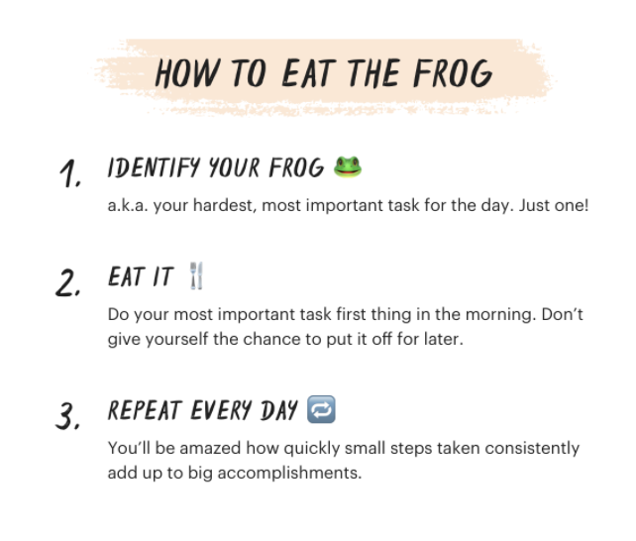
Eat a frog!
“If it's your job to eat a frog, it's best to do it first thing in the morning.
And If it's your job to eat two frogs, it's best to eat the biggest one first.”
Does this work for you?

Slide 12
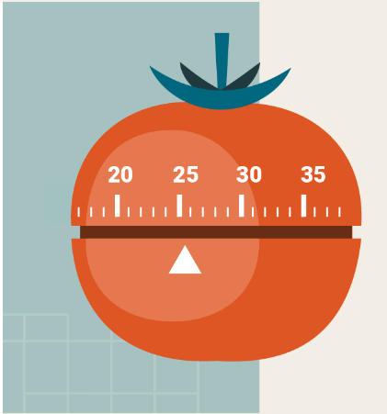
Pomodoro Technique
Choose one and only one task to be done (e.g., eat a frog)
Set-up productive environment
Prevent disruptions
Prepare all resources
Have a notepad ready to write-down any non-related ideas
Start a Pomodoro
Set a timer to 25 minutes, then focus on the task until timer expires. After it does, have a 5-minute break
Session lengths can differ - 25/5 or 50/10 … find out what works for you
Have a longer break (20-30 min) after 2 hours

Slide 13
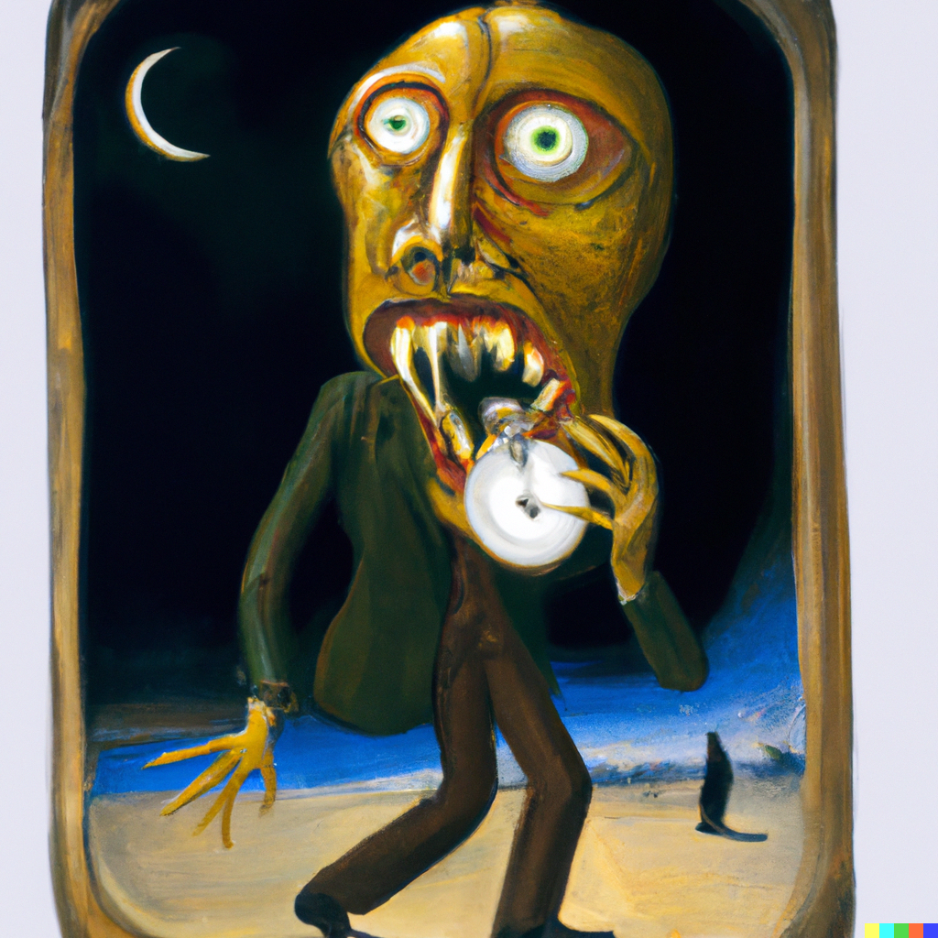
What are your time eaters / distractors?

Slide 14
What are your time eaters / distractors?
No goals and priorities
No daily/weekly/monthly plans
Doing too many things at once
Lack of motivation
Perfectionism
Small talks / IM / Social networks
Poor time estimation
No delegation
Can’t say “no”
Bad listener – can’t focus on what others say
Bad organization – dunno where things are
Meetingitis – too many meetings
Too many “downtimes” – idle times between tasks

Slide 15
Fight your time eaters / distractors!
Identify yours
Find a coping strategy how to deal with it

Slide 16
Coping with external distractions
DISTRACTION | CAN IT BE PREVENTED? | PREVENTIVE MEASURE
Room-mates want to play PS5 | Yes | Plan game sessions
FB Notifications | Yes | Disable notifications
Boss wants you to do something | Hardly | “I’ll do it once I finish this task I’m working on right now, supreme leader”
…

Slide 17
Coping strategy for internal distractions
Introspect yourself what behavior/feelings distract you.
Is there a pattern?
Do you understand why do you behave/feel like this?
Note:
You gotta know yourself
Things one do that are emerging suddenly or that are hard to rationally explain are caused by some emotion

