Slide 1
Human Computer Interaction (HCI)
prof. David Smahel, Ph.D.

Slide 2
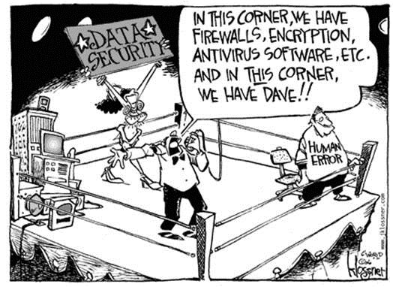
“Humans are the weakest link in cyber security.”

Slide 3
Uživatel (znalosti, osobní charakteristiky…)
Počítač - interface (informatika)
HCI

Slide 4
Jaké různé obory vstupují do HCI a jakým způsobem?

Slide 5
Sociální a humanitní vědy
Psychologie x
Sociologie x
Mediální studia x
Pedagogika x
Sociální práce x
Právo x
Lingvistika x
.....

Slide 6
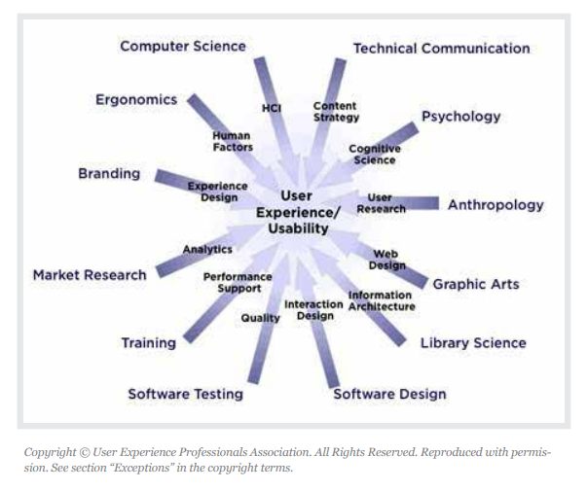
Co je HCI
Carroll, J. M. (2009). Human computer interaction (HCI). Interaction Design Encyclopedia. Retrieved on June, 6, 2010.
Notes:
When installing antivirus program on PC, one of steps in installation is user dialog whether user want or not also detect potentially unwatend application. Potentially unwanted application is spyware and adware that lays in „greay zone“. They are not as harmful as viruses but stil may spy users or make his PC slow and so no. The very interesting is the legal aspect of whole challenge. PUA producers have tendency to sue ESET when detect/do not detect options will not be equal.

Slide 7
Co je HCI
Experti HCI studují, jak lidé komunikují s počítači, a poté vyvíjejí nové technologie, které lidem pomohou používat počítače efektivněji. Cílem HCI je minimalizovat náklady na interakci a učinit interakce „lidštějšími“.
Oblast HCI si klade za cíl zlepšit interakci člověka a počítače prostřednictvím zlepšení funkčnosti, použitelnosti, spolehlivosti a pohodlí počítačových rozhraní.
(Association of HCI: https://www.hci.org.uk/human-computer-interaction)
Notes:
When installing antivirus program on PC, one of steps in installation is user dialog whether user want or not also detect potentially unwatend application. Potentially unwanted application is spyware and adware that lays in „greay zone“. They are not as harmful as viruses but stil may spy users or make his PC slow and so no. The very interesting is the legal aspect of whole challenge. PUA producers have tendency to sue ESET when detect/do not detect options will not be equal.

Slide 8
Oblasti HCI
User experience (+ metody výzkumu pro UE)
Interaction design
Usable security
Gaming
Augmented reality & Virtual reality
Human AI Interactions (Explainable AI, User-friendly AI)
Interaction with robots
Health HCI
Assistive technology
Speech recognition technology (Alexa …)
Eye tracking
Notes:
When installing antivirus program on PC, one of steps in installation is user dialog whether user want or not also detect potentially unwatend application. Potentially unwanted application is spyware and adware that lays in „greay zone“. They are not as harmful as viruses but stil may spy users or make his PC slow and so no. The very interesting is the legal aspect of whole challenge. PUA producers have tendency to sue ESET when detect/do not detect options will not be equal.

Slide 9
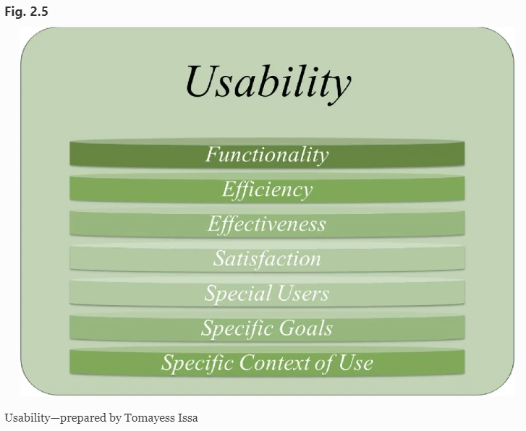
Použitelnost (usability)
Použitelnost jako „kvalita interakce ve smyslu parametrů, jako je čas potřebný k provedení úkolů, počet chyb a čas potřebný k tomu, abychom se stali kompetentním uživatelem“ (Benyon et al. 2005, s. 52).
atribut kvality, který posuzuje, jak snadno se uživatelská rozhraní používají
(Issa, T., & Isaias, P. (2022). Usability and human–computer interaction (hci). In Sustainable Design: HCI, Usability and Environmental Concerns (pp. 23-40). London: Springer London.)
Notes:
When installing antivirus program on PC, one of steps in installation is user dialog whether user want or not also detect potentially unwatend application. Potentially unwanted application is spyware and adware that lays in „greay zone“. They are not as harmful as viruses but stil may spy users or make his PC slow and so no. The very interesting is the legal aspect of whole challenge. PUA producers have tendency to sue ESET when detect/do not detect options will not be equal.

Slide 10
Kritéria použitelnosti
Learnability: pomocí které mohou noví uživatelé zahájit efektivní interakci a dosáhnout maximálního výkonu.
Flexibilita: množství způsobů, jak si uživatel a systém vyměňují informace.
Robustnost: úroveň podpory poskytované uživateli při určování úspěšného dosažení a hodnocení cílů.
Efektivita: jakmile se uživatel „naučí systém“, je to rychlost, s jakou může provádět úkoly.
Zapamatovatelnost: jak snadno si uživatel zapamatuje funkce systému po určité době, kdy jej nepoužívá.
Chyby: Kolik chyb uživatelé dělají, jak závažné jsou
Spokojenost: jak příjemná a příjemná je práce se systémem
(Issa, T., & Isaias, P. (2022). Usability and human–computer interaction (hci). In Sustainable Design: HCI, Usability and Environmental Concerns (pp. 23-40). London: Springer London.)
Notes:
When installing antivirus program on PC, one of steps in installation is user dialog whether user want or not also detect potentially unwatend application. Potentially unwanted application is spyware and adware that lays in „greay zone“. They are not as harmful as viruses but stil may spy users or make his PC slow and so no. The very interesting is the legal aspect of whole challenge. PUA producers have tendency to sue ESET when detect/do not detect options will not be equal.

Slide 11





Usable security:
Experimental research of ICT user behavior in the domain of security
David Smahel
Vaclav Matyas
Vlasta Stavova
Lenka Dedkova
Hana Machackova
Kamil Malinka
Radim Polcak

Slide 12
ESET: Potentially unwanted applications
How to encourage users to enable PUA (potentially unwanted application) detection?
Increase user's security by increasing number of users who enable detecting PUA (spyware, adware, etc.) during antivirus installation process
Legal issues – user‘s own decision, no recommendation
PC platform
Notes:
When installing antivirus program on PC, one of steps in installation is user dialog whether user want or not also detect potentially unwatend application. Potentially unwanted application is spyware and adware that lays in „greay zone“. They are not as harmful as viruses but stil may spy users or make his PC slow and so no. The very interesting is the legal aspect of whole challenge. PUA producers have tendency to sue ESET when detect/do not detect options will not be equal.

Slide 13
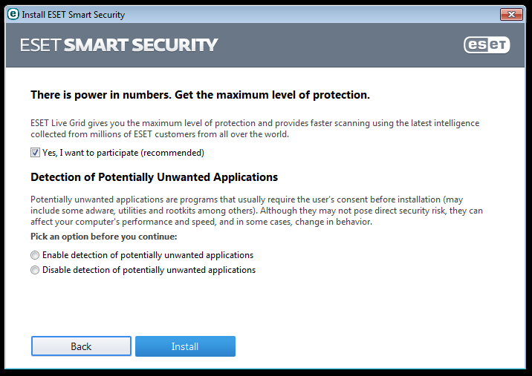
Staňte se UX designery!
Notes:
Základní obrazovka, jedná se o jeden krok v instalaci.

Slide 14
ESET: Potentially unwanted applications
Experiment 1:
  designed 15 versions (incl. original one)
  tested on beta users, N = 87 028
Experiment 2:
  repeated on standard users
  2.1 N = 499 142
  2.2 N = 600 000+ (still collecting; prior to data cleaning)
  difference in behavior of beta x standard users

Slide 15
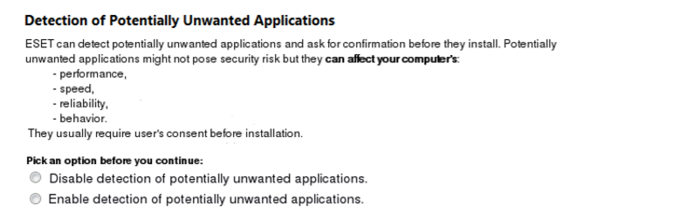
Proposed variants
Notes:
We used several good practises, such as adding a pictorial in contrast colors, add structure, text in a bold type, provide example, variant with and without explanatory text, etc.
The changes we made may seem subtle, but it was impossible to make more
Changes we made may seem subtle, but a conceptual redesign was out of question due to several limitations imposed by the company.
However, we feel that even with our ``subtle'' changes we were able to incorporate some traditional warning design features.

Slide 16
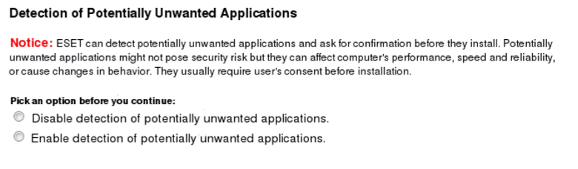
Proposed variants
Notes:
We used several good practises, such as adding a pictorial in contrast colors, add structure, text in a bold type, provide example, variant with and without explanatory text, etc.
The changes we made may seem subtle, but it was impossible to make more
Changes we made may seem subtle, but a conceptual redesign was out of question due to several limitations imposed by the company.
However, we feel that even with our ``subtle'' changes we were able to incorporate some traditional warning design features.

Slide 17
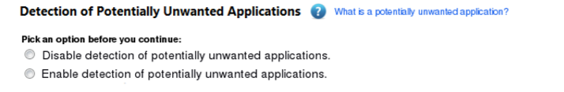
Proposed variants
Notes:
We used several good practises, such as adding a pictorial in contrast colors, add structure, text in a bold type, provide example, variant with and without explanatory text, etc.
The changes we made may seem subtle, but it was impossible to make more
Changes we made may seem subtle, but a conceptual redesign was out of question due to several limitations imposed by the company.
However, we feel that even with our ``subtle'' changes we were able to incorporate some traditional warning design features.

Slide 18
Beta testers: Detecting PUA across screens
Original version
Average

Slide 19




PUA detection: The good choice
Original screen
The order of options
New screen
83.9%
89.8%
positive first
„enable“ better than „detect“

Slide 20
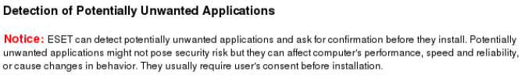

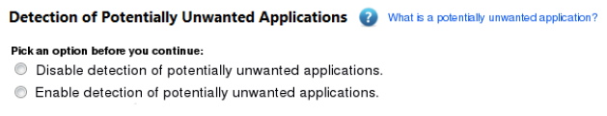
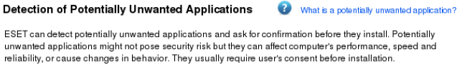
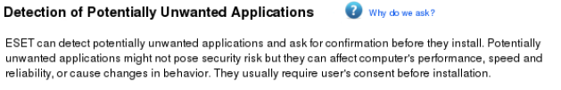
PUA detection: Does not matter
Warnings
Links

Slide 21
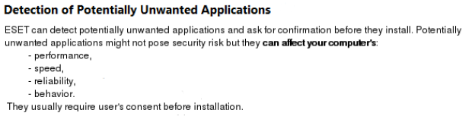
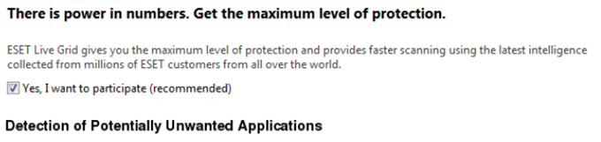
PUA detection: Does not matter
Text structure
Presence of „live grid“

Slide 22
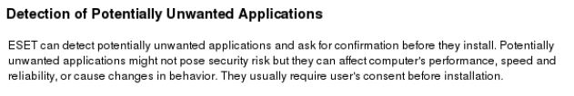

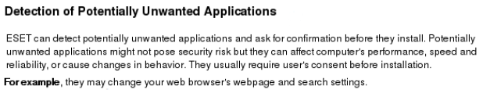
PUA detection: The bad choice (but…)
Original screen
74.5%
New screens
71.4%
72.8%
„full“ screen
72.4%

Slide 23
Beta testers vs. standard users

Slide 24
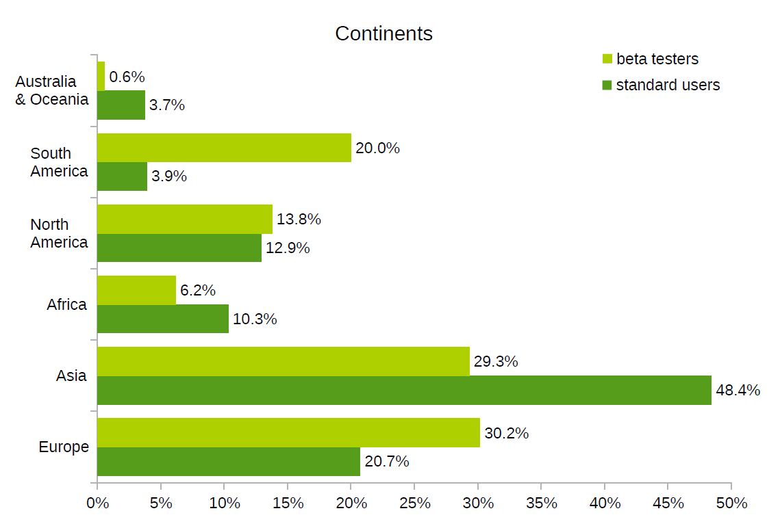
Beta testers vs. standard users
Studie: https://www.youtube.com/watch?v=H7ik9SeAexQ
Negligible differences in terms of HW and SW (platform (32/64-bit), CPU model, RAM size, OS version)
Differences in location

Slide 25
Beta testers vs. standard users
Small differences in gender and age
Beta testers slightly more skilled
But overal, both sub-samples are quite similar (in ESET‘s case)
A large-scale comparative study of beta testers and standard users: Case study of a software security system
(Stavova, V., Dedkova, L., Ukrop, M., & Matyas, V.)
published in Communications of the ACM

Slide 26
Metody používané v HCI

Slide 27
Metody: online nebo offline
Kvalitativní (rozhovory, fokusní skupiny ..)
Uživatelské testování
Kvantitativní (online surveys)
Experimentální metody (exp. design)
Obsahové analýzy
Pozorování
Diáře
Ekologické momentální hodnocení (EMA)
Technické metody
Smíšené metody

Slide 28
Populace: kdo jsou naši uživatelé?
Kdo jsou naši uživatelé a proč chtějí SW používat?
Jak se k nim pro výzkum dostat?
Můžeme je zkoumat online?
Pro jaké typy výzkumů je vhodné online prostředí?

Slide 29
Ecological momentary assessment (EMA): example of research
Michaela Lebedikova, Martina Smahelova, David Smahel, Steriani Elavsky, Martin Tancos, Michal Tkaczyk, Jana Blahosova, Jaromir Plhak, Ondrej Sotolar, Michal Schejbal
Interdisciplinary Research Team on Internet and Society
Masaryk University, Brno, Czech Republic
Notes:
Hi, my name is Michaela Lebedikova and today I will present you how we are testing innovative methods in order to capture more precise data of childrens‘ and adolescents‘ technology usage.

Slide 30





Background
Adolescents and Smartphones
More screen time, internet usage, variability in apps, individualized use (Bedrosova et al., 2018)
Possible diverse impact
Current Research
Self-report > not objective data! (Barbovschi, Green & Vandoninck, 2013)
Call for new methods (Holloway et al., 2013)
Ecological Momentary Assessment
  Ecological validity, shortened recall bias
  Temporal relationships
  Different sources of variability
  BUT: researcher-provided phones (i. e. Jensen et al. 2019)
Notes:
Currently, the majority of adolescents use their mobile phones as their first choice device to access the internet. That leads to more screen time, and variability in use, with a possible diverse impact on their well-being and development. Until few years ago, researchers primarily relied on self-report via surveys, focus groups or interviews to investigate adolescent behavior online. However, with new possibilites, such as the ecological momentary assessment that relies on intensive sampling few times a day for a brief period of time, it became possible to enhance ecological validity and shorten the recall bias. Further, it allows to see detailed unfolding of temporal relationships and distinguish Between different sources of variability. However, this method is mostly used in health and mood research, typically also on researcher provided phones, which means that current research cannot yet sample objective behavior. To overcome the self-report bias in reporting technology use, we propose following solution: combination of intensive sampling and objective smartphone data collection from participants own device with repeated measurement periods, that allows us to see participants objective smartphone behavior and their development over time.

Slide 31
Background
Project
Modelling the FUTURE: Understanding the Impact of Technology on Adolescent‘s
Well-Being
How to best capture adolescents‘ technology usage?
  Example: social media use
Solution
Combine:
  Intensive sampling (EMA)
  Objective smartphone data collection
  Participant‘s device!
Measurement-burst design (Sliwinski 2008)
Notes:
Currently, the majority of adolescents use their mobile phones as their first choice device to access the internet. That leads to more screen time, and variability in use, with a possible diverse impact on their well-being and development. Until few years ago, researchers primarily relied on self-report via surveys, focus groups or interviews to investigate adolescent behavior online. However, with new possibilites, such as the ecological momentary assessment that relies on intensive sampling few times a day for a brief period of time, it became possible to enhance ecological validity and shorten the recall bias. Further, it allows to see detailed unfolding of temporal relationships and distinguish Between different sources of variability. However, this method is mostly used in health and mood research, typically also on researcher provided phones, which means that current research cannot yet sample objective behavior. To overcome the self-report bias in reporting technology use, we propose following solution: combination of intensive sampling and objective smartphone data collection from participants own device with repeated measurement periods, that allows us to see participants objective smartphone behavior and their development over time.

Slide 32




Our Study
Smartphone App
3 data sources
Installed in participant‘s device via Google Play
Available on Android v5 Lollipop +
Ethical Standards
Approval of all relevant ethical bodies
& project lawyer
Standard data protection practices
Machine-learning-based anonymization software of screenshots and all third-party data (Sotolář, Plhák, Šmahel 2021)
Questionnaires
4 times per day
Objective data
IRTIS App
Conversations
Screenshots
Notes:
Our project, Modelling the FUTURE, is concerned with how technology impacts psychological, social and physical wellbeing of adolescents. We developed a research app for Android devices, that is available on Google Play, which combines three data sources: self-report questionnaires (in which we ask about sleep habits, affects or momentary stressors), objective smartphone data (such as the name of currently used application and time spent in it), and screenshots. Additionally, some participants also provided their Messenger conversation data. All data are being sent to encrypted servers of the university, and apart from adhering to standard ethical procedures, we developed a machine learning based anonymization software for all the textual data.

Slide 33

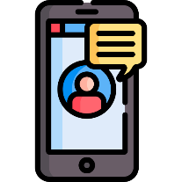


Research Design
Entry
questionnaire
1. burst
5-6/2021
2. burst
9-10/2021
3. burst
1-2/2022
4. burst
4-5/2022
Output
questionnaire
Each measurement burst: 15 days
15
th
Post-burst
questionnaire
3 data sources
Intensive sampling
Notes:
Our study takes one year. In the beginning, participants fill in an online entry questionnaire and download our application. We opted for the measurement burst design, where data collection periods are repeated over time. In our study, we have four bursts, each taking 15 days. For 14 days, the data from three sources are collected: EMA questionnaires four times a day on a semi-random basis, objective smartphone data and screenshots. On the fifteenth day, there is only one questionnaire summarizing the past fourteen days. At the end of the whole study participants fill in an online output questionnaire.

Slide 34
Illustrative Example
With this type of research design we could, for example, ask …
What is the impact of social media use on momentary affect?
  Is the impact of social media on affect different for girls and boys? (between-person hypothesis)
  Is the impact of social media on affect different on days when the use is higher than average? (within-person hypothesis)
Notes:
To explain the analytical advantages and the kinds of answers you can get with our research design, let me show you on an example research question. Lets imagine we want to figure out what is the impact of social media use on momentary affect. Our app logs time spent in every app use duration, so for each participant we can aggregate their daily social media use.

Slide 35

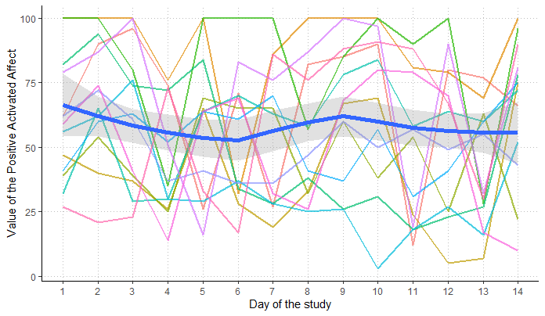

Illustrative example: Analytical advantages
June 2021
N = 201
73
%
Compliance rate
Example: Between-Person Variability in Positive Activated Affect
subset of 13 people with data from evening EMA questionnaire
Notes:
I will illustrate on an example data from our first measurement burst that took place this year in June with two hundred and one participants and a questionnaire compliance rate of 73 %. These data are only a subset of 15 participants and please, do not treat them as results, these are just shown to illustrate my points.
As I mentioned, one of the many advantages is the ability to monitor detailed temporal unfolding of variability. Here I have an example of variability in positive activated affect, which is one of the affective components we measure in the EMA questionnaires that asks whether are participants feeling happy or excited. If you remember, we wanted to see whether social media use impacts affect. Each line represents a participants‘ fluctuation over the 14 days, and the blue line shows mean of all participants, but you can see that no one looks like the mean. Lets assume that affect varies with social media use – the more use, the higher affect. The trajectories are however different – and that is not only because people are different – for example, they have different traits, but also because their behavior changes – for example, someone that is used to use social media a lot will have their parent restrict their access. In cross sectional data, you cannot disentangle these two sources of variability and as Brose and colleagues point out, these type of data are then not illustrative for any kind of variability. But in this type of design, you actually can distinguish between the sources, and also with very precise objective data.

Slide 36
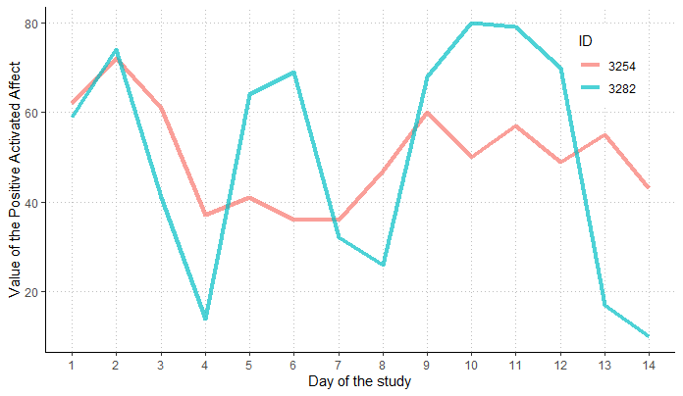
Illustrative example: Analytical advantages
June 2021
M = 50.43 (SD = 11.17)
N = 201
73
M = 50.21 (SD = 25.79)
%
Compliance rate
Example: Within-Person Variability in Positive Activated Affect
subset of 13 people with data from evening EMA questionnaire
Notes:
To further illustrate my point, lets have a look at these two participants. They have nearly the same average, however, that is not very representative of the individual trajectories Only by examining their trajectories we can see how they felt on specific days and whether these fluctuations had anything to do with their media use – for example, our participant 3282 might have had the highest affect on days with high social media use where they talked to their friends, followed by low affect in days in which they haven‘t had enough time on social media. As demonstrated, our data allow for detailed insights, coming in handy for different types of inquiries.
Přidat SNS use

Slide 37
Illustrative example: Analytical advantages
June 2021
M = 50.43 (SD = 11.17)
N = 201
73
M = 50.21 (SD = 25.79)
%
Compliance rate
Example: Within-Person Variability in Positive Activated Affect
subset of 13 people with data from evening EMA questionnaire
Notes:
To further illustrate my point, lets have a look at these two participants. They have nearly the same average, however, that is not very representative of the individual trajectories Only by examining their trajectories we can see how they felt on specific days and whether these fluctuations had anything to do with their media use – for example, our participant 3282 might have had the highest affect on days with high social media use where they talked to their friends, followed by low affect in days in which they haven‘t had enough time on social media. As demonstrated, our data allow for detailed insights, coming in handy for different types of inquiries.
Přidat SNS use

Slide 38

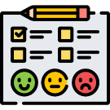


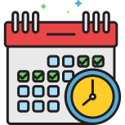
Feasible? Yes!
However…
Technical issues
Different devices, Google Play policy, questionnaire notifications
Intensive testing required
5 pilot studies (N=85), numerous in-house pilot tests
Recruitment difficulties
Combination of recruitment agency and social media (low willingness to participate)
Privacy concerns
Parents, participants, schools (research advertisement problem)
Study protocol adjustments
Fitting questionnaire window to adjust participants‘ school attendance and hobbies
Notes:
With that said, we found this type of study is feasible with adolescents, however, we faced some serious challenges. First of all, our decision to collect data from participants own devices was the most challenging, as each device is different and we faced many technical difficulties. The biggest issue was with correct questionnaire notifications, as some phones, usually with asian origin such as xiaomi or huawei, did not notify correctly. We also had problems with Google Play policy, for example one time they suspended our app without notice until we made some changes in the data we collect. All of that equired intensive testing on multiple devices within our own team, with college students and then finally with potential participants – we had 5 pilot studies, each testing a new version of the app. For the main study, we faced low willingness to participant. Our recruitment agency was not able to find enough participants – we had to recruit some on our own through social media. Among reasons for non participantions were repeatedly privacy concerns. Finally, we had to adjust the time windows for questionnaires to fit participants schedules.

