Slide 1
Introduction
PV236 – Time management & Effectiveness
Josef Spurný

Slide 2
Course Organization
1 session every 2 weeks
Topics coverage:
  Core Time management Concepts & Techniques
  Lectures focused on topics of your interest

Slide 3
To pass the course
Non-mandatory: lecture attendance (yet recommended)
Mandatory:
  After each session:
      1 homework assignment
      Short reflection (takeaway message)
  Once per semester:
      Short presentation (5-10 minutes + discussion)
      Book review / personal experience with some method or productivity app, success / failure stories, short interactive workshop, etc.
      Aim = to inspire others ☺
Deadline is the midnight before next lecture
Submission via IS ROPOT
2 Options:
during semester (on voluntary basis – contact me via email)
At the end of semester (presentation day)

Slide 4
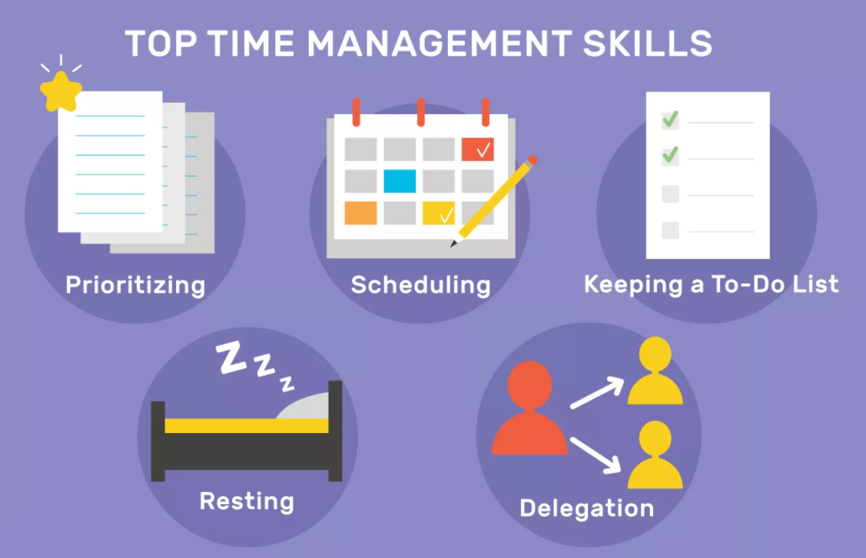
Core Concepts

Slide 5
Topics up to your preference

Slide 6
Topics up to your preference
Procrastination
Emotions, Values, Motivation
Effective Communication
Expectations Management
Crisis Communication
Teamwork, Team dynamics, Agile Teams
Work-life Balance
Building up Habits
Stress, Burnout Syndrome
Uncertainty, Impostor Syndrome
Learn how to say “No”
Self-awareness & Self-delusion

Slide 7
What is more important and why?
Are you EFFECTIVE?
        Are you EFFICIENT?
        What’s the difference?
        What’s more important?

Slide 8
What is more important and why?
Effectiveness = do the right things
Efficiency = do the thing right
So… what’s more important?

Slide 9
Effectiveness vs. Efficiency
Effectiveness
Focus on the accomplishment - to reach for the right goal (or fail)
Efficiency
Focus on the process – to achieve the goal with least amount of resources

Slide 10
Effectiveness vs. Efficiency
Eliminate
Optimize
“There is no code faster than no code”
Kevlin Henney
80 % of results is achieved by 20 % of effort.
Pareto principle

Slide 11
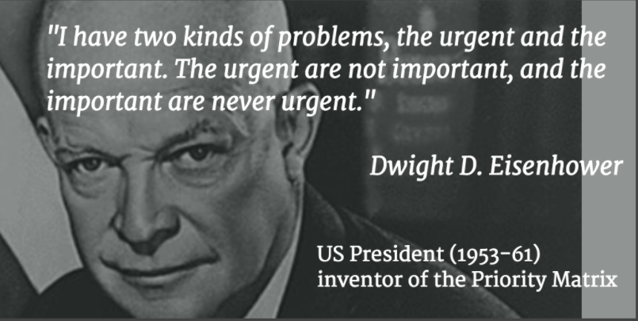
Eisenhower’s Priority Matrix

Slide 12
Important and/or Urgent?
Answer phone call from your boss
Read fresh morning FB wall feed
Finalize class assignment to submit it by midnight
Choose topic for diploma thesis
Confirm calendar event for today’s pub quiz

Slide 13
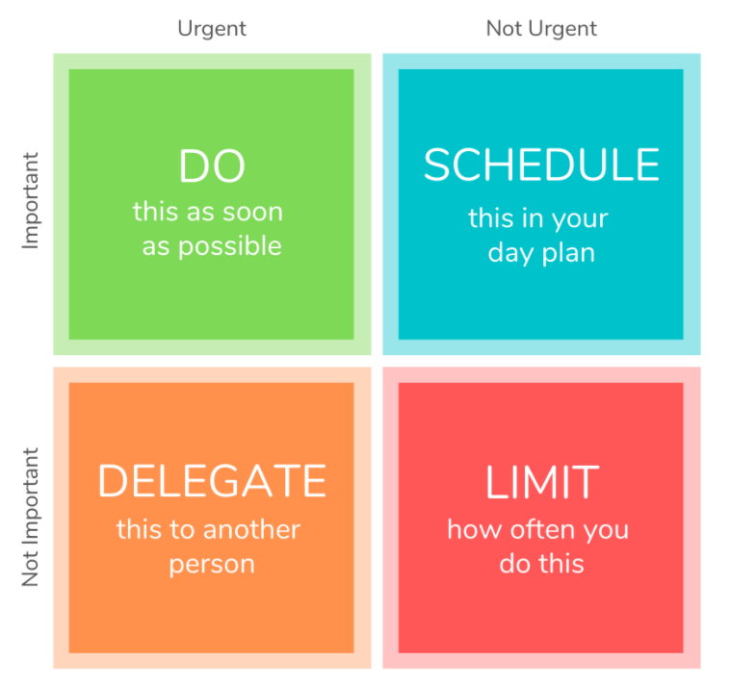
Eisenhower’s Priority Matrix

Slide 14
How much of your time do you spend with each quadrant on daily basis…?

Slide 15
How much of your time do you spend with each quadrant on daily basis…?
What would you like to change…?
I will limit the time spent on … and invest it into…

Slide 16
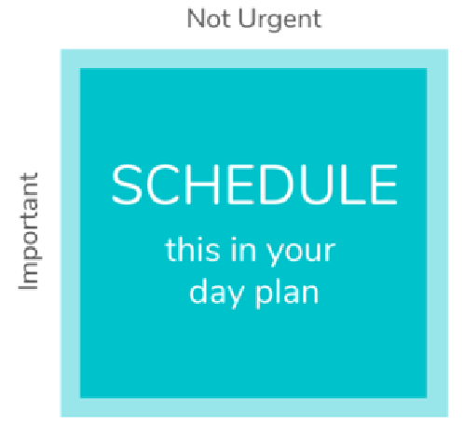
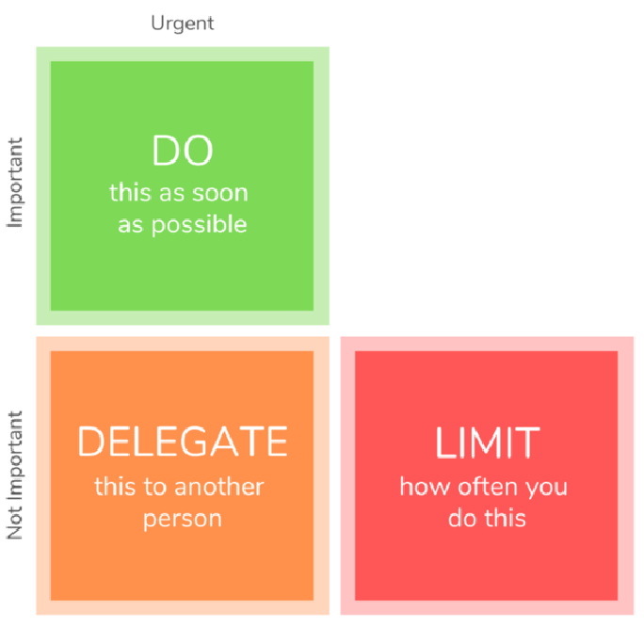
Eisenhower’s Priority Matrix
Don‘t forget to schedule for important but non-urgent tasks:
highest impact on your personal growth
often postponed or forgotten

Slide 17
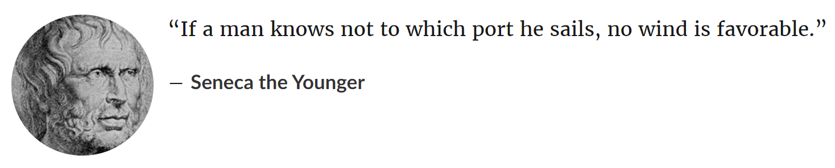
Setting goals

Slide 18
Setting goals
Goals motivate
Only clearly defined goals help to achieve outstanding performance
Goals must be:
  Achievable
  Measurable

Slide 19
“Lack of goals” downward spiral
Lack of goals
Impaired willpower to work
Lack of plans
Feelings of inferiority
Low feeling of success

Slide 20
Are these goals achievable/measurable?
I want to lose weight significantly
I want to win a lottery
I would like to get a better job to get more money
I want to work on my relationship with my wife/husband/ girl-/boyfriend…

Slide 21
Formulation of goals
Formulate goals such that they are specific, realistic and easy to check for success/fail
Avoid ambiguity and goals based on chance or coincidence
Decompose ambitious goals into several easier steps

Slide 22
Reformulate these wishes to be real goals:
Sometime in the future, I would like to travel to Americas.
If I had some extra time, I would learn some new language.
I would like to improve my cardio.

Slide 23
Goals and life roles
Professional
Personal growth
Family / Relationships
Spiritual / Meaning of life
Financial
Hobbies

Slide 24
Which goals are important?
Retrospective exercise:
Imagine yourself 5 years ago (mid-high-school yourself)
Can you recall what was important for you back then?
  Relationships
  Family
  Health
  Studies / Career
  Partying
  Progaming
  Fashion
  …
Are those things still important for you?

Slide 25
Managing goals
Life goals → Plan of goals → Long-term plan → Yearly plan → Monthly plan → Daily plan
Long-term plans give meaning to short-term plans
Do not just think about them – write them down
Does your daily routine help to achieve your goals?
Achieving goals motivate!

Slide 26
Your homework assignment
Make your goals list:
Life goals → Plan of goals → Long-term plan → Yearly plan → Monthly plan → Daily plan

