Slide 1
Emotions, Values, Motivation
PV236 – Time Management & Effectiveness
Josef Spurný

Slide 2


The “Abigail” Group Activity

Slide 3
The “Abigail” - Instructions
Rank-order the characters by personal sympathy

Slide 4
The “Abigail” - Instructions
Rank-order the characters by personal sympathy
Group-up with classmates by most sympathetic character

Slide 5
The “Abigail” - Instructions
Rank-order the characters by personal sympathy
Group-up with classmates by most sympathetic character
Per each group, present why given character is most sympathetic

Slide 6
The “Abigail” - Instructions
Rank-order the characters by personal sympathy
Group-up with classmates by most sympathetic character
Per each group, present why given character is most sympathetic
Create an ordered list of characters for the whole class
  Argue
  Persuade
  Trade-off
  …

Slide 7
The “Abigail” - Archetypes
Abigail – emotional principle
  Courage, willpower... vs. instability, suggestibility, manipulability…
Ivan – assertive principle
  Objective, just … vs. uninterested, selfish, buck-passing…
Ahmed – business principle
  Good deal, keeps his word vs. cynical, abusing…
Jeffrey – orthodox principle
  Has believe in good values… vs. selfish, ruthless…
Rambo – aggressive principle
  Protector of weak, knight… vs. aggressor, looking for incentives to fight

Slide 8
The “Abigail” - Reflections
Sympathies are based on your (recent) experience
Sympathies might change throughout your life
Archetypes apply to many situations in life
  Work team dynamics
  Politics
  Family reunion
  …
People with similar IQ/Education/Social status/… might have very different preferences!
Are you happy with the result of the game? Why (not)?
What life events formed your preferences?
Which character was most irritating? Who from your real life does he/she resembles?

Slide 9
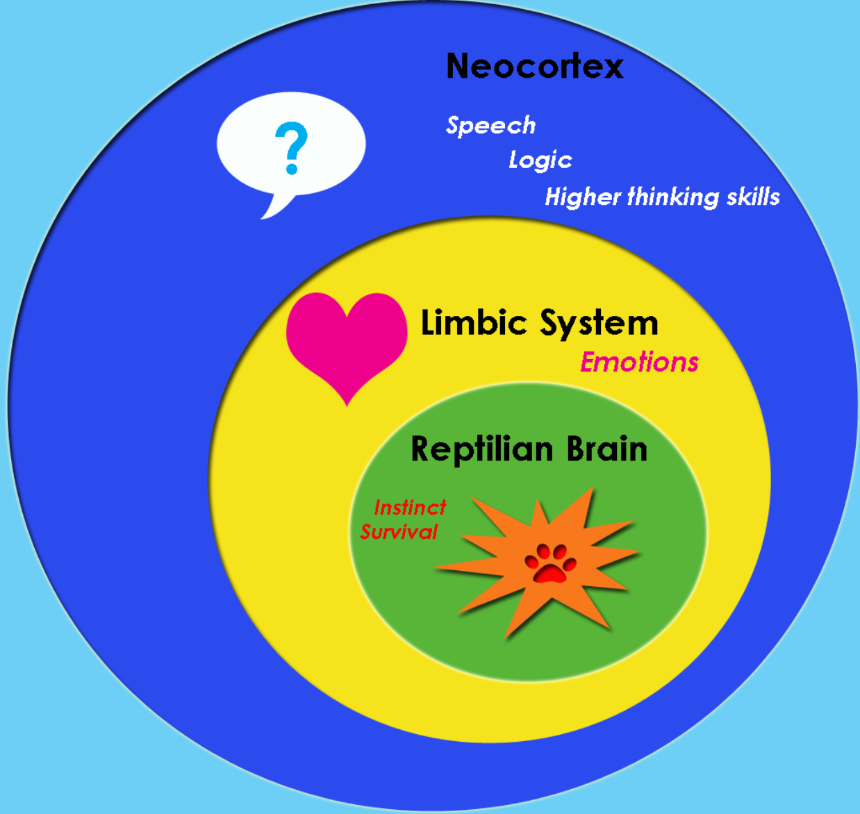
Emotions
Emotions have evolutionary value
  To promote beneficial behavior (increase survival)
  To avoid harmful or threatening stimuli
Emotional Brain
  MacLean Triune Brain Hypothesis
  Limbic system (amygdala, hippocampus, hippothalamus…)
Experience
  Neuronal network
  DNA

Slide 10
Attachment Theory
0-4 years
Child needs → parents’ responses
Attachment types
  Secure
  Insecure
    Anxious – Ambivalent
    Anxious – Avoidant
    Fearful – Avoidant (Disorganized)
Structure of Personality
Equifinality

Slide 11
Equifinality
+
Emo. Valence
-
Strength
Emotional responses tend to repeat themselves
Emotional responses are unexpected, irrational…
People do not change (…just like that…)
Different initial setup results in the same outcome

Slide 12
Are humans rational or emotional?

Slide 13
Emotions
Emotions bear energy (stimulation, activation)
Reason does not bear energy
Emotions provide meaning
  “I’m gonna kill you!”
Long-term emotional patterns give rise to (abstract) values

Slide 14
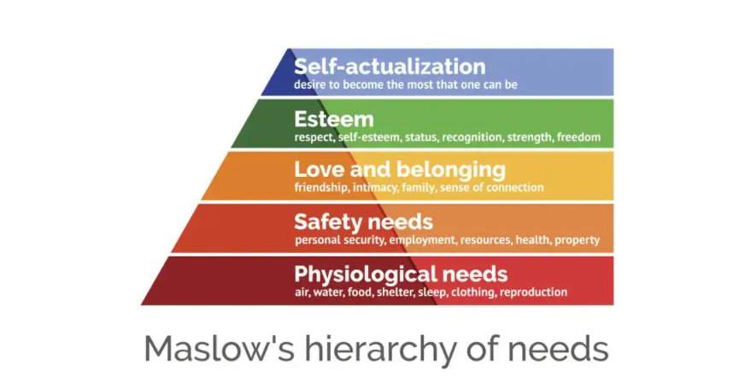
Theory of Human Motivation

Slide 15
Motivation, Will
Actions require energy
Emotions bear energy
“Only dead fish swim with the stream”
Maintaining “emotional metabolism” allows one to swim against the stream
  Will is a higher-order emotion, token of emotional metabolism
  Metabolism has to be provided with resources

Slide 16
Narcissistic Equilibrium
A balance between “wants” and “musts”
In psychoanalytic terms: ego and superego
  Ego = your values, attitudes, desires
  Superego = internalized authority (parent, boss, teacher…)
    “guilty consciousness”
    In order to deliver duties, your ego has to be saturated
    Long-term disequilibrium leads to burnout syndrome
    Manage your narcissistic equilibrium (resources vs expenses)

Slide 17
Emotional saturation – focus on resources
There is no universal guide – you have to know yourself
  Do hobbies
  Relax in a way you enjoy
  Do anything what would bring you positive emotions
  Reward in form of acknowledgement / appreciation
Free time is not a wasted time!

Slide 18
Homework assignment
Resources
Expenses
?
?
Hints:
What charges and discharges your battery?
Can one activity both charge and discharge you? What prevails?
How much time do you invest in these activities?
Does the greatest expense also take the most time?
Can you recharge the battery without guilty consciousness?

