Slide 1
Procrastination & Flow Experience
PV236 – Time Management & Effectiveness
Josef Spurný

Slide 2

Procrastination

Slide 3
What is procrastination?
avoiding doing things
postponing duties
doing “substitute” activities
  Not fulfilling duties, neither relaxing
task swapping

Slide 4
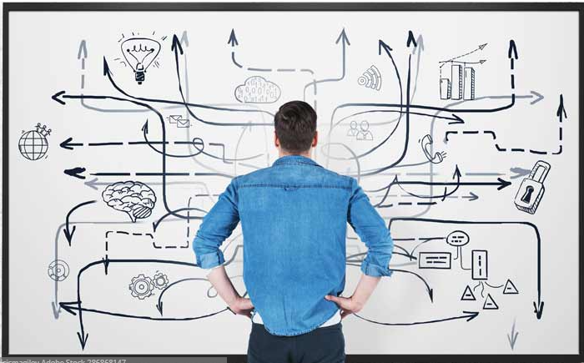
How to become the best procrastinator?

Slide 5
How to become the best procrastinator?
You need to set up your:
  web browser
  smartphone
  room & desk
  time of day
  roommates
  …

Slide 6
Do you procrastinate globally or locally?
Everyone procrastinates, from time to time
Do I have a problem?
    Ongoing, recurrent procrastination
    Procrastinating enjoyable activities
    Consistent struggle to deliver school/work tasks in time
    Subjective feeling that something is wrong, but I can’t help myself

Slide 7
Two aspects of procrastination
Emotional
  I must do things that I do not like
      Do I even know what I enjoy?
  Fear of failure / criticism
Cognitive
  I must do vaguely defined tasks
  I am not sure how to solve it
  Choice paralysis
  → at the end of the day, it still might be an emotional problem
  – uncertainty, lack of self-confidence
  = impaired ability to make decisions

Slide 8
Know yourself to ride the procrastination horse
It’s in your personality
  Self-awareness
  Self-development (vs personal development)
  Therapy / Coaching (aka “guided introspection”)
  Seek meaning
Do you need stress to get to “your” performance level?
  Concept of “psychological hardiness”

Slide 9
Time management paradoxes
Using TM tools and techniques to advocate procrastination
Applied TM leads to increased pressure instead or reducing it
Investing more willpower to self-motivate instead of changing “the system”
  Forming habits
  Removing distractions

Slide 10
Caution: teacher’s subjective opinion!
In the long term, you cannot “solve” procrastination just by pushing yourself to do things you do not want to do (by using tools/techniques)
  This way you are only getting more efficient at discharging your battery
    Burnout syndrome
    Psychosomatic symptoms / diseases
    Stress, aggression, easy irritation
  These techniques should be combined with maintenance of narcissistic equilibrium, and self-awareness

Slide 11
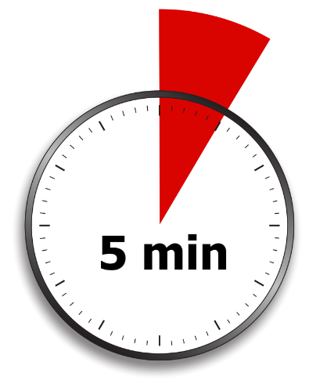
Anti-procrastination tips & techniques
5-minute Wonder
  Choose a task that can be done withing 5 minutes
  Set your timer
  Once you start working, you are much likely to go on
  Unfinished tasks are likely to be stuck in your memory

Slide 12
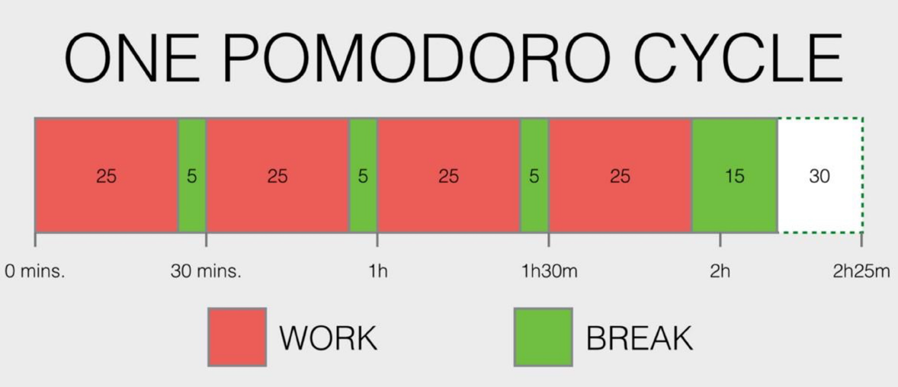
Anti-procrastination tips & techniques
Pomodoro
  25 minutes of focused work followed by 5 minutes brake

Slide 13

Anti-procrastination tips & techniques
Forgive yourself
  The more you can forgive yourself for past procrastination, the more you are likely to stop procrastinating
  break the downward spiral, forgive yourself
  practice mindfulness – meditation, self-appreciation

Slide 14
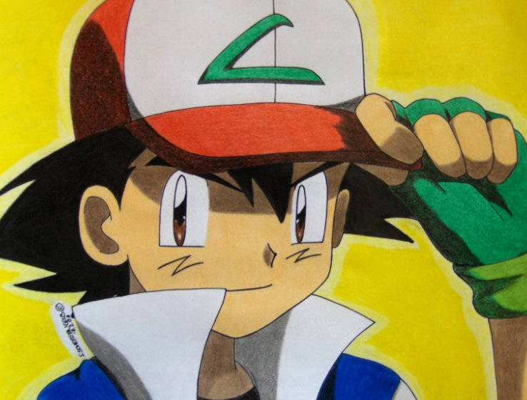
Anti-procrastination tips & techniques
Power Song
  pick a song that is energizing and positive
  play (and sing) that song when you achieve something or when you feel good
  that song will be associated in your brain with positive emotions
  play (and sing) that song when you want start doing something

Slide 15
Anti-procrastination tips & techniques
Reduce decision making
  making decision requires attention and energy
  when feeling good, make planes for upcoming day(s) to avoid decision making later (and multiple times)
    One big thing – plan for one demanding task TBD next day
    No-matter-whats – at least 30min activity that you enjoy
  form up routines (e.g., gym every Wed 6PM) or habits (separate lecture)

Slide 16
Anti-procrastination tips & techniques
All or nothing
  tip by novel writer Raymond Chandler
  when facing a task, dedicate a timeslot (e.g. 90 minutes)
  during this time, you may work on that task (or you don’t – you don’t have to)
  but you should not do anything else!
    Turn-off phone, wifi, doors, windows…whatever
  you are likely to at least start thinking about the task, which is a first step to success
  don’t feel bad when you haven’t written anything – this just wasn’t your day

Slide 17
Anti-procrastination tips & techniques
What else works for you?

Slide 18
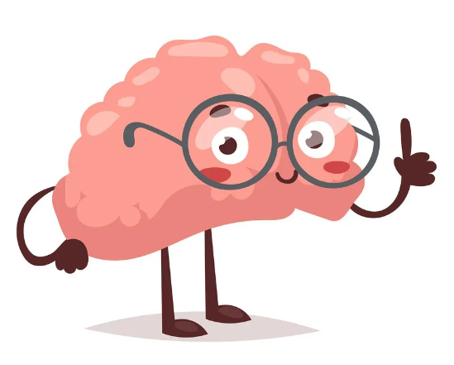
The Flow experience

Slide 19
The Flow experience
Theoretical concept introduced by Hungarian psychologist Mihaly Csikszentmihalyi
A state of high productivity and effortless motivation
No external reward is necessarily present
Positively correlates with motivation level
  Enjoyable activity together with concentration may lead to flow experience more often

Slide 20
How the Flow looks like?
Action-awareness merging
  Involvement in action is automatic and natural
  You become what you do
Full concentration
  Immersion, full engagement in the activity
  Ability to divert distractions
Sense of control
  Rather than consciously trying to remain “in control”, flow experience is about feeling of control without willpower involvement
Loss of Ego
  Normally, we monitor and regulate our behavior to be acceptable by others
  In the flow, people are involved in the activity to such extent that self-monitoring is suppressed
Time distortion
  Subjective feeling of loosing track of time
  Time can be slowed, accelerated or may become irrelevant

Slide 21
How to enter the Flow?
Do you experience flow?
In what situations? Can you repeat it?

Slide 22
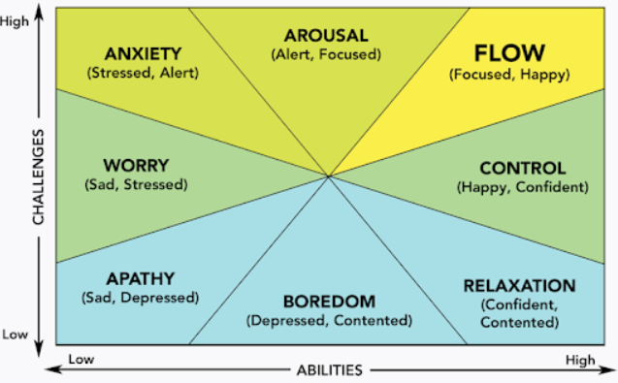
The Flow model

Slide 23
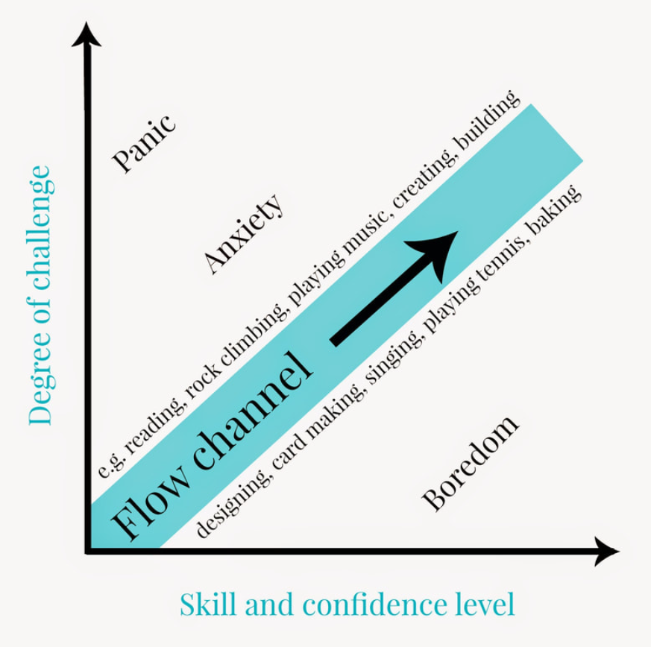
The Flow channel

Slide 24
The Flow preconditions by Csikszentmihalyi
Challenge-skill balance
  Task is not too hard, nor too easy
  “Zone of proximal development”
Well-defined task, consistent feedback
  Both the goal and the path leading to it are clear

Slide 25
Exercises/Tips:
Evaluate your skill level and set appropriate, clearly-defined goals (write them down)
Adjust your daily routine & environment
Create own mission statement – what do you want to achieve?
Focus on internal validation of success instead of external

Slide 26
Homework assignment
1. What are the typical situations that trigger your procrastination?
2. What do you do when you procrastinate? What would you like to do instead?
3. Try out some of the procrastination tips mentioned in this presentation (or any other you will search for) and write a short reflection whether it worked (or not) for you.

