Slide 1
Stress
Burnout Syndrome
Avoiding Getting Overwhelmed
PV236 – Time Management & Effectiveness
Josef Spurný

Slide 2
Stress

Slide 3
Society vs. mind
Acceleration of life pace (Paul Virilio – Dromology)
Fast progress in technology & science
  Boomer: “When I was a little kid, I was curious, I was playing with all kind of technical appliance, a radio for example. Today’s kids don’t do that anymore. How will they become radio-engineers…?”
    Yes, but radios 40 years ago were much simpler than anything nowadays’ kids can play with ☺
  Knowledge grows linearly, but potential combinations grow exponentially → increased specialization in engineering and science
Increased communication (media/social media, advertising…)
Globalization

Slide 4
Society vs. mind
Our brain is a result of exponential growth, too:
    550 M years of brain evolution
    60 M years of primate brain evolution
    200-400 K years of Homo sapiens brain evolution
    50 K years of cultural development
    10K years since agricultural revolution
    150 years since industrial revolution
    50 years since computer revolution
We live in modern society, but our brain is mostly the same as it was thousands of years ago

Slide 5
What is stress?
Living organisms:
  Intake information from their environment
  Process, accumulate and transform information into internal structure (i.e., they learn → evolution)
    Information initiate reaction (fight vs flight)
  Get rid of excess information
Excess information that cannot be “dissipated” (relaxed) causes damage (stress)
Hans Selye
  Nobel Prize laureate in medicine
  author of stress response (alarm – resistance – exhaustion)
  Origin of “civilization” and psychosomatic diseases

Slide 6
The Stress model - discussion
Coping strategy / Relaxation
Internal structure
intake
excess
Source of stress
Psychosomatic health

Slide 7
Healthy techniques of managing stress
increasing awareness about what happens to me
direct efficient solution
looking for alternative solutions
avoiding stressful situation
seeking emotional & social support
maintaining narcissistic equilibrium (discussed already) → Burnout Syndrome

Slide 8
Burnout Syndrome
accumulated emotional exhaustion from work-related stress
feeling of pressure that is
  out of control
  not possible to avoid
Symptoms:
  feelings of being worn-out, depleted of energy, discouraged
  negative attitude towards work and co-workers (paranoia, blaming others, problem-evading…)
  unhappiness at work, mood-swings, lack of concentration…
Long-term consequences may include:
  depression
  sleeping disorders
  psychosomatic diseases (migraine, eczema, non-specific digestion problems…)
  weight-gain (or loss)
  decreased immunity

Slide 9
How not to manage stress?

Slide 10
How not to manage stress?
denying reality
not seeking help
refusing offered help
self-destructive behavior (substance abuse, promiscuity…)
social isolation
…

Slide 11
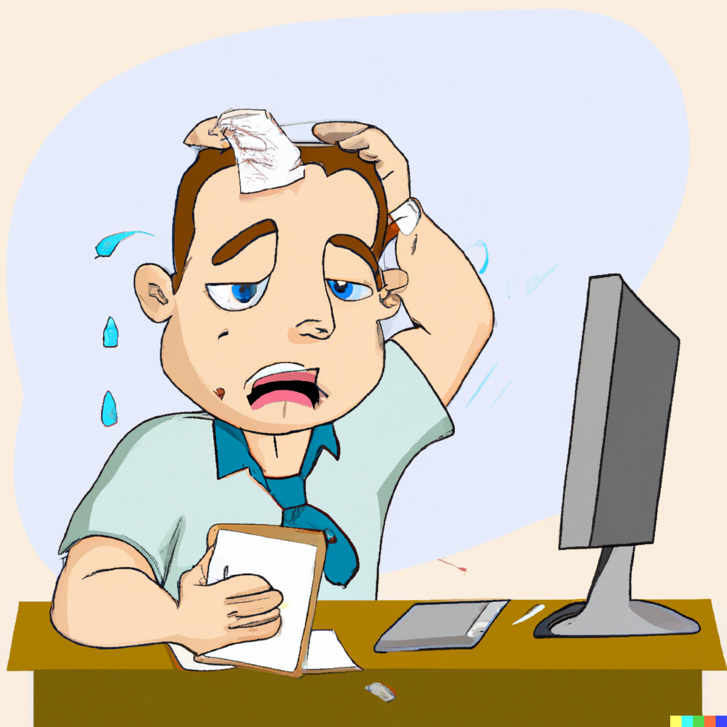
Avoiding Getting Overwhelmed
How can we use TM techniques to avoid getting overwhelmed?

Slide 12
Why do we get overwhelmed…?
Procrastination
Poor planning → Feeling of “lack of control”
“Wrong” time management
  Using TM techniques to fill-in all available time with work AND/OR Forgetting about leisure activities
Being high performer, but losing “the big picture”
  Do I really need to do these tasks to achieve what I aspire for?
  “Anti-Time Management” by Richie Norton

Slide 13
Why is it better to make plans?
Better control
  Think about your hardiness level
More efficient prioritization
Saving time
Avoiding “constant firefighting”
Lower risk of making mistakes
Less anxiety & procrastination

Slide 14
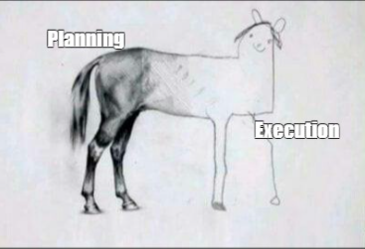
More complex project need more time planning

Slide 15
Golden rules of planning
Plan with deadlines
Record things down in writing
Know your strengths & weaknesses
Merge similar activities into blocks
Plan only for 60 % of time, the rest goes for
  Time buffer
  Unexpected tasks
  Time eaters/disturbances/etc.

Slide 16
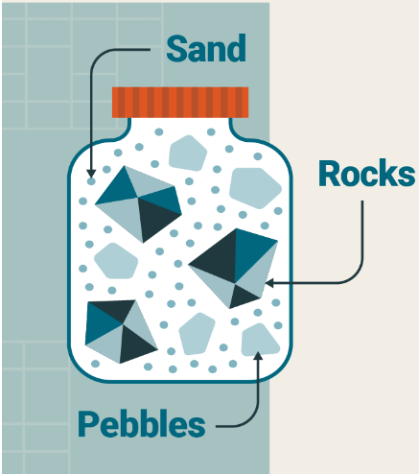
Pickle Jar Theory
Rocks – most important task(s) of the day – place them into jar first
Pebbles – everyday agenda, non-critical tasks – second
Sand – communication overhead, procrastination, unplanned disruptions – last
“Plan only for 60 % of time”

Slide 17
Inspiration from Project Management
Plan consecutive tasks to save time
Think about activities that can happen simultaneously
A
B
B
A

Slide 18
Inspiration from Project Management – Diploma Thesis Preparation
Work Breakdown Structure
  Introduction 2D
  Theory 14D
    Conceptual Framework 5D
    Description of existing approaches 5D
    Review of most used tools 3D
    Choosing best tool 1D
  Case study 28D
    Company overview 3D
    Organizational structure 1D
    Processes mapping 14D
    … …

Slide 19
…but beware of Parkinson Law
“Work expands so as to fill the time available for its completion”
Deadline cutting
  Set personal deadlines earlier (e.g., 33 % sooner) and use extra time meaningfully
Limit “overhead activities”
  Max 20 minutes a day to reply to emails

Slide 20
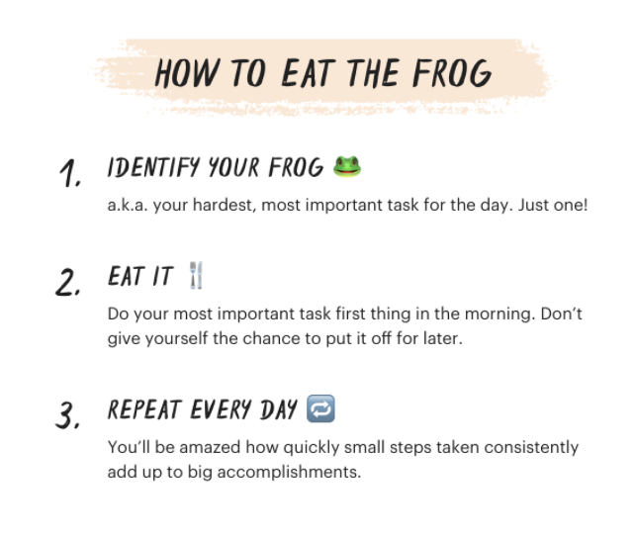
Eat a frog!
“If it's your job to eat a frog, it's best to do it first thing in the morning.
And If it's your job to eat two frogs, it's best to eat the biggest one first.”
Does this work for you?

Slide 21
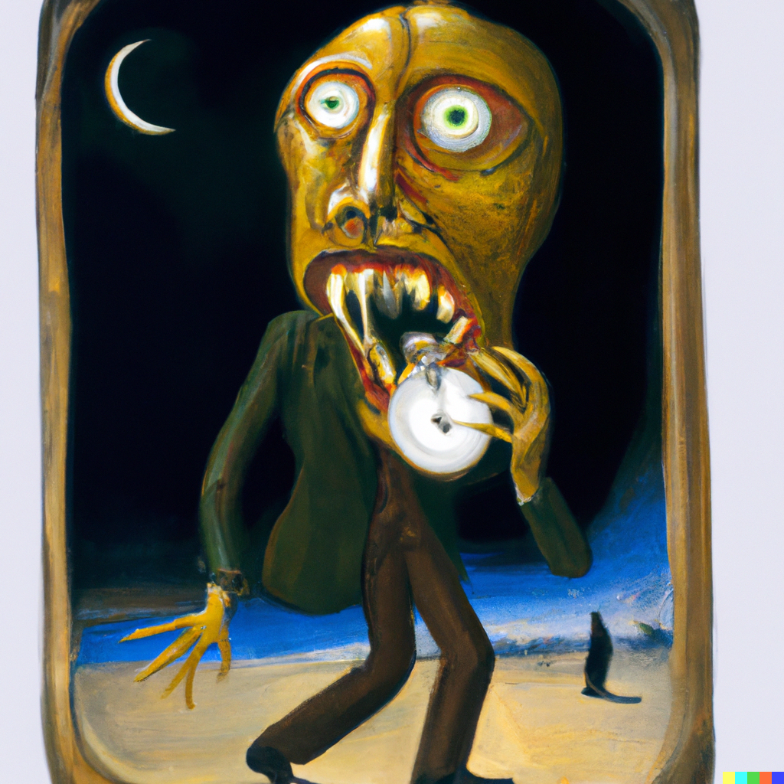
What are your time eaters / distractors?

Slide 22
What are your time eaters / distractors?
No goals and priorities
No daily/weekly/monthly plans
Doing too many things at once
Lack of motivation
Perfectionism
Small talks / IM / Social networks
Poor time estimation
No delegation
Can’t say “no”
Bad listener – can’t focus on what others say
Bad organization – dunno where things are
Meetingitis – too many meetings
Too many “downtimes” – idle times between tasks
Note: Some are internal (in our head), some are external

Slide 23
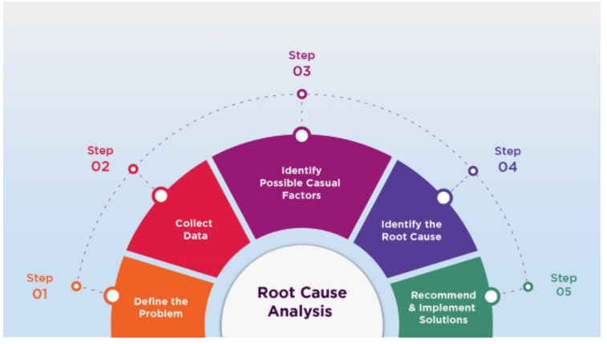
Coping strategy for internal distractions
Introspect yourself what behavior/feelings distract you.
Is there a pattern?
Do you understand why do you behave/feel like this?
Note:
You gotta know yourself
Things one do that are emerging suddenly or that are hard to rationally explain are caused by some emotion

Slide 24
Homework:
Fight your time eaters / distractors!
Identify yours (internal, external)
Can it be prevented?
Find a coping strategy how to deal with it.

Slide 25
Homework:
Fight your time eaters / distractors!
DISTRACTION | CAN IT BE PREVENTED? | PREVENTIVE MEASURE
Room-mates want to play PS5 | Yes | Plan game sessions
FB Notifications | Yes | Disable notifications
Boss wants you to do something | Hardly | “I’ll do it once I finish this task I’m working on right now, supreme leader”
…

