Slide 1
Welcome to
VB 035
English I Course

Slide 2
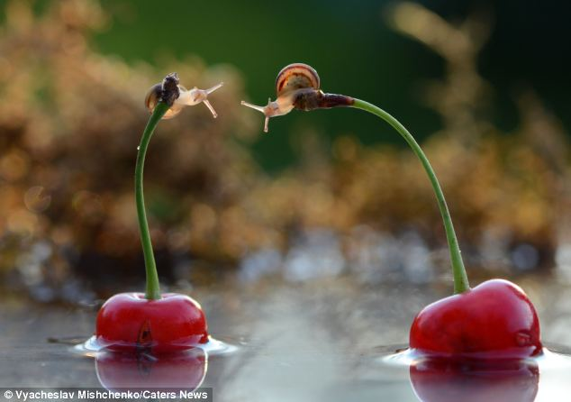
GET TO KNOW EACH OTHER

Slide 3


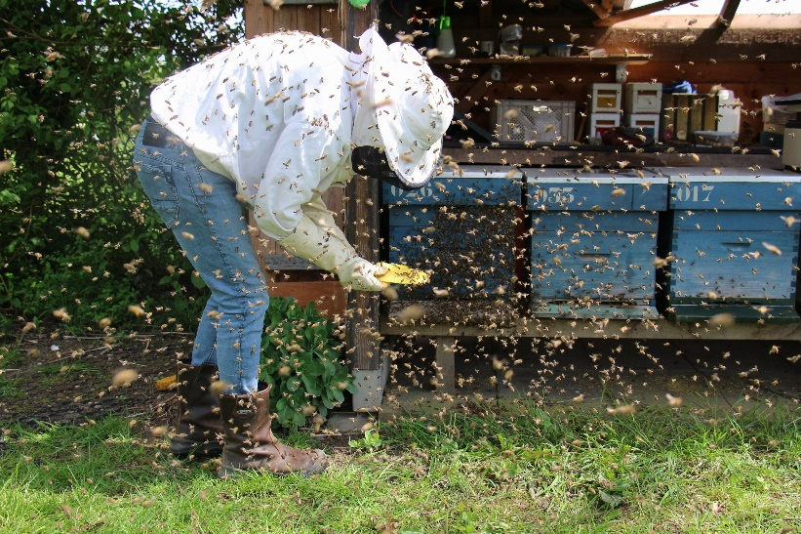
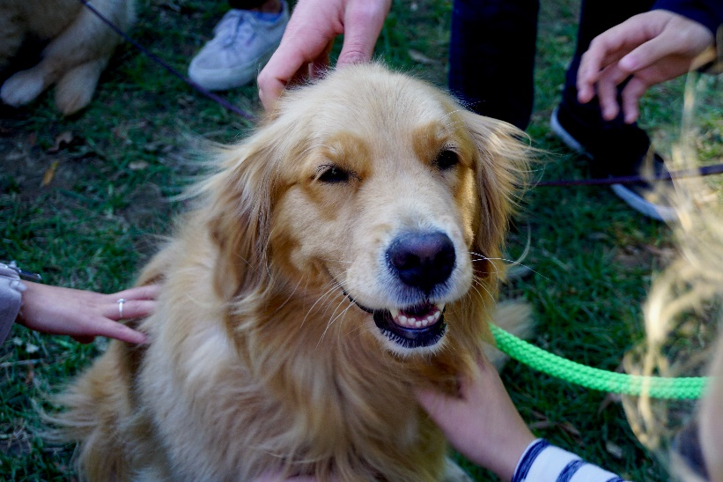
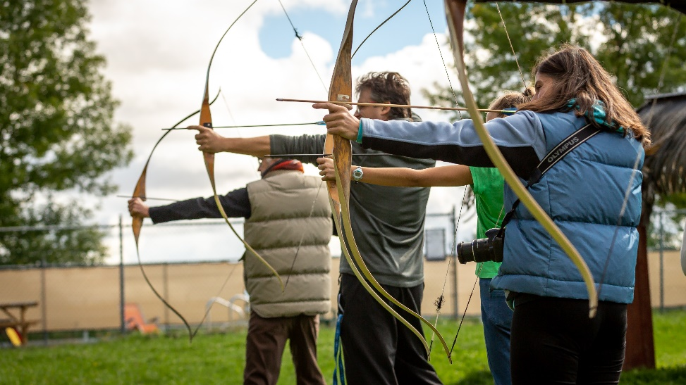
MEMORABLE ME
1. takE three minutes to think of a unique or memorable fact about yourself that makes it easy for others to remember you.
2. We will start with one person introducing themselves by saying their name and sharing their memorable fact.
3. the next person will repeat the previous person‘s name, their memorable thing before introducing themselves, etc.

Slide 4
Course Requirements
Attendance
formal language quiz
a reply to a formal letter
active participation in class assignments
final group project - creation and presentation of the final escape game

Slide 5
Classroom Activities
discussions
individual, pair and group presentations
work with sources
peer review
writing tasks, homework assignments

Slide 6


Slide 7
Session 1 Introductory class
Session 2 Formal language and writing formal emails
Session 3 Discuss the progress of your escape games
Session 4 Present your escape games to the class. Learn how to provide feedback
Session 5 Presentation of the escape game
Session 6 Presentation of the escape game + feedback to the course

Slide 8
EXAM
Listening (True/False statement), sentence completion
Reading (gap filling, correcting mistakes)
Grammar and vocabulary (paraphrasing, word formation, gap filling)
Writing (a reply to formal/semi-formal e-mail)
Presentation, discussion.

Slide 9
English Courses at FI
VV066 English Conversation
VB040 Presentations in English II
CJVAEA English Autonomously

