Slide 1
Service level agreement
PV028 AIS
J. Spurný

Slide 2
Contract for work → SLA
Typically, service for SW is provided by the same company who has delivered the system
Contract for service begins after the system is being handed-over/taken-over
Service contract often has a flat monthly rate
Per year, the service can represent 5-20 % of the total cost for system development, which is an interesting source of income for IT companies

Slide 3
Four basic areas typically covered by SLA
Incident management
Change management
Consultations, training
Prophylaxis (prevention)

Slide 4
Incident management
Solves any kind of problem with the SW, no matter who have caused it (either client, you as provider, or some third party)
Incident needs to be reported through a defined communication channel
  Hotline
  In writing
  Helpdesk – some ticketing system (e.g., Atlassian JIRA)
  Availability: 5x10 / 7x24
SLA may define how incident must be submitted (screenshots, description how to replicate problem, system log files, etc.)

Slide 5
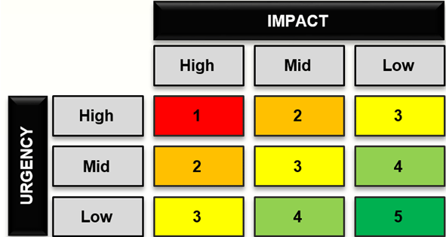
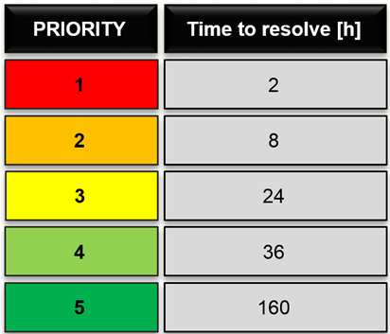
Incident management
Typically, two deadlines are specified in the SLA:
  First response time
  Time to resolve
Incidents are categorized, category has impact on the due times:

Slide 6
Change management
Sometimes called as “development”
Customers often want to improve the system even when it is officially “finished”
Any improvement (adding new data field, changing print templates, improving existing features…) that does not count as incident falls into the change management category

Slide 7
Change management
Typically, SLA has some predefined amount of work expenditure covered (e.g., 5 MD per month)
Unused MD may be transferred to a next month, typically with some cap (e.g., no more than 15 MD can be “collected”)
Additional change requirements are paid separately based on price of extraworks

Slide 8
Consultations, training
SLA may define availability of a service provider for consultations
Consultations are any questions by a customer regarding how to operate the system, where to find some button or functionality, etc.
The extent of consultations provision (and by which means) differs:
  Documentation of code
  User Manuals
  “How-to” videos
  Periodic trainings or workshops (e.g., once per year or after major update is released, etc.)

Slide 9
Prophylaxis - Prevention
SLA may define periodic “health checks” of the system, e.g. twice a year
Prophylaxis is planned such that it will not affect everyday business of the customer (prophylaxis usually takes more than one business day)
Provider will run system tests to determine performance, usage of disc space, CPUs, etc.
Follow-up report is provided to determine, when preventive update of HW will be commendable to avoid system failure in the future

Slide 10
Penalties / Sanctions
Every SLA defines penalties for provider to ensure quality of service
  Missed deadlines
    Incident: first response, time to resolve
      Penalty differ per incident category
    Development: time to deliver new feature
  Repeated unavailability of hotline or helpdesk
  Fixed cost of penalty (e.g., 2000EUR) or percentage of monthly rate (5 %), typically with some cap (no more than 100 % of monthly rate)

Slide 11
Termination of SLA
SLA may be defined for a fixed time (e.g., ten years of operation)
Often times, SLA contract is signed for indefinite period
Termination from any party has to be announced in advance (e.g., 2 year ahead)
SLA may define conditions under which contract may be terminated immediately (serious breach of contract)

Slide 12
Your Homework / Last assignment
Consider the system you have described in your previous assignment
Suggest a suitable concept of SLA for this system
  Is the system critical? Will it need 24x7 support? Or 10x5?
  Think about the typical areas covered by SLA (incident and development are covered almost every time, consultation and prophylaxis not necessarily)
  Think of potential sanctions
Aim of this assignment is to think about importance of SLA and to know what areas it typically covers
It is not necessary to go into details, but at least 1 page is required

