Slide 1
Length of cryptographic keys
Zdeněk Říha

Slide 2
Security of RSA
We choose randomly 2 primes and compute n and φ(n) :
  p, q
  n = p·q
  φ(n) = (p-1)(q-1).
e is chosen such that gcd(e, φ(n)) = 1.
We compute d = e⁻¹ (mod φ(n)).
Public key: n, e.
Private parameters: p, q, d.
Private key: d.
Security of RSA cryptosystem is based on the problem of factoring large numbers
If public n can be factored into p and q, we can calculate φ(n) and derive d from e.
Integer factorization is taught at primary schools
But when integers are very big it takes very long time even for fast computers to factor the number

Slide 3
Computational Security
Unconditional vs. computational security
Security based on a hard problem
The problem is solvable, but it takes impractically long time to solve
The attacker cannot wait thousands/millions of years to break the encryption
Our expectations can change:
  Progress in the speed of HW
  Progress in the efficiency of algorithms

Slide 4
History of RSA Security
RSA is considered secure
  But the key size does matter
1977: published in “Scientific American”
  RSA-129 (129 decimal digits of modulus n)
  Challenge of 100 dollars
  40 quadrillion years estimated to factor …
  Factored in 1994
    “The magic words are squeamish ossifrage.”

Slide 5
History of RSA Security II
1999
  512 bit integer was factored
2005
  663 bit integer was factored
January 2010
  768 bit integer was factored
February 2020
  829 bit integer (RSA-250) was factored
1024 bit integers are (probably) factorable at the moment by large organizations

Slide 6
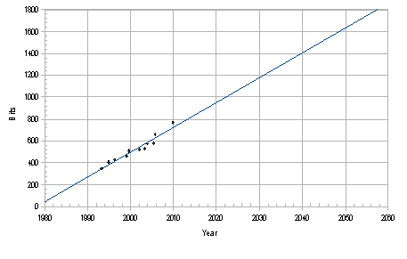
Security of RSA
Source: P. Layland, RSA Security and Integer Factorization: The Thirty Years
War from 1990 to 2020, IS2 2010, Praha

Slide 7
Key size
Algorithms are public & keys must be secret
Key must be large enough that a brute force attack is infeasible
Depending on the algorithm used it is common to have different key sizes for the same level of security
  Representing the level of security – number of combinations needed for the brute force attack
  E.g. 1024 bit RSA key equivalent to 80 bit symmetric encryption key

Slide 8
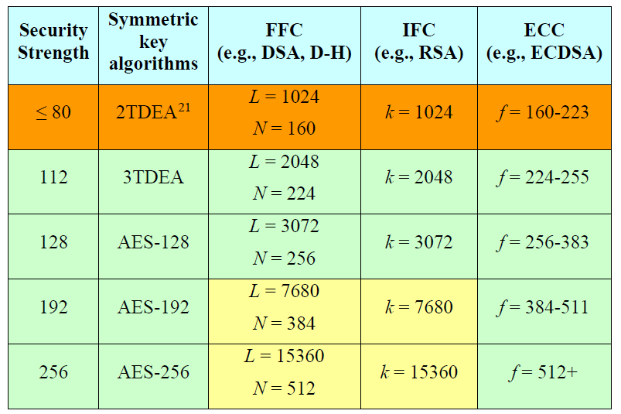
Comparable strengths of cryptosystems
Source:
NIST SP800-57

Slide 9
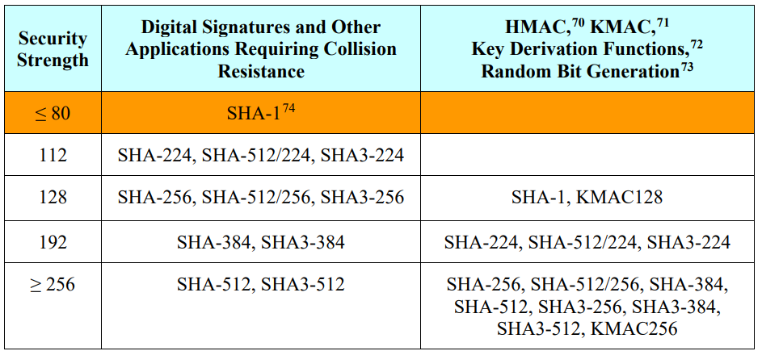
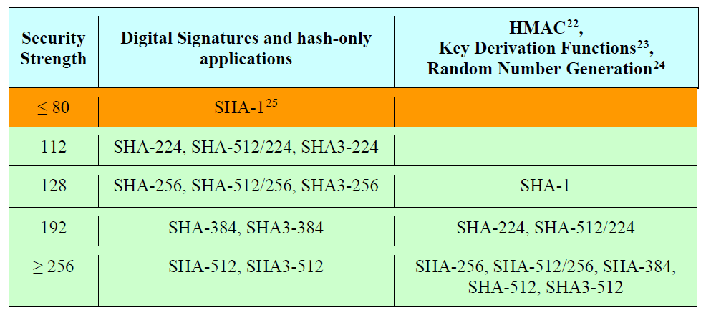
Security strengths of hash functions
Source:
NIST SP800-57

Slide 10
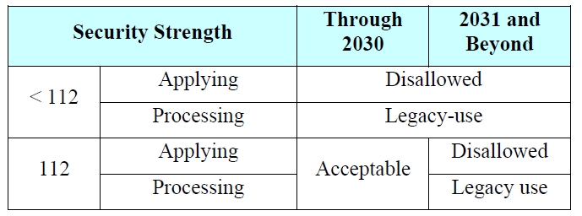
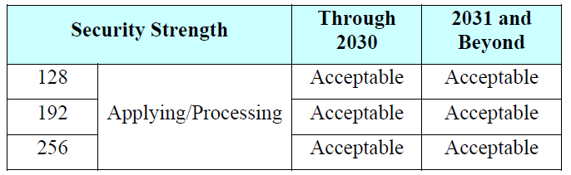
Recommended key sizes
Source:
NIST SP800-57

Slide 11
Recommended key sizes
“Acceptable” indicates that the algorithm or key length is not known to be insecure.
“Deprecated” means that the use of an algorithm or key length that provides the indicated security strength may be used if risk is accepted
“Legacy use” means that an algorithm or key length may be used because of its use in legacy applications
“Disallowed” means that an algorithm or key length shall not be used for applying cryptographic protection.
Source:
NIST SP800-57

Slide 12
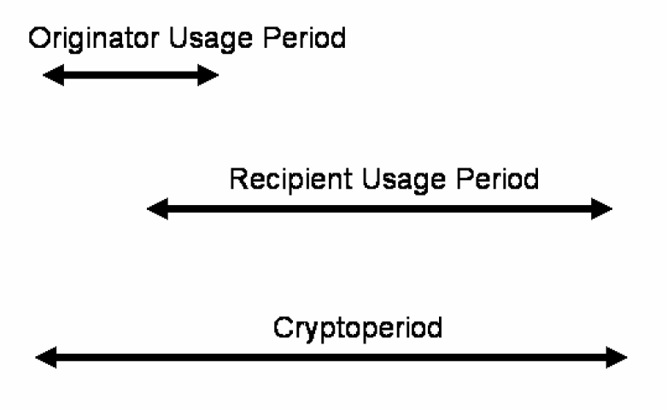
Crypto period
Source:
NIST SP800-57

Slide 13
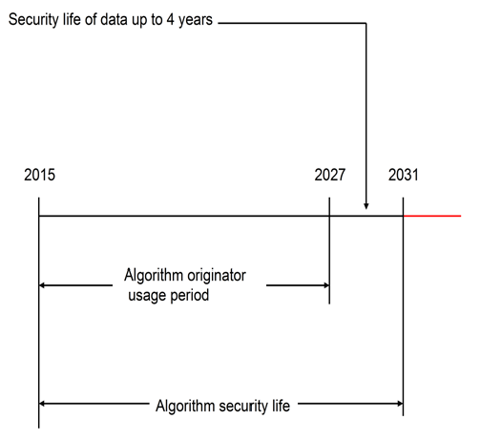
Crypto period example
Source:
NIST SP800-57

Slide 14
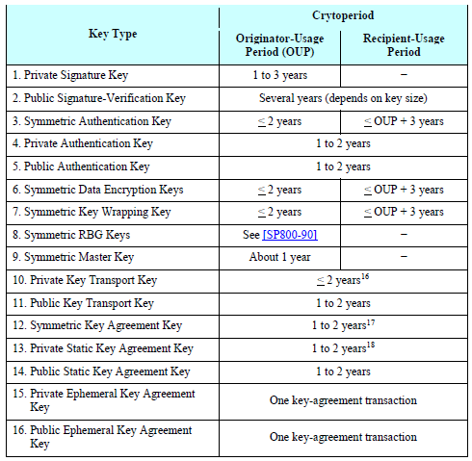
Recommended crypto periods
Source:NIST SP800-57

Slide 15
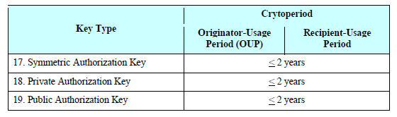
Recommended crypto periods
Source:NIST SP800-57

Slide 16
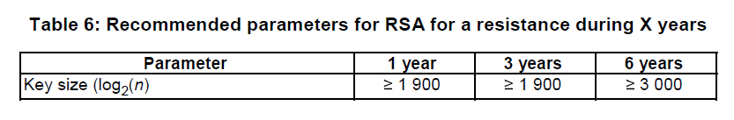
ETSI recommendation (RSA)
Source: ETSI TS 119 312 V1.4.3 (2023-08)
Recommended key sizes for RSA for a resistance during X years
Starting date: 2023

Slide 17

ETSI recommendation (DSA)
Source: ETSI TS 119 312 V1.4.3 (2023-08)
Recommended key sizes for DSA
Starting date: 2023

Slide 18
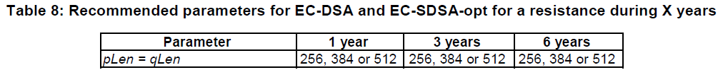
ETSI recommendation (ECDSA)
Source: ETSI TS 119 312 V1.4.3 (2023-08)
Recommended key sizes for ECDSA
Starting date: 2023

Slide 19
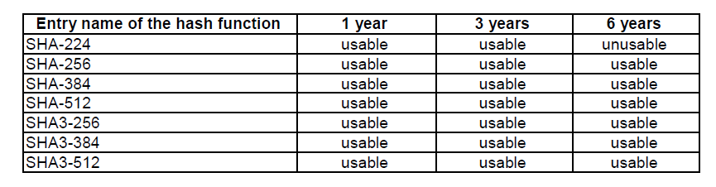
ETSI recommendation (hash functions)
Source: ETSI TS 119 312 V1.4.3 (2023-08)
Recommended hash functions
Starting date: 2023

Slide 20
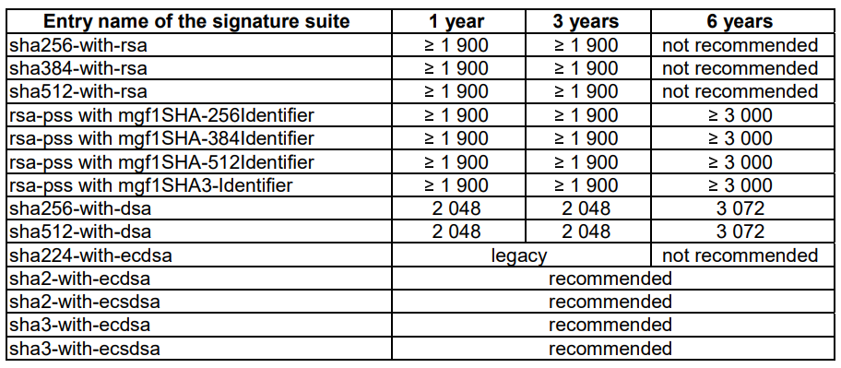
ETSI recommendation
Source: ETSI TS 119 312 V1.4.3 (2023-08)
Recommended signature suites
Starting date: 2023

Slide 21
ICAO recommendation
International Civil Aviation Organization
  Electronic passports
  Data signed by the issuing country to protect integrity
  One CA per country, certificates issued for entities producing passports (so called Document Signers).
  Standard validity of passports: 10 years

Slide 22
ICAO recommendations
RSA (UK, CZ, France, …)
  Padding: PKCS#1 v1.5, PSS (recommended)
  For CA: min 3072 bits
  For DS: min 2048 bits
DSA
  For CA: min 3072/256 bits
  For DS: min 2048/224 bits
ECDSA (Germany, Switzerland, …)
  For CA: min 256 bits
  For DS: min 224 bits
Hash functions
  SHA-1, SHA-2
“Issuing States or organizations SHALL choose appropriate key lengths offering protection against attacks.” 8th edition of ICAO9303
Source: ICAO Doc. 9303

