Slide 1
Session 2

Slide 2
Agenda
Intro
Warm-up (handout)
Grammar activities (handout)
Formal vs Informal Register
Email etiquette basics
Escape game discussion

Slide 3
What is wrong in these sentences?
We have never been in the USA.
You always leave your things everywhere! You should be more organized!
My English gets better and better.
When has this book been published?
My grandparents have got married in London.
The bus to Brighton is leaving at 5 pm.
Princess Diana has been involved in charities and humanitarian work.
The river Nile is flowing into the Mediterranean.

Slide 4
FormFormal vs. Informal Registeral vs. Formal vs. Informal Register
The three most common language registers (in writing) are:
Formal
Informal
Neutral

Slide 5
………………is non-emotional and sticks to facts. I appropriate for technical writings.
……….. is conversational and appropriate when writing to friends and people you know very well.
……….. is more appropriate for professional writing and letters to a superior or a stranger.

Slide 6
Using an appropriate register
(the handout)

Slide 7
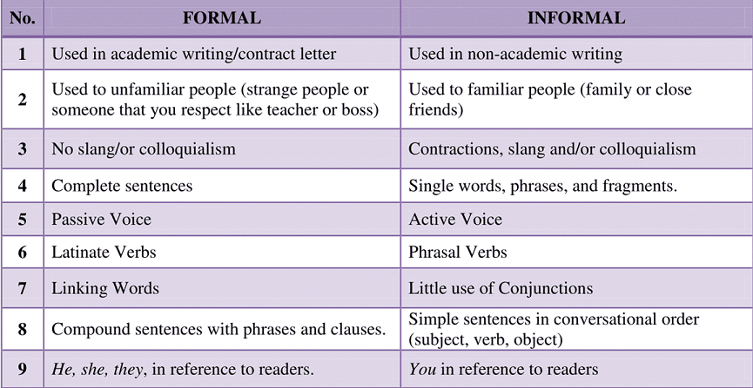

Slide 8
Formal Email Writing
See ppt in the IS.

Slide 9
Escape Game Discussion
Did you meet during the last two weeks in person/online to discuss the game?
Did you assign roles and responsibilities?
Did you decide on the topic?

