Slide 1
VB035
Session 4

Slide 2
Agenda
Warm-up (the crossword)
How to give feedback
Email peer feedback
The escape game presentation
Grammar: questions, question tags

Slide 3
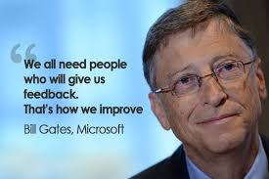



Slide 4
The handout

Slide 5
1 Feedback means editing and correcting mistakes. -
2 I should give feedback on every single aspect of the other person’s work. -
3 I shouldn’t give any suggestions for improvement.
4 I should only provide general comments.
5 I should address specific behaviours, not the reviewee’s personality.
6 Feedback is about pointing out flaws; I should only comment on what needs improvement, not on what’s been done well.
7 When providing feedback, I should use a respectful and considerate tone.
8 I don’t think it’s necessary to ask the reviewee how they want to receive feedback.
9 The main goal of feedback is to help the person grow and develop their skills.
10 I should prioritize and provide feedback only on several key areas.
11 I should ask the reviewee to reflect on their own work before giving my feedback.

Slide 6
Peer review benefits
Develop your own critical and evaluative capacities
As the reviewer you gain just as much if not more than the reviewee
If you learn what to look for in a piece of writing of others you will be much better equipped to evaluate your own writing

Slide 7
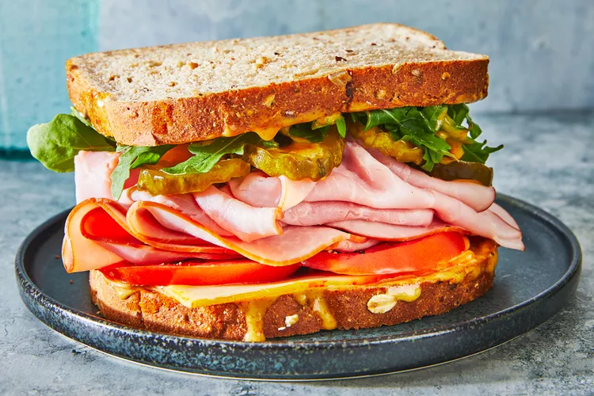
You might have heard of the sandwich feedback approach. What do you think it means? Would you like to be given feedback this way? Why? Why not?
1. ____________________
2_____________________
3._____________________

Slide 8
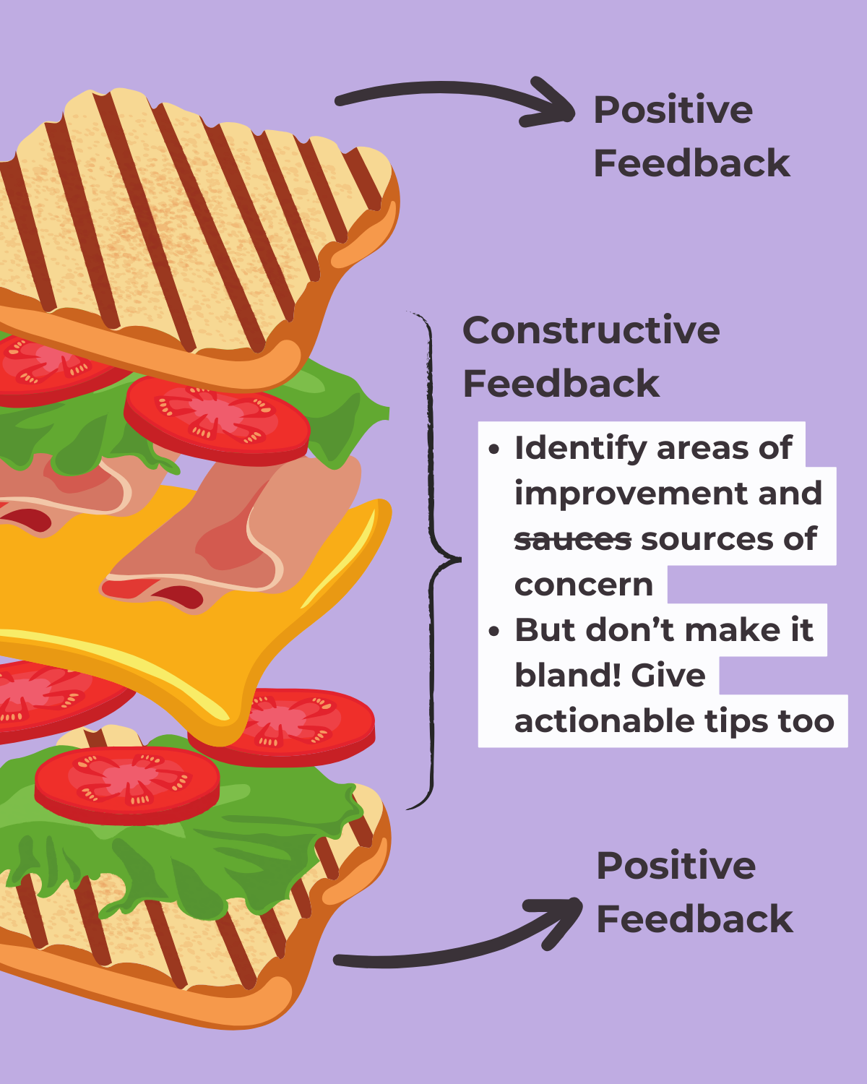

Slide 9
Strategies to give feedback
Provide both positive and negative aspects of a performance
Language to praise: I appreciate how you…
I was impressed by… You did well with… Great job on…
Language to express criticism and suggestion: You could … I would like to see more … I think you should… One area to work on …. One suggestion is… It might help to…

Slide 10
1) Describe what your peer did rather than pass judgment
ie. Instead of saying “it’s good”, say something like “you used a wide variety of sentence structures that made it more interesting to read”
2) Praise
Tell your peer what they did well!
  I think you used a lot of good details
  I liked when you used the word ______
  My favorite part was ________ because…
  This was really fun to read because…

Slide 11
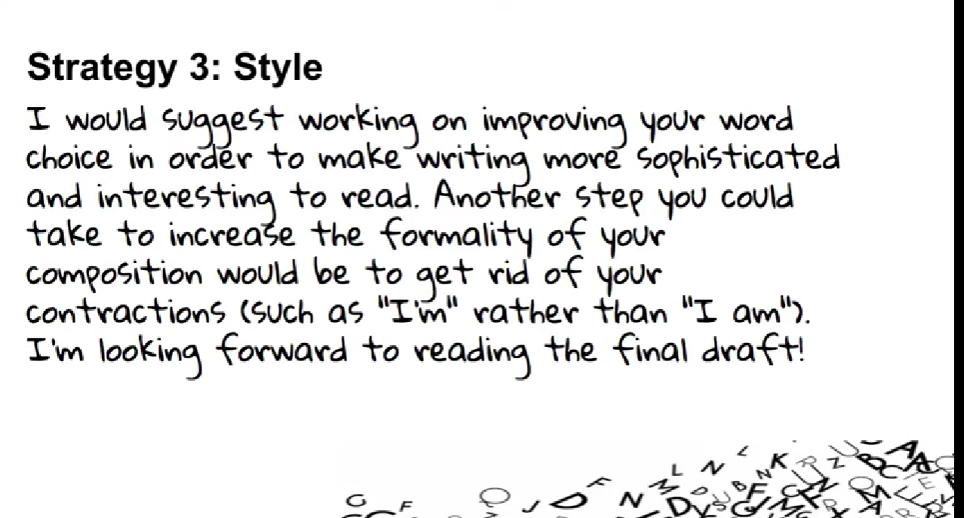

Slide 12
Take-aways
Be specific
Stay positive
Your goal is to help your peer improve
Feedback is not about correcting mistakes and editing
Feedback is providing guidance

Slide 13
Comment on a letter written by a fellow student.
In your comments consider the following aspects
Content (Is the email relevant? Do you understand the key points?)
  Structure (Appropriate salutation and title of address, intro, purpose, description of the problem, solution, conclusion, polite closing phrases, sign-off, signature (name + surname)
Style (appropriate, formal)
Vocabulary (formal, accurate, etc.)
Grammar (word order, articles etc)
Punctuation
Tone (polite)

Slide 14
Question tags exceptions
aren’t I?
I am I am still a part of the team,
Need (negative) He doesn’t need to repeat the year,
does he?
Let’s
Let’s try this new restaurant.
Shall we?
Wait a minute,
can you?
Have some more rice,
will you?
There is a mosque in that street,
isn’t there?
Someone’s been taking my food again,
haven’t they?
Nobody has planned,
have they?

Slide 15
2) Complete the question tags.
Get me some chewing gum when you go to the shop, ____________ you?
b) Let’s watch a new film, ____________ we?
c) There’s not really much point waiting, ____________ there?
d) Tonia will put us up for the weekend, ____________ she?
e) Nobody seems to like Jessica, ____________ they?
f) I’m not making much sense now, ____________ I?
g) Let’s go because it’s getting late, ____________ it?
h) If you borrow my coat, don’t get it dirty, ____________ you?
i) Bill should be here by now, ____________ he?
j) I’m making you feel uncomfortable, ____________ I?
k) Someone left the door open, ____________ they?
l) Nobody knows about this, ____________ they?

Slide 16
1. At which faculty do you study?
2. Do you have any practicals?
3. Is attendance required at all your lectures?
4. How many seminars do you have per week?
5. Are you studying for a Bachelor's or Master's degree?
6. Are you carrying out any research?
7. Have you taken any notes at this lecture?
8. Do you receive any grants for your studies?
9. Who is giving the lecture tomorrow?
10. Have you completed your first degree?

