Slide 1
Welcome to
VB035
English Skills for IT I
Course

Slide 2
Agenda
Introductions
Ice-breaker
VB035 intro and requirements
CJV FI courses
Escape Game

Slide 3
Introductions
Roksoliana Radchuk
Room C505, office hours: by email appointment
Centrum jazykového vzdělávání | MUNI
CJV FI

Slide 4
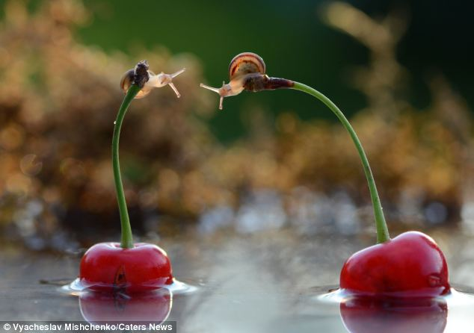
GET TO KNOW EACH OTHER

Slide 5



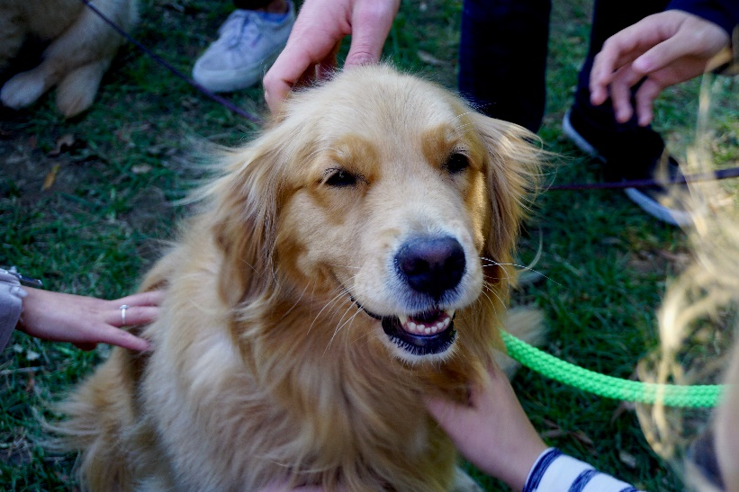

MEMORABLE ME
1. takE three minutes to think of a unique or memorable fact about yourself that makes it easy for others to remember you.
2. We will start with one person introducing themselves by saying their name and sharing their memorable fact.
3. the next person will repeat the previous person‘s name, their memorable thing before introducing themselves, etc.

Slide 6
Compulsory Courses
VB035 English I (focus: formal language, email writing)
VB036 English II (presentation skills, discussion skills)
VB001 English Exam:
written part - see the mock test in the IS
oral part - presentation, discussion

Slide 7
VB035: Course Intro
Course Focus:
Email writing, language register (formal/informal language use),
teamwork, peer review
Interactive syllabus IS - course information

Slide 8
Course Requirements
Attendance
formal language quiz
formal letter+ peer review
active participation in class assignments
final group project - creation and presentation of the final escape game

Slide 9
VB035 Projects: Escape Game
Suggested tool: Genially
Genially, the platform for interactive animated content
group work
7-10min (15min playing time)
educative purpose (English), meaningful/challenging riddles, topic of your choice

Slide 10
Class Principles
Immersion
students in charge
mistakes are to be appreciated

Slide 11


Slide 12
EXAM
Written part
Listening (True/False statement), sentence completion
Reading (gap filling, correcting mistakes)
Grammar and vocabulary (paraphrasing, word formation, gap filling)
Writing (a reply to formal/semi-formal e-mail)
Oral part
Presentation and discussion

Slide 13
Session 1 Introductory class
Session 2 Formal language and writing formal emails
Session 3 Discuss the progress of your escape games
Session 4 Present your escape games to the class. Learn how to provide feedback
Session 5 Presentation of the escape game
Session 6 Presentation of the escape game + feedback to the course

Slide 14
English Courses at FI
VV066 English Conversation
VB039 and VB040: Presentations in English I and II
VB064 Academic and Professional Skills for IT
VB037 writing in English
CJVAEA English Autonomously
VV079 English Online - English Exam Support
VB000Eng Introduction to Academic Writing

