Slide 1
Biomechanics 2
Force
Daniel Jandačka, PhD.

Slide 2
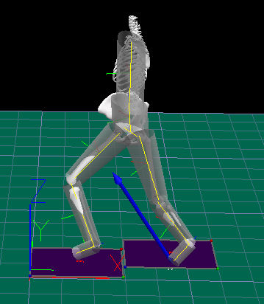
Force The unit of force is newton (N). The symbol used is F.
If we omit inertia forces, force is a quantitative description of the interaction between two physical bodies, such as an object and its environment.
Force causes free body to undergo a change to its speed or a change to its shape.
For the needs of biomechanics we can state, in a simplified way:
that force is produced by pull, push, or gravity.
To study many topics in human biomechanics it is sufficient to replace human body with a model composed of rigid segments.
In rigid body mechanics forces do not cause bodies to undergo a change to their shape, only a change to their speed, in the absence of opposing forces.
Roundhouse kick - Measured at Human Motion Diagnostic Center University of Ostrava

Slide 3
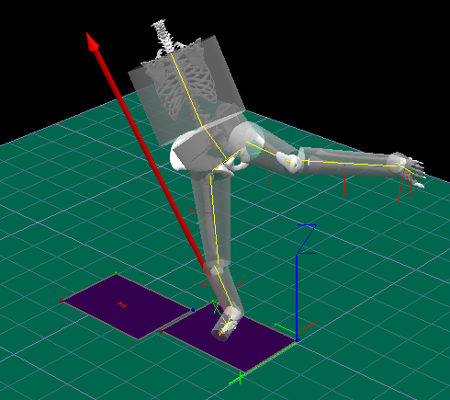
Force is a vector quantity
A force has both magnitude and direction.
Impact of Roundhouse kick - Measured at Human Motion Diagnostic Center University of Ostrava

Slide 4
Forces Classification
Forces are divided into:
1. Internal forces are forces exerted by one part of the observed system on another.
2. External forces cause changes to the motion of the center of gravity of human body

Slide 5
External Forces
Contact forces
Contact forces are forces that act at the point of contact between two objects.
Contact forces are produced by mutual contacts of objects. Objects can be rigid or fluid.
Non-contact forces
Gravitational force, acting on all objects on the Earth.
Cause changes to the motion of the centre of gravity of human body

Slide 6
Gravitational force
The force that is resultant of gravitational force and centrifugal force of the Earth’s rotation is force of gravity.
Weight is a pressure force exerted by an object (human body) on a surface, or a traction force exerted on suspension.
If we let go of any object, it will start falling to the ground and accelerate under the influence of gravity. If we neglect the air resistance it will start moving with the acceleration of 9,81 m·s⁻² regardless of its mass or volume.
This acceleration is called gravitational acceleration g. Gravitational force F_{G} = m.g

Slide 7
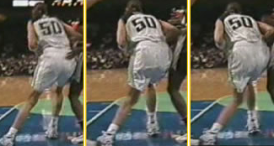
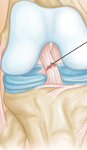
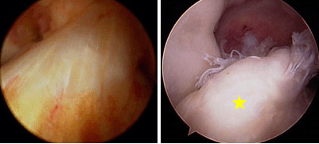
Internal forces
Human body is a system of internal structures: organs, bones, muscles, tendons, ligaments, cartilages, and other types of tissue. These structures exert forces on one another and deform one another.
Sometimes the traction or pressure forces are higher than what the internal forces of the given structure can endure, the resulting deformation is too large and the given structure snaps or breaks. Among examples are strained femoral biceps, ruptured Achilles tendon, broken tibia, or ruptured cruciate ligament in the knee (see Figures below).

Slide 8
Study of internal forces allows to describe the motions of individual body parts, as well as the nature and the causes of injuries.
Activity of muscles produces internal forces which cause movements of extremities and other body parts, but cannot cause a change to the motion of the centre of gravity of human body without external forces having effect on human body.

Slide 9
Friction Force
Static
biggest possible friction
Dynamic
Dry friction acts between surfaces of rigid objects or parts of human body that are not covered with any connective tissue.

Slide 10
Friction force is directly proportional to normal contact force F_{n}.
Friction force is also influenced by properties of the surfaces that are in contact.
Dry friction is not influenced by the area of the surfaces that are in contact.
.
Mathematically friction force can be expressed as:
F_{t} = μ F_{n}
Where F_{t} is static or dynamic friction force (N), μ is coefficient of static or dynamic friction, i.e. the number expressing the influence of individual materials on friction force, and F_{n} is normal contact force (N).

Slide 11
Friction in sport and human locomotion
For example in skiing we demand the lowest possible kinetic friction coefficient so that we can glide along the snow as fast as possible without being slowed down by friction (that is why we wax the runners). In other activities, such as dancing or bowling, we demand a relatively low kinetic friction coefficient of shoe soles so that we can make use of sliding across the surface.
In most sport shoes we demand high friction forces, so the soles have a high kinetic friction coefficient. For example footballers have screw-in studs on the soles of football boots to increase the friction force. Handles of hockey sticks and tennis rockets are covered with special tapes to increase friction, and magnesium powder is used on palms in gymnastics and javelin throw.

Slide 12
Thank you for your attention

