Slide 1
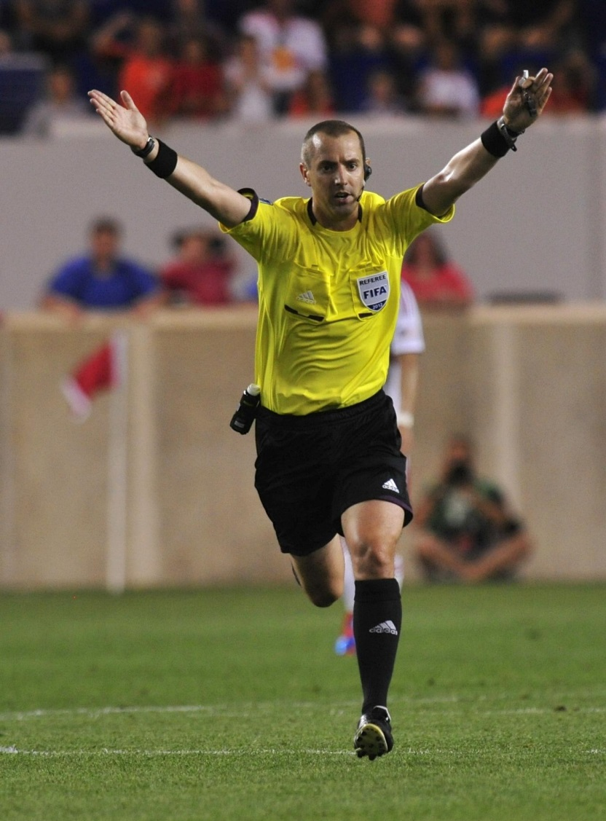
YOU ARE THE REFEREE

Slide 2
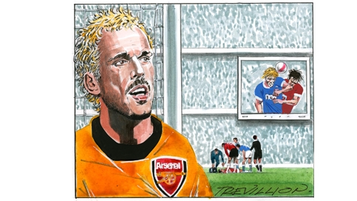
Players Collide

Slide 3
Players Collide
Two players collide when they jump to head a high ball. One falls to the ground holding his head, so you call on the physio. But while you are waiting, you notice the big screen showing a replay: the player being treated had been viciously, deliberately elbowed by his opponent. The crowd go wild. Now that you have seen the incident on the replay, what should you do?

Slide 4
Players Collide
You should take action and punish the player.
You should ignore it and do nothing.

Slide 5
Players Collide
Keith Hackett: You are not allowed to use the big screen in the decision-making process (and the screen should not have shown the incident). You should, though, communicate with your assistants to seek their view on the challenge – but if they’ve seen nothing wrong, that is the end of the matter. The situation would later be looked at by the FA, who could take it further if they were satisfied that none of the match officials had witnessed the elbowing.

Slide 6
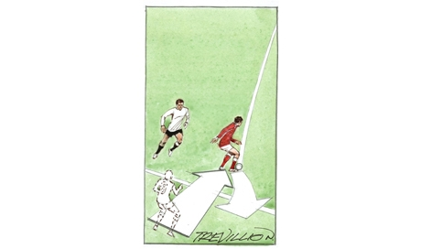
Goal Kick
A goalkeeper takes a goal kick, which loops up very high. An attacker on his team, who was standing in an offside position when the ball was kicked, runs back into his own half unmarked and collects the ball.
Do you still give offside?

Slide 7
Goal Kick
You cannot be offside from a goal kick – it´s a trick question.
I am often amazed that players and managers aren’t aware that players can’t be offside from a goal kick. Some teams still fail to take advantage of Law 11 and push their players up into off side positions to gain an advantage.

Slide 8
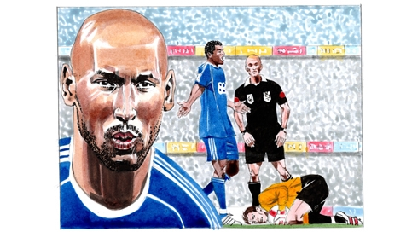
Drop Ball

Slide 9
Drop Ball
You’ve awarded a drop ball inside the penalty area. One of the players who contests the drop is the defending goalkeeper – who, as soon as it lands, dives on to the ball and smothers it.
Is this legal?

Slide 10
Drop Ball
Yes, the keeper can do this.
No, the keeper can´t do this.

Slide 11
Drop Ball
Well done! This is correct.
The goalkeeper is allowed to do this. However, you must also consider whether it was a dangerous play. If you think that it was dangerous, either for the goal keeper or the opponent, then you should award an indirect free-kick against the goalkeeper.

Slide 12
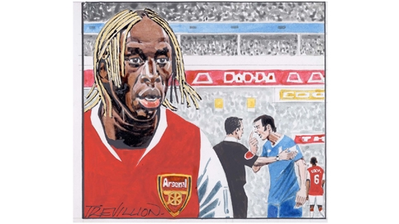
Hair Strike

Slide 13
Hair Strike
During a top-flight game, an away team player dashes up to you in a fury, complaining that when he went up for a header, his opponent’s long bleached dreadlocks (his hair) caught him in the eye. He says they’re dangerous, and the player shouldn’t be allowed to play on with his hair ‘all over the place’.
What do you do?

Slide 14
Hair Strike
Do nothing.
Order the player to cut his dreadlocks off.

Slide 15
Hair Strike
Keith Hackett: There’s nothing in the laws of the game to cover this particular point, and if, in your judgment, the dreadlocks don’t represent a danger to other players, you should not intervene.

Slide 16
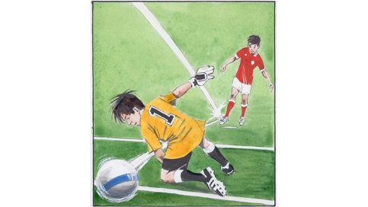
Unhappy Keeper

Slide 17
Unhappy Keeper
In an under-11 game, a striker takes a penalty that beats the keeper, but rebounds off the bar. The ball bounces back towards the striker who scores from the rebound, but no one else has touched the ball.
The goalkeeper starts crying.
What do you do?

Slide 18
Unhappy Keeper
Allow the goal.
Do not allow the goal.

Slide 19
Unhappy Keeper
You can't allow the goal as no other player has touched the ball. Re-start play with an indirect free-kick.
That should cheer the keeper up!

Slide 20
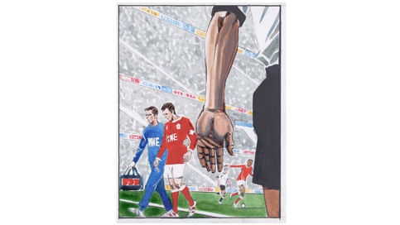
Taken off for Treatment

Slide 21
Taken off for Treatment
A defender goes down injured, and you order him off the pitch for treatment. But two minutes later the star striker who he was man-marking scores. You suddenly realise that you’d forgotten to wave the defender back on. The defender’s team are really angry, demanding the goal is disallowed (that you cancel the goal on the scoresheet).
What do you do?

Slide 22
Taken off for Treatment
Disallow the goal.
Allow the goal.

Slide 23
Taken off for Treatment
You cannot disallow the goal. You’ll have to put up with all the criticism because you’ve made a serious mistake in not allowing the player back on. Fortunately, this shouldn’t happen in the professional game because of the combination of the fourth official and the communication system.
Keith Hackett: The rule about having to leave the field after receiving treatment is one that I would love to see changed. A few seasons ago, Thierry Henry was injured from a challenge which resulted in a penalty. Having received treatment, he was then forced to leave the field of play – meaning Henry, Arsenal’s penalty taker, couldn’t take the kick. What a nonsense.

Slide 24
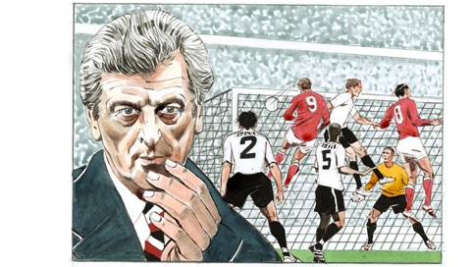
Controversial Equaliser

Slide 25
Controversial Equaliser
In the last seconds of a cup tie, the away team score a dramatic last minute equaliser from a corner. You give the goal, and play restarts. But then one of your assistants informs you that the away side had 12 players on the pitch when the goal was scored – one of their substitutes had come on unnoticed seconds earlier.
Can you answer the questions?

Slide 26
Controversial Equaliser
What do you do with the spare player?

Slide 27
Controversial Equaliser
Show the ‘spare’ player the yellow card for entering the field of play without your permission, and order him to leave the field.

Slide 28
Controversial Equaliser
Can you rule out the goal retrospectively?

Slide 29
Controversial Equaliser
Yes, disallow the goal, because if there is an illegal number of players on the field, you are required to restart the game from a suitable point – and in this situation, the suitable point would be before the goal was scored. So restart play with a retaken corner kick.

Slide 30
Controversial Equaliser
How do you re-start?

Slide 31
Controversial Equaliser
If there is an illegal number of players on the field, you are required to restart the game from a suitable point – and in this situation, the suitable point would be before the goal was scored. So restart play with a retaken corner kick.

Slide 32
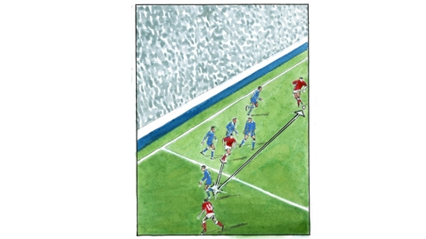
Offside?

Slide 33
Offside?
A home team player passes back towards a team-mate – but the ball strikes the heel of an opponent and flies forward to the home team’s star striker, who is in an offside position. The striker races away unchallenged and scores – but the keeper insists he was offside. The striker says he was ‘played on’.
What is your decision? Is it a goal?

Slide 34
Offside?
Yes, it´s a goal!
No, it isn´t a goal!

Slide 35
Offside?
The home player in the off side position has an unfair advantage, so must be penalised, as stated in law, ‘the moment the ball touches or is played by one of his team’.
‘Played on’ hasn’t existed in the laws of the game since 1978.

Slide 36
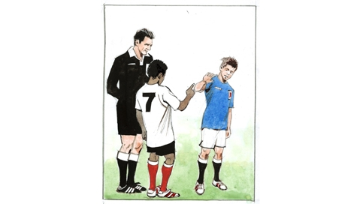
Racist Remark

Slide 37
Racist Remark
During a stoppage in a U12’s game, a forward complains that an opponent made a racist remark to him. The opponent admits it, and says sorry.
What do you do?

Slide 38
Racist Remark
You should punish the player.
You should not punish the player.

Slide 39
Racist Remark
Although racism in football is never acceptable, you cannot take action because you, the referee, did not hear the remark yourself. However, for the rest of the game, you should keep an eye on the two players, and after the game send a report to the appropriate competition stating that the boy admitted making the remark, in case the forward (the other player) wishes to take it further.

