Slide 1
What is Health and
Wellness Coaching?
Meg Jordan, PhD, RN, CWP, ACC
ICF Health & Wellness Community of Practice
Notes:
Describe the Learning Objectives:
At the end of this expert presentation, you will be able to
- Explain why health and wellness coaching is a growing coaching niche
- Discuss definitions for health and wellness coaching
- Explore contexts where health and wellness coaching is practiced
- Discuss how these contexts impact on the coaching process
- Describe similiarities and differences between life coaching and health & wellness coaching and competencies
Describe the specific content covered in the event that is applicable to ICF Core Competencies
Dr Jordan will lead a discussion related to the impact of context on all aspects of the coaching process from Setting the Foundation (including ethical considerations), to Co-Creating the Relationship (as Client-Coach v Expert-Patient), to Communicating Effectively to Facilitating Learning and Results.
The discussion around comparing and contrasting 'life coaching' and 'health and wellness coaching' will include discussion around application of core coaching competencies in a health and wellness coaching setting.
Building on the foundation of the ICF code of ethics, Dr Jordan will discuss additional ethical considerations relevant to coaching in the health and wellness field
(The discussion on the specific content applicable to ICF Core Competencies will be continued in the HWCP facilitated discussion in May.)

Slide 2
Learning Outcomes
Explain why health and wellness coaching is a growing coaching niche
Discuss definitions for health and wellness coaching
Explore contexts where health and wellness coaching is practiced
Describe similarities and differences between life coaching and health & wellness coaching
Notes:
Here are the Learning Outcomes for this webinar. At the end, I’ll lead a discussion and hear from all of you about how HWC process still follows an ICF competencies of Setting the Foundation, including ethical consideration, to Co-Creating the Relationship (as Client-Coach v Expert-Patient), to Communicating Effectively to Facilitating Learning and Results. You should join in to compare how those applications compare between life coaching and health and wellness coaching, and then we’ll consider how there are some additional ethical considerations relevant to the practice of HWC.

Slide 3
1. Why Is Health and Wellness Coaching
A Growing Niche?

Slide 4
HW Coaching:
Analyzing the Niche (USA)
U.S. Estimates:
~150,000 self-identifying as health or wellness coaches in 2017
16,000 trained in ICHWC-approved programs
5,000 college degrees or academic certificates
20,000 self-taught
100,000 mislabeled
Estimated that about 1,000 will take the National Certifying Examination for Health and Wellness Coaches - (Sept 6-18, 2017)
Notes:
Of the approximate 150-200,000 people in the US today self-identifying as a health or wellness coach, the estimates are that about 16-20,000 of them have gone through legitimate training programs, that is ICHWC-transition approved programs, that’s the 11% in blue, another 5,000 have graduate certificates or college degrees (only 4%) ; another 20,000 may be coaches who are self-taught or self-motivated to gain healthy lifestyle knowledge and have moved into the profession through their own motivation to learn and be of service, that’s another 14%, and a great majority -- about 100,000 are calling themselves coaches without any recognized coaching credential or training.

Slide 5
HW Coaching:
Analyzing the Niche (International)
Global. Estimates:
~ 22,000 members of ICF (2014) (approx)
16,000 trained in ICHWC-approved programs
5,000 college degrees or academic certificates
20,000 self-taught
100,000 mislabeled
Estimated that about 1,000 will take the National Certifying Examination for Health and Wellness Coaches - (Sept 6-18, 2017)
Notes:
Now when we try to estimate how many are self-identifying as health coaches internationally, we don’t have any centralized data, but I’ve done a brief survey of international associations in countries from A to Z, and found that and ICF membership, which is at 222,000 members as of 2014.

Slide 6
The New Era of Personal Responsibility
The escalating cost of lifestyle-related disease is estimated to comprise approximately 70% our health care dollars
No one can afford it
Not business
Not the government
Not society
Notes:
It became apparent that we’ve entered a new era of personal responsibility when research showed that lifestyle-related disease accounts now for 70% of our health care dollars.
Lifestyle-related disease, then became the topic of a Summit 2009 at the Institute of Medicine…the US health care advisor. Healthful lifestyles play a vital role in the prevention of chronic disease and mental and physical ailments; and
The escalating cost of lifestyle-related disease is estimated to comprise approximately 70% our health care dollars; and
The recent debate on health care reform has underscored the need for personal responsibility of individuals to adopt lifestyles which prevent and ameliorate disease, and

Slide 7


Chronic Disease & Lifestyle
Notes:
Many people struggle with poor health and vitality because they lack the motivation, skills, knowledge, resources, concerted effort and sustained support needed to succeed in the complex task of transforming multiple health habits.
The existing methods of informing, instructing, directing, prescribing, warning, and incenting in health care have so far been unable to achieve significant and sustainable behavior changes for the majority of patients; and

Slide 8
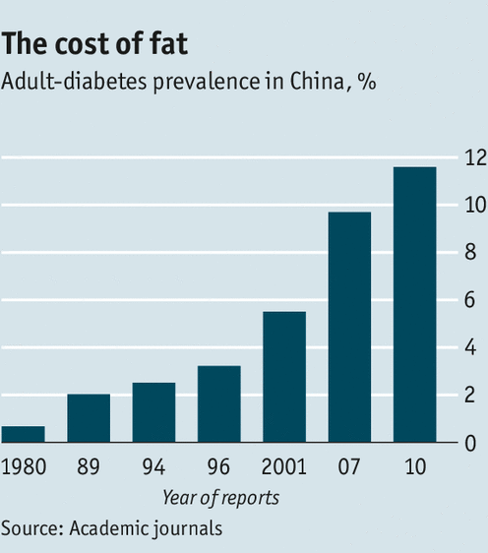

Future forecasts grim for
Global Diabetes and Obesity

Slide 9

Diabesity
“The modern epidemic that one of two Americans have…but 90% don’t even know it yet.”
  Mark Hyman, MD
    Blood Sugar Solution

Slide 10
Causes of Death (2005, U.S.)
IDENTIFIED
ACTUAL
Heart disease
Cancer
Stroke
Chronic respiratory disease
Accidents
Diabetes
Poor diet
Physical inactivity
Unmanaged stress
Cigarette smoking
Excessive alcohol use
Reckless, high accident-risk
Source: Mokdad, A, et al. Actual Causes of Death in the United States, 2000. JAMA 2004;291:1238-1245

Slide 11
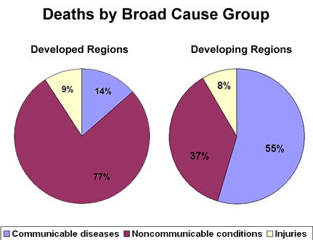
With industrialization, more deaths due to non-communicable disease (lifestyle)

Slide 12
The Antidote to Chronic Disease is Lifestyle Improvement
Regular exercise
Healthful eating
Weight management
Moderate drinking
Non-smoking
Mind-body stress reduction
All evidence-based, safe & effective breakthrough medicines

Slide 13



If Knowledge Alone Made a Difference…
1 in 20 adults engages in all of the six top health behaviors:
  Regular exercise
  Healthful fat intake
  5-9 servings of fruits and vegetables daily
  Healthy weight
  Moderate drinking
  Non-smoking
Notes:
If knowledge alone made a difference, then we would see more than 1 in 20 adults engage in all of the six top health behaviors: regular exercise, healthful fat intake, 5 servings of fruits and vegetables daily, healthy weight, moderate drinking, and non-smoking. But 1 in 20 barely does. There are over 2000 media messages generated a week on diet and exercise.

Slide 14

People Lack Skills & Support for Lifestyle Change
  MISSING are skills for autonomous, sustainable lifestyle change:
  Psychological hardiness
  Behavioral skills
  Capacities for resilience
  Process for self efficacy
  Tools for new habit formation
  Support

Slide 15

Existing Models That…
Inform
Instruct
Direct
Prescribe
Warn
Incent
Scold, humiliate, insult, debase, insult…
…so far…are unable to achieve significant and sustainable behavior changes for the majority of patients.
Notes:
In our current delivery model, health care professionals are often denied the time to facilitate lifestyle change for their clients, or may not have received the knowledge or training in motivational or behavioral change; and

Slide 16


If _____ is Good for Me, Why Don’t I DO It?
(FILL IN THE BLANK) Exercise, Following a Healthy Diet, Not Smoking,
Ask the 80% who don’t do enough to positively impact their health.
1200 responded over 5 years

Slide 17
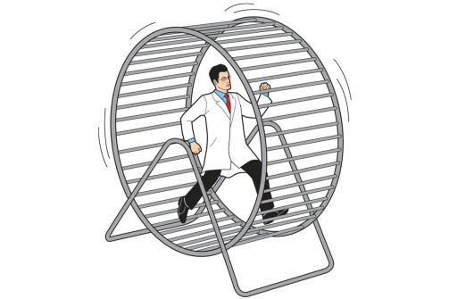
In the Current Healthcare Delivery Model…
Notes:
Health care professionals are often denied the time to facilitate lifestyle change for their clients, or
—May not have received the knowledge or training in motivational or behavioral change; and

Slide 18
Why is Health Coaching Needed?
Current health education in place for over 35 years
Epidemic of obesity and diabetes
Chronic disease requires lifestyle changes
Addiction: fat, salt, sugar
Greater ambivalence from high-jacked motivation centers
Pull out intrinsic motivation
Notes:
Our most lasting solutions are the ones we happen upon ourselves…our best ideas for behavior change are self-generated.

Slide 19
2. definitions for health and wellness coaching

Slide 20
Definition of Health and WEllness Coaching
Health and Wellness Coaches partner with clients seeking self-directed, lasting changes, aligned with their values, which promote health and wellness and, thereby, enhance well-being.
In the course of their work health and wellness coaches display unconditional positive regard for their clients and a belief in their capacity for change, and honoring that each client is an expert on his or her life, while ensuring that all interactions are respectful and non-judgmental.
Source: International Consortium for Health and Wellness Coaching (ICHWC)
Notes:
ICHWC is committed to developing practice standards for education and training of professional healthand wellness coaches, supporting the intergration of health and wellness coaching into the health care systems globally, supporting collaborative research, and offering the first national certification, launching this year. More on that later.

Slide 21
Another Definition of HW Coaching
A health coach employs the art and science of the coaching relationship to optimize health, well-being for the client
HW Coaches are professionals from diverse backgrounds and education who work with individuals and groups in a client-centered process to facilitate and empower the client to achieve self-determined goals related to health and wellness.
Successful coaching takes place when coaches apply clearly defined knowledge and skills so that clients mobilize internal strengths and external resources for sustainable change.
      (Source: NCCHWC Presentation to National Wellness Institute 2015)

Slide 22
Milestone Events (USA)
1970 Humanistic psychology altering health-related dialogs for change
1980 Rising rates of chronic disease lifestyle related
1990 Universal call for health care reform
2000 First real growth of health and wellness coach training programs
2010 First Summit of health and wellness coaches (80 stakeholder groups)
2017 First National Certification of health and wellness coaches
Notes:
Leaders at a 2009 Institute of Medicine Summit on Integrative Health called for a new profession of health and wellness coaches to assist the medical and public health professions in addressing this need for lifestyle turnaround; and

Slide 23
Growing Research Base
Among other frameworks, health and wellness coaching has been variously defined in the context of health education, nursing, medicine, life coaching, and behavioral health and psychology.
Multiple disciplines have tried to claim health and wellness coaching as their own. Multiple training programs have tried to claim that their way is the best way.
Wolever, R (2013). Collaboration and Synergy in the Field of Health and Wellness Coaching: Naïve or Necessary? GLOBAL ADVANCES IN HEALTH AND MEDICINE, Volume 2, Number 4

Slide 24
3. Explore contexts where health and wellness coaching is practiced

Slide 25
Where DO HC Coaches Work?
Healthcare organizations, hospitals and clinics; insurance third-party payers,
Employee Benefits companies; disease management companies
Fitness facilities
Community Wellness Centers
On-Site employee wellness programs for corporations; Human Resources departments
Private coaching practitioners
Health and wellness coach educational and training programs
Academic institutions; schools
Notes:
HC Coaches work in a variety of settings

Slide 26
ICHWC Survey 2015 (USA)
Notes:
Most HC coaches survey by NCCHWC in 2015 work in private practice. A growing number are health care professionals who are adding health coaching to their practice – but that’s only 10% of the total, Another 10% work for benefits companies, and a small portion work in wellness promotion.

Slide 27
Sounds a lot like life coaching, right?
So what’s the difference?

Slide 28
ICF Definition of coaching
ICF defines coaching as partnering with clients in a thought-provoking and creative process that inspires them to maximize their personal and professional potential, which is particularly important in today's uncertain and complex environment.

Slide 29
COACHING
Facilitate a process of discovery for the client, where insights and strengths are built, and values are clarified, while progress is made and sustained toward client’s goals.
Notes:
The coach then is more of a guide, pointing out the signposts that may or may not be visible to the client.

Slide 30

Coaching Roles
EXECUTIVE COACH
LIFE COACH
HEALTH /WELLNESS COACHES
Notes:
“Health and Wellness Coaches are professionals from diverse backgrounds and education who work with individuals and groups in a client-centered process to facilitate and empower the client to achieve self-determined goals related to health and wellness. Successful coaching takes place when coaches apply clearly defined knowledge and skills so that clients mobilize internal strengths and external resources for sustainable change.”

Slide 31
The Coaching Process
Explore & Build
Self-Awareness, Strengths
Hopes, dreams, tied to health goals
Action Steps & Goals
Motivational
Overcome Obstacles
Monitor & Evaluate
Plans for Setbacks
Maintenance

Slide 32
ICF Core Competencies
a. Setting the foundation
1. meeting ethical guidelines and professional standards
2. establishing the coaching agreement
b. Co-creating the relationship
3. establishing trust and intimacy with the client
4. coaching presence
c. Communicating effectively
5. active listening
6. powerful questioning
7. direct communication
d. Facilitating learning and results
8. creating awareness
9. designing actions
10. planning and goal setting
11. managing progress and accountability

Slide 33
WELLNESS
10
9
8
7
6
5
4
3
2
1
SOCIAL RELATIONS
EXERCISE
SPIRIT & BELONGING
NUTRITION
10 9 8 7 6 5 4 3 2 1
1 2 3 4 5 6 7 8 9 10
1
2
3
4
5
6
7
8
9
10
OCCUPATION
INTELLECTUAL
RECREATION
EMOTIONAL
© 2013 Global Medicine Enterprises, Inc.

Slide 34
Health coaching is not health education or counseling
Counseling in Medicine
Health Coaching
Medical model
Diagnosable illness in paradigm of pathology
Focus on fixing a problem
Expert provides information
“Why” questions, with past/present focus
Restore to level of functioning
Learning/development model
Desirable goals & achievement in paradigm of possibility
Focus on optimal performance
Non-judgmental partner supports exploration of health priorities
“How” questions with present/future focus
Move to optimal behavior

Slide 35
Levels of Practice
BASIC COACHING
Training ranges from 24 hours to 18 months
Private firms
University certificates
Online courses
ADVANCED SKILLS
Requires health-related college degrees or health profession
CIIS Certificate for Integrative Wellness Coaching – within M.A. in Integrative Health Studies
Notes:
The best practices of well-trained professional health coaches and wellness coaches are based upon the translation and integration of evidence-based psychological processes of change combined with evidence-based lifestyle interventions into coaching models designed to enable people to outgrow their old ways of thinking, feeling, and behaving, and change lifestyles for good.
On a small but growing scale, health professionals, including physicians, nurses, case managers, physical therapists, occupational therapists, psychotherapists, and exercise physiologists, are also being taught to integrate basic skills in coaching and motivational interviewing in current practices, a highly promising development. The goal is to improve health outcomes by helping patients get engaged in changing lifestyles to improve health, moving away from sole reliance on medicines and quick fix programs, and ultimately support the referral to health and wellness coaches.

Slide 36
Health Coaching Defined
A health coach employs the art and science of the coaching relationship to optimize health, well-being for the client
Health coaches engage in a process that allows the client to:
  Tap into inner resources
  Develop strengths, identify and clarify values
  Discover external allies
  Set goals and achieve them
  Monitor progress and celebrate outcomes

Slide 37
Executive Coaching Defined
The aim of executive or life coaching is sustained cognitive, emotional, and behavioral changes that facilitate goal attainment and performance enhancement, either in one’s work or in one’s personal life.
      (Source: Stober & Grant, 2006)

Slide 38
So what is Health and Wellness coaching, again?
A specific methodology for changing behavior and attitudes to improve your lifestyle choices, habits and actions for the long haul.
HOW?
    By building growth-promoting relationships
    Eliciting self-motivation
    Increasing capacity to change
    Facilitating process of change

Slide 39
Why Coaching works so well for lifestyle imProvement….
HEALTH / MEDICINE
COACHING
• TREATMENT MODEL
Top down, unilateral, authoritarian
Imposes correct information
Normative, information-driven
Applies rules of behavior
Focus on relief, fixing, cure
PARTNERSHIP MODEL
Egalitarian
Collaborative
Elicits goals
Evokes change from within
Holds client as capable, no need to “fix”
Focus on process

Slide 40
What HW COACHING IS NOT
Coaching is also distinct from the following:
NOT psychotherapy,
NOT health education,
NOT case or disease management;
NOT personal training, and
NOT nutritional counseling

