Slide 1
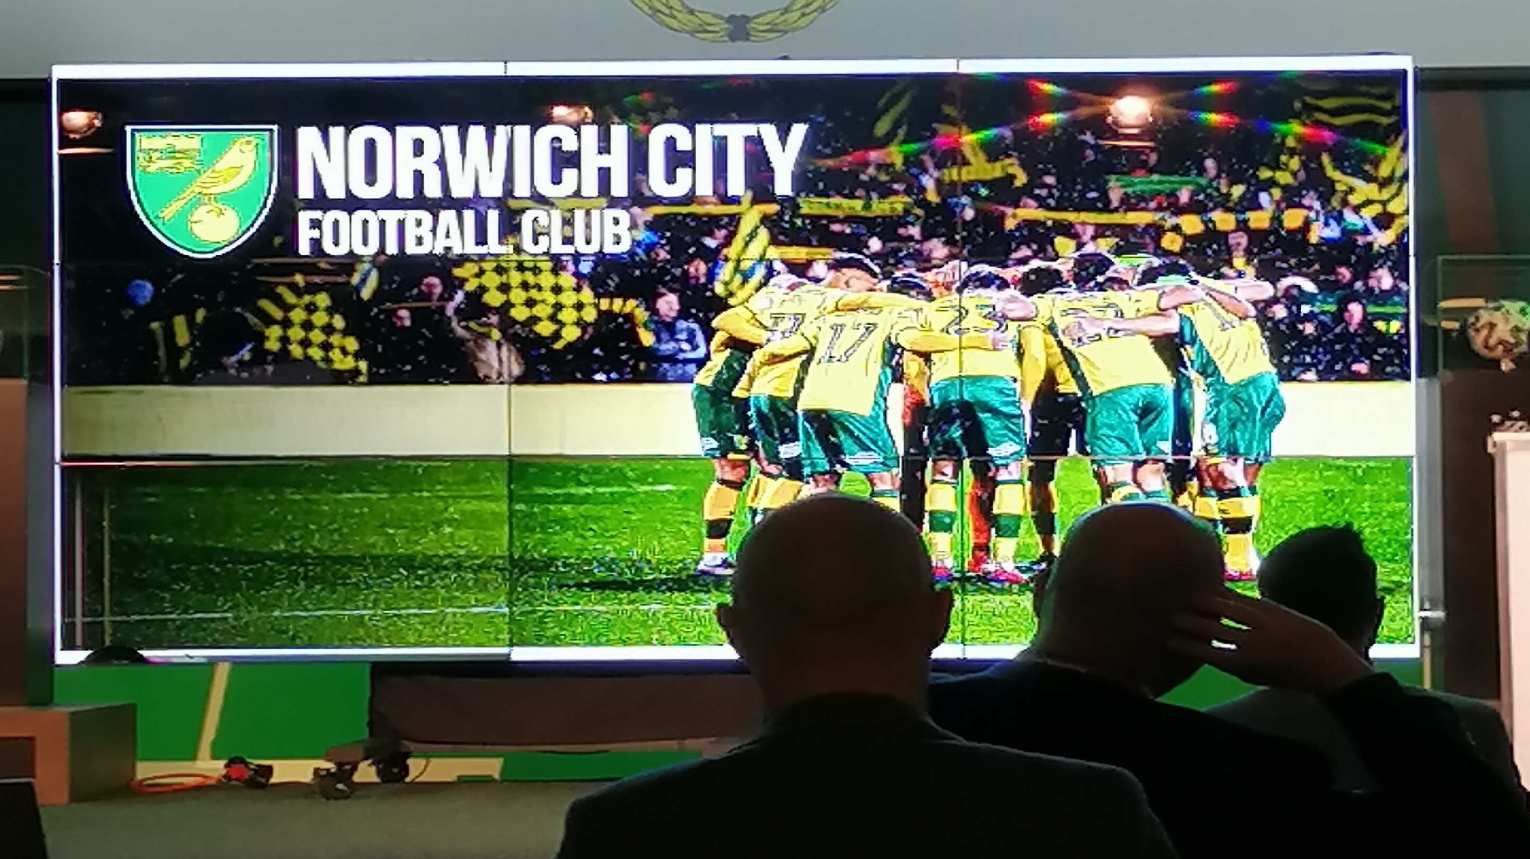

Slide 2
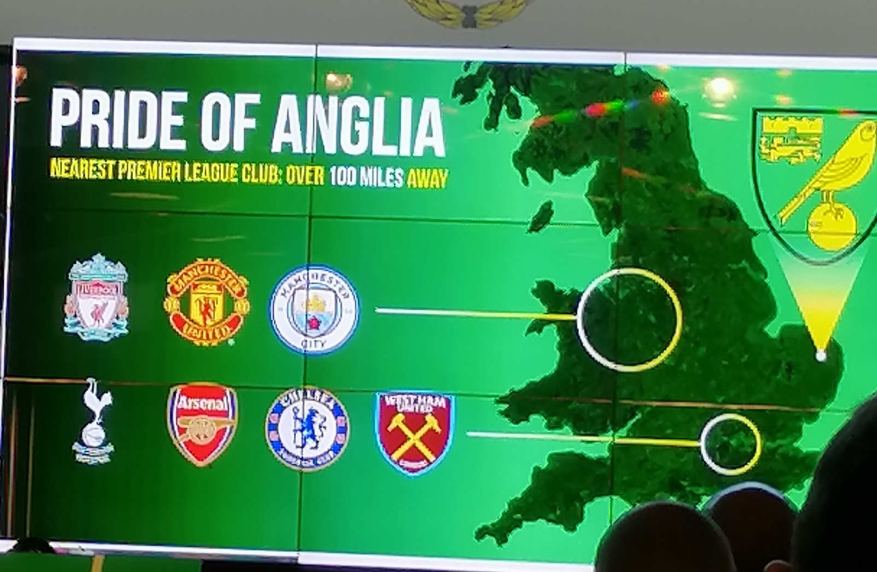

Slide 3
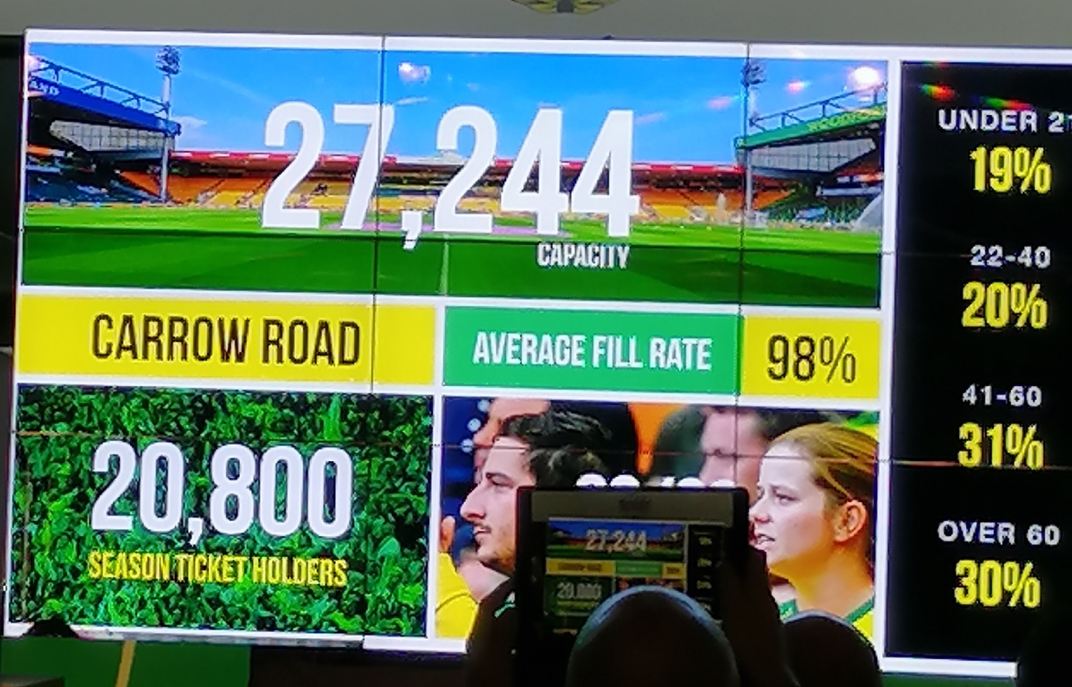

Slide 4
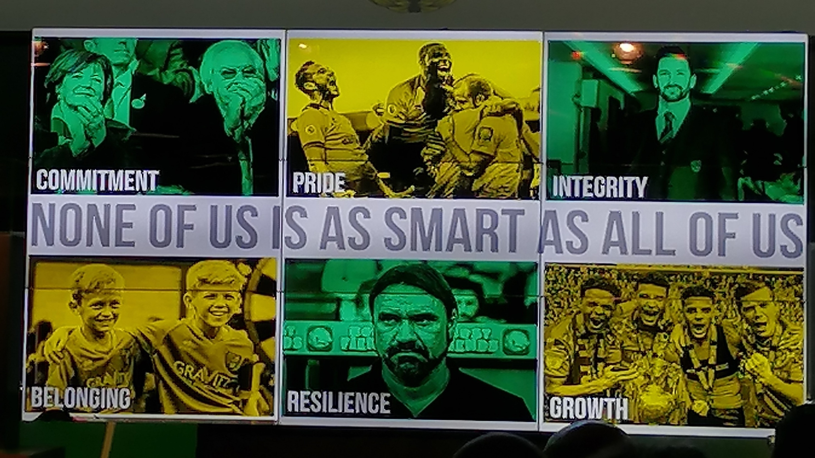

Slide 5
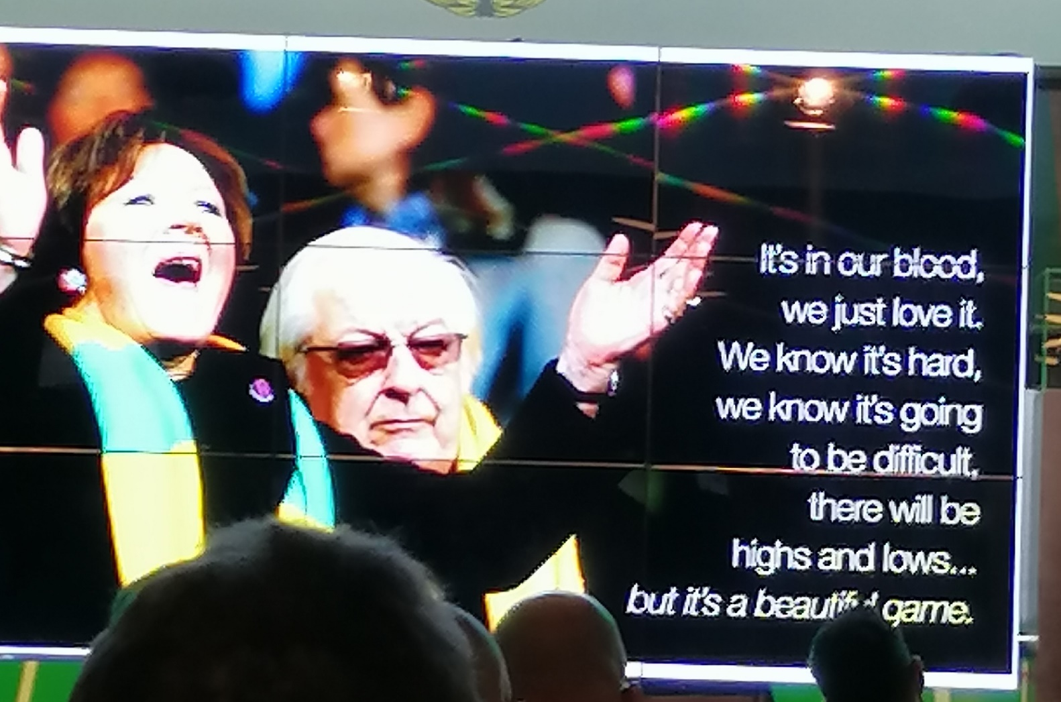

Slide 6
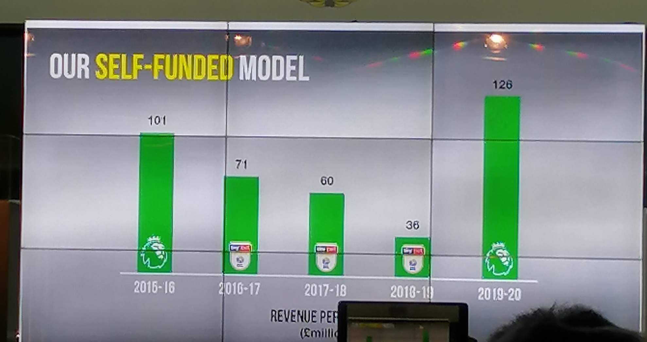

Slide 7
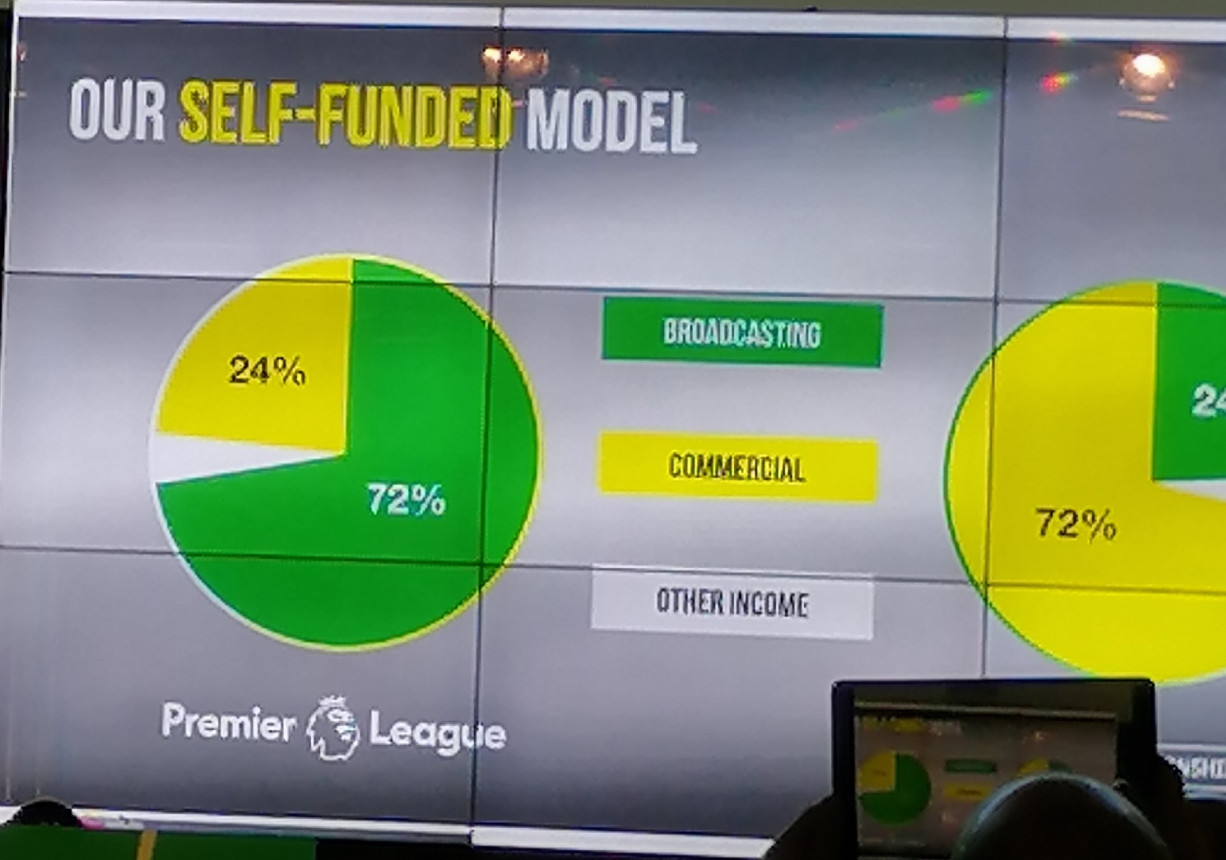

Slide 8
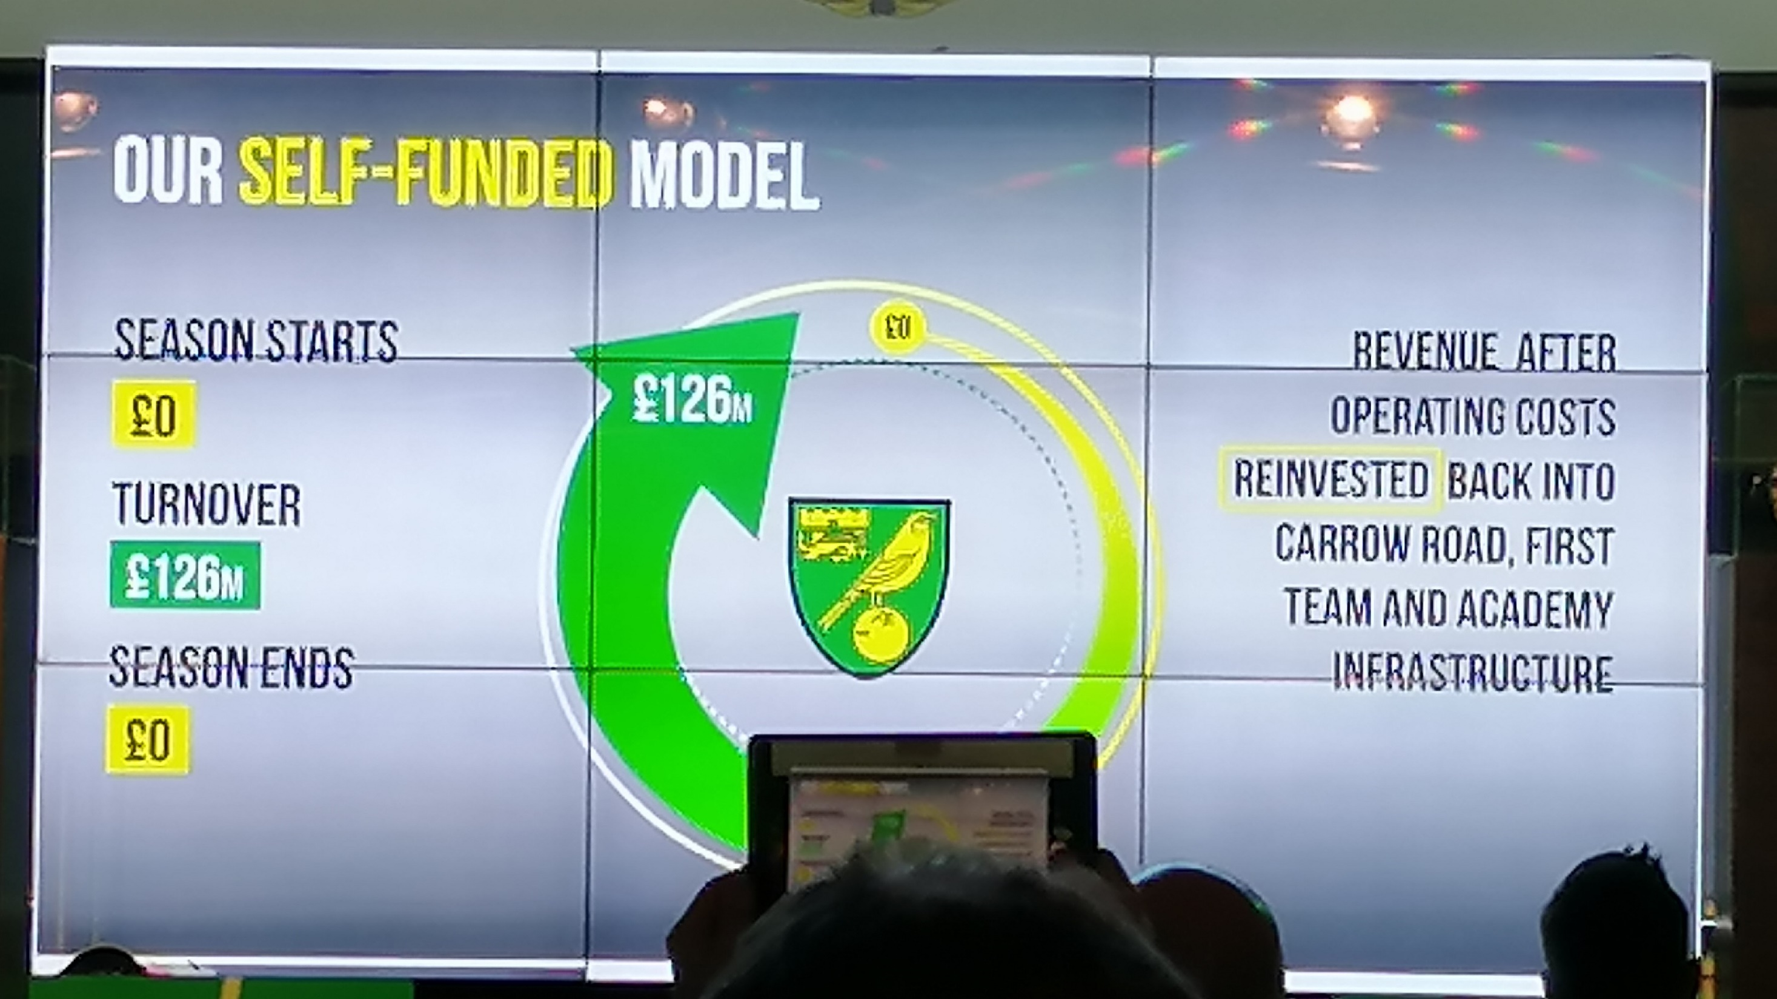

Slide 9
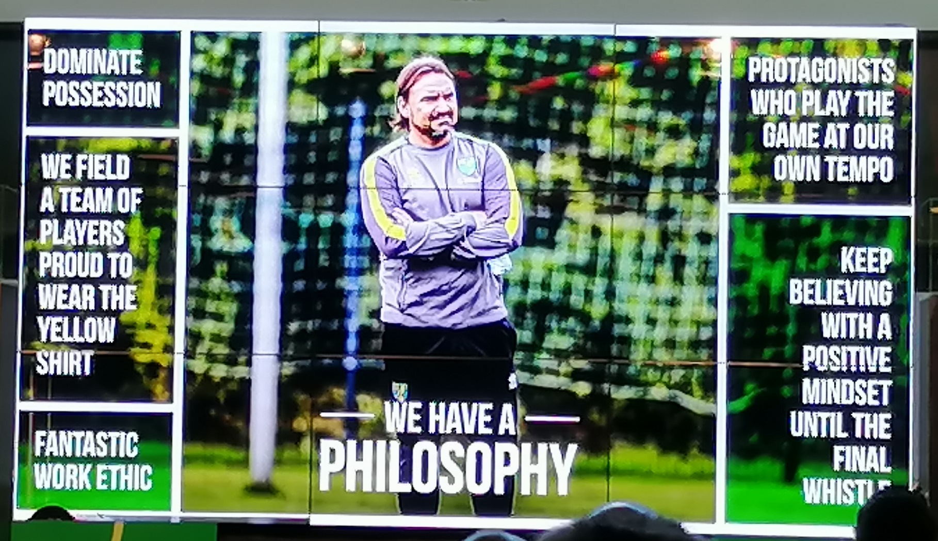

Slide 10
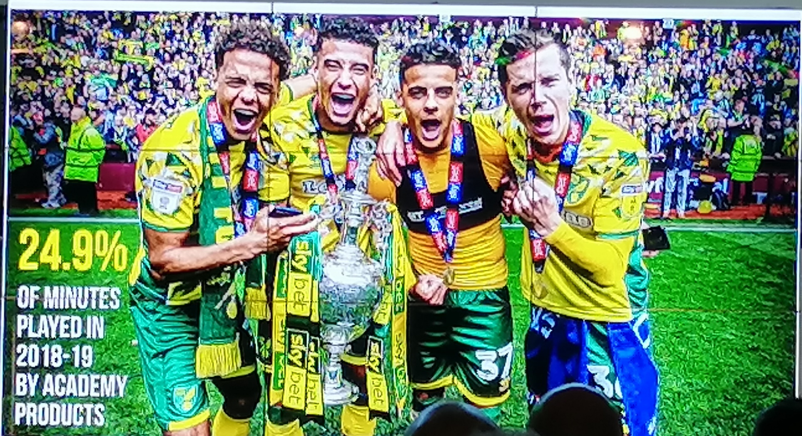

Slide 11
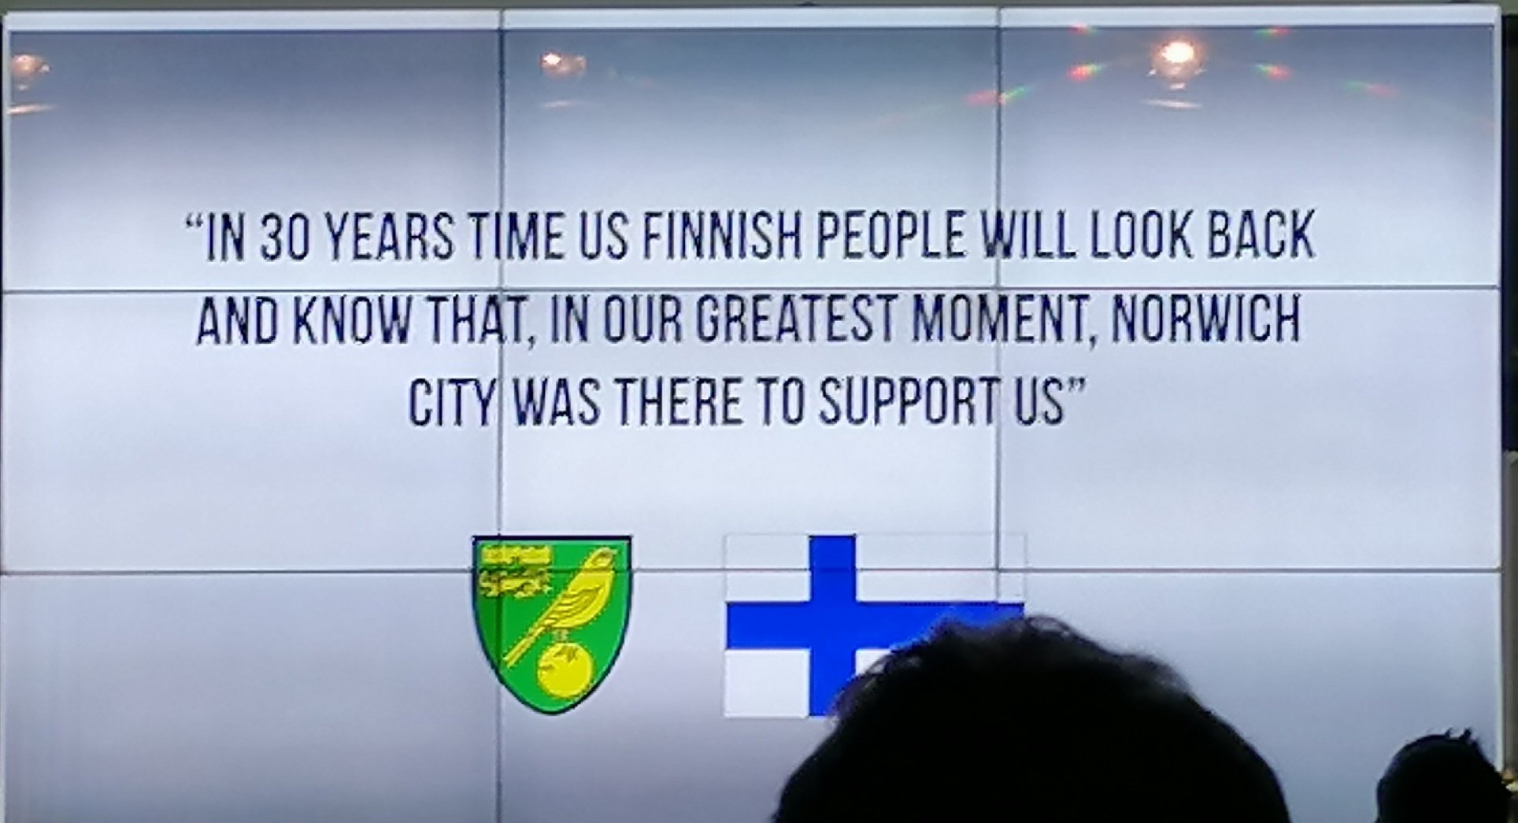

Slide 12


Slide 13
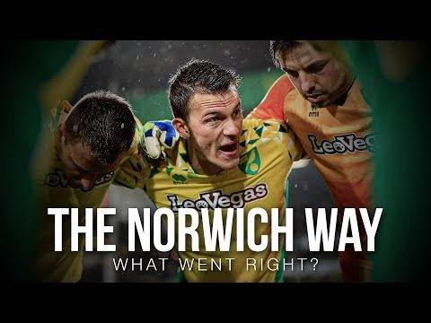

Slide 14
Summary
Norwich City FC
  Club info
  Club philosophy (Second video)
  https://www.youtube.com/watch?v=TAtFw4rJVKw
  International strategy (first video – aiming for the Finnish market)
  https://www.youtube.com/watch?time_continue=2&v=fxhD9Lx890g

