Slide 1
Self Defence
Zdenko Reguli
Michal Vít

Slide 2
Course objectives
After completing the course student is able to
explain taxonomy of self-defence and combatives
explain theory of personal self-defence
know different self-defence systems and schools
practically demonstrate the basic techniques of self-defence
explain role of different factors in self-defence situation (psychology, technique, tactics)

Slide 3
Syllabus of the course
Practical lessons enable to practice the knowledge acquired at theoretical lectures.
Introduction, influence of the culture and technology to understanding the need of personal safety
Theory of combatives, taxonomy of self-defence
Theory of martial arts
Strategy and tactics in self-defence
Awareness and reaction time
Cycle of Conflict
The need of physical development
Natural movements and manipulation with objects
Self-defence systems
Preventive movements: self-defence in children (making space, making self-confidence, games)
Preventive movements: self-defence in adults (pre-conflict, conflict, and post-conflict)
Conditioning in self-defence
Self-defence skills
Conclusions, questions and answers, ideas for further study

Slide 4
Assessment methods
You will choose any conflict/self-defence/self-protection/ … situation from video, newspaper, your own experience etc.
a) online part – essay (300-500 words):
Description (situation, context, environment)
What happened and way
What was possibly wrong
b) practical part (gym)
Examples of exercises

Slide 6
Physical culture
Health/sport/strength/physical body etc. movement
Originated in 19th century
Promoted through:
Military academies, private gyms, social movements (19th century)
Physical education, schools, sports (20th century)
Social networks, media (21st century)

Slide 7
Physical culture 19th century
German (Turnverein) system
Heavy gymnastics, paralel bars, pommel horses, climbing
Czech Sokol
Solo exercises, equipment exercises, exercises with help of partners, exercises against partner
Swedish gymnastics
Calisthenics, breathing, stretching, massages
Influenced PE in Japan Order of Educational System (Gakusei, 1872), “Illustration of Room Gymnastics” (Shachu Taisoho-zu, 1873), “Illustration of Gymnastics” (Taiso-zu, 1873)
Muscular Christianity
YMCA, YWCA

Slide 8
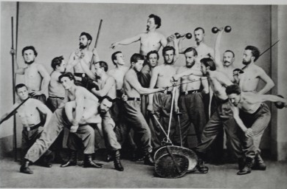
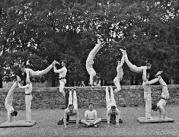

Slide 9
Physical culture 20th century
Eugen Sandow, body building
Weight lifting, building physical body
George Herbert
Natural movement, parcour
Women PE/sports (Joseph Pilates, Jane Fonda)
Pilates, jazzgymnastics, taebo
K. Cooper
Endurance, aerobics

Slide 10
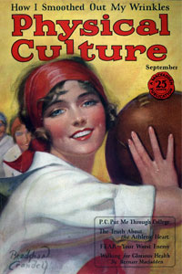
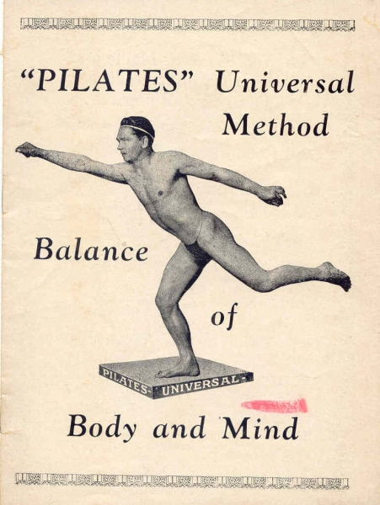
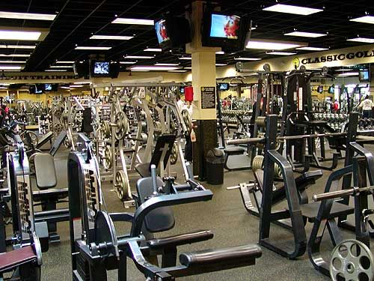

Slide 11
Physical culture 21st century
Natural movement
Movnat, Ido Portal, Caveman, Movement Evolve, TacFit
Performance challenging events
Spartan race, crossfit, 300, running races
Technology persuasive
Computer/social media/smartphones controlled activities
Healthy oriented
Minimum of physical activity, fight against obesity, hearth problems

Slide 12
Utilitarianism and PE, sport, and health
Utilitarianism is an ethical theory which states that the best action is the one that maximizes utility: the well-being (pleasure minus pain)
PE, sport should lead to health, pleasure, well-being
PE, sport should benefits as much people as possible without harming the environment

Slide 13
John Stuart Mill (20 May 1806 – 8 May 1873)
English philosopher, political economist, libertianist and civil servant
Contributed in social history, political theory, political economy
Proponent of utilitarianism developed by
Jeremy Bentham (1748-1832)
English philosopher, jurist, social reformer
Fundamental axiom of his philosophy: "it is the greatest happiness of the greatest number that is the measure of right and wrong"
“Nature has placed mankind under the governance of two sovereign masters, pain and pleasure. It is for them alone to point out what we ought to do, as well as to determine what we shall do. On the one hand the standard of right and wrong, on the other the chain of causes and effects, are fastened to their throne. They govern us in all we do, in all we say, in all we think”

Slide 14
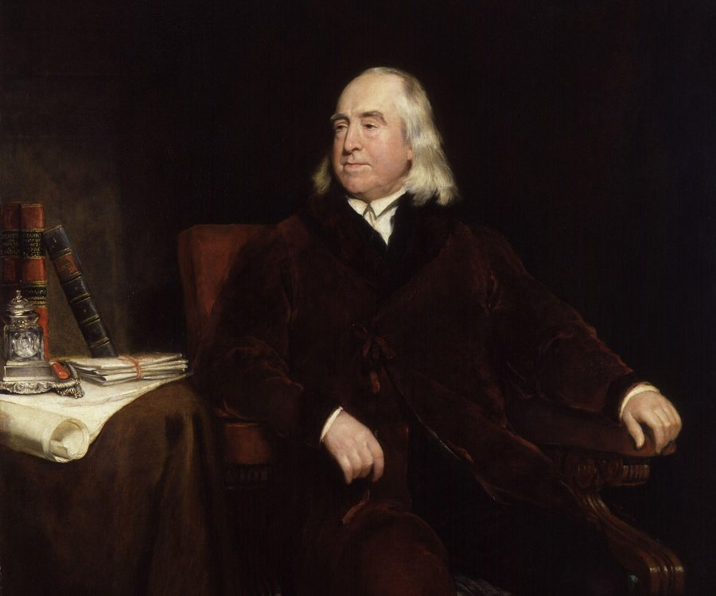
Jeremy Bentham John Stuart Mill

Slide 15
Quantitative and qualitative measurement
J.S.Mill: “It is quite compatible with the principle of utility to recognize the fact, that some kinds of pleasure are more desirable and more valuable than others. It would be absurd that while, in estimating all other things, quality is considered as well as quantity, the estimation of pleasures should be supposed to depend on quantity alone.”

Slide 16
Wide meaning of utilitarian exercises
To bring biggest benefit from exercises for as much people as possible
Exercises leading to
Personal safety
Personal protection
Natural use of body
Overall development through exercises

Slide 17
Wide meaning of utilitarian exercises
Personal safety
Self-defense, how to avoid (or de-escalate) conflict, what to do, how to move
Personal protection
Taking care of body in unexpected situation, how to avoid injury when falling down or when in collision with an object
Natural use of body
Body restart, learning how to move in natural way
Overall development through exercises
Exercises as a mean of self-development

Slide 18
Philosophical backgrond in utilitarianism
Utilitarianism is an ethical theory which states that the best action is the one that maximizes utility: the well-being (pleasure minus pain)
There is narrow and wide meaning of utilitarian exercises
Narrow - for a purpose (Occupational, House holding, Transportation, Gardening)
Wide – to bring biggest benefit from exercises for as much people as possible (Personal safety, Personal protection, Natural use of body, Overall development through exercises)

Slide 19
Long-term-athlete-development (LTAD)

Slide 21
Fundamental movement skills
movement patterns that involve different body parts such as the legs, arms, trunk and head, and include such skills as running, hopping, catching, throwing, striking and balancing. They are the foundation movements or precursor patterns to the more specialised, complex skills used in play, games, sports, dance, gymnastics, outdoor education and physical recreation activities.

Slide 22
Fundamental movement skills
1. Body management skills
Balancing the body in stillness and in motion.
2. Locomotor skills
transporting the body in any direction from one point to another.
3. Object control skills
require controlling implements (for example, bats, racquets or hoops) or objects (such as balls) either by hand or foot.

Slide 23
1. Body management skills
Balancing the body in stillness and in motion.
Examples are: static and dynamic balancing, rolling, stopping, landing, bending, stretching, twisting, turning, swinging, and climbing.
The skills included in this Resource are Balance on one foot, Walk on a line or beam, Forward roll, and Climb.

Slide 24
2. Locomotor skills
transporting the body in any direction from one point to another.
Examples are: crawling, walking, running, hopping, leaping, jumping, galloping, skipping, dodging, and swimming.
The skills included in this Resource are Sprint run, Hop, Continuous leap, Jump for distance, Jump for height, Gallop, Side gallop, Skip, and Dodge.

Slide 25
3. Object control skills
require controlling implements (for example, bats, racquets or hoops) or objects (such as balls) either by hand or foot.
Examples are: throwing, catching, kicking, striking, bouncing, and dribbling.
The skills included in this Resource are Underhand throw, Overhand throw, Chest pass, Catch, Kick, Punt, Two-handed strike, Hand dribble and Foot dribble.

Slide 26
Basic movement patterns
a way of categorising exercises based on their biomechanical demands
Hip Hinge (Romanian Deadlift (RDL) and its variations (e.g. single-leg), Kettlebell Swing)
Hip Dominant (Glute Bridges, High-Box Step-Ups)
Knee Dominant (Single-Leg Squats, Lunge)
Vertical Push (Military Press, Overhead Dumbbell Press)
Vertical Pull (Pull-Ups, Lat Pull-Downs)
Horizontal Push (Press-Ups, Bench Press)
Horizontal Pull (Inverted Row, Bench Row)
Rotational and Diagonal (Russian Twist, Barbell Torque)
Anti-Rotation (Horizontal Palov Press, Single-Arm Dumbbell Chest Press)
Anti-Flexion (Squat. Deadlift)
Anti-Extension (The Plank, Crocodile Crawls)
Anti-Lateral Flexion (Single-Arm Overhead Press, Imbalance Lunges)

Slide 27
Functional movements
Functional, by definition, means something that is ‘designed to be practical and useful, rather than attractive’. Though this has become a huge buzzword in recent years with trainers using any form of ‘fancy’ or ‘attractive’ equipment they can get their hands on, it simply refers to any training methods that are applicable and useful for that sport, regardless of complexity or attractiveness. For example, a simple barbell deadlift is practical and useful for athletic development in rugby, therefore this may be referred to as ‘functional’

Slide 28
Fundamentals in martial arts / combative sports
1. Basic combative relationships
2. Basic combative skills

Slide 29
1. Basic combative relationships
a) Centrifugal (pulling)
b) Centripetal (pushing)
c) Opposition
The aim of oppositions can vary as follows:
Translocation:
moving (catching the opponent off balance) (horizontally as well as vertically),
change the position of a predetermined body part (extremities, torso, head),
take an object held by the opponent,
Hold/grip:
Keeping the opponent in a position (horizontally as well as vertically),
Holding („Locking“) an agreed part of the opponent’s body (extremities, torso, head)
Hold on to/ keep an object,
Contact establishment:
Touch or grip the opponent (or his/her predetermined body part), or the object the adversary is holding,
Preventing any contact:
Denying the opponent the opportunity to establish a contact or grip

Slide 30
2. Basic combative skills
postures:
stances,
sitting,
lying,
kneeling,
transfers, changing position
arm movements,
leg movements,
turning the body,
contact establishment,
touch,
grip,
embrace,
lifting, carrying and dropping of a live load (partner)
falling techniques.

Slide 31
Wide meaning of utilitarian exercises
Natural use of body
Body restart, learning how to move in natural way
Personal protection
Taking care of body in unexpected situation, how to avoid injury when falling down or when in collision with an object
Personal safety
Self-defense, how to avoid (or de-escalate) conflict, what to do, how to move
Overall development through exercises
Exercises as a mean of self-development

Slide 32
Differences
Combat sports
Martial arts
Self-defence

Slide 33
Differences
Combat sports
Rules, intentional performance, aimed on measurable aims
Martial arts
Self-defence

Slide 34
Differences
Combat sports
Rules, intentional performance, aimed on measurable aims
Martial arts
Rules/rituals, intentional performance, not aimed on measurable aims
Self-defence

Slide 35
Differences
Combat sports
Rules, intentional performance, aimed on measurable aims
Martial arts
Rules/rituals, intentional performance, not aimed on measurable aims
Self-defence
No rules, not intentional performance, not aimed on measurable aims

Slide 36
Combat
Combative
Combatives
What does it mean?

Slide 37
Combat (v)
Etymology: 1560s, from M.Fr. combat (16c., O.Fr. combattre, 12c.), from L.L. combattere, from L. com- "with" (each other) + battuere "to beat, fight“
1. to fight or defy
2. to struggle or strive (against); be in conflict (with)
Synonyms: fight, battle against, oppose, contest, engage, cope with, resist, defy, withstand, struggle against, contend with, do battle with, strive against

Slide 38
Combat (n)
a fight, conflict, or struggle
(Military) an action fought between two military forces
Synonyms: fight, war, action, battle, conflict, engagement, warfare, skirmish

Slide 39
Combative (adv.)
eager or ready to fight, argue, etc.; aggressive
having or showing a willingness to fight or argue
Synonyms: aggressive, agonistic, argumentative, assaultive, bellicose, brawly, chippy, belligerent, confrontational, contentious, discordant, disputatious, feisty, gladiatorial, militant, pugnacious, quarrelsome,scrappy, truculent, warlike

Slide 40
Combatives
There is many definitions of combatives. It is usualy connected to military / army forces, e.g.:
Combatives is the United States Army's term for hand-to-hand combat training and techniques.

Slide 41
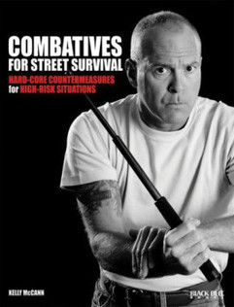
Combatives is what you do to somebody - martial arts is what you do with somebody
(Kelly McCann A.K.A. Jim Grover )

Slide 42
THE INTEGRATED CLOSE COMBAT FORUM
A system of close personal combat, with and without weapons, conceived by means of embracing simple to learn and easy to apply unified techniques, which originated in the traditional martial arts and sports of both the oriental and occidental cultures.

Slide 43
THE INTEGRATED CLOSE COMBAT FORUM
Combatives can be further subdivided into three distinct yet overlapping categories.
Military, kill or be killed, offensive/defensive,
Police/Correctional Officer, restraining/defensive,
Civilian Self-defense or protection.

Slide 44
The term combatives in the Czech environment - úpoly
There is a unique Czech word úpoly used in all Czech sources.
Úpoly is a neologism originated by Miroslav Tyrš (19th century).
There is no adequate term in English nor other languages.
We strictly use term combatives as a translation of úpoly

Slide 45
Starting point
Nowadays we comprehend combatives as one of recources of:
PE
general education
personal development
selfdefence
part of physical culture generally.

Slide 46
Combatives definition
are physical exercises aimed at the physical defeat of a partner. Combatives comprise specific exercises, which prepare a participant to overcome a partner by physical contact.

Slide 47
Taxonomy of combatives
Three levels
Preparatory combatives
Combat sports
Self-defence

Slide 48
Preparatory combatives
The first level is the level of combatives pre-requisites. It comprises of the simplest combative activities (movement activities in contact with one or more partners), which are the necessary pre-requisite for the next two levels. The content is the basic fighting technique needed for all the fighting activities (posture, guard, falls, ...). These activities are preparation and basics and we call them preparatory combatives.

Slide 49
Combat sports
The second level involves individual combative systems. Each of them is a comparatively independent unit and it fulfils the criteria of an independent combative branch. We call them combative sports and we can further subdivide them. The level of combative systems is the greatest and most important part of combatives.

Slide 50
Self-defence
The third level is the level of applied combative activities to be used in necessary self-defence with appropriate legal, ethical, social and other norms. This category is somewhat separate from the system of combative sports as it is closely linked with other, especially technical indicators that fall outside the field of sport (especially with the usage of firearms and other weapons).
open system of any precautions and actions preventing victimization, deflecting acute threat using tactical, psychological, verbal or physical tools including use of reasonable force in accordance with the law in the defence of necessity and mitigation of the negative effects of assault.

Slide 51
Basic terms
Defend actions – the act of defending yourself or someone or something from attack.
Victimology - an area of criminology which studies the victim of crime and their relationship with offenders.
Victim - a person who is actually and directly affected by an act or omission that is incompatible with the European Convention on Human Rights, or a person who is at risk of being directly affected.
Victimization - the process in which one becomes a victim of crime.
Particularly vulnerable victim - persons who are particularly vulnerable or who find themselves in situations that expose them to a particularly high risk of harm, e.g. persons subjected to repeat violence in close relationships, victims of gender-based violence, children, disabled people etc.
Scenario training - the method used in the self-defence teaching both for training and evaluation purposes consisted in the pre-prepared course of a situation similar to a theatre script with fixed roles and activity of the actors where the roles of the actors (assailants) and the defender (a tested person) are already given.

Slide 52
Four-dimensional development of human being
noosphere, spirituality
sociosphere
biosphere
psychosphere

Slide 53
Bloom's taxonomy of learning objectives
set of three hierarchical models used to classify educational learning objectives
Benjamin Bloom ((February 21, 1913 – September 13, 1999)
american educational psychologist
Originator of taxonomy of learning objectives
Taxonomy: the practice and science of classification of things or concepts, including the principles that underlie such classification

Slide 55
Cognitive domain
Remembering
Remembering involves recognizing or remembering facts, terms, basic concepts, or answers without necessarily understanding what they mean. Its characteristics may include:
Knowledge of specifics—terminology, specific facts
Knowledge of ways and means of dealing with specifics—conventions, trends and sequences, classifications and categories, criteria, methodology
Knowledge of the universals and abstractions in a field—principles and generalizations, theories and structures
Example: Name three common technigues of striking or kicking.
Comprehending
Comprehension involves demonstrating understanding of facts and ideas by organizing, comparing, translating, interpreting, giving descriptions, and stating the main ideas.
Example: Compare the identifying characteristics of judo and boxing

Slide 56
Cognitive domain
Applying
Applying involves using acquired knowledge—solving problems in new situations by applying acquired knowledge, facts, techniques and rules. Learners should be able to use prior knowledge to solve problems, identify connections and relationships and how they apply in new situations.
Example: Idetify and apply communication skills for de-escalation of conflict situation
Analyzing
Analyzing involves examining and breaking information into component parts, determining how the parts relate to one another, identifying motives or causes, making inferences, and finding evidence to support generalizations. Its characteristics include:
Analysis of elements
Analysis of relationships
Analysis of organization
Example: Analyze the probability conflict situation in the given scenario

Slide 57
Cognitive domain
Evaluating
Evaluating involves presenting and defending opinions by making judgments about information, the validity of ideas, or quality of work based on a set of criteria. Its characteristics include:
Judgments in terms of internal evidence
Judgments in terms of external criteria
Example: What principles was used in the self-defence model situation?
Synthesizing/Creating
Synthesizing involves building a structure or pattern from diverse elements; it also refers to the act of putting parts together to form a whole. Its characteristics include:
Production of a unique communication
Production of a plan, or proposed set of operations
Derivation of a set of abstract relations
Example: Create a plan of personal safety

Slide 58
Affective domain
Receiving
The lowest level; the student passively pays attention. Without this level, no learning can occur. Receiving is about the student's memory and recognition as well.
Responding
The student actively participates in the learning process, not only attends to a stimulus; the student also reacts in some way.
Valuing
The student attaches a value to an object, phenomenon, or piece of information. The student associates a value or some values to the knowledge they acquired.
Organizing
The student can put together different values, information, and ideas, and can accommodate them within his/her own schema; the student is comparing, relating and elaborating on what has been learned.
Characterizing/Internale the value system
The student at this level tries to build abstract knowledge.

Slide 59
Psychomotor domain
Perception
The ability to use sensory cues to guide motor activity: This ranges from sensory stimulation, through cue selection, to translation.
Examples: Detects which techniques was used by instructor.
Key words: chooses, describes, detects, differentiates, distinguishes, identifies, isolates, relates, selects.
Set
Readiness to act: It includes mental, physical, and emotional sets. These three sets are dispositions that predetermine a person's response to different situations (sometimes called mindsets). This subdivision of psychomotor is closely related with the "responding to phenomena" subdivision of the affective domain.
Examples: Knows and acts upon a sequence of defensive moves. Recognizes his or her abilities and limitations do defend.
Key words: begins, displays, explains, moves, proceeds, reacts, shows, states, volunteers.

Slide 60
Psychomotor domain
Guided response
The early stages of learning a complex skill that includes imitation and trial and error: Adequacy of performance is achieved by practicing.
Examples: Follows instructions to make a defense. Responds to hand-signals of the instructor while applying different moves.
Key words: copies, traces, follows, react, reproduce, responds.
Mechanism
The intermediate stage in learning a complex skill: Learned responses have become habitual and the movements can be performed with some confidence and proficiency.
Examples: Chooose a propper defensive moves to defend yourself according to the situation in simple self-defense model.
Key words: assembles, calibrates, constructs, dismantles, displays, fastens, fixes, grinds, heats, manipulates, measures, mends, mixes, organizes, sketches.

Slide 61
Psychomotor domain
Complex overt response
The skillful performance of motor acts that involve complex movement patterns: Proficiency is indicated by a quick, accurate, and highly coordinated performance, requiring a minimum of energy. This category includes performing without hesitation and automatic performance. For example, players will often utter sounds of satisfaction or expletives as soon as they hit a tennis ball or throw a football because they can tell by the feel of the act what the result will produce.
Examples: Chooose a propper defensive moves in co-ordinance with the communication (both verbal and non-verbal) to defend yourself according to the situation in simple self-defense model.
Key words: assembles, builds, calibrates, constructs, dismantles, displays, fastens, fixes, grinds, heats, manipulates, measures, mends, mixes, organizes, sketches. (Note: The key words are the same as in mechanism, but will have adverbs or adjectives that indicate that the performance is quicker, better, more accurate, etc.)
Adaptation
Skills are well developed and the individual can modify movement patterns to fit special requirements.
Examples: Responds effectively to unexpected situation in complex self-defence model. Modifies instruction to meet the needs. Performs a defense with a tool using it as improvised weapon.
Key words: adapts, alters, changes, rearranges, reorganizes, revises, varies.

Slide 62
Psychomotor domain
Origination
Creating new movement patterns to fit a particular situation or specific problem: Learning outcomes emphasize creativity based upon highly developed skills.
Examples: Develops a new and comprehensive training program. Creates a new routine of defensive movements.
Key words: arranges, builds, combines, composes, constructs, creates, designs, initiate, makes, originates.

Slide 63
Self-defence
Personal
Self-defence of specific groups
Professional
In international law
Nation (state) self-defence

Slide 64
Self-defence of specific groups
Self-defence of women
Self-defence of children
Self-defence of elderly persons
Specific
Threats
Environment
Means
Learning process

Slide 65
Self-defence: women
Threats
Harasment, sexual violence
Environment
Known environment (home, work, with friends and coleagues)
Means
Defensife technical means (chemical, electronical,….)
Learning proces
Motivation, that fighting is sometimes necessary

Slide 66
Self-defence: children
Threats
Silly jokes, bullying, robberies
Environment
School, clubs, routine way to school/club, with friends
Means
communications, working with the space, runnig out, looking for help
Learning proces
Game, motivation that fighting is not always neccssary

Slide 67
Predictors of children´s successful defence against adult attacker
Material & Methods: The research sample: 48 students (40 female, 8 male) from three secondary schools. Average age: 16.6 years. Six self-defence experts performed ex-post evaluation of each video recorded scenario. Spearman’s rank correlation coefficient, classification trees C&RT and logistic regression were used for analysis. Results: Correlation between increasing personal score obtained by evaluation of selected criteria and the probability of a successful defence was confirmed by the high correlation r^{s} = 0.735 significance level of p<0.05. Active defence, escape and technical means respectively, were found the best predictors out of the total number of six evaluation criteria. Communication and safe distance keeping varied in the fifth position depending on the selected statistical method. Guard position was found the weakest predictor. Conclusions: There are 13.88 times higher odds of successful defence when children are dealing with an adult attacker actively. The activity should be aimed at looking for an escape route as there are 7.69 times higher odds of successful defence when the child is trying to escape. Finally, there are 3.75 times higher odds of successful defence when the child uses appropriate technical means to distract attacker’s attention.

Slide 68
Self-defence: elderly persons
Threats
Robbery
Environment
Known environment (home, shop, public transport)
Means
Communication, protective barriers, technological home safety
Learning proces
Ability to recognise threat, drilling elementary/trivial safety rules

Slide 70
Pre-conflict
Preventive behaviour
To be ready physicaly and psychologicaly
To create conditions for defense
Space
Time
People
Communication
Asertive
Adequate to situation
To feel possible danger and escalation of the danger

Slide 71
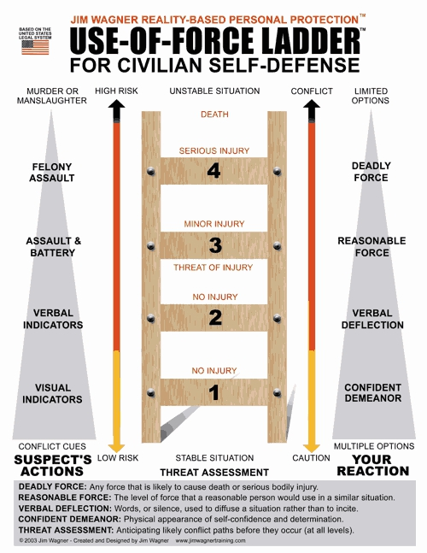

Slide 72
Post-conflict
Stabilization
What is the solution of the confict?
Fly away
Detention of attacker
First aid (defender and attacker)
Contact to police or others authority according to the situation
Normalization
Hospitalization (not to underestimate even small / hidden injuries, also due to further criminal-law liability)
Contemplation (coping with the situation, psychological help
Criminal proceedings (testimony, witnesses, evidence (photo, video)
Evaluation – learning from experience, progress in training
Feedback for further training
Awareness of all conditions leading to success / failure
Awareness of possible mistakes in the pre-conflict phase: what to do to prevent the conflict next time in the same conditions

Slide 74
Timing of defense
Defense by attack (before an attack of attacker)
Preventive attack
Preemptive attack
Defense by counterattack (during of attacker attack)
Defense by after attack
Traditional stratégy in martial arts?
Consequences in ethics and law

Slide 75
Defense by attack (anticipatory defense)
Defense by attack (before an attack of attacker)
Used also in internetioal law
State defense
Fight against terrorism
There can be conflict of legality in personal self-defense
Preventive attack (defense)
We assume that there is a danger
The objective is to prevent a potential attack
The attack is potentially at risk
Preemptive attack (defense)
There is a real danger
The goal is to prevent the planned attack
The attack is in real danger

Slide 76
Stages of defense
Default position
Creating a controlled situation by entering the attack (spear, shield, pensador, ...)
Elimination of attack (or attacker)
Controll
Fly away
Physical control

Slide 77
Default position: reaction in the stress Walter G. Cannon (1871-1945)
FxFxF
Flight
Fight
Freeze

Slide 82
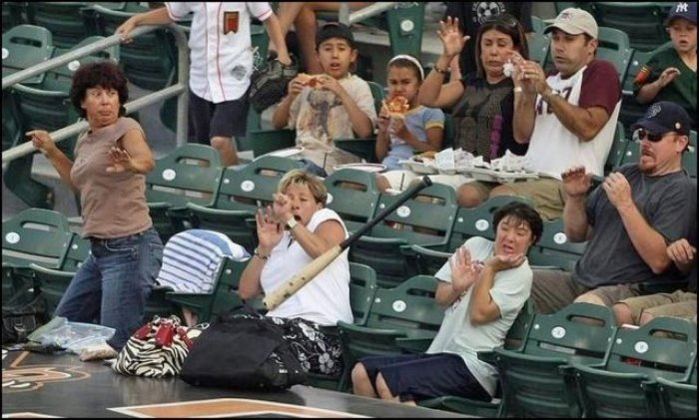

Slide 83
Default position: reaction in the stress
FxFxF
Flight
Fight
Freeze
How each of that reaction can be helpful in selfdefence?

Slide 84
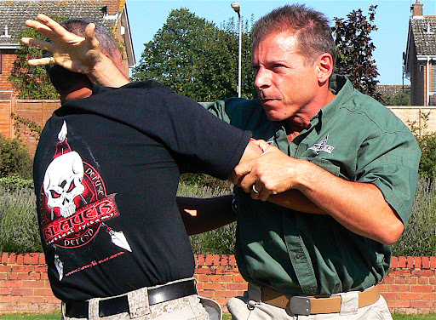
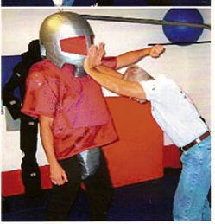
Default position - pushing
Lee Morrison: Defining the default position
S.P.E.A.R. flinch (Tony Blauer)
Cow-catcher (Lee Aldridge)

Slide 85
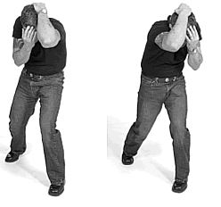
Default position – protection, covering
Lee Morrison: Defining the default position
Crazy Monkey (Rodney King)
Keysi Fighting Method: pensador

Slide 86
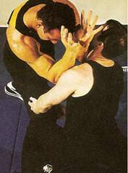
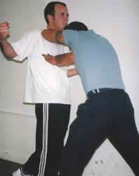
Default position – half pushing/half covering
Lee Morrison: Defining the default position
Dynamic Combat: The shield (Richard Ryan)
Dermot O’Neil

Slide 87
Default position
Using natural movement reactions and natural movement skills
Extended arms – pushing out (fight)
Benden arms – protection (flight)
Conditions
Protection of the body (vital parts)
Possibility of fluent movement from defense to atttack (defense is an attack)
Protective against different attacks (strikes, holds, from different angles)
Using in different positions and in variable environment

Slide 88
Conclusion
Self-defense is not just physical fight, in fact this is the last thing we want
There is a paradox in physical self-defence – we learn it for not using it
Self-defence is open process of communication (verbal and nonverbal)
Defensive movements come out from fundamental movement skils (FMS)

