Slide 1
Basis for training
Strength Training and Conditioning

Slide 2
Scope of training
Biomotor ability
(bioenergetics)

Slide 3
Objectives of Training
Multilateral physical development
Sport-specific physical development
  Blending of key aspects (power, muscle endurance, …)
Technical skills
Tactical abilities
Psychological factors
Health maintenance
Injury resistance
Theoretical knowlage

Slide 4
Auxiliary sciences

Slide 5
Classification of Skill
Cyclic
Acyclic
Acyclid combined
Rowing
Fencing
High jump

Slide 6
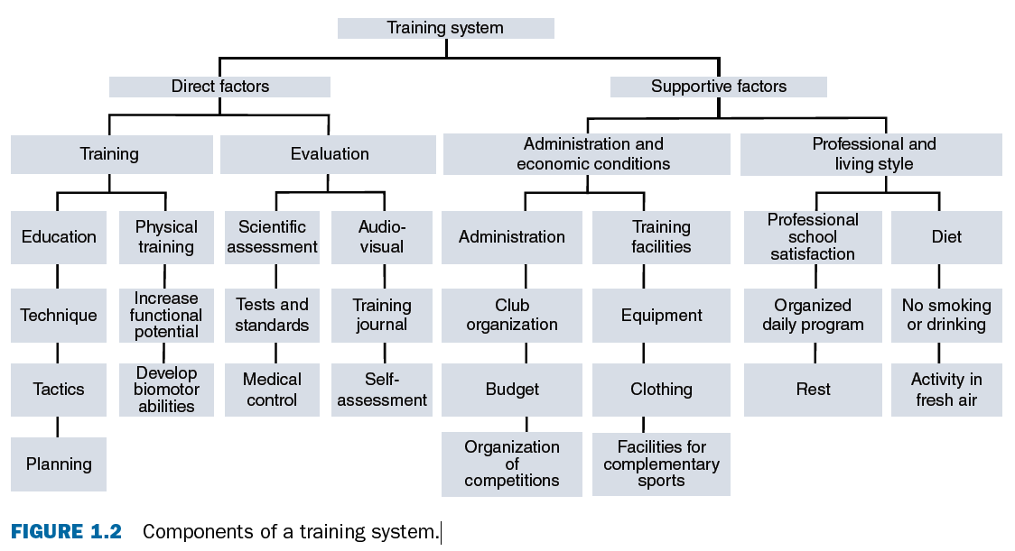
System of Training
Bondarchuck:
Uncovering the system’s forming factors
Determining the system’s structure
Validating the efficacy of the system

Slide 7
Factors that affect training quality

Slide 8
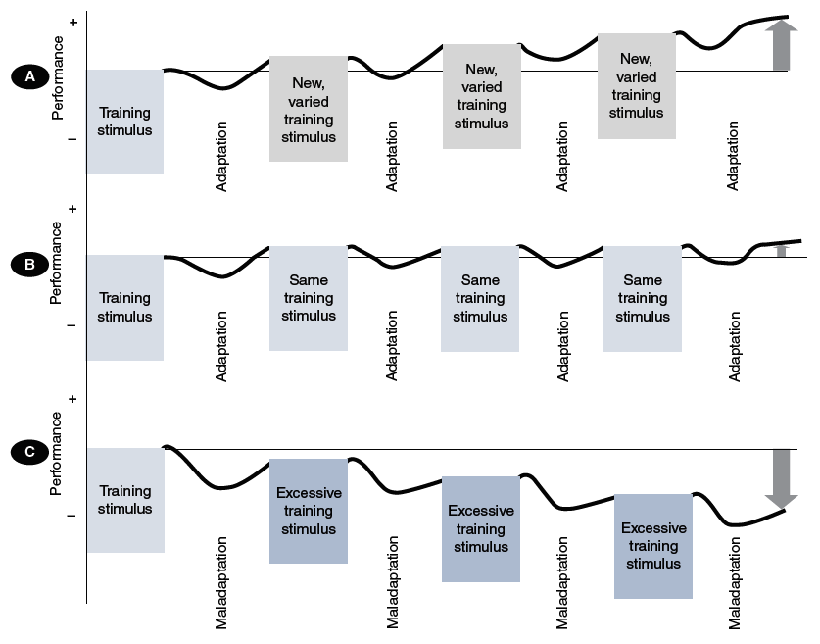
Adaptation
Fatigue, overreaching, overtraining
Increasing stimulus (load) ➞ Adaptation ➞ Performance improvement
Lack of stimulus ➞ Plateau ➞ Lack of improvement

Slide 9
Standard load results in improvements only during the early phase of the plan

Slide 10
Specificity of Adaptation
Neuromuscular - motor unit firing rate (rate coding), muscle hypertrophy
Metabolic – ATP+PCr, lactid acid, glycolitic systém, oxidative systém
Cardirespiratory – stroke volume, VO₂max
Preadaptation
Compensation
Stable or precompetitive adapt.
State of readiness for competition

Slide 11
Training effect
Immediate TE
Delayed TE
Cummulative

Slide 12
Supercompensation Cycle and Adaptation
Supercompensation
General adaptation syndrome
Progressive overloading
Microcycles, sequenced training, periodization

Slide 13
Phases of Sepercompesantion
Four phases:
#1: 1 to 2 hours
#2: 24 to 48 hours
#3: 36 to 72 hours
#4: 3 to 7 days

Slide 15
Sources of Energy
Anaerobic phosphagen systém (ATP-CPr)
Anaerobic glycolitic systém (La)
Aerobic oxidative systém (O₂)

Slide 16
Ralation between time and (an)aerobic energy supply

Slide 17
Energy sources for competitive sport

