Slide 1
High-intensity inteval training (HIIT)
E022

Slide 2
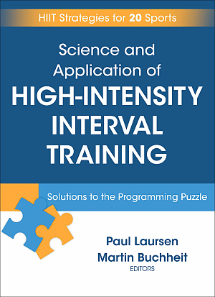
Science and Application of HIIT
Laursen & Buchheit, 2019
MUNI VPN: https://www.humankineticslibrary.com/encyclopedia?docid=b-9781492595830

Slide 3
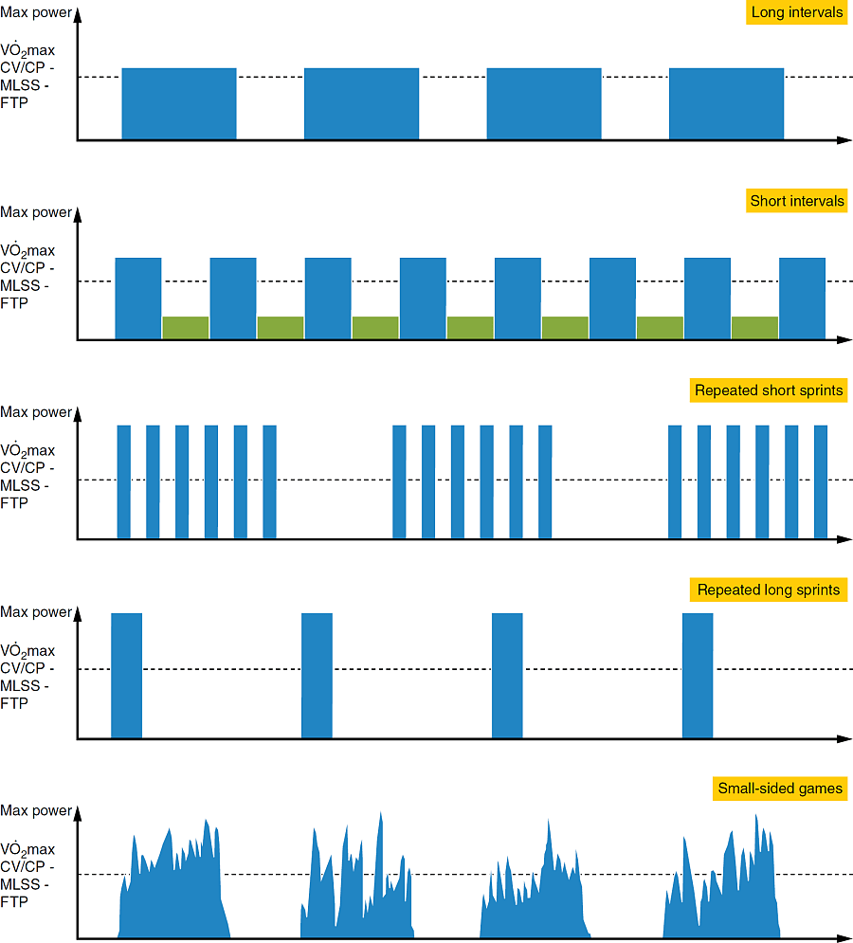
Schematic diagram illustrating the general concept of HIIT
Blue bars = effort intervals
Green = relief intervals

Slide 4
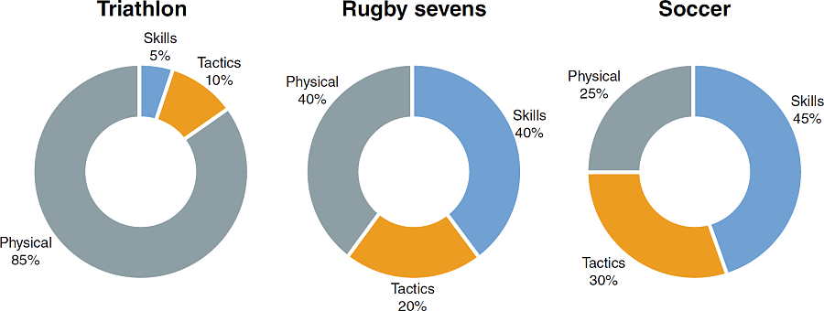
Respective importance of skills, tactics, and physical capacities for successful performance

Slide 5
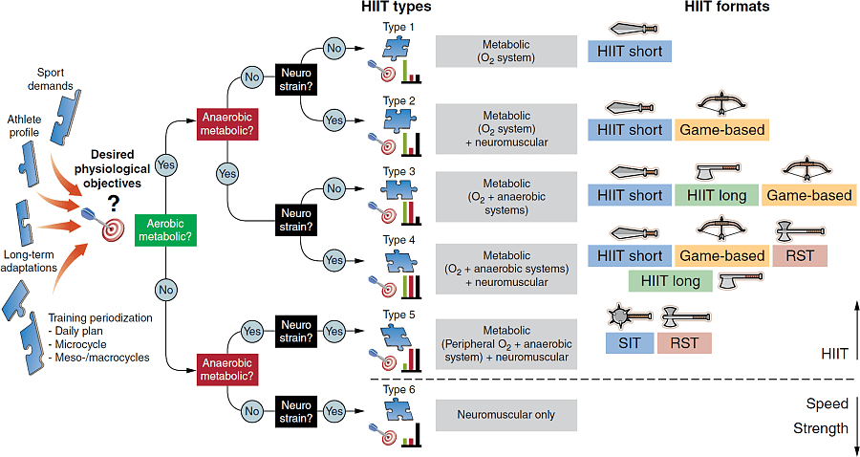
Type 1, metabolic, eliciting essentially large requirements from the cardiopulmonary system and oxidative muscle fibers;
Type 2, metabolic as per type 1, but with a certain degree of neuromuscular strain;
Type 3, metabolic as per type 1, but with a large degree of anaerobic glycolytic energy contribution;
Type 4, metabolic (oxidative/anaerobic) as per type 3 plus a certain degree of neuromuscular strain;
Type 5, essentially a large anaerobic contribution combined with neuromuscular strain; and
Type 6, essentially a large neuromuscular strain, with limited metabolic contribution (neither oxidative nor anaerobic).

Slide 6
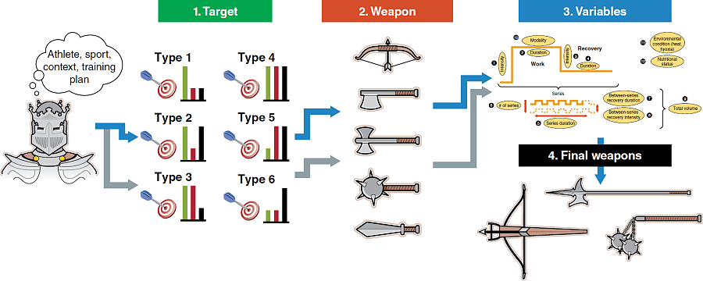
think differently: what do you want (HIIT type/target), how do you do it (format/weapon), what variables do you adjust to hit your targets before final creation of your weapon

Slide 7
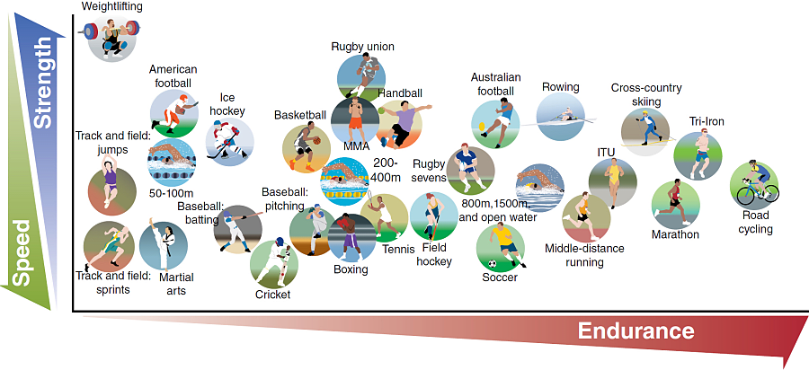
Various sports, their physical demands relative to needed speed, strength, and endurance

Slide 8
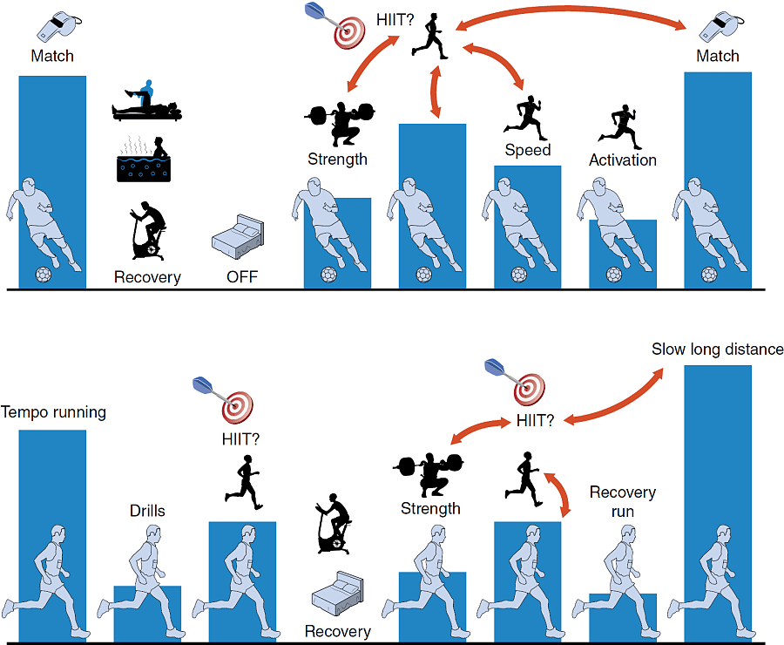
Two different typical weekly patterns (Team sports, with endurance, strength, and speed sessions on different days) and road running

Slide 9
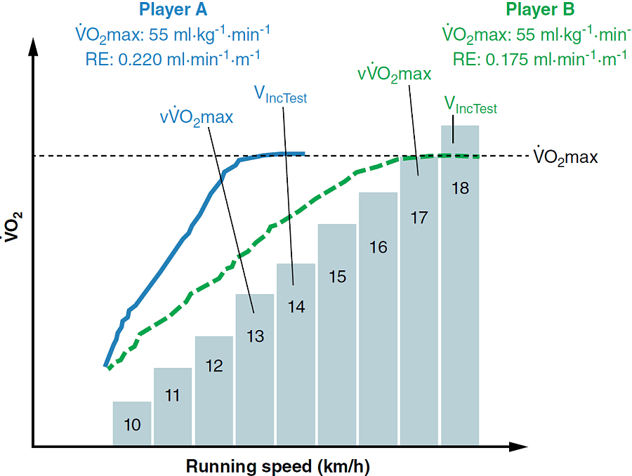
VO2 during an incremental test for two players with similar VO2max but with different RE

Slide 10
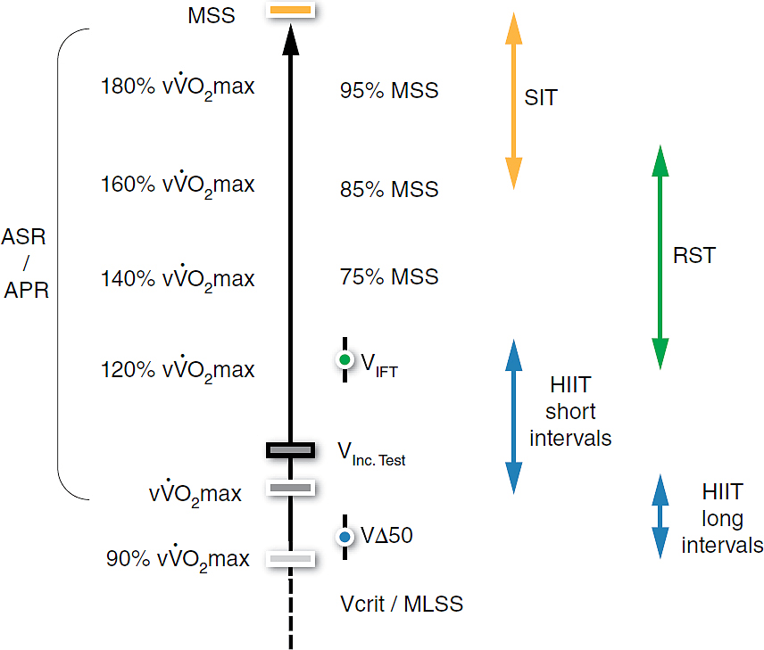
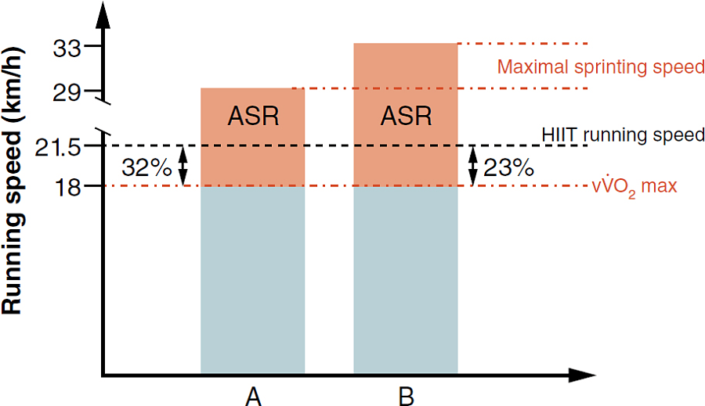
Intensity range used for the various HIIT formats (L). ASR=anaerobic speed reserve (R)

Slide 11
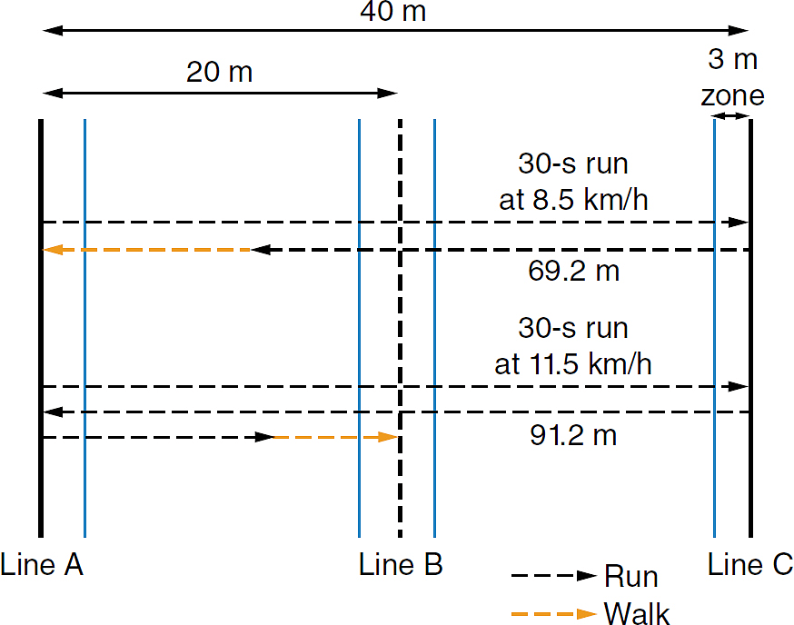
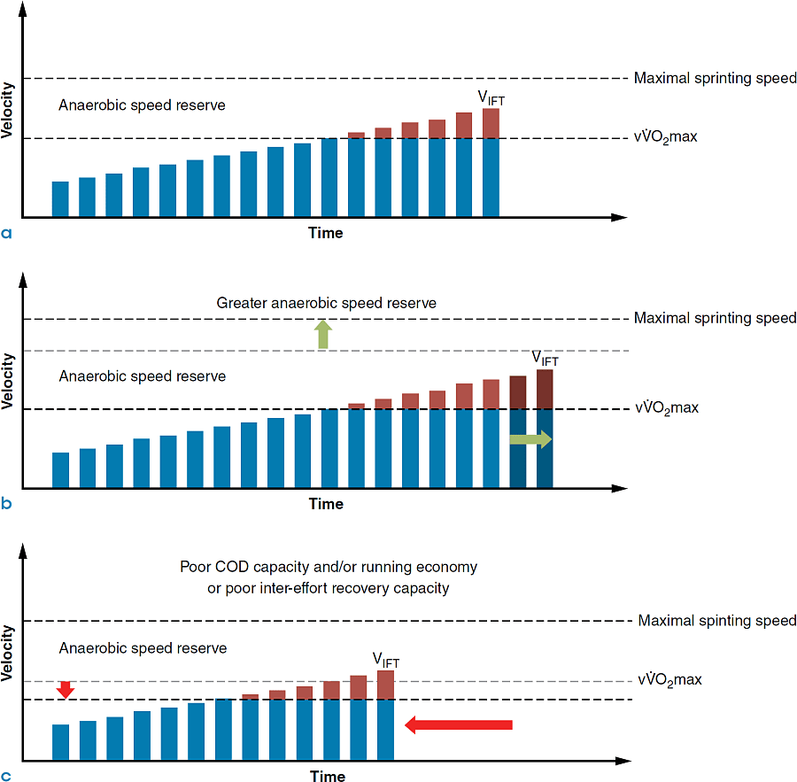
30-15 Intermittent Fitness Test (30-15 IFT) (https://30-15ift.com)

Slide 12
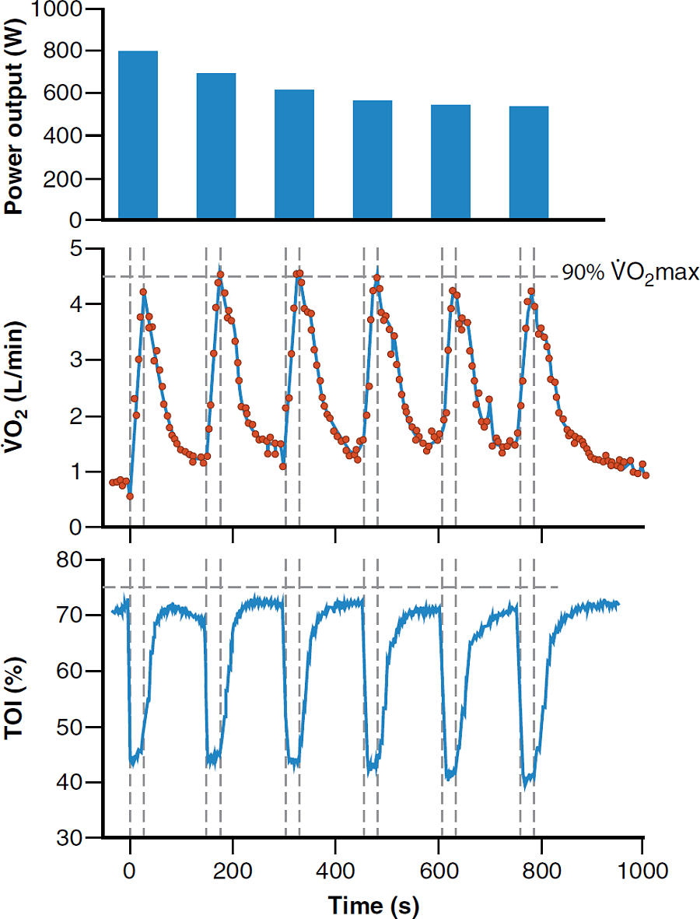
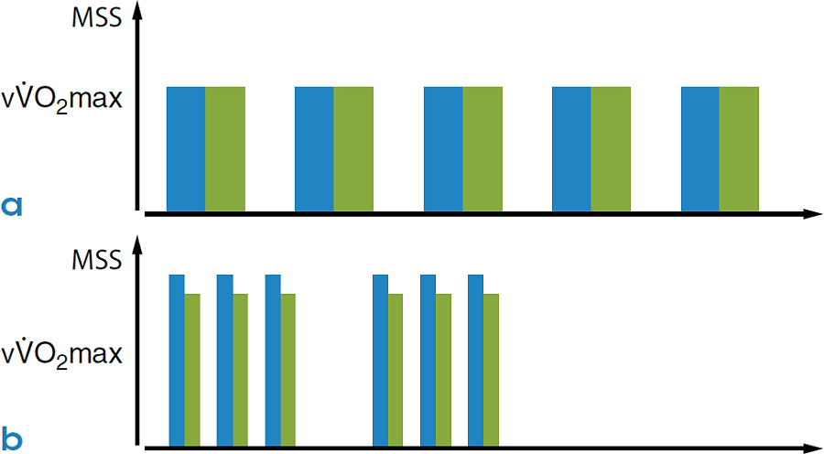
Power output, oxygen uptake (⩒O₂), and muscle tissue oxygenation index (TOI) during a sprint interval training session (6 ×30 s all-out cycling sprints, 2 min passive recovery)
Running objectives during two track sessions for two athletes with different locomotor profiles. Runner A: V_{IncTest} 21.5 km/h, MSS 33.5 km/h; runner B: V_{IncTest} 21.5 km/h, MSS 29 km/h. (a) 12 × 400 m (only the first 5 repetitions are shown). As runs are performed around the V_{IncTest}, they perform the same work in 65 s. (b) 2 ×3×200 m. As runs are performed at a speed close to MSS, runner A (blue) performs these in 25 s, while runner B (green) performs these in 29 s.

Slide 13
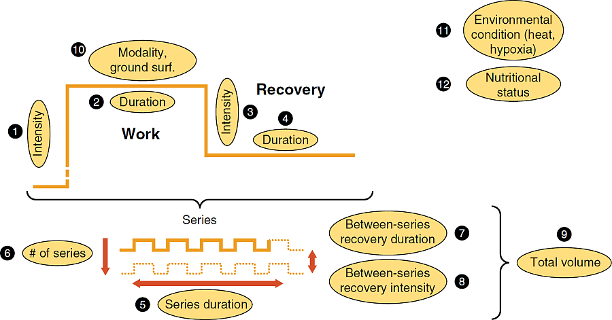
The 12 variables that can be manipulated to prescribe different HIIT sessions

Slide 14
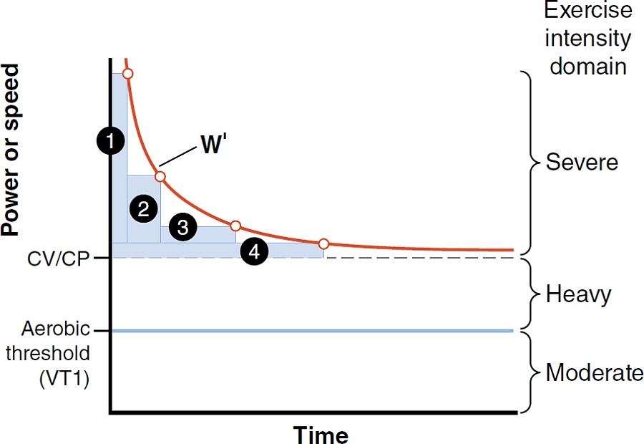
Exercise Period Duration = Critical Power (CP) + Anaerobic Work Capacity (W′)

Slide 15
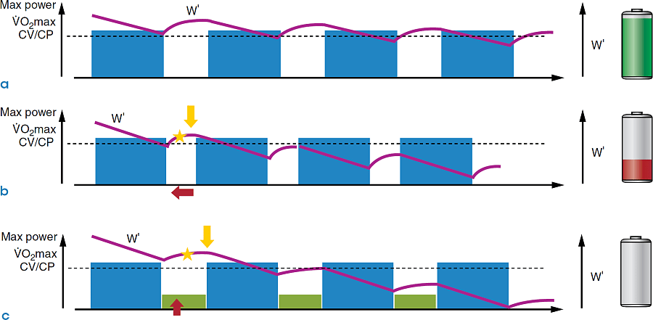
Recovery

Slide 16
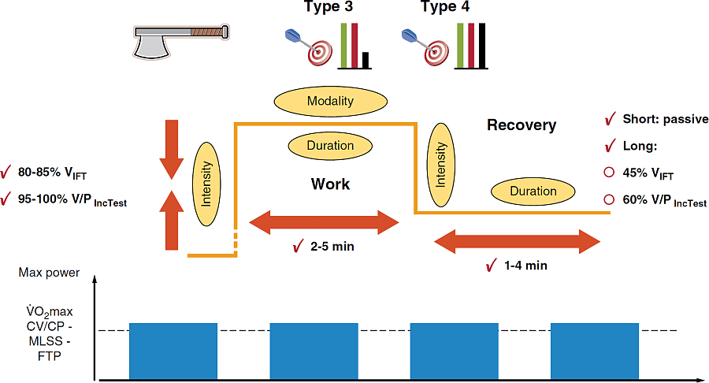
Long intervals

Slide 17
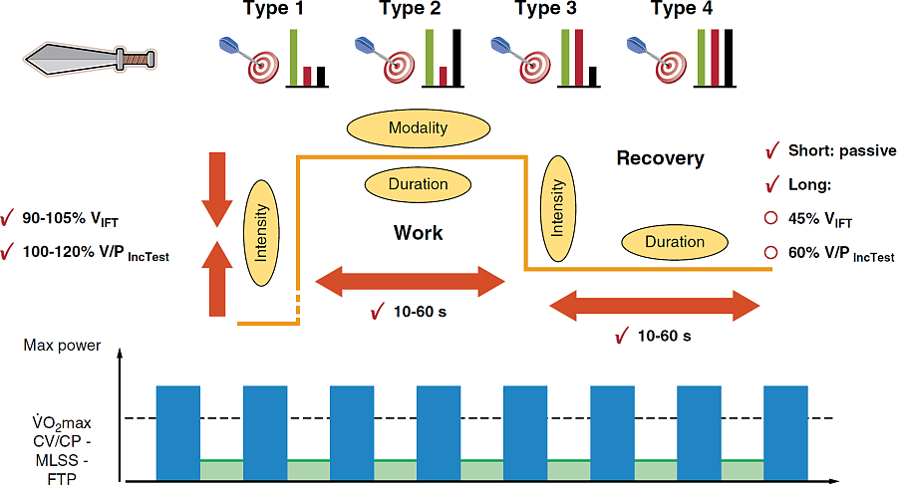
Short intervals

Slide 18
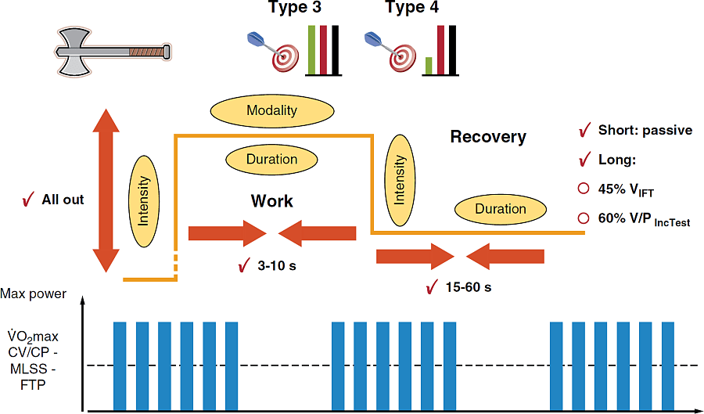
Repeated-sprint training

Slide 19
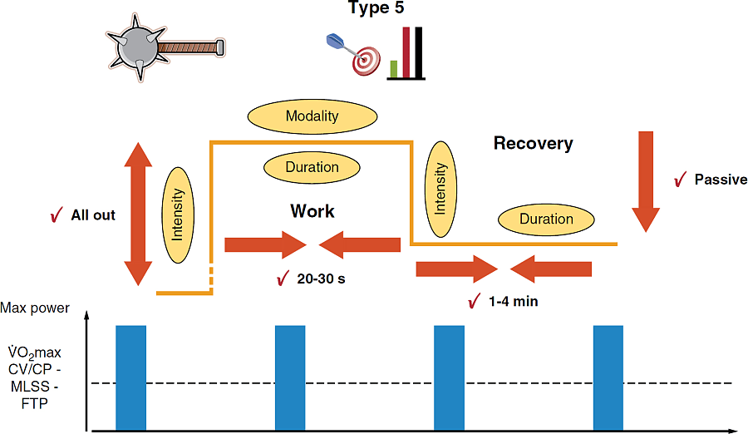
Sprint interval training

Slide 20
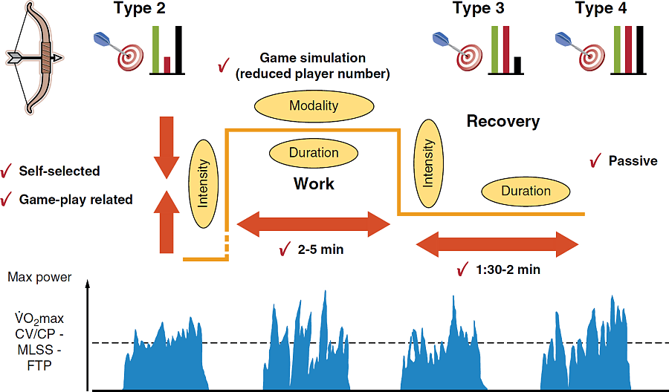
Game-based HIIT

Slide 21
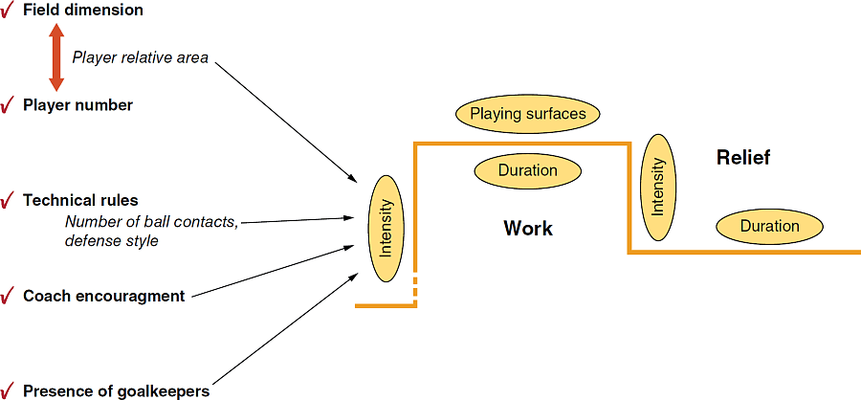
Methods used to modulate exercise intensity during GBHIIT
Soccer drills | Traditional running
A small-sided game with specific constraints (scoring, targets, balls, players, rules, and area) | A controlled running session with players exercising for a specific time or distance
Advantages
Improved motivation | Exact work intensity can be easily controlled
Enhanced training of movement efficiency | Improvements can be monitored objectively
Improvements in tactical awareness | Comparisons can be made between players
Improvements in technical skill | Gain insight into player character or motivation
Optimizes training time and physical load
Potential decrease in injuries
Disadvantages
Exact work intensity is difficult to control | Less movement associated with match play
Often difficult to organize optimal training structure | Players do not practice technical skills
Increased risk of contact injuries and overuse injuries (repeating over and over the same movement patterns) | No game-based tactical elements
Need numbers to make up session | Players do not like running
Certain degree of technical ability required | May increase risk of some injuries (tendonitis, lumbopelvic problems) due to unaccustomed running
Possible ceiling effect for very fit players

