Slide 1
COMPETITION SWIMMING
Juliana Santos 530305
Matilde Costa 530153

Slide 2
What is competition swimming?
Swimming is an individual or team racing sport that requires the use of one's entire body to move through water. The sport takes place in pools or open water.
Competitive swimming is one of the most popular Olympic sports, with varied distance events in butterfly, backstroke, breaststroke, freestyle, and individual medley.

Slide 3
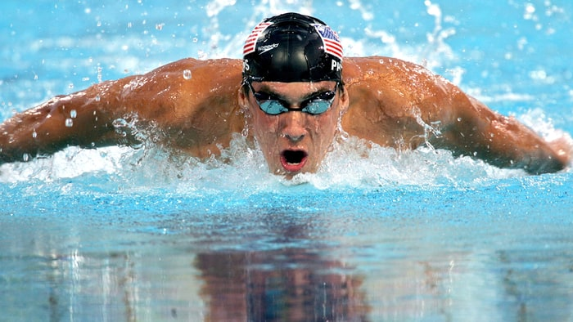
BENEFITS OF SWIMMING
Increase conditioning and physical endurance
Builds endurance, muscle strength and cardiovascular fitness.
Helps you maintain a healthy weight, healthy heart and lungs.
Tones muscles and builds strength

Slide 4
WHAT ARE THE GOALS?
Outcome goals: ultimate, big-picture goals
“Qualify for the national team”
Performance goals: the benchmark goals you set that will ultimately lead you to your outcome goals.
“Consistently complete a 50 fly with 25 strokes or less”
Process goals: specific, day-to-day actionable steps you need to implement that build up to your performance and outcome goals.
- “Attend every practice, including both the morning and afternoon sessions”

Slide 5
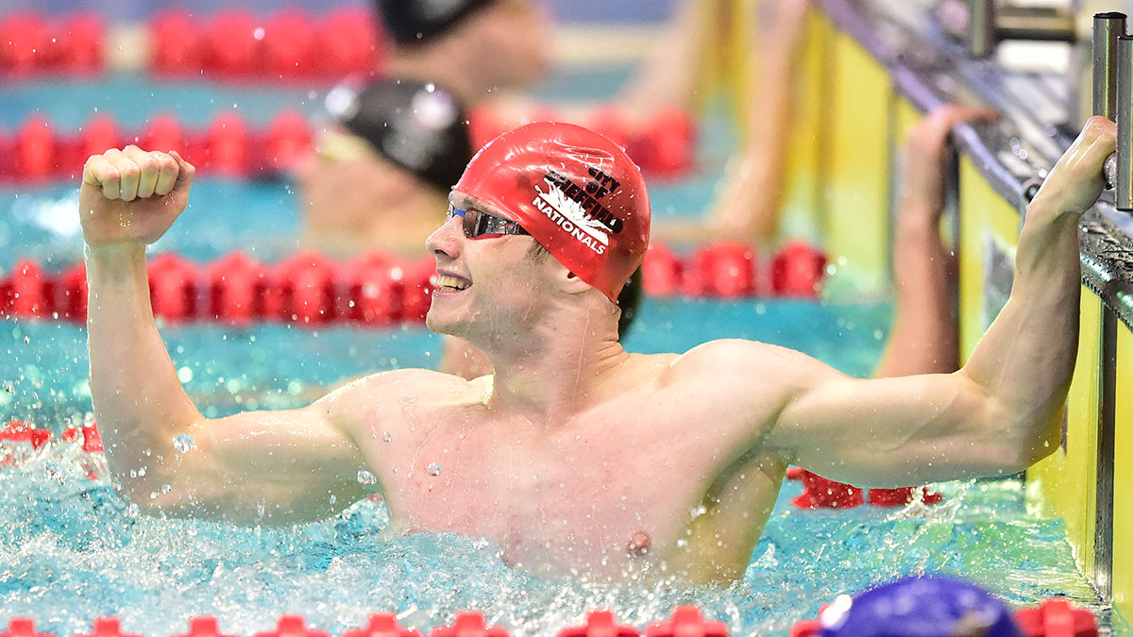
Determinants of success
The key to setting goals at each of these levels is to keep it SMART:
(S)pecific. 'Swim faster' shouldn't be your only goal.
(M)easurable. Have a criteria for success so you can track your progress.
(A)ttainable. Is your goal something you can reasonably accomplish given where you are today?
(R)ealistic.
(T)ime-bound

Slide 6
The four main swimming strokes
Freestylers
Butterflyers
Breaststrokers
Backstrokers

Slide 7
Factors influencing swimming performance
Sex diferences:
- Males tend to swim faster than females
Strenght:
- Swimming power and especially upper body strength have been demonstrated to be crucial to success in sprint swimming
Swimming Performance:
- Dynamic strength is an important determinant of swimming performance.
- Studies have found that upper-body muscular strength and/or power output correlate highly with swim velocity over distances ranging from 23 to 400m.
Energy Generation
-The amount of energy required to swim is related to the intensity and strokes used.
- The demand for energy is reduced proportionally with the skill of the swimmer.

Slide 8
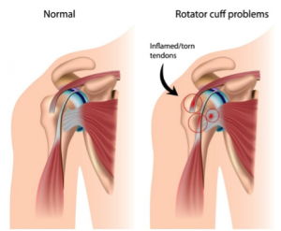
Common swimming injuries
Neck and shoulder injuries are among the most common injuries that swimmers face
Irritation and inflammation in the shoulders
Rotator cuff tendonitis or tears
Shoulder impingement syndrome, which is a result
of pressure on the rotator cuff muscles from part of the
shoulder blade when the arm is lifted overhead
Tears in the cartilage around the shoulder socket
Neck and low back pain
Bicep tendonitis
Swimmers might also experience knee injuries. Stress on the knees can result in pain under or around the kneecap or at the inside of the knee.

Slide 9
Causes of swimming injuries
Overtraining
Not enough rest periods
Poor stroke mechanics
Poor breathing technique
Poor flexibility or range of motion
Decreased rotator cuff or shoulder blade (scapular muscle) strength
Poor core strength or stability
Decreased hip muscle strength

Slide 10
HOW to prevent these injuries
Warm up properly before swimming, and take part in preseason and in-season strengthening and conditioning programs.
Use proper techniques
Work out all your muscle groups not just the muscles you think you’ll use in the water
Gradually increase the intensity and length of swims to avoid overtraining.
Vary your training program
Allow the body proper rest periods between competitions and training sessions.

Slide 11
Warm up before swimming
SHOULDERS: The shoulder is the most intricate joint in the entire body, so you must warm up properly by performing a series of rotations to really extend them
1) Forward shoulder rotation with one arm only
2) Backward shoulder rotation with one arm only
3) Forward rotation using both arms
4) Backward rotation using both arms
ARMS: After starting work on the shoulders, it makes sense to also focus on the arms.
5) Lateral arm raises
6) Alternating arm raises moving one arm forwards and
one arm backwards
7) Lateral arm raises finishing with the movement
with straight arms

Slide 12
REST OF THE BODY: Upper body and hamstrings

Slide 13
Exercises suitable from strength training to swimming training
Back muscles: lat pulldown, 3-way back
Tricipe: Alternate D/B bench press
Biceps: single arm seated row, chin ups (+weight), lying cable pullover
Pectoral muscles: single arm seated row, Alternate D/B bench press, lying cable pullover
Quadricipe: Single-leg press
Gluteus muscles and hamstrings: twisty machine, reverse back extension, med ball kickback, leg press
Core:
single arm seated row, twisty machine, woodchopper
swiss ball: crunches, russian twist, leg tucks, lateral roll
med ball: side pass, 45 degree sit, overhead throws, twists

Slide 14
Training for competitive swimmers
When designing a resistance training program for competitive swimmers the following must be considered:
• Goal of the program—hypertrophy, maximum strength, maximum power, strength endurance.
• Number of reps, sets and rest —depends on goals
• Choice of exercise
• Order of exercise.
Type | Reps | Sets | Intensity (%) | Rest
Power | 1-3 | 3-4 | 90-100 | 3-5 min
Maximum strenght | 1-6 | 3-4 | 85-100 | 2-5 min
Strenght endurance | >12 | 3-6 | 40-65 | 30-90 sec
Hypertrophy | 8-12 | 3-6 | 65-80 | 30-90 sec

Slide 15
Session 1 | Set 1 | Set 2 | Set 3 | Set 4 | Set 5
Lat pulldowns | 8 | 8 | 8 | 6 | 6
Single leg press | 6 | 6 | 6 | 4 | 4
Alternate D/B bench press | 8 | 8 | 8 | 6 | 6
Single arm seated row | 8 | 8 | 6 | 6
Rotator cuff | 8 | 8 | 8 | 8
Twisty machine | 8 | 8 | 8 | 8 each side
Abdominals (See below)

Slide 16
Session 2 | Set 1 | Set 2 | Set 3 | Set 4 | Set 5
Chin ups | 8 | 8 | 8 | 6 | 6
Reverse back extension | 8 | 8 | 6 | 6 | 4
Single leg squat | 6 | 6 | 4 | 4 | 4
3- way back | 8 | 8 | 8 | 6
Med ball kickback | 6 | 6 | 6 | 6 each arm
Woodchopper | 8 | 8 | 8 | 6 | 6
Abdominals (see below)

Slide 17
Session 3 | Set 1 | Set 2 | Set 3 | Set 4 | Set 5
Chin ups + weight | 6 | 6 | 6 | 4 | 4
Leg press | 6 | 6 | 6 | 4 | 4
Alternate D/B bench press | 8 | 8 | 6 | 6 | 6
Lying cable pullover | 8 | 8 | 6 | 6
Twisty machine | 8 | 8 | 8 | 8 each side
Single-arm seated row | 8 | 6 | 6 | 6 | 8

Slide 18
Abdominal session
Abdominals | 200 reps from below
Swiss ball
Crunches | 2 x 20
Russian twist | 2 x 20
Leg tucks | 2 x 20
Lateral roll | 2 x 20
Med Ball
Side pass | 2 x 10 each side
45 degree sit | 2 x 30
Overhead throws | 2 x 20
Twists | 2 x 20

Slide 19
References :
Newton, Robert U., et al. "Strength and power training of Australian Olympic swimmers." Strength & Conditioning Journal 24.3 (2002): 7-15.
Gonjo T, Olstad BH. Race Analysis in Competitive Swimming: A Narrative Review. International Journal of Environmental Research and Public Health. 2021; 18(1):69.
Cellini M, Vitiello P, Nagliati A, Ziglio P G, Martinelli S, Ballarin E and Conconi F (1989) Noninvasive determination of the anaerobic threshold in swimming. International Journal of Sports Medicine 7:347-351.
Costill DL, Maglischo E.W and Richardson AB (1992) Handbook of Sports Medicine and Science - Swimming. Blackwell Scientific Publications.
Draper J, Minikin B and Telford R (1991) Test Methods Manual - Section Three - Swimming. National Sports Research Centre, Australian Sports Commision.
Keskinen KL, Komi PV and Rusko H (1989) A Comparative Study of Blood Lactate tests in Swimming. International Journal of Sports Medicine 10:197-201.

