Slide 1
Strength training and handball players
Laura Polačiková

Slide 2
Handball
Contact sport
High intensity, short duration
Fundamental skill is throwing
Succesfull performance depends on explosive muscular contractions as : jumping, sprints, acceleration, changing directions
No early specialization, but multilateral development (peak at 25)

Slide 3
Majror determinants of succes are :
Maximal Strength
Power
Throwing velocity
To optimize effctiveness of training programe, where we need power and strength, we also need to improve technical and tactical skills (near the in season)

Slide 4
Which exercises are suitable from Strength trainig to handball trainig program?
Resistance and strength training involves wide range of resistance loads and different modalities as:
Throw with ball or medicine ball
Olympic weightlifting
Elastic band training
Plyometric training
All this are aimed at developing maximal strength and power

Slide 5
Chest and Triceps workouts
Flat Bench (BB or DB), Incline Bench (BB or DB), Weighted Dips, Diamond Push-ups, Weighted Push-ups, Triceps Cable Extensions, Chest Flys,
Shoulders and Back Workouts
Weighted Pull-ups, Weighted Chin-ups, DB Military Press, Shoulder Raises, Lat Pull Downs, Lower Back Pull Downs, Shrugs (BB or DB), Reverse Flys, Weighted Shoulder Circles
Core Workouts
Weighted Decline Sit-ups, Russian Twists, Flutter Kicks, Leg raises (off pull-up bar), planks, medicine ball throws, oblique lifts, supermans, weighted glute-ham raises
Speed Work Ideas
Hill springs, ladder work, plyometrics, box jumps, sprinting intervals, backpedal sprints and strides
Leg Strength Workouts
Weighted Lunges (walking, 1 foot on bench, standing), pistol squats, slow count squats, leg press, 1-leg and both leg jumps and box jumps

Slide 6
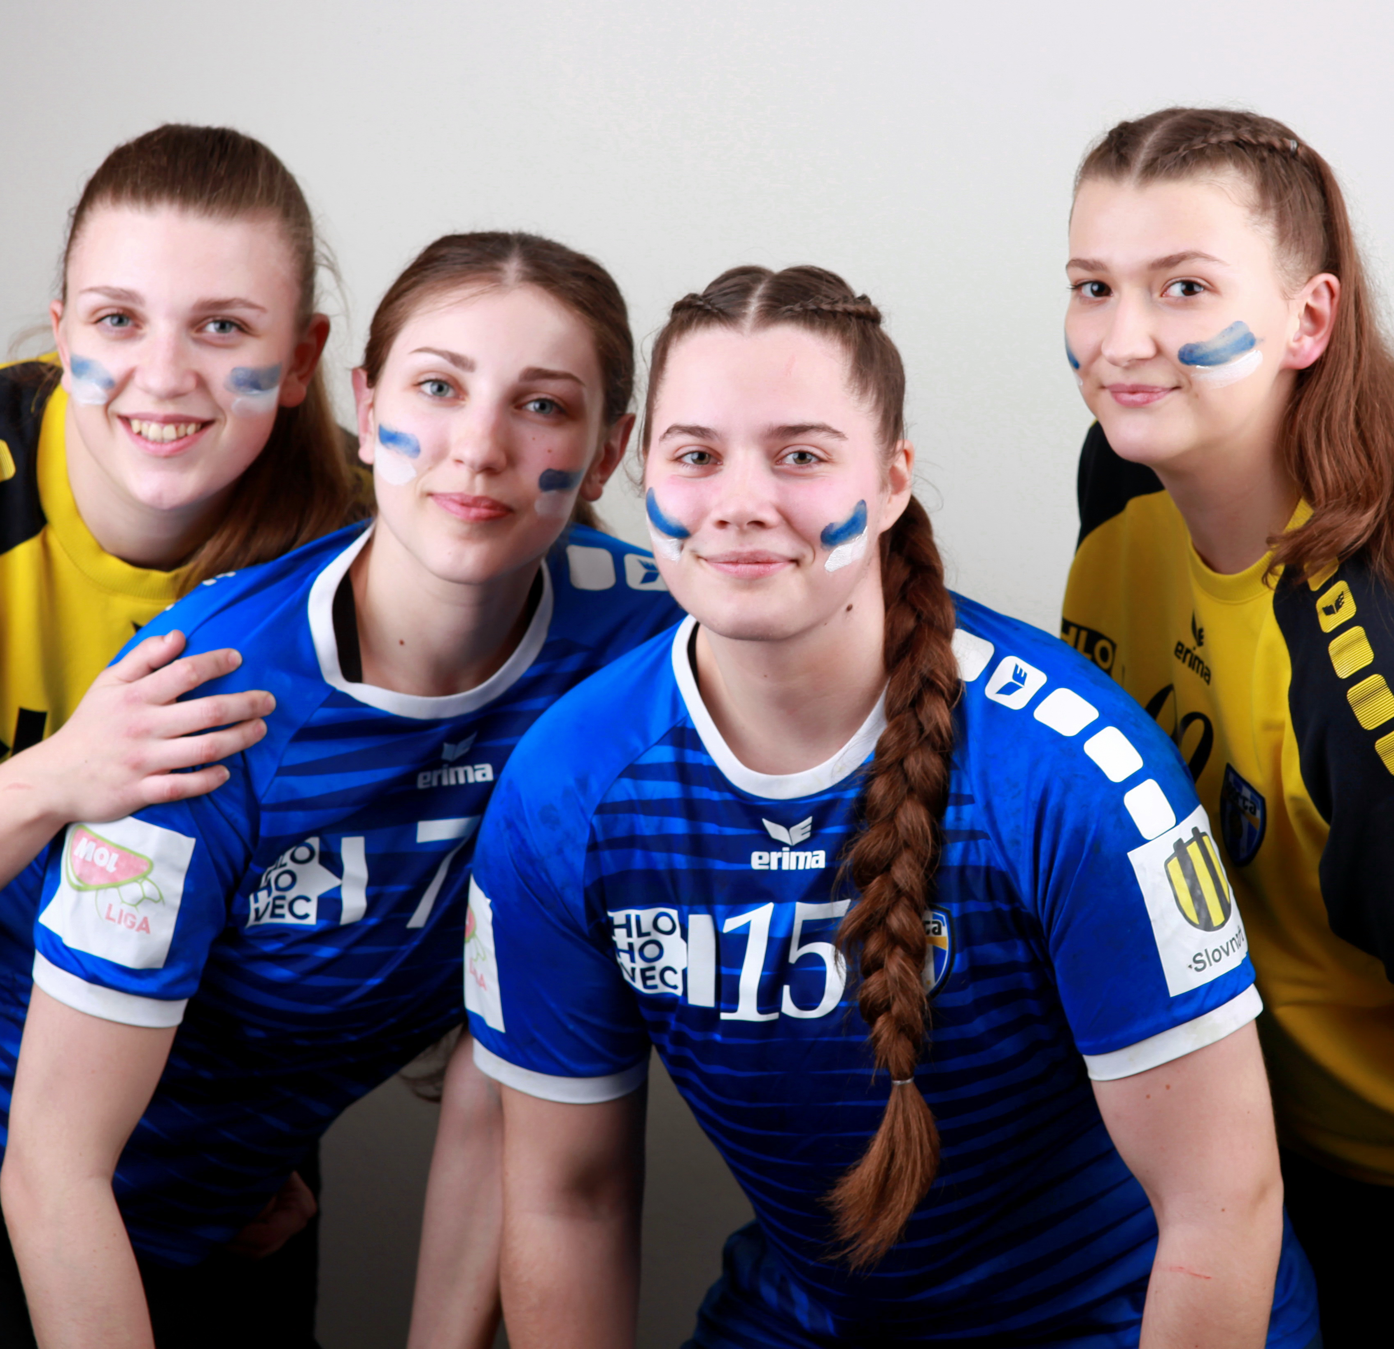
Training program
The best approach to design strength trainig program for handball players consists from at first:
- Collecting informations about their injury history (individually)
- Strengths and weaks of the group
- Plan program to improve strength, power and lower incidence of injuries

Slide 7
Throwing ball velocity
After practising resistnce training and plyometric training handball players achieve higher trhowing ball velocities of all types: standing throw, 3step running throw, jump throw
Increasing loads, higher throwing weights with small number of reps – less time is required to obtain optimal response
Studies are more concerned on concentric exercises, but in lot of actions there is importatnt also eccentric part and their combintion
Throwing medicine ball 1kg/3kg,

Slide 8
Maximal strength
Deadlift, lounges, squat pull over, bench press, barbell squat...
This exercises despite of explosive contraction are performed in slow velocity and have gretest effect on strength improvement
Best for maximising strength are longer contraction duration exercises with heavier loads
Smaller number of sets and reps, but heavier 1RM

Slide 9
Muscle power
Resistance trainig using dynamic excentric- concentric exercises on peak muscle power for upper and lower limbs leads to improvement of relative and absolute power
Plyometry
Squat jumps, box jumps, clean and jerk, dynamic bench press, jumping lounges
Exercises in 80-90% 1RM

Slide 10
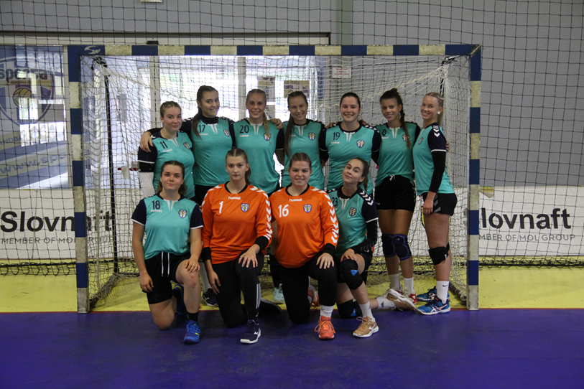
Specific skills
Dribbling
Cathing
Throwing
Jumping
Accuracy
Saving

Slide 11
aerobic/anaerbic
Aerobic training
Is important, because well develped aerobic training allows to tolerate high intensities and physiological load traiing
Anaerobic training
Is important, because it improves performance of intense match activities such as sprints, jumps, shots

Slide 12
Injuries
Ankle – sprains (more woman)
Knee - ACL anterior crucial ligament (healing long time- most serious), meniscus
Shoulder , elbow, fingers
Head
Notes:
High speed running forward, backward and alsoside running

Slide 13
Prevention of injuries
Proper warm up
Exercises for stabilisation of joints
Balance exercises focusing on neuromuscular control and landing
Compensation exerises
Orthosis
Taping
Healthy lifestyle (food, suplements, relax)

Slide 14
How much training sessions are suitable to sustain strength and power?
1 x a week – too little
2 x a week – good stimulus, but sometimes not enought for improvement
3 x a week - improvement

Slide 15
Warm up
10minutes
Jogging, high knees, running
Calistenics (burpees, jump squats, rope skipping...)
Dynamic stretching (hand to toe touch, hamstring, quadriceps, trapezius stretches...)
Mobility exercises (joint rotations)

Slide 16
Early preseason
Players are preparing for the season and building up after the offseason, adaptation
Training is built on building aerobic fitness, functional strength, and hypertrophy
More general exercises, high volume (sets and repetitions)
5sets, 10 reps at 1RM 60-70% 4 exercises, 3 min rest
Push (benchpress, pushups, dips, leg press)
Pull (pull ups, deadlift, lat pullownds, curls, chin upps)
Strenght (various types of squats and lounges,hip thrusts, clean and jerk)

Slide 17
Late preseason
Building anaerobic fitness and maximum strength and power- includes sprints and all-out effort training to build cardiovascular capacity and top-end effort for quick bursts of energy
Building maximum strength and power includes quick movements under load. Some examples include lifting heavy weights and using plyometric
Focusing more on specific skills
Less volume, faster
3 sets 5 reps 80-85% of 1RM 4 exercises, 3 min rest
Push
Pull
Medicine ball – unilateral, bilateral, slums to the ground, overhead
Plyometrics- box jump, single leg hop, split squat jump

Slide 18
Strength training in late preseason
a) week 1
Bench Press, Push ups, Dips
4 sets of 6 reps at 75% of 1RM or 5 sets of 4 reps at 85% of 1RM
Medicine ball
Chest and Triceps
b) week 2
Back Squat, Goblet squat, Loaded plank
4 sets of 6 reps at 75% of 1RM or 5 sets of 4 reps at 85% of 1RM
Plyometric training
Core and Speed Work
c) week 3
Shoulder Press, Latisimus dorsi pulldown, Chinn ups
4 sets of 6 reps at 75% of 1RM or 5 sets of 4 reps at 85% of 1RM
Medicine ball
Shoulders and Back
d) week 4
Power Clean, Hanging leg circles, Lateral wood chop
6 sets of 3 reps at 80% of 1RM or 5 sets of 2 reps at 90% of 1RM
Plyometric training
Core and Speed Work
e) week 5
Front Squat, Reverse lounges, Deadlift
4 sets of 6 reps at 75% of 1RM or 5 sets of 4 reps at 85% of 1RM
Leg Strength Work

Slide 19
in season
Players are expected to be fully functional for competition. Training involves maintaining speed, aerobic and anaerobic fitness, and emphasizing strength and power
During this time, competition takes precedence over other training, so gym sessions are decreased but are still important. A blend of speed training with sprints and strength training are performed

Slide 21
Off season
When the season is over, it is time to relax for a while, but handballers still need to remain active
Rest and recovery with the maintenance of light activity—heal cross-training, light gym work, core training, circuit training injuries
Muscle compensations, visit physiotherapist and work on instabilities and heal injuries

Slide 22
conclusion
Weightlifting exercise offer a stimulus that should be included in any resistance-training program for healthy handball players, who require quick, powerful movements
Biweekly in-season weight training improved the muscle volume, maximal strength of the upper limbs, and ball throwing velocity in healthy handball players relative to their standard training program

Slide 23
Thank you for your attention

Slide 24
refferences
https://www.rookieroad.com/handball/list-handball-skills/#saving
https://www.mdpi.com/1660-4601/16/22/4520/htm
https://pubmed.ncbi.nlm.nih.gov/31731726/
https://pubmed.ncbi.nlm.nih.gov/32162502/
https://www.ncbi.nlm.nih.gov/pmc/articles/PMC6888376/
https://www.aspetar.com/journal/upload/PDF/2014410103654.pdf

