Slide 1




Methodology and Statistics in Sports Sciences
e059

Slide 2
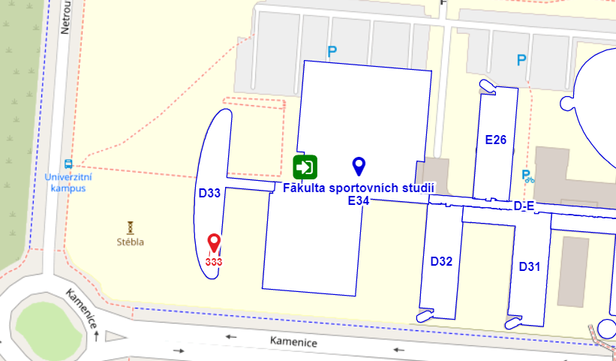
MaSiSS
Guarantor and Teacher subject
Mgr. Michal Bozděch, Ph.D.
  Email: Michal.bozdech@fsps.muni.cz
  Phone number: 549 49 6863
  Department of Kinesiology
  Room: D33/333

Slide 3
MaSiSS
Research Methodology
Statistica Analysis
A review of the Fundamentals
Type of Research
  Selected Types of Qualitative Research
  Selected Types of Quantitative Research
Research Project
Research Ethics
The Literature Review
The Research Hypotheses
Data Collection Methods
  Collecting a Primary and Secondary Data
  Collecting a Qualitative and Quantitative Data
Characteristics of a Good Test
Variable Types and Scaling
  Research Variables
  Levels of Measurement (Scale of Measure)
Descriptive Statistic
  Measures of Distribution or Frequency
  Measures of Central Tendency
  Measures of Dispersion or Variation
  Measures of Position
Inferential or Analytical Statistic
  Hypothesis (or Predictions) Testing
  Choosing a Comparison Test
  Choosing a Correlation Tests
  Choosing a Regression Tests
The effect size

Slide 4
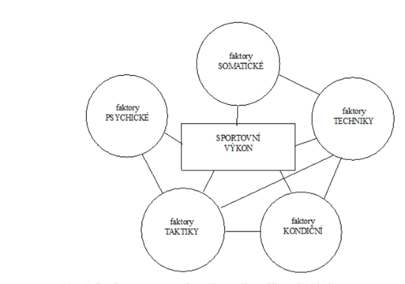
MaSiSS
Research Methodology
Examples of theory
Science (Benešová, 1999) - is a systematic, critical and methodological pursuit of true and common knowledge in a defined area of reality
Science (Ferjenčík, 2000) - is a comprehensive system of information obtained by a scientific method. Science provides guidelines for examination (methods) and an explanation of collected information (scientific theory)
Theory (Zháněl, 2014) - The primary goal of science is , i.e. an attempt to find general explanations of natural phenomena (via science research)
(Dovalil et al., 2012)

Slide 5

MaSiSS
Research Methodology
Sport science – Kinesiology, Kinanthropology, Sportwissenschaft - is multidisciplinary science about human (voluntary) movement.
Paradigm - a fundamental concept of a certain scientific discipline, which is considered to be exemplary. Defines proper procedures and methods, according to which rules and conventions.
Methodology vs methods (Gabriel, 2011) – method is a research tool (interwiew in qualitatice study) and methodology is the justification for using this method.
Methodology – the summary and study of methods, or the science of methods.
Method – a tool or process for monitoring, researching, learning, exploring and achieving certain goals.
Methodical guidelines – specific instructions for carrying out specific activities.

Slide 6
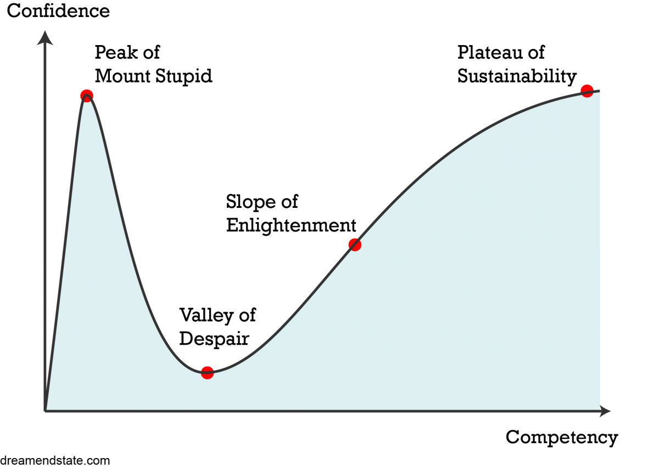
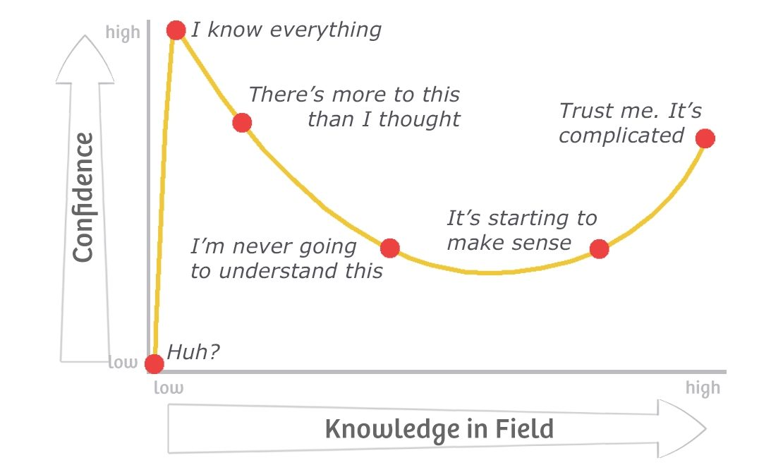
MaSiSS
Dunning-Kruger effect

Slide 7
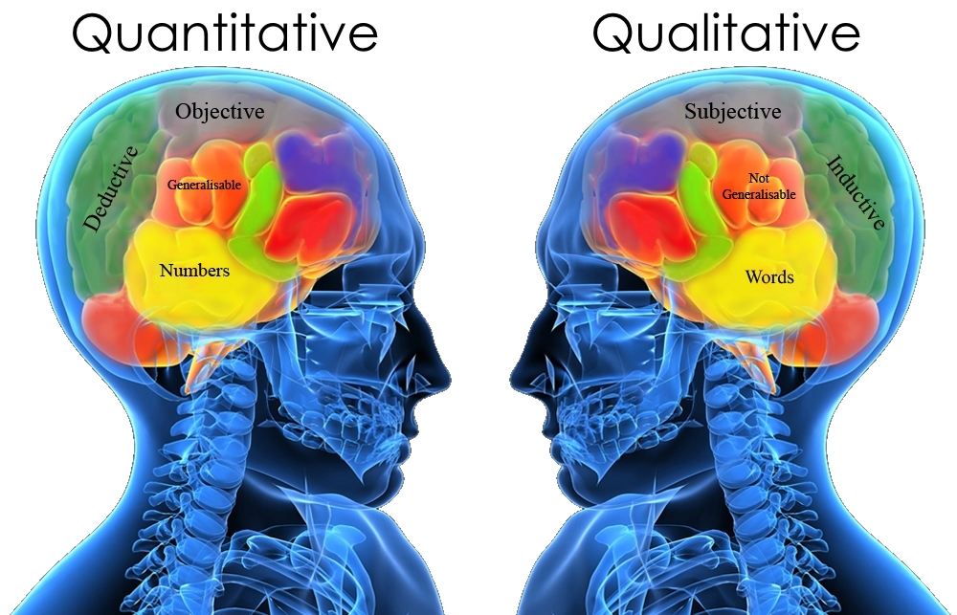
MaSiSS
Type of Research
Qualitative research
  Quantitative research

Slide 8
MaSiSS
Type of Research
Qualitative research - According to Švaříček & Šeďová et al. (2007) it is a process of examining phenomena and problems in an authentic environment in order to obtain a comprehensive picture of these phenomena based on deep data and a specific relationship between a researcher and a research participant. The aim of a qualitative research is to uncover and represent how people understand, experience and create social reality. It focuses on how individuals and/or groups view, understand and interpret the World (Zháněl, 2014), via non-numerical data.
  Quantitative research - is the process of collecting and analyzing numerical data. It can be used to find patterns and averages, make predictions, test causal relationships, and generalize results to wider populations (Bhandari, 2021).
  A common mistake: when it is relatively simple to transforming words (eg answers in a questionnaire) into numbers (occurrence) these are quantitative data
Mixed research
Hendl (2005) then talks about a combination of quantitative and qualitative methods in a single research activity when speaking of a mixed research strategy, in which the results obtained by the two strategies complement each other

Slide 9

MaSiSS
Type of Qualitative Research
Type of Quantitative Research
Phenomenological method – how participant experiences, feel have opinion about a specific event or activity. It utilizes in-depth interviews, observation or survey to gather information
Grounded theory - tries to explain why a course of action evolved the way it did. Need large subject number to developer theoretical model based on existing data (DNA – genetic model)
Case study - in-depth look at one test subject (opposite of grounded theory). Various data are compiled to create a bigger conclusion
Focus groups - group of individuals who are asked questions about their opinions and attitudes towards certain fenomen
Ethnographic research - subjects are experiencing a culture that is unfamiliar to them
  Descriptive research - seeks to describe the current status of an identified variable. The researcher does not usually begin with an hypothesis, but is likely to develop one after collecting data
  Correlation research - aim is to determine the extent of a relationship between two or more variables using statistical data. This type of research will recognize trends and patterns in data
  Causal-Comparative/Quasi-Experimental - establish cause-effect relationships among the variables. The researcher does not randomly assign groups
  Experimental Research - establish the cause-effect relationship. Subjects are randomly assigned to experimental

Slide 10

MaSiSS
Type of Research
Types of different research (Hendl, 2016)
Methodological study, Case study, Comparison, Correlation-predictive study, Experiment, Quasi-experiment, Evaluation, Development studies, Trend analysis, attitudes, Status, Exploration, Historical study, Modelling, Proposal and demonstration, systematic review, Meta-analysis, Theoretical studies, Analytical, Qualitative study
Types of different research (Mishra & Alok, 2017)
  Descriptive vs. analytical research
  Applied vs. fundamental research
  Conceptual vs. empirical research
Other types of research
  one-time research vs. longitudinal research
  field-setting research vs. laboratory research vs. model research
  clinical vs. diagnostic research
  case-study methods vs. exhaustively approaches
  exploratory vs. formalized research
  The objective of exploratory research (creation of hypotheses rather than their testing) vs. formalized research (specific hypotheses are tested)
  conclusion-oriented and decision-oriented research

Slide 11
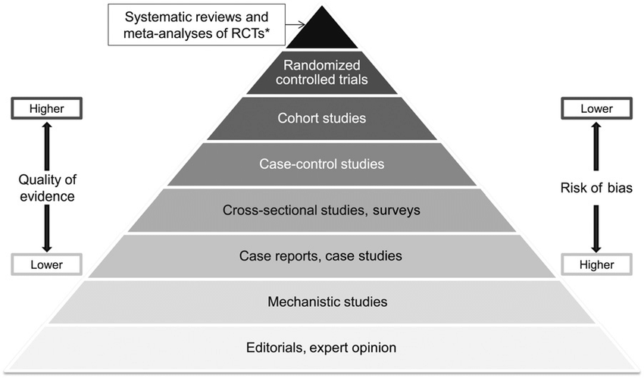
MaSiSS
Type of Research Studies
RCT* = randomized controlled trial

Slide 12
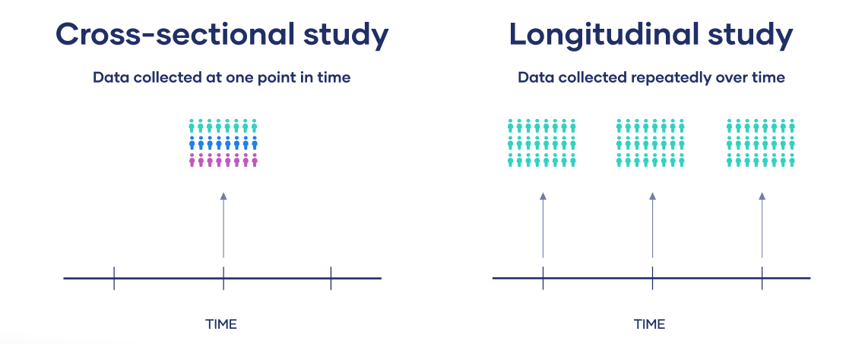
MaSiSS
Type of Research Studies
Cross-sectional study | Longitudinal study
One point in time | Several point in time
Different samples | Same sample
Change at a societal level | Change at the individual level

Slide 13
MaSiSS
Type of Research Studies
Longitudinal study | Pseudo-longitudinal study | Semi-longitudinal study
Several point in time | One point in time | Several point in time
Same sample | Different (age) samples | Different and same samples
Change at the individual level | Maturation | Until the youngest group become the oldest group

Slide 14
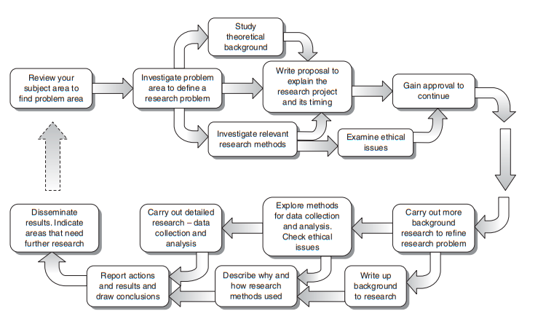
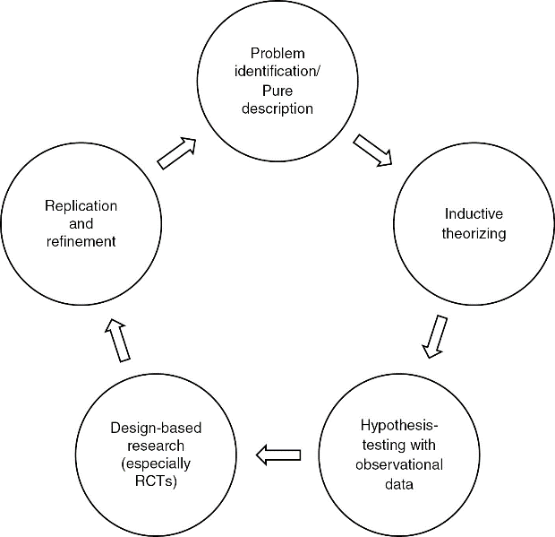
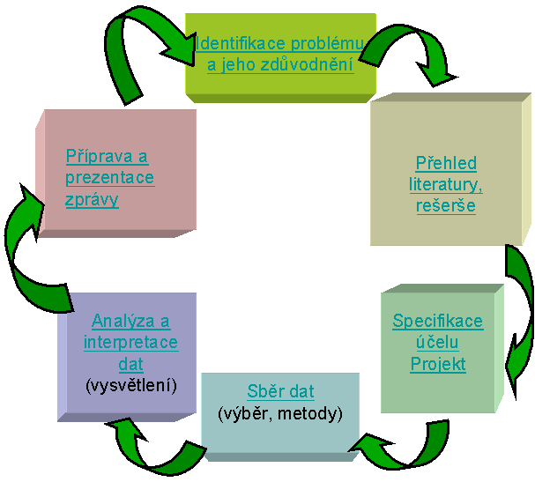
MaSiSS
Research Project
(Williman, 2011)
  (Elman & Mahoney, 2020; Hendl, 2016)

Slide 15
MaSiSS
Research Project
Phases of the research process (Rockmann & Bömermann, 2006)
Formulation of a research problem
Research planning
Implementation of Research
Evaluation of research
Publication of research results
Scheme of logical thought progress of scientific work (Zháněl, 2014)
Research intention → Research problem → Research objective → Research question (hypothesis)
Principles of a good research project (Robson, 1993)
it says what you want to do and why do you want to do
is written clearly and without unnecessary description (secondary facts),
is clearly organized and straightforward

Slide 16
MaSiSS
Research Ethics
There are two aspects of ethical issues in research (Williman, 2011)
The individual values of the researcher relating to honesty and frankness and personal integrity.
The researcher’s treatment of other people involved in the research, relating to informed consent, confidentiality, anonymity and courtesy.
Most commen problems are
Plagiarism (or wrong used of citations)
Non-disclosure acknowledgement
Data collection/analysis/interpretation
Disclosure of interest; using third-party materiál
Plagiarism - It is a simple matter to follow the clear guidelines in citation that will prevent you being accused of passing off other people’s work as your own (Williman, 2011)

Slide 17
MaSiSS
Research Ethics
Helsinki Declaration
General Principles
The health of my patient will be my first consideration
Physician must promote and safeguard the health, well-being and rights of patients
… never take precedence over the rights and interests of individual research subjects
researcher protect the life, health, dignity, integrity, right to self-determination, privacy, and confidentiality of personal information of research subjects
…
Adopted by the 18th The World Medical Association (WMA) General Assembly, Helsinki, Finland, June 1964
Statement of ethical principles for medical research involving human subjects, including research on identifiable human material and data

Slide 18
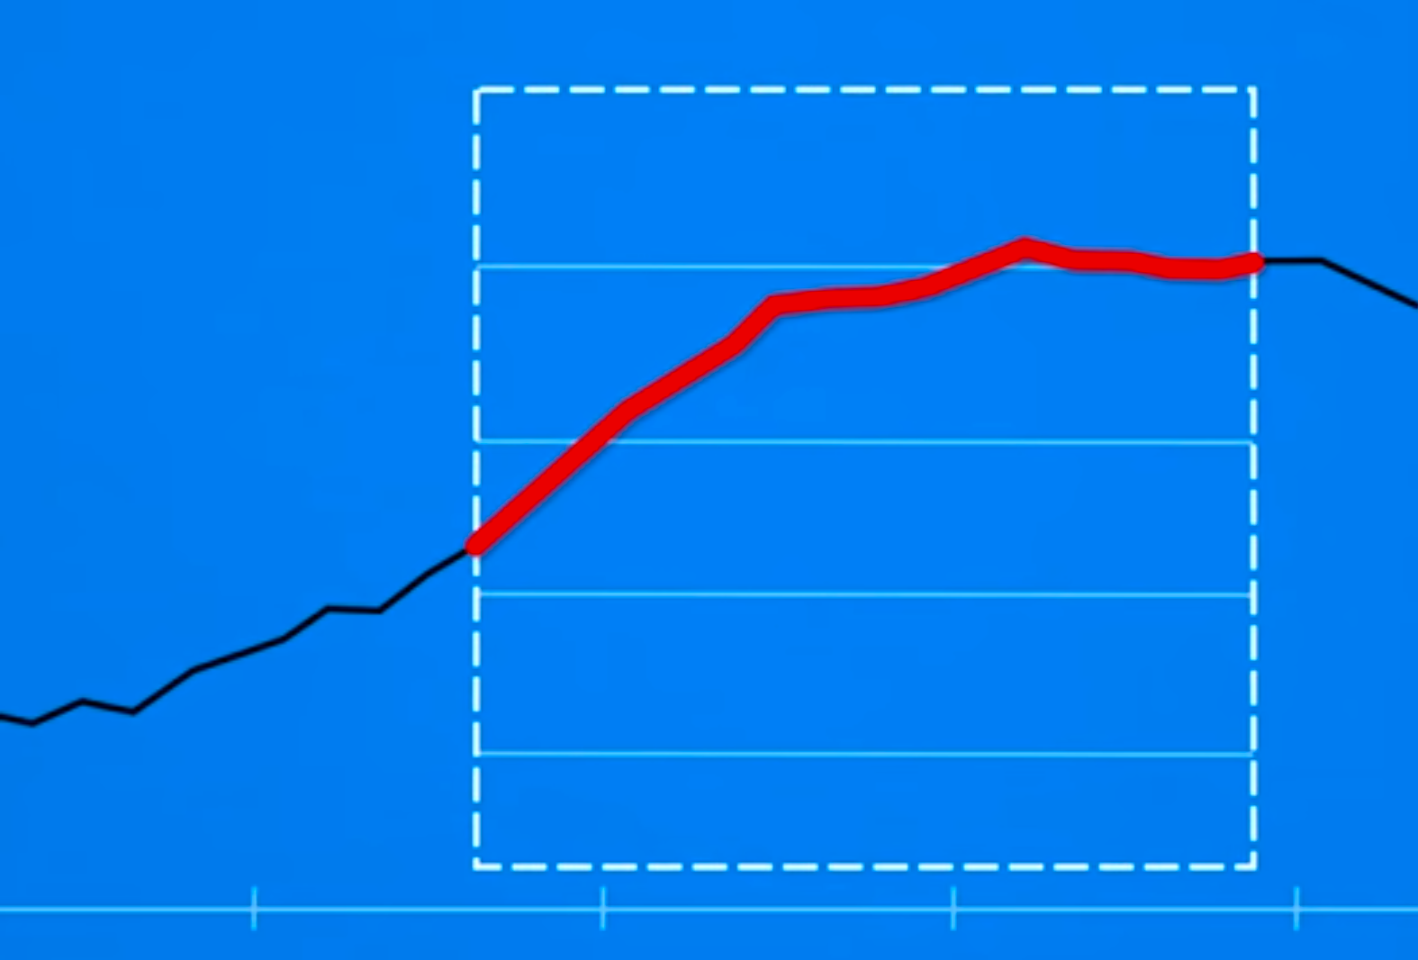
MaSiSS
Research Ethics
Cherry pick data
Carefully chosen time range (on x-axis) or data scale (on y-axis)
Picked specific data points can hide important changess in between
This mean grap his not wrong, bud leaving out relevant data can give a misleading impression

Slide 19
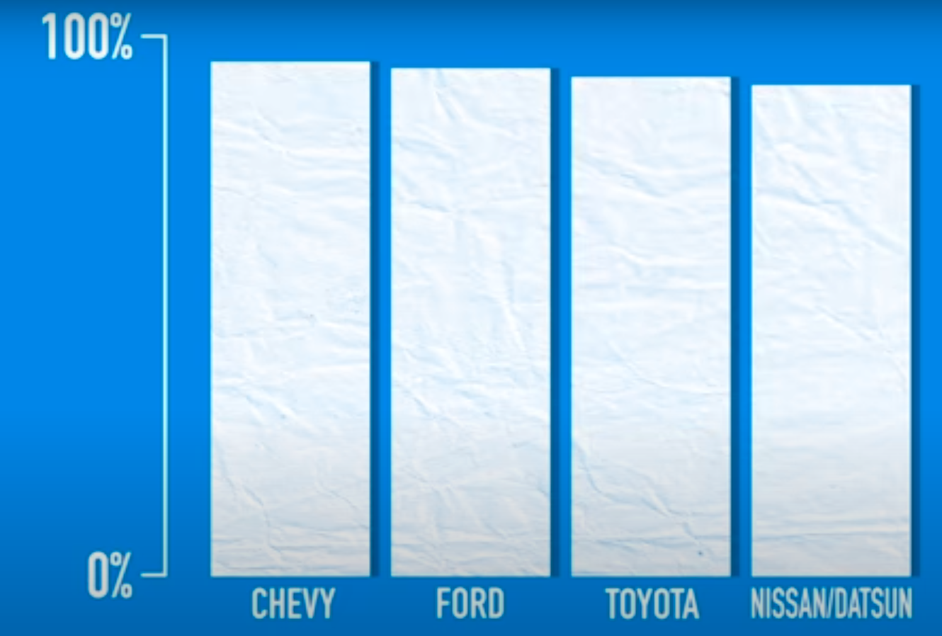
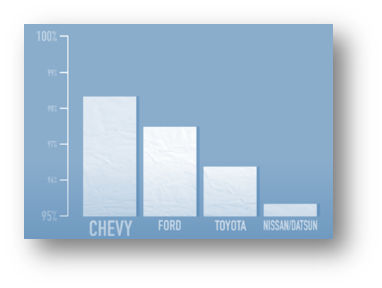
MaSiSS
Research Ethics
Cherry pick data
Example of cherry-picking (on y-axis)
In 1992 Chevrolet car ads claims that all Chevy trunks sold in the last 10 years are still on the road. For soporting this claim there use this graph.
The graph can also by intepret that Chevy can are twice as dependable as Toyota trucks
Until you see scala of graf, which is from 95% to 100%
Seond graf shows how graf will look on 0% to 100% scale

Slide 20
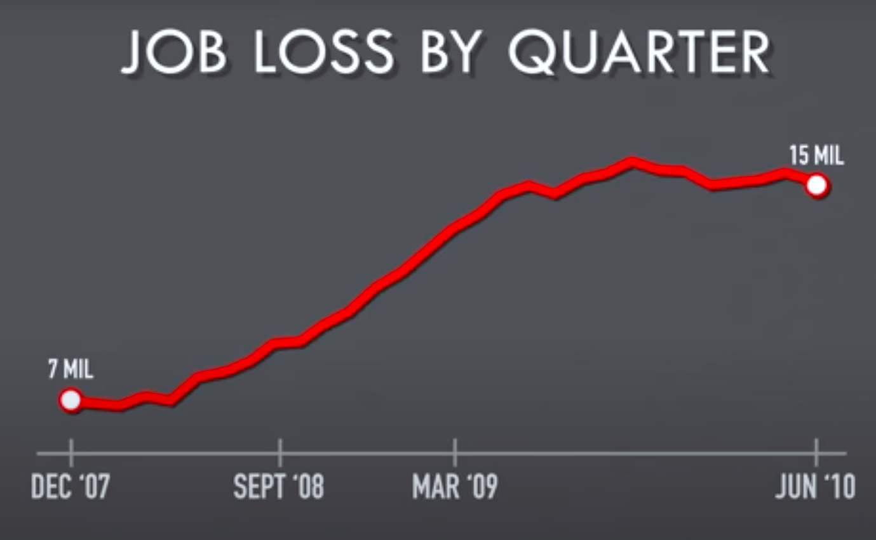
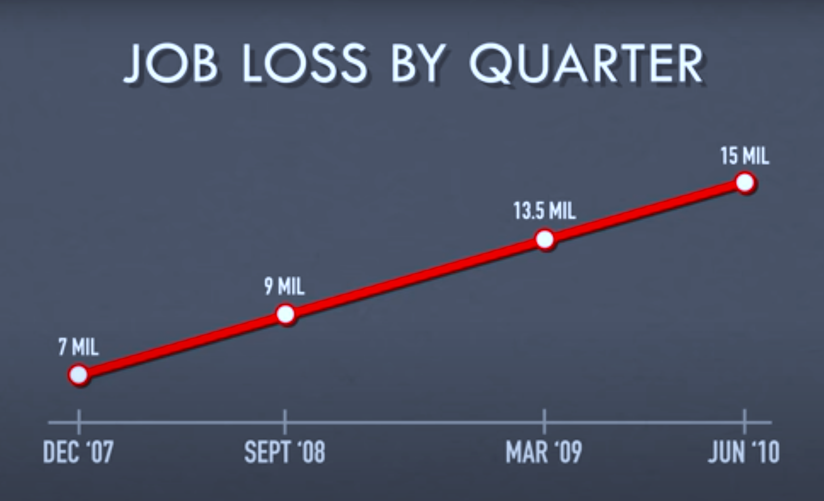
MaSiSS
Research Ethics
Cherry pick data
Example of cherry-picking (on x-axis)
Usuali in line graphs showing something changing over a time
Graph show job loss by quater
But scale on x-asis is inconsistent
  September 08 to march 09 = 6 months
  March 09 to jun 10 = 15 months

Slide 21
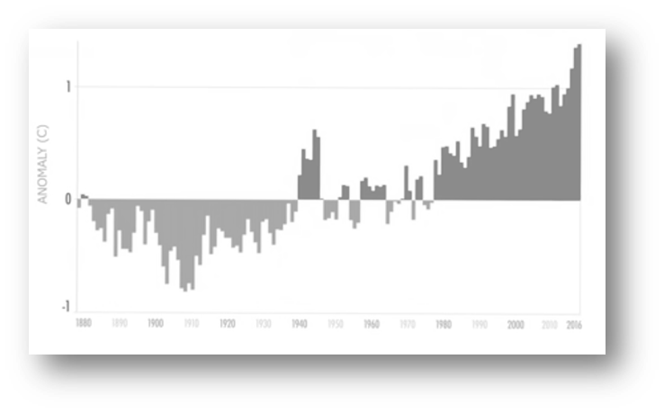
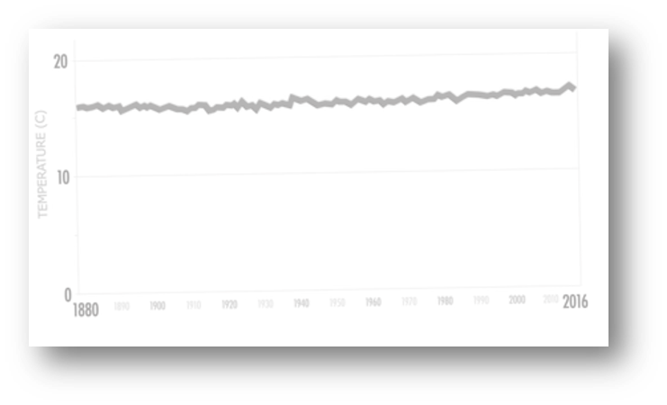
MaSiSS
Research Ethics
Cherry pick data
Knowing the full signifikance of data that graph presented
If boths graphs used same data (Annual global ocean average temperatus), whay they look so different?
And if you know that even a rise of half a degree Celsius can cause massive ecological disruption, which graph you thing is more appropriate?

Slide 22
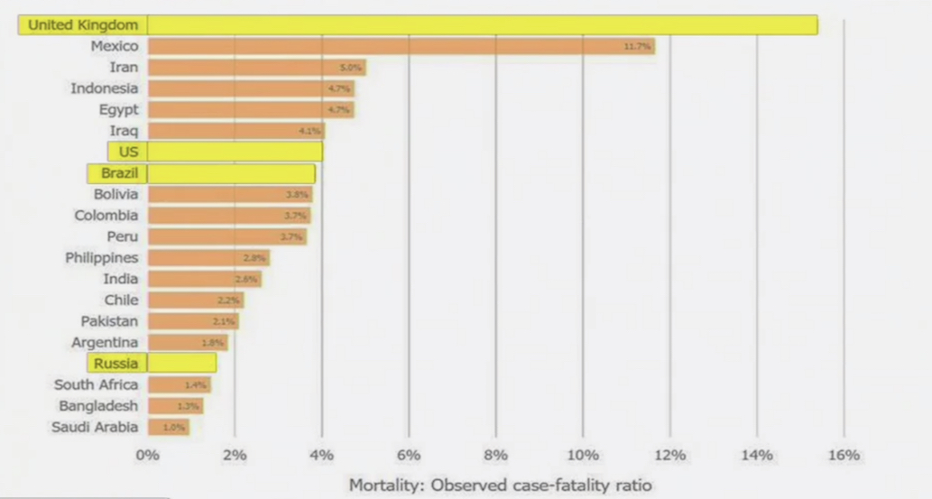
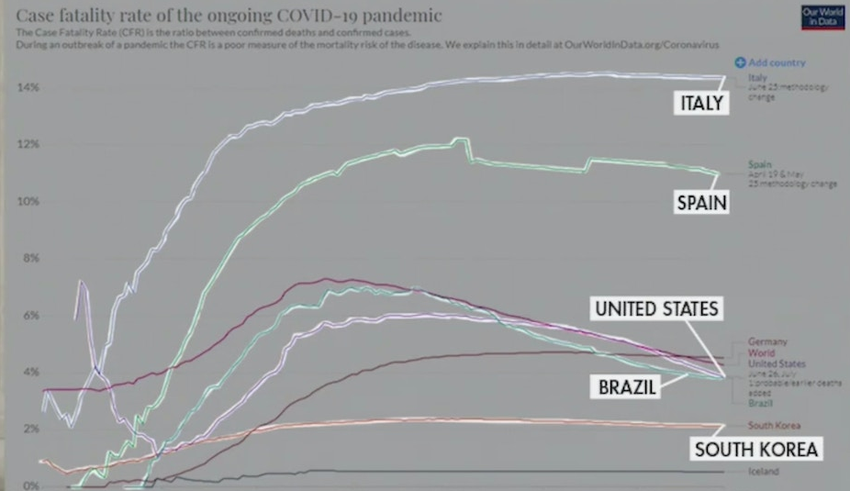
MaSiSS
Research Ethics
Cherry pick data
Example of omitting variables
Donald J. Trump: USA has the lowest / best mortality rate.
  if we omit better states
Bonus
Donald J. Trump: "I noticed that the more tests we do, the more we get infected"
  = tests cause COVID-19?

Slide 23
MaSiSS
Research Ethics
Hacking of p-value
Also know as data dredging, data snooping, data fishing or data butchery
Statistically significant, when in reality, there is no underlying effect (Head et al., 2015; Norman, 2014)
Academic journal prefer articles with statistically significant results and researchers are force to publish in high quality journals (with higher Impact Factor, IF)
In practice we often encounter so-called p-hacking and salami publication/slicing (splitting research data/results into several publications) with caused false TYPE I ERROR (accept a true null hypothesis – false positive, α)
  Prevention from p-hacking
  Create two sets of data (cross-validation method)
  build strong project (don’t change the projekt methodology during the research)
  used Bonferroni correction (for more statistical analyses),
  Scheffé's method
  False discovery rate,
  Raw data publishing
p-haking leads to false positive results = negative impact to future research field and researchers prestige

Slide 24
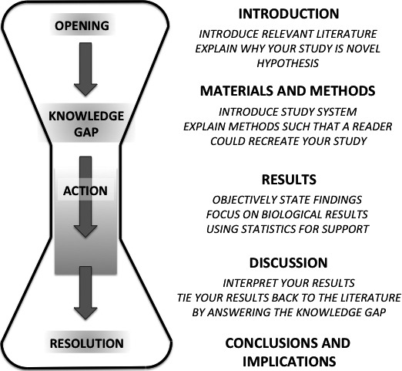
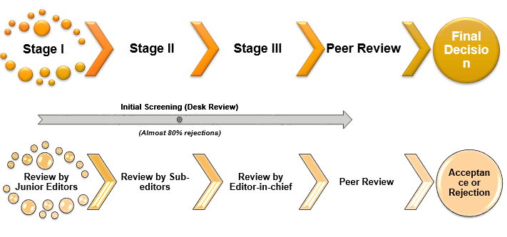
MaSiSS
Research Ethics
Hacking of p-value
1. step
New way to reduce p-hacking or other non-ethical manipulation is 2-step manuscript submission
  1st you submit only introduction and description of your method and journal decides whether to publish before seeing your results
2. step
Blind peer review submission process

Slide 25
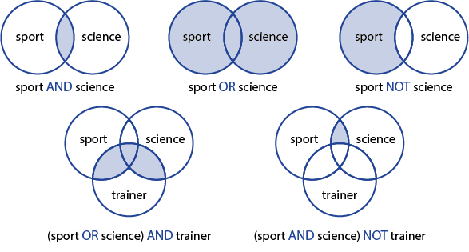
MaSiSS
The Literature Review
Step-by-step guide of literature review
Search for relevant literature on selected topic
  What? – books, academic sources (journal articles)
  Where? Google Scholar, discovery.muni.cz; Web of science; ScienceDirect; PubMed
  Define your keywords and their synonyms
  For more relevant results use Boolean operators
Evaluate and select sources
Identify themes, debates and gaps
outline your project structure
write and rewrite what you wrote
“If you steal from one author it’s plagiarism, if you steal from many it’s research”
- Wilson Mizner

Slide 26
MaSiSS
The Literature Review
Step-by-step guide of literature review
Search for relevant literature on selected topic
Evaluate and select sources
  you can’t read everything that has ever been written (unless your topic is very)
  read just abstract, which normally consists of background, aim, methods, results, conclusion and sometimes even recommendations for practice
  save relevant articles (in pdf) for later purposes
  check cite literature to find other relevant sources
  tips: pay attention to the citation count and experts in the selected field

Slide 27
MaSiSS
The Literature Review
Step-by-step guide of literature review
search for relevant literature on selected topic
Evaluate and select sources
Identify themes, debates and gaps
  Find connection between different sources
    in what they agree and disagree,
    slightly or very different conclusions
    trends and patterns
    used process, methods, equipment and statistic tests
    gaps
outline your project structure
  different approaches: the most used approach is from general to specific (this applies to chapters, subchapters and also to paragraphs)
write and rewrite what you wrote

Slide 28
MaSiSS
The Research Hypotheses
Hypotheses are statements that relate to the existence of the relationship between variables or prediction of defined variables using other variables (Zháněl, 2014)
Without hypothesis the research in unfoucussed
Hypothesis is necessary link between theory and investigation
Sources of hypothesis
Theory and studies (literature research)
Observation (from own practice / experience)
Intuition (less then theory and observation)
Culture (behavior or beliefs of social, ethnic or age group)
New trend (possible future experience)

Slide 29
MaSiSS
The Research Hypotheses
Charakcteristic of good hypothesis
Power of prediction – predict the future situation, not only the present situation
Based on observation – If we cannot verificated a thing, which we cannot observed
Simplicity – everyone should be able to understand it
Clarity – It should be clear from ambiguous information
Testability – it should be able to by be tested empirically
Limit the unninteraction
Relevant to problem – A hypothesis is guidance for the identification and solution of the problem
Specific – avoid generalization terms, omit unwanted factors (variables)
Relevant to available researchers techniques – you must know workable techniques before formulating a hypothesis
Provide new suggestion/knowledge/technique/process…- it is not a repetition of what we already know
Consistency and harmony – There must be a close relationship between variables which one is dependent on other
(Mill, 1963)

Slide 30
MaSiSS
The Research Hypotheses
Types of research hypotheses
Working hypothesis – not very specific, they can be easily modified, used with insufficient data; example: Chocolates before training ensures maximum performance
Descriptive hypothesis – variable can be situation, event, organization, person, group, object
Relation hypothesis (describes relationship – positive, negative or casual – between two variables) example: Children from higher incomes families spend more times at leisure physical activities
Formalised hypothesis (cause and effect relationship between independent and dependent variable) example: If families have higher incomes, than they spend more money on leisure physical activities
Null hypothesis (H₀) – predicts that there is no relationship between two variables; example: after a 3-month training program, there are no statistically significant differences in the muscular strength of the knee extensors between the experimental and control groups.
Alternative hypothesis (H_{a}/H₁) – the opposite statement than H₀. For acceptance of H_{a}, H₀ must be rejected first. Exapmle: after a 3-month training program, there are statistically significant differences in the muscular strength of the knee extensors between the experimental and control groups
  Directional (left or right tailed test) – hypothesis in which we can predict effect (positive/negative) of one variable on others. Example: Girls are more flexible than boys
  Non-directional (two tailed test) – hypothesis in which we cannot predict effect, but stat a relationship between variables (we do not know what kind of difference); example: there will be a difference in the performance of experimental and control groups
(Zháněl, 2014; Cauvery et al., 2010)

Slide 31
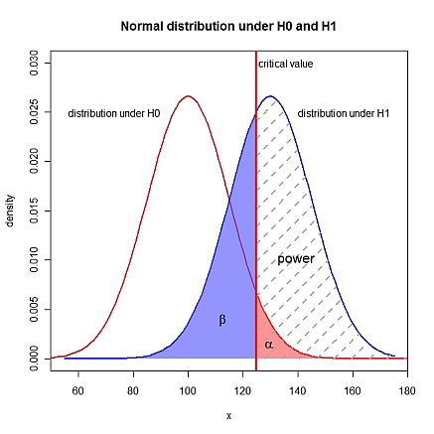
MaSiSS
The Research Hypotheses
Rejecting the null hypothesis
 |  | Actual Value (reality)
 |  | Positive | Negative
Conclusion from hypothesis test | Positive | Positive Positive == TRUE Positive (Power, 1 – β) | Negative Positive == FALSE Positive, Type I Error (α)
 | Negative | Positive Negative == FALSE Negative Type II Error (β) | Negative Negative == TRUE Negative

Slide 32
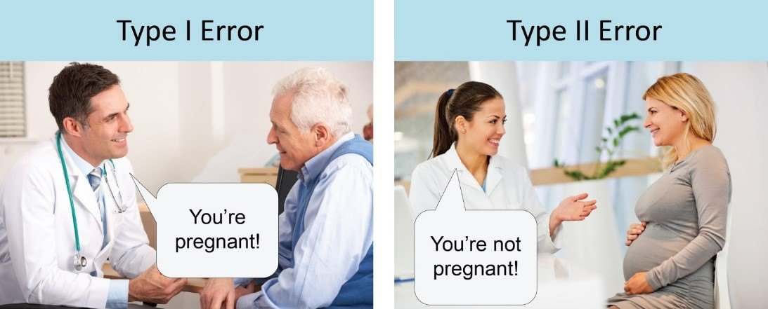
MaSiSS
The Research Hypotheses
Rejecting the null hypothesis
 |  | Actual Value (reality)
 |  | Positive | Negative
Conclusion from hypothesis test | Positive | Positive Positive == TRUE Positive | Negative Positive == FALSE Positive, Type I Error (α)
 | Negative | Positive Negative == FALSE Negative Type II Error (β) | Negative Negative == TRUE Negative
Correct
Correct

Slide 33
MaSiSS
The Research Hypotheses
Rejecting the null hypothesis
β = probability of a Type II error,
  known as a "false negative"
1-β = probability of a "true positive"
  correctly rejecting the null hypothesis.
  also known as the Power of the test.
α = probability of a Type I error
  known as a "false positive"
1-α = probability of a "true negative",
  correctly not rejecting the null hypothesis

Slide 34
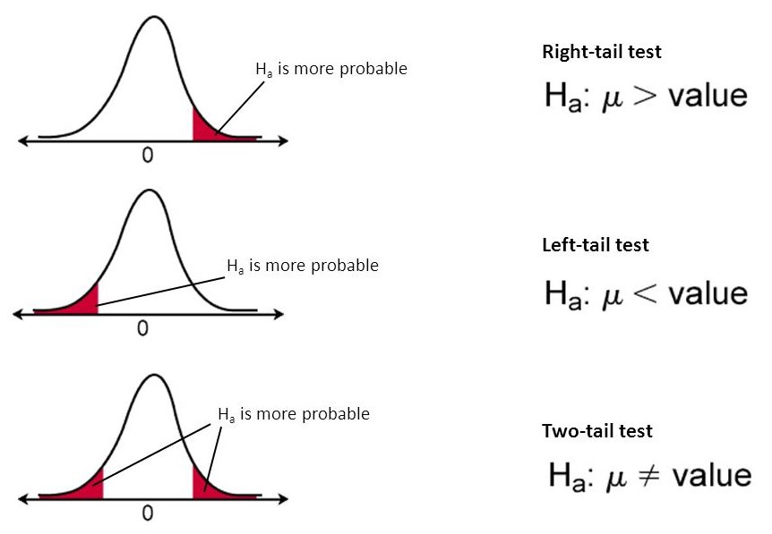
MaSiSS
The Research Hypotheses
Rejecting the null hypothesis

Slide 35
MaSiSS
Statistical Hypothesis Testing
Null hypothesis (H₀)
  Assumption about the outcome
    There is no relationship between two variables (for correlation)
    There is no difference between the means of two populations (for t-test)
p-value
  Propability of observing the result given that the null hypothesis is true
  p <= α (0.05):
    reject H₀, different distribution.
  p > α (0.05):
    fail to reject H₀, same distribution.
Type I Error
  Reject the null hypothesis when there is in fact no significant effect (false positive).
  The p-value is optimistically small.
Type II Error
  Not reject the null hypothesis when there is a significant effect (false negative).
  The p-value is pessimistically large.

Slide 36
MaSiSS
Statistical Power
Statistical power (or the power of a hypothesis test)
  is the probability that the test correctly rejects the null hypothesis.
Statistical power has relevance only when the null is false.
The higher the statistical power = the lower the probability of making a Type II error
  (false negative)
= That is the higher the probability of detecting an effect when there is an effect
1-α
1-β
  (Ellis, 2010)

Slide 37

MaSiSS
Statistical Power
Low Statistical Power:
  Large risk of committing Type II errors (a false negative)
High Statistical Power:
  Small risk of committing Type II errors
Experimental results with too low statistical power will lead to invalid conclusions about the meaning of the results.
  Therefore a minimum level of statistical power must be sought
It is common to design experiments with a statistical power of 80% or better, e.g. 0.80.
  This means a 20% probability of encountering a Type II area.
  This different to the 5% likelihood of encountering a Type I error for the standard value for the significance level.

Slide 38
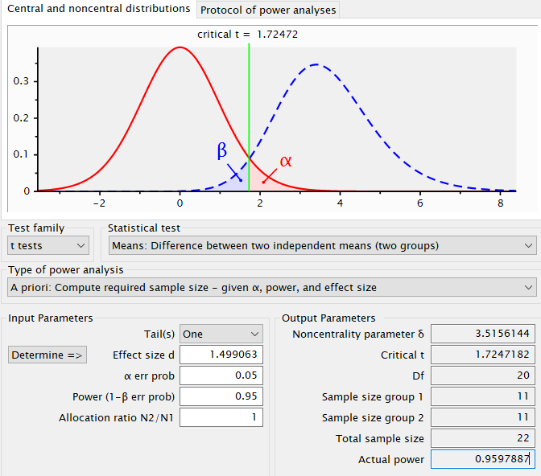
MaSiSS
Statistical Power
It is common to design experiments with a statistical power of 80% or better, e.g. 0.80.
  This means a 20% probability of encountering a Type II area.
  This different to the 5% likelihood of encountering a Type I error for the standard value for the significance level.
G*Power

Slide 39

MaSiSS
Statistical Power
Power Analysis
Statistical Power
Sample Size
Effect size
Significance

Slide 40
MaSiSS
Statistical Power
Power Analysis
Effect Size
  The quantified magnitude of a result present in the population
    Pearson’s correlation coefficient (r) for the relationship between variables
    Cohen’s d for the difference between groups
Sample Size
  The number of observations in the sample.
Significance
  The significance level used in the statistical test
    Alpha (α) = 5% or 0.05
    Alpha (α) = 1% or 0.01
    Alpha (α) = 0.1% or 0.001
Statistical Power
  The probability of accepting the alternative hypothesis if it is true.

Slide 41
MaSiSS
Statistical Power
Power Analysis
All variables are related:
a larger sample size can make an effect easier to detect
the statistical power can be increased in a test by increasing the significance level

Slide 42
MaSiSS
Statistical Power
Power Analysis
All variables are related:
The statistical power can be estimated given an effect size, sample size and significance level
The sample size can be estimated given different desired levels of significance

Slide 43
MaSiSS
Statistical Power
Power Analysis
Power analysis answers questions:
How much statistical power does my study have?
How big a sample size do I need?
  Or for estimation of the minimum sample size reguired for an experiment
Post-hoc Power (Observed Power) = used as a follow-up analysis, if a finding is non significant
Priori Power Analysis = Power analyses made before a study is conducted

Slide 44
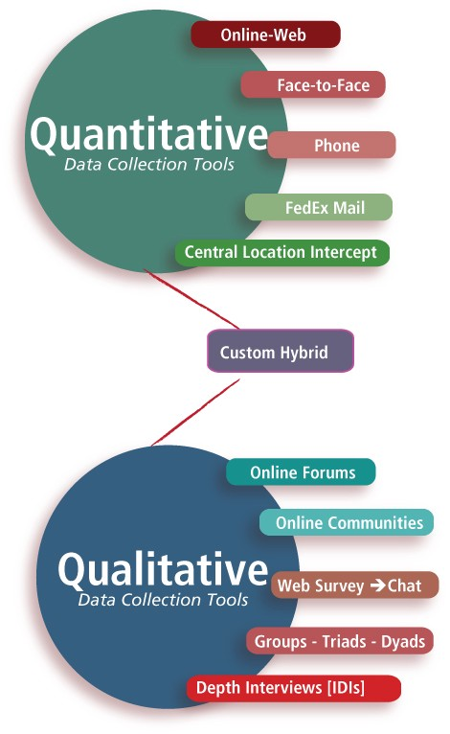
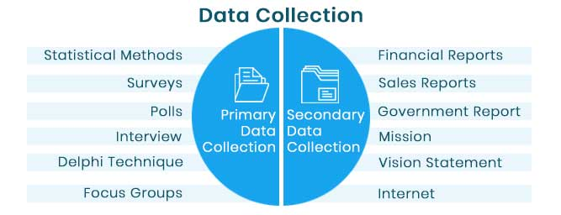
MaSiSS
Data Collection Methods
Collecting of a Primary and Secondary Data
Collecting a Qualitative and Quantitative Data

Slide 45
MaSiSS
Sampling
The study of the total population is not possible and it is impracticable.
The practical limitation cost, time, and other factors which are usually operative in the situation, stand in the way of studying the total population
Sampling is the process of selecting a few (a sample) from a bigger group (the sampling population) to become the basis for estimating or predicting the prevalence of an unknown piece of information, situation, or outcome regarding the bigger group
Basically we have two types of sample:
Random sample
Non-random sample
(Singh, 2006; Kumar, 2011)

Slide 46
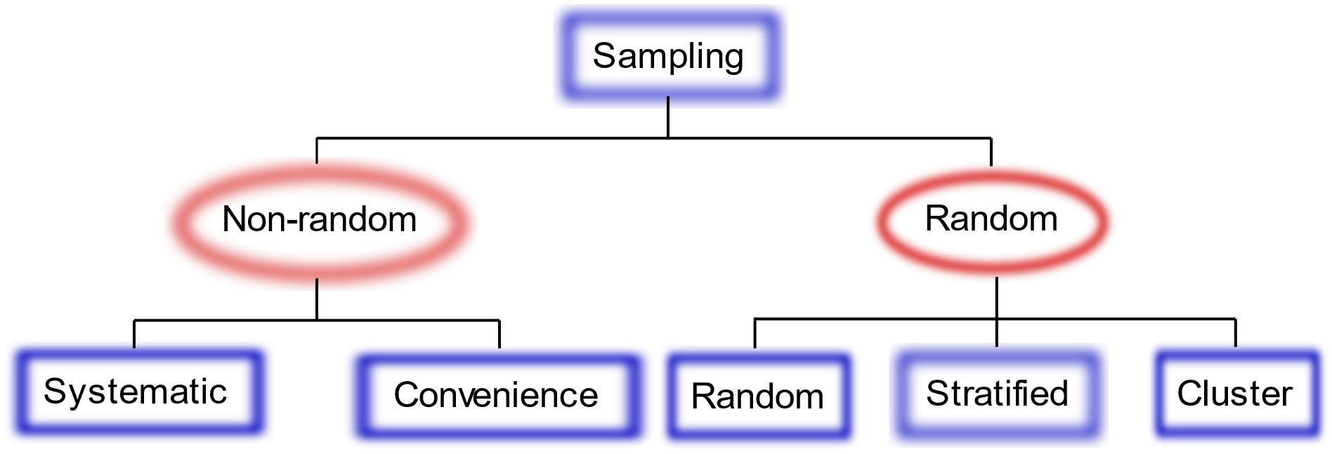
MaSiSS
Sampling
Population
Research Population
Random Sample
Non-random Sample

Slide 47
MaSiSS
Sampling
Characteristics of a Good Sample
true representative of the population
free from bias
is an objective one
is comprehensive in nature
maintains accuracy
it yields accurate results
Size of a Sample
General rule is large sample is better (is likely more representative of population, data are more accurate and precise with smaller standard error).
But this is not always true, because the chances of a Type I Error increase with the sample size (claim that something exists when it is not true).
We can reduce this risk by using the Effect size tests or calculate Statistical Power of our sample to determinate adequate sample size.
(Singh, 2006)

Slide 48
MaSiSS
Statistical Analysis
Statistical analysis is the science of collecting data and uncovering patterns and trends
After collecting data you can analyse it to:
Summarize the data (make a pie chart)
  By Measures of Distribution or frequency
Find key measures of location (median, mean, …)
  By Measures of Central Tendency
Calculate measures of spread – find if your data are tightly or spread out cluster (R, SD, IQR)
  By Measures of Variation and Position
Make future prediction based on past behavior
Test an experiment’s hypothesis (hypothesis testing)
  p < 0.05 = statistically significant results, we reject H₀ (because valid H₀ occurred in less than 5% of cases)
  p > 0.05 = statistically not significant results, we fail to reject H₀ (because valid H₀ occurred in more than 5% of cases)

Slide 49

Research Methodology and Statistics
Statistical Analysis
Statistical analysis is the science of collecting data and uncovering patterns and trends
  note: you cannot accept H₀ (only reject or fail to reject) or H_{a} …
  … after rejecting H₀, we can add „we can accept H_{a}

Slide 50
MaSiSS
Characteristics of a Good Test
Reliability, Validity, Objectivity and Usability
Reliability is consistency, dependence or trust
measurement reliability is the consistency with which a test yields the same result in measuring whatever it does measure
Example 1: If after first test mean score is 80, and after one week we used same test on same sample and the mean score is:
  80 = test provided stable and dependent results
  102 = test results are not consistent
Example 2: how two different teachers will evaluate the same test results
Types of reliability testing methods:
Test-retest method (the same test over time)
Interrater method (the same test conducted by different people)
Parallel forms method (different version of a test which are designed to be equivalent)
Split-half method (same test divides into two equivalent values)
Internal consistency method (correlation between multiple items in a test that are intended to measure the same construct)
Methods of determining reliability
Intraclass Correlation Coefficient (ICC) - defines a measure's ability to discriminate among subjects
Standard Error of Measurement (SEM) - quantifies error in the same units as the original measurement
(Gronlund and Linn, 1995; Ebel and Frisbie, 1991)

Slide 51
MaSiSS
Characteristics of a Good Test
Reliability, Validity, Objectivity and Usability
Factors that’s Affecting Reliabitity
Length of the test
Content of the test
Spread of Scores
Heterogeneity of the group
Experience with the test
Motivation
testing procedure
time limit of test
Cheating opportunity
How Higher Should Reliability be?
Cronbach’s Coefficient Alpha (α) | Reliability
0.80 to 0.95 | Very good
0.70 to 0.80 | Good
0.60 to 0.70 | Fair
< 0.60 | Poor
Note: what's wrong with this interval?

Slide 52
MaSiSS
Characteristics of a Good Test
Reliability, Validity, Objectivity and Usability
It means to what extent the test measures that, what the test maker intends to measure
  means truthfulness of a test
Validity do not have different types. It is a unitary concept, based on various types of evidence
Factors that affecting validity
  Unclear directions to the respond of the test
  Difficulty of the reading vocabulary and sentence structure
  Too easy or too difficult test items
  Ambiguous statements in the test items
  Inappropriate test items for measuring a particular outcome
  Inadequate time provided to take the test
  Length of the test
  Unfair aid to individual students (asking for help)
  Cheating during testing
  Unreliable scoring
  Anxiety, Physical or Psychological state of the pupil
  Response set (pattern in responding)

Slide 53

MaSiSS
Characteristics of a Good Test
Reliability, Validity, Objectivity and Usability
It means to what extent the test measures that, what the test maker intends to measure
  means truthfulness of a test
Validity do not have different types. It is a unitary concept, based on various types of evidence
Both Reliable and Valid
Reliable but not Valid
Neither reliable or valid
Not Reliable but Valid
Tato fotka od autora Neznámý autor s licencí CC BY-SA-NC
Tato fotka od autora Neznámý autor s licencí CC BY-SA-NC
Tato fotka od autora Neznámý autor s licencí CC BY-SA-NC
Tato fotka od autora Neznámý autor s licencí CC BY-SA-NC
Tato fotka od autora Neznámý autor s licencí CC BY-SA-NC

Slide 54
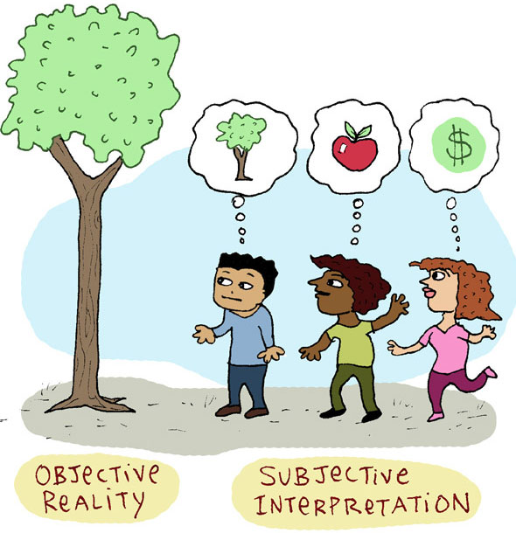
MaSiSS
Characteristics of a Good Test
Reliability, Validity, Objectivity and Usability
The extent to which the instrument is free from personal error (personal bias), that is subjectivity on the part of the scorer (Good, 1973)
a test is considered objective when it makes for the elimination of the scorer’s personal opinion and bias judgement
It affects both validity and reliability of test scores

Slide 55
MaSiSS
Characteristics of a Good Test
Reliability, Validity, Objectivity and Usability
While constructing a test, two main aspects of objectivity you need to keep in mind
Objectivity in scoring - same person or different persons scoring the test at any time arrives at the same result without may chance error (personal individual judgement should not affect the test scores), The scoring procedures must be clearly defined (without doubt and ambiguity)
Objectivity of test items - the item must call for a definite single answer
  free from ambiguity and dual meaning sentences (it makes the test subjective)

Slide 56
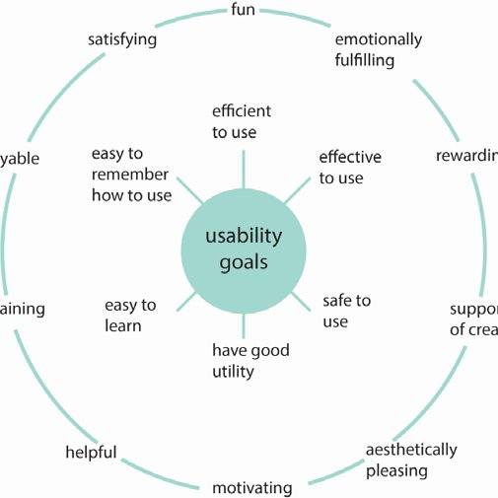
MaSiSS
Characteristics of a Good Test
Reliability, Validity, Objectivity and Usability
The test must have practical value from time, economy, and administration point of view
Practical considerations cannot be neglected
While constructing or selecting a test you must be taken into account:
Ease of Administration – any trained person can use it and evaluated
Time required for administration – Appropriate time limit for test (20–60 minute)
Ease of Interpretation and Application – If the results are misinterpreted, it is harmful and not applied results are useless
Availability of Equivalent Forms – You should have available equivalent forms of the same test in terms of content, level of difficulty and other characteristics
Cost of Testing - A test should be economical from preparation, administration and scoring point of view

Slide 57
MaSiSS
Variable Types and Scaling
Research Variables
The most common types of variable
Independent variable (IV) - is a singular characteristic that the other variables in your experiment cannot change, but IV can change other variables
  Age (eating or exercise habits are not changing your biological age, but you will not lift same weight as senior)
Dependent variable (DV) - relies on and can be changed by other components, IV can influence DV, DV can’t influence IV. Researchers goals are determine what makes the dependent variable change and how.
  A grade on exam (it depends on factors as how much your slept or how long you studied, but your test does not affect the time you spent studying)
Control (controlling) variables - are constant and do not change during a study, they have no effect on other variables.
  If we are investigating how much your slept (IV) effect a grade on exam (DV), we need to control time spent learning, the same level of students and more
Research variables are things you measure, manipulate and control in statistics and research
Person, place, thing, idea, …
  Other variables: Intervening (mediator) variables, Moderating (moderator) variables, Extraneous variables, Quantitative (numerical) variables, Qualitative (categorical) variables, Composite variables

Slide 58
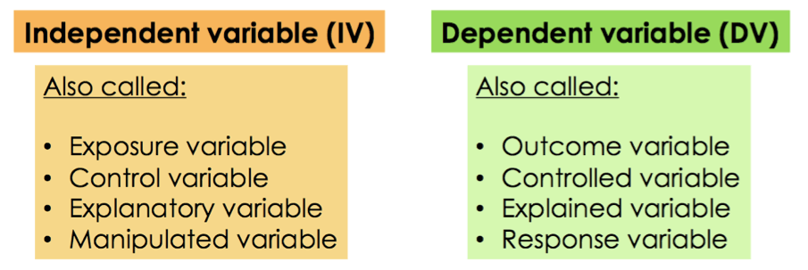
MaSiSS
Variable Types and Scaling
Research Variables
The most common types of variable
Independent variable (IV) - is a singular characteristic that the other variables in your experiment cannot change, but IV can change other variables
  Age (eating or exercise habits are not changing your biological age, but you will not lift same weight as senior)
  In t-test/ANOVA IV = categorical variable (nomina/ordinal)
Dependent variable (DV) - relies on and can be changed by other components, IV can influence DV, DV can’t influence IV. Researchers goals are determine what makes the dependent variable change and how.
  A grade on exam (it depends on factors as how much your slept or how long you studied, but your test does not affect the time you spent studying)
  In t-test/ANOVA DV = continuous measurement (interval/ratio)
Independent variable
Dependent variable

Slide 59
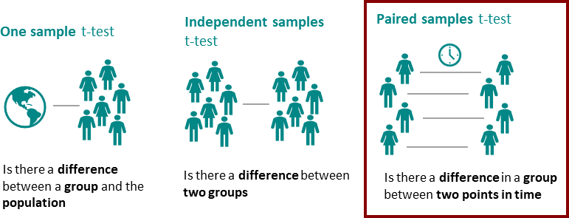
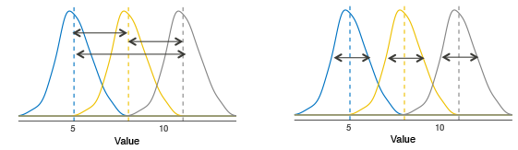
MaSiSS
Variable Types and Scaling
Research Variables
t-test (independent, one or two sampes)
2 IV groups
1 IV group
2 IV groups
One sample t-test
Independent samples t-test
Paired samples t-test
IV (1x)
DV (1x)
Independent variable
Dependent variable
1-2 IV groups
Group A/B
Value
One-Way ANOVA (Analysis of Variance)
Between-group variation
(Diff amoug group means)
Within-group variation
(Variability within each group)
IV (1x)
DV (1x)
Independent variable
(Factor)
Dependent variable
(Response Variable)
3+ IV groups
Studying Technique A/B/C
Exam Score

Slide 60
MaSiSS
Variable Types and Scaling
Research Variables
ANCOVA (Analysis of Covariance)
IV (2x)
DV (1x)
Studying Technique
Exam Score
Covariates
Current Grade
One-Way ANOVA (Analysis of Variance)
One-Way MANOVA (Multivariate Analysis of Variance)
IV (1x)
DV (1x)
IV (1x)
DV (2x)
Independent variable
(Factor)
Dependent variable
(Response Variable)
Level of Education
Annual Income
3+ IV groups
Student Loan Debt
Studying Technique A/B/C
Exam Score

Slide 61
MaSiSS
Variable Types and Scaling
Levels of Measurement
Quantitative data
or
Parametric data
or
Scale
is a classification that describes the nature of information within the values assigned to variables (Stevens, 1936)
nominal, ordinal, and interval/ratio
Named variables
Named
+
Ordered variables
Named
+
Orderd variables
+ Proportionate interval between variables
Named
+
Orderd variables
+
Proportionate interval between variables
+
Absolute zero
Ratio
Interval
Ordinal
Qualitative data
or
Nonparametric data
Nominal

Slide 62
MaSiSS
Variable Types and Scaling
Levels of Measurement
Levels of Measurement (Scale of Measure) are Nominal, Ordinal, Interval, Ratio
Types of variables
Qualitative variable (categorical, words)
Division according to the possibility of arrangement
Division according to number of categories
Quantitative variables (numerical, numbers)
Discrete variable
Nominal variable (cannot by order)
Ordinal variable (can by order)
Dichotomous (2 variant)
Multiples (> 2 variant)
Continous variable
(Litschmannová, 2011)

Slide 63
MaSiSS
Variable Types and Scaling
Levels of Measurement
Levels of Measurement (Scale of Measure) are Nominal, Ordinal, Interval, Ratio
Nominal
Qualitative
Dichotomis
Ordinal
Categorical
Interval
Discrete
Multiples
Quantitative
Ratio
Continous
(Řezanková et al., 2017)

Slide 64
MaSiSS
Variable Types and Scaling
Levels of Measurement
Levels of Measurement (Scale of Measure) are Nominal, Ordinal, Interval, Ratio
Nominal data:
  The number of female athletes in football association
  Your political party affiliation
  The state/region/city where you were born
  The color of your hair
Ordinal data:
  Order of finish in race/contest/tournament
  A school grades (A, B, C, D, F)
  Ranking of chilli peppers (hot, hotter, hottest; not Scoville scale, SHU)
  Student’s year of study (freshman, Sophomore, junior, senior)
  Cancer stage (I, II, III, IV)
Interval data:
  Intelligence Quotient scores
  Dates on calendar
  The heights of waves in the ocean
  Shoe size
  Longitudes on map/globe
Ratio data:
  Height
  Pulse
  length
  Money in your bank/wallet/pocket
  Monthly Income/expenses

Slide 65
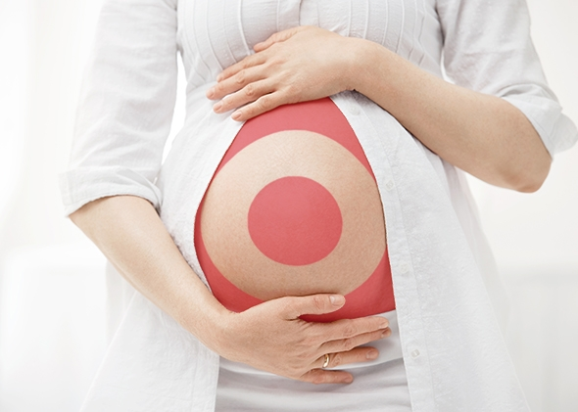
MaSiSS
Misuse of statistics
Target (2002): Can we determine which customers are pregnant?
  Even if they don‘t want us to wnow.
Andrew Pole:
  yes + also they expectd due date is
= Target send right coupons at the right time

Slide 66

MaSiSS
Misuse of statistics
Elderly woman was robbed (1964):
  She saw: Blonde woman, ponytail
  a passing man saw: yellow car driven by a black man (had beard and a mustache)
  Police catche: Janet and Malcom Collins
    They matched all the descriptions
Prove of guilt for Collins by mathematician
Mathematician calculated the probability of just randomly selecting a couple that was inocent and also share all charakteristice
  1 in 12 million chance that Collins are innocent

Slide 67
MaSiSS
Misuse of statistics
Sally Clark: guilty of murdering her two infant son‘s in 90s.
  1st son: died suddenly due to unknown causes
  2nd son: found dead 8 week after birth of suddent unknown causes
  During the trial a pediatrician professor: chance of two suddent unknown causes is 1 in 73 million

Slide 68


MaSiSS
Misuse of statistics
Elderly woman was robbed (1964)
People v. Collins
  Example of Prosecutor‘s fallacy
  P(A/B) ≠ P(B/A)

Slide 69


MaSiSS
Misuse of statistics
Given:
  Behind curtain is an animal with 4 leg
What is the probability that it‘s a dog
1 in 1000
Given:
  Behind curtain is a dog
What is the probability that it has 4 legs?
Almost 100%
By switching the given and the question = change of probability

Slide 70
MaSiSS
Misuse of statistics
Elderly woman was robbed (1964)
People v. Collins
  Example of Prosecutor‘s fallacy
  P(A/B) ≠ P(B/A)
Given:
  Couple fit all description (blonde woman,…).
< 1 in 12 million chance of innocence
WRONG

Slide 71


MaSiSS
Misuse of statistics
People v. Collins
Given:
  Innocent couple
< 1 in 12 million
Probability of fiffing all descriptions
Right
  Example: random couple (of a mall) had very small chance of fitting the description
Given:
  Couple fit all description (blonde woman,…).
< 1 in 12 million chance of innocence
WRONG
(eg. Prosecutors fallacy)

Slide 72
MaSiSS
Misuse of statistics
Sally Clark - guilty of murdering her two infant son‘s
Bacterial test reveal more specific information that a simple multiplication of two probabilities
  They were independent of each other (genetic and enviromental factor)
Lost childrens (due natural caused), accused of murdering, found guilty (due to a misuse of statistic), spent 3 years in prison, after release not able to recovery and died (alcohol poisoning)

Slide 73


MaSiSS
Misuse of statistics
If high school dropout rates go from 5% to 10%
5% increase
5%
10%
100% increase

Slide 74


MaSiSS
Misuse of statistics
If dropout rates are 1 in a million people and then next year go to 2 in million people
Headlines 1: Dropout rates go up by 100%
Heallines 2: Dropout rates go up by .0001%
100% increase
1 in 1 mil
  .0001%
2 in 1 mil
  .0002%
+ .001%

Slide 75

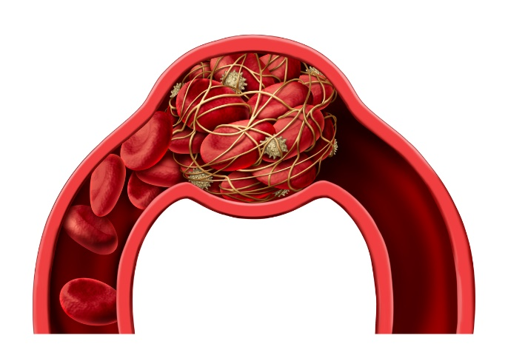
MaSiSS
Misuse of statistics
UK committee on sefty of medicines (1995)
certain type of birth control pill increaased the risk of life-threating blood clots by 100%
New pill
Older pill
100% increase
1 in 7000
  ≈.014%
2 in 7000
  ≈.028%
+ .014%

Slide 76

MaSiSS
Misuse of statistics
Correlation or Causation?
  Or both?
If A correlated with B, it don‘t mean that A cause B
Rotating turbines correlated with wind
  but tubine don‘t cause wind, wind cause rotation of turbine

Slide 77
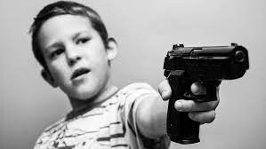

MaSiSS
Misuse of statistics
Correlation or Causation?
  Or both?
Violent show cause kids to be more violent?
  it is posible but …
More violent kids watch more violent TV shows
  Also seens reasonable

Slide 78
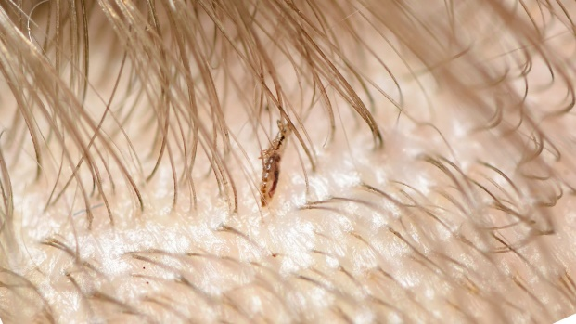


MaSiSS
Misuse of statistics
Correlation or Causation?
  Or both?
Peole how had head lice were healthy and sick people were ralely even had head lice
  Head lice cause bettet health
  But head lice is very sentive to the body temperature

Slide 79

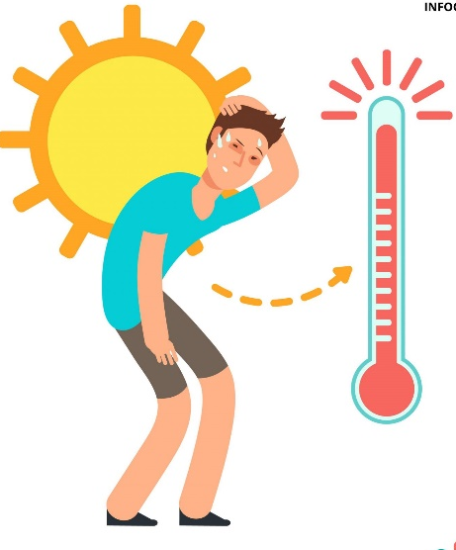
MaSiSS
Misuse of statistics
Correlation or Causation?
  Or both?
Ice cream sales do not cause increase in heat strokes or other way, even though are correlated
  Hot weather cause both (eg. Third-Cause Fallacy)

Slide 80


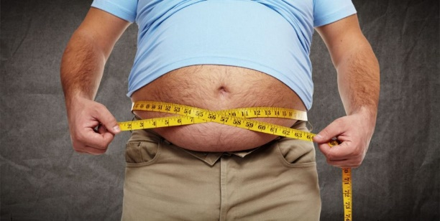
MaSiSS
Misuse of statistics
Correlation or Causation?
  Or both?
CO₂ production increased along with obesity. Does one cause the other?
  No, wealthy population eat more and produce more CO2
    (eg. Third-Cause Fallacy)

Slide 81
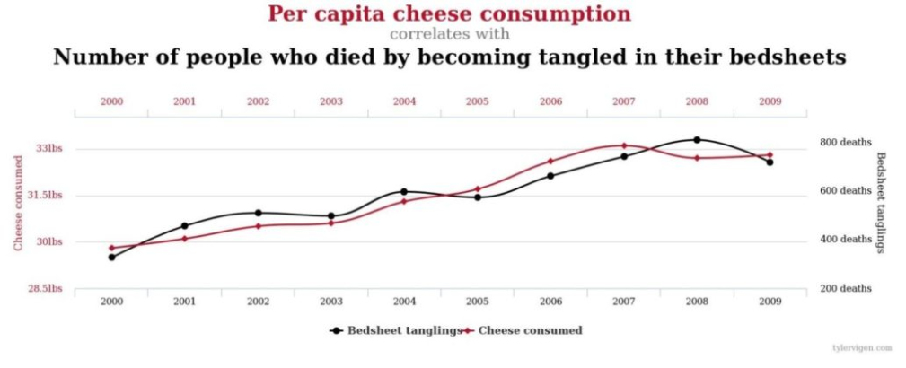
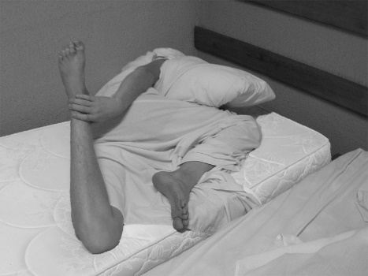
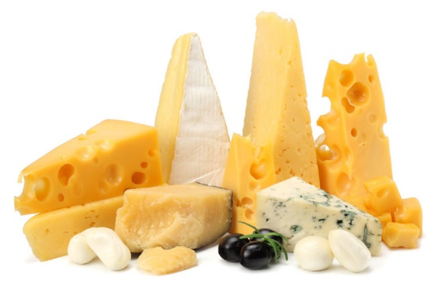
MaSiSS
Misuse of statistics
Correlation or Causation?
  Or neither?
Cheese consumption per person and the number of people who died as a result of tangling in the sheets
  (r = 0.947)

Slide 82
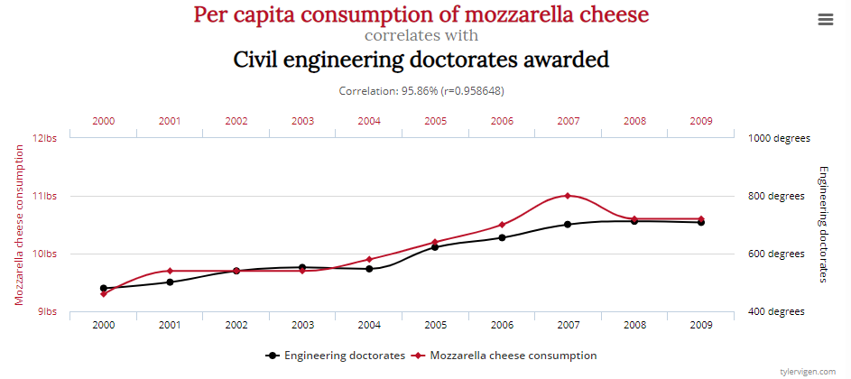
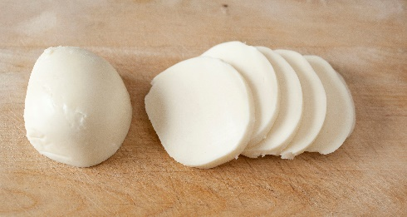
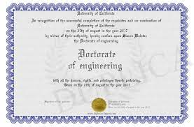
MaSiSS
Misuse of statistics
Correlation or Causation?
  Or neither?
Consumption of mozzarella cheese per person with doctorates from engineering
  (r = 0.950)
Both examples are an example of a false correlation

Slide 83
MaSiSS
Descriptive Statistic
Inferential Statistic
Presenting, organizing, simplifying, and summarizing data
Drawing conclusions about a population base on data observed in a sample
1st step
2nd step
Measures of Distribution or Frequency
Measures of Central Tendency
Measures of Dispersion or Variation
Measures of Position
Comparison tests
Correlation tests
Regression tests

Slide 84

MaSiSS
Descriptive Statistic
Measures of Distribution or Frequency
Measures of Central Tendency
Measures of Dispersion or Variation
Measures of Position

Slide 85
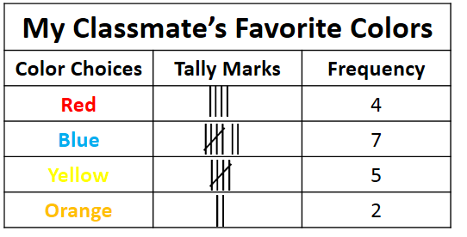
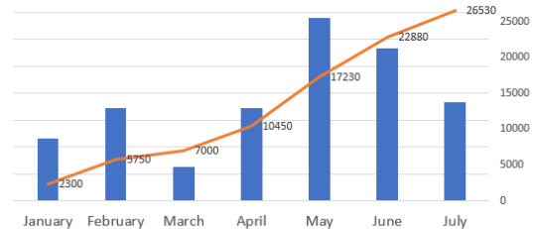
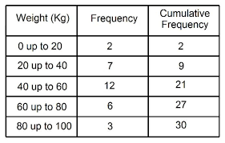
MaSiSS
Descriptive Statistic
Measures of Distribution or Frequency
a graph or data set organized to show the frequency of occurrence of each possible outcome of a repeatable event observed many times
compare one part of the distribution to another part of the distribution
Count, Percent, Frequency

Slide 86
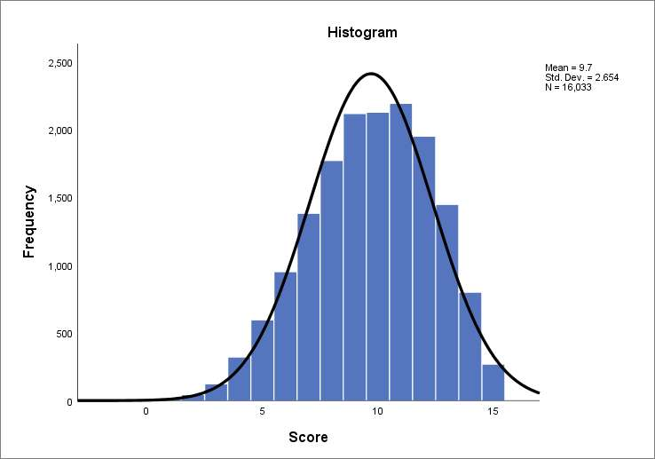
MaSiSS
Descriptive Statistic
Measures of Distribution or Frequency
a graph or data set organized to show the frequency of occurrence of each possible outcome of a repeatable event observed many times
compare one part of the distribution to another part of the distribution
Count, Percent, Frequency

Slide 87

MaSiSS
Descriptive Statistic
Measures of Central Tendency
is defined as the number used to represent the center or middle of a set of data values
Mean, Median, Mode

Slide 88


MaSiSS
Descriptive Statistic
Measures of Central Tendency
Positive kurtosis or Leptokurtic
Normal kurtosis or Mesokurtic
Negative kurtosis or platykurtic
Right or Positive skew
Left or Negative skew

Slide 89

MaSiSS
Descriptive Statistic
Measures of Dispersion or Variation
how far apart data points lie from each other and from the center of a distribution (mean±SD)
Range, IQR, Standard Deviation, Variance
  Range (R) = x_{Max} - x_{min}
  Interquartile range (IQR) = Q₃ - Q₁
  Standard deviation (SD, s) is the average amount of variability in your dataset
    s = sample standart diviation
    σ = population standard deviation
  Variance (s²) is the average of squared deviations from the mean
    To get variance, square the standard deviation (s)
    s² = sample variance
    σ² = population variance

Slide 90


MaSiSS
Descriptive Statistic
Measures of Dispersion or Variation

Slide 91


MaSiSS
Descriptive Statistic
Measures of Dispersion or Variation

Slide 92

MaSiSS
Descriptive Statistic
2.3.4 Measures of Position
Determines the position of a single value in relation to other values in a sample or a population data set.
Quantiles (Percentile, Decile, Quartile), Outliers, standard scores
  Percentile (P_{i})= divide a rank-ordered data set (from the smallest to the largest) into 100 equal parts
  Decile - divide a rank-ordered data set into ten equal parts
  Quartiles (Q_{i}) - divide a rank-ordered data set into four equal parts
    Q₁ = P₂₅, Q₂ = P₅₀ = median
  Standard scores: raw scores that, for ease of interpretation, are converted to a common scale of measurement, or z distribution
    z-Score indicates how many standard deviations an element is from the mean
    t-score enables you to take an individual score and transform it into a standardized form, which helps you to compare scores.

Slide 93
MaSiSS
Inferential or Analytical Statistic
Inferential statistics takes data from a sample and makes inferences about the larger population from which the sample was drawn
the goal of inferential statistics is to draw conclusions from a sample and generalize them to a population

Slide 94



MaSiSS
Inferential statistic (p-value)
Lady tasting tea
Ronald Fisher (1890–1962)
The experiment provides a subject with 8 randomly ordered cups of tea
  4 prepared by first pouring the tea, then adding milk
  4 prepared by first pouring the milk, then adding the tea
n = 8 total cups
k = 4 cup chosen

Slide 95



MaSiSS
Inferential statistic (p-value)
Lady tasting tea
n = 8 total cups
k = 4 cup chosen

Slide 96

MaSiSS
Inferential statistic (p-value)
Lady tasting tea
How many cups must be correctly identified to concludes that subject can truly tell the difference?
Lady Ottoline Violet Anne Morrell (1873–1938)
English aristocrat and society hostess

Slide 97

MaSiSS
Inferential statistic (p-value)
Lady tasting tea
4 of 4 successe
  1 / 70 = 0.0143 (1.14%)
3 of 4 success
  (16 + 1) / 70 = 0.243 (24.3%)
Fisher willing to reject the null hypothesis … acknowledging the lady's ability at a 1.14% significance level
n = 8 total cups
k = 4 cup chosen
Fisher's Exact Test

Slide 98

MaSiSS
Inferential or Analytical Statistic
Hypothesis (or Predictions) Testing
Comparison tests
  t-test, ANOVA, Mann-Whitney U test, Wilcoxon test, Kruskal-Wallis H test
Correlation tests
  Pearson’s r, Spearman’s rho, Chi square test
Regression tests
  Simple linear regression, Multiple linear regression, …

Slide 99

MaSiSS
Inferential or Analytical Statistic
Hypothesis (or Predictions) Testing
Comparasion tests
  t-test, ANOVA, Mann-Whitney U test, Wilcoxon test, Kruskal-Wallis H test
Correlation tests
  Pearson’s r, Spearman’s rho, Chi square test
Regression tests
  Simple linear regression, Multiple linear regression, …
For Choosing adequate Comparasion test You need to know:
Which test answer the research question (Validity)
Scales of measurement
  Nominal, Ordinal, Interval, Ratio data
  Binary, Multiple, Discrete Continuous data
  Binary, Nominal, Ordinal, Discrete, Continuous data
Parametric or nonparametric data
  using the normal distribution test (just for quantitative data)
Paired (repeated measurements) or independent (unpaired) sample

Slide 100

MaSiSS
Inferential or Analytical Statistic
Hypothesis (or Predictions) Testing
Comparasion tests
  t-test, ANOVA, Mann-Whitney U test, Wilcoxon test, Kruskal-Wallis H test
Correlation tests
  Pearson’s r, Spearman’s rho, Chi square test
Regression tests
  Simple linear regression, Multiple linear regression, …
Example of Comparison Tests
Suitable tests for nominal data
  Odds ratio test (OR),
  Relative risk (RR)
Suitable tests for ordinal data
  Chi-square test, χ²
    Goodness of fit (observed vs. Expected)
    Homogeneity (separate subgroups)
    Independence (same population)
Suitable tests for interval and Ratio data (Scale data)
  t-test
    one sample
    two independent samples
    two paired samples
  ANOVA test
    for three or more sample
    also for repeated measurements

Slide 101

MaSiSS
Inferential or Analytical Statistic
Hypothesis (or Predictions) Testing
Comparasion tests
  t-test, ANOVA, Mann-Whitney U test, Wilcoxon test, Kruskal-Wallis H test
Correlation tests
  Pearson’s r, Spearman’s rho, Chi square test
Regression tests
  Simple linear regression, Multiple linear regression, …
Example of Comparison Tests
Suitable tests for nominal data
  Odds ratio test (OR),
  Relative risk (RR)
Suitable tests for ordinal data
  Chi-square test, χ²
    Goodness of fit (observed vs. Expected)
    Homogeneity (separate subgroups)
    Independence (same population)
Suitable tests for interval and Ratio data (Scale data)
  t-test
    one sample
    two independent samples
    two paired samples
  ANOVA test
    for three or more sample
    also for repeated measurements
William Sealy Gosset (aka Student)

Slide 102


MaSiSS
Inferential or Analytical Statistic
Hypothesis (or Predictions) Testing
Comparasion tests
  t-test, ANOVA, Mann-Whitney U test, Wilcoxon test, Kruskal-Wallis H test
Correlation tests
  Pearson’s r, Spearman’s rho, Chi square test
Regression tests
  Simple linear regression, Multiple linear regression, …
Pearson’s r
  parametric, quantitative data
Spearman’s rho
  nonparametric, quantitative which are handled like qualitative data
Chi-square test (χ²)
  qualitative data
Dimension reduction techniques
  Factor analysis (use when you assume association if you want to understand the latent factors)
  Principal Component Analysis (seeks to identify, to predict using the factors, PCA)

Slide 103


MaSiSS
Inferential or Analytical Statistic
Hypothesis (or Predictions) Testing
Comparasion tests
  t-test, ANOVA, Mann-Whitney U test, Wilcoxon test, Kruskal-Wallis H test
Correlation tests
  Pearson’s r, Spearman’s rho, Chi square test
Regression tests
  Simple linear regression, Multiple linear regression, …
Simple linear regression (1 metric IV; 1 metric DV)
Multiple linear regression (2+ metric IV; metric DV)
Logistic regression (1 any IV; 1 binary variable)
Nominal regression (1 any IV; 1 nominal variable),
Ordinal logistic regression (1 any IV; 1 ordinal variable)

Slide 104


MaSiSS
Inferential or Analytical Statistic
Hypothesis (or Predictions) Testing
Comparasion tests
  t-test, ANOVA, Mann-Whitney U test, Wilcoxon test, Kruskal-Wallis H test
Correlation tests
  Pearson’s r, Spearman’s rho, Chi square test
Regression tests
  Simple linear regression, Multiple linear regression, …
Simple linear regression (1 metric IV; 1 metric DV)
Multiple linear regression (2+ metric IVs; metric DV)
Logistic regression (1 any IV; 1 binary variable)
Nominal regression (1 any IV; 1 nominal variable),
Ordinal logistic regression (1 any IV; 1 ordinal variable)

Slide 105

MaSiSS
Inferential or Analytical Statistic
Hypothesis (or Predictions) Testing
Comparasion tests
  t-test, ANOVA, Mann-Whitney U test, Wilcoxon test, Kruskal-Wallis H test
Correlation tests
  Pearson’s r, Spearman’s rho, Chi square test
Regression tests
  Simple linear regression, Multiple linear regression, …
Simple linear regression (1 metric IV; 1 metric DV)
Multiple linear regression (2+ metric IVs; metric DV)
Logistic regression (1 any IV; 1 binary variable)
Nominal regression (1 any IV; 1 nominal variable),
Ordinal logistic regression (1 any IV; 1 ordinal variable)
Win/pass
Loss/fail
Serves speed / test points

Slide 106

MaSiSS
Multiple comparisons problem
  If for 1 test: p = 0.04 (α < 0.05)
  If for 2 tests: p = 0.04 and 0.02 (α < 0.05)
  α ≠ 0.05 = 0.025
  If for 4 tests: p = 0.04; 0.02; 0.01; 0.001 (α < 0.05)
  α ≠ 0.05 = 0.0125

Slide 107
MaSiSS
α = 0.05
Adjusted α = 0.0041
Multiple comparisons problem
Table 2. Mean and SD of analysed parameters in forward gait for 0.00% and 0.11% BrAC conditions in females and males.
 | 0.00% BrAC |  |  |  |  | 0.11% BrAC |  |  |  |  | Dif. 0.00% and 0.11% BrAC
 | Females |  | Males |  | p (gender dif.) | Females |  | Males |  | p (gender dif.) | p (females) | p (males)
 | Mean | SD | Mean | SD |  | Mean | SD | Mean | SD
Foot rotation, ° | 3.24 | 4.06 | 7.87 | 5.84 | <0.001* | 3.94 | 4.17 | 7.80 | 4.97 | <0.001* | 0.484 | 0.001*
Stride length, cm | 128.40 | 12.40 | 135.07 | 13.42 | 0.006* | 134.87 | 13.84 | 138.47 | 14.75 | 0.167 | 0.572 | 0.401
Step width, cm | 9.26 | 2.16 | 12.09 | 2.80 | <0.001* | 9.54 | 2.47 | 11.96 | 3.56 | <0.001* | 0.025* | 0.508
Stance phase, % | 63.04 | 2.12 | 62.55 | 2.19 | 0.132 | 61.90 | 2.36 | 62.34 | 2.55 | 0.620 | 0.013* | 0.308
Load response, % | 12.77 | 1.78 | 12.80 | 2.13 | 0.615 | 12.42 | 2.02 | 12.32 | 2.23 | 0.482 | 0.806 | 0.496
Single limb support, % | 37.39 | 2.17 | 37.49 | 2.34 | 0.807 | 37.49 | 1.94 | 37.67 | 2.58 | 0.566 | 0.498 | 0.140
Pre-Swing, % | 12.89 | 1.71 | 12.24 | 1.88 | 0.069 | 12.08 | 1.71 | 12.35 | 2.27 | 0.684 | 0.295 | 0.020*
Swing phase, % | 36.96 | 2.12 | 37.45 | 2.19 | 0.132 | 38.10 | 2.36 | 37.66 | 2.55 | 0.620 | 0.013* | 0.308
Double stance phase, % | 25.66 | 3.06 | 25.03 | 3.55 | 0.201 | 24.47 | 3.26 | 24.68 | 4.17 | 0.863 | 0.308 | 0.088
Stride time, sec | 1.12 | 0.10 | 1.18 | 0.09 | 0.002* | 1.13 | 0.10 | 1.19 | 0.09 | <0.001* | 0.057 | 0.134
Cadence, steps/min | 107.58 | 9.45 | 102.20 | 7.53 | 0.002* | 106.91 | 8.83 | 101.55 | 6.96 | <0.001* | 0.052 | 0.249
Velocity, km/h | 4.17 | 0.65 | 4.14 | 0.48 | 0.885 | 4.34 | 0.67 | 4.22 | 0.49 | 0.391 | 0.521 | 0.197

Slide 108

MaSiSS
Multiple comparisons problem
  False Discovery Rate (FDR) – expected proportion of type I error
  Family-wise effer rate (FWER) – probability of making at least one type I error
  If you repeat a test enough times, you will always get a number of false positive

Slide 109

MaSiSS
Multiple comparisons problem
How to correct rist of type I error
Benjamini-Hochberg (p_{k} = (k / m) * Q)
  Controls the FDR
Holm correction (p_{k} = α / (m + 1 – k))
Powerfull then Bonferroni
Control the FWER
Bonferroni correction/adjustment (p_{k} = α / m)
  Control the FWER
k = rank of ordered p-value; m = number of tests; Q = FDR (0.05-0.25)

Slide 110
MaSiSS
Multiple comparisons problem
When not to correct
If false negative are also importent for future research
Example: you‘re researching a new AIDS vaccine. A high number of false positives may be hint to that you‘re on the right track
When the results are not statistically significant (p > α)
For a single test
In the case of an exploratory study
  we do not know the hypotheses in advance
(McDonald, 2014; Hendl & Remr, 2017)

Slide 111



MaSiSS
Multiple comparisons problem
What if …?
Bonferroni correction (p_{k} = α / m)
Number of tests (m) = 6; α = 0.05
p_{k} = 0.008
Number of tests (m) = 3; α = 0.05
p_{k} = 0.017
Class | Upper limb |  |  | Lower limb
Class | Right | Left | p | Right | Left | p
1st | Mean±SD | Mean±SD | 0.015 | Mean±SD | Mean±SD | 0.010
2nd | Mean±SD | Mean±SD | 0.041 | Mean±SD | Mean±SD | 0.032
3rd | Mean±SD | Mean±SD | 0.05 | Mean±SD | Mean±SD | 0.063

Slide 112

MaSiSS
Multiple comparisons problem
What if …?
Bonferroni correction (p_{k} = α / n)
Number of tests (n) = 6; α = 0.05
p_{k} = 0.008
Number of tests (n) = 3; α = 0.05
p_{k} = 0.017
Class | Upper limb |  |  | Lower limb
Class | Right | Left | p | Right | Left | p
Max GS [Nm] | Mean±SD | Mean±SD | 0.015 | Mean±SD | Mean±SD | 0.010
Power GS [W] | Mean±SD | Mean±SD | 0.041 | Mean±SD | Mean±SD | 0.032
Time to Max GS [s] | Mean±SD | Mean±SD | 0.05 | Mean±SD | Mean±SD | 0.063

Slide 113
MaSiSS
The Effect size (ES)
Is a quantitative measure of the magnitude of the experimental effect
Is considered an essential complement of the statistical significance test, because it allows to know the relevance of the difference and discerning between the statistical significance of a test and its practical importance.
The effect size allows to make comparisons between the statistical significant differences from groups with a very different number of items, and studying groups from different scientific works (meta-analysis)
Effect size hepl undestend the magnitude of differences found (statistical signifikance examines whether the findings are likely to be due to chance)
Most common effect size tests
  Cohen‘s d (Effect size index d)
    Appropriate to campared two means (t-test)
    Small (d = 0.2; 58%*), Medium (d = 0.5; 69%*), Large (d = 0.8; 79%)
  Pearson correlation (r)
  Confidence interval (CI)
    is a range of values that you can be (95%) certain contains the true mean of the population.
    there are variants of 90 % CI, 95% CI, 99% CI
    Cohen‘s d [95% CI] = d [lower bound; higher bound] = 0.9 [0.12; 1.52]
  Odds ratio test (OR)
    For 2x2 table, (AD) / (BC)
    Example for OR (95% CI): 2.1 (2.0 to 2.2)
  Others Effect size tests
    Epsilon-squared (ε²), Cohen‘s ω (ω), Eta-squared (η²), Cramer‘s V (V), Effect size Phi (ϕ), Relative risk or risk ratio (RR), Coefficient of determination (r²), Common Language Effect Size (CLES), ...
*Procentige of control group below the mean of experimental group

Slide 114

MaSiSS
The Effect size (ES)
Most common effect size tests
  Cohen‘s d (Effect size index d)
    Appropriate to campared two means (t-test)
    Small (d = 0.2; 58%*), Medium (d = 0.5; 69%*), Large (d = 0.8; 79%)
  Pearson correlation (r)
  Confidence interval (CI)
    is a range of values that you can be (95%) certain contains the true mean of the population.
    there are variants of 90 % CI, 95% CI, 99% CI
    Cohen‘s d [95% CI] = d [lower bound; higher bound] = 0.9 [0.12; 1.52]
  Odds ratio test (OR)
    For 2x2 table, (AD) / (BC)
    Example for OR (95% CI): 2.1 (2.0 to 2.2)
  Others Effect size tests
    Epsilon-squared (ε²), Cohen‘s ω (ω), Eta-squared (η²), Cramer‘s V (V), Effect size Phi (ϕ), Relative risk or risk ratio (RR), Coefficient of determination (r²), Common Language Effect Size (CLES), ...
*Procentige of control group below the mean of experimental group

Slide 115


MaSiSS
The Effect size (ES)
Most common effect size tests
  Cohen‘s d (Effect size index d)
    Appropriate to compared two means (t-test)
      Small (d = 0.2; 58%*)
      Medium (d = 0.5; 69%*)
      Large (d = 0.8; 79%*)
*Procentige of control group below the mean of experimental group

Slide 116



MaSiSS
The Effect size (ES)
Most common effect size tests
Pearson correlation (r)
  Summarises the strenght of the bivariate relationship
  r correlation varies between -1 to +1
    (A perfect negative to a perfect positive correlation)
Correlation matrix for all variables (Banerje et al. (2009)

Slide 117

MaSiSS
The Effect size (ES)
Most common effect size tests
  Confidence interval (CI)
    is a range of values that you can be (95%) certain contains the true mean of the population.
    there are variants of 90 % CI, 95% CI, 99% CI
    Cohen‘s d [95% CI] = d [lower bound; higher bound] = 0.9 [0.12; 1.52]
Schwarz et al. (2013)

Slide 118


MaSiSS
The Effect size (ES)
Most common effect size tests
  Odds ratio test (OR)
    For 2x2 table, (AD) / (BC)
    Example for OR (95% CI): 2.1 (2.0 to 2.2)
  Relative Risk (RR

Slide 119
MaSiSS
Probability
Classic probability
Frequentist probability
Bayesian probability

Slide 120


MaSiSS
Probability
Classic probability
  Measure the likelihood (probability) of something happening.
Frequentist probability
  Null hypothesis signifikance testing
  Probability of observed data under the assumption that the null hypothesis is true
Bayesian probability
  Probabilities of both hypothesis
  Bayes theorem
  Uses the idea of updating belief with new information
Tossing a coin or dice, …
P(A) = f / N
  P(A) = probability of event A
  f = frequency (or number) of possible times the event could happen
  N = the number of times the event could happen
For example, the odds of rolling a 6 on (a fair) die are 1 out of 6 (1/6)
  = one possible outcome divided by the number of possible outcomes

Slide 121
MaSiSS
Probability
Classic probability
  Measure the likelihood (probability) of something happening.
Frequentist probability
  Null hypothesis signifikance testing
  Probability of observed data under the assumption that the null hypothesis is true
Bayesian probability
  Probabilities of both hypothesis
  Bayes theorem
  Uses the idea of updating belief with new information
P(E|H_{o})
Important:
The p-value is not the probability of a theory or hypothesis, but the probability of the observed data

Slide 122
MaSiSS
Probability
Classic probability
  Measure the likelihood (probability) of something happening.
Frequentist probability
  Null hypothesis signifikance testing
Bayesian probability
  Probabilities of both hypothesis
  Bayes theorem
  Uses the idea of updating belief with new information
P(H|E)

Slide 123





MaSiSS
Probability
Bayesian probability
Treasure hunting
    Tommy Thimpson (1988) – SS Central America with $700,000,000 worth of gold
Scientists use Bayes how new data validetes or invalidates their models
Programmers use to building artificial intelligence (kvantification of machines belief)
How you view yourself,
  your own opinions and what it takes for your mind to change (reframing your thought itself)
Spam filter (looks at words)
  = probability that the email is spam, given that those words appear
=
P(Spam|Word) $= \frac{P\left(Spam\right) ∗ P(Word\text{|}Spam)}{P(Word)}$
P(H|E) $= \frac{P\left(H\right) ∗ P(E\text{|}H)}{P(E)}$

Slide 124



MaSiSS
Probability
Bayesian probability
Bayes never publish his treorem
He submit it to the Royal Society
Publish after he died (Richard Price)
  Man coming first time out of a cave and saw the sun rise for the first time and ask himself: Is this one-off or does the sun always do this? An then every day after that, as the sun rose agan he yould get a little bit more confident, that the World works.
  Origin thought experiment
  He was sitting back to a perfectly flat, perfectly squared table, then he ask assistant to throw a ball onto the table and he wanted to figure out where it was. So, he asked his assistant to throw on another ball and then tell him if it land to the left, or to the right, front, behind of the first ball. He would note that down and then ask for more and more balls to be thrown on the table. Through this method he yould keep updating his idea of where the first ball was. He will never be completely certain, but with each new piece of evidence, he would get more and more accurate
    And that‘s how Bayes saw the world

Slide 125

MaSiSS
P(H|E)$= \frac{P\left(H\right) ∗ P(E\text{|}H)}{P(E)}$
Probability
Bayesian probability
P(H|E) = Posterior = probability a hypothesis is true given some evidence
  belief about the hypothesis after seeing the evidence
P(H) = Prior = probability a hypothesis is true (before any evidence)
hardest part of te equation (sometimes just guess)
𝑃(𝐸|𝐻) = likelihood = the probability that evidence given the hypothesis is true
  probability of seeing the evidence if the hypothesis is true
P(E) = Marginalization = The probability evidence being true
  probability of seeing the evidence

Slide 126


MaSiSS
P(H|E) $= \frac{P\left(H\right) ∗ P(E\text{|}H)}{P(E)}=\frac{P\left(H\right) ∗ P(E\text{|}H)}{P\left(H\right)∗P\left(E\text{|}H\right)+P\left(¬H\right)∗P(E\text{|}¬H)}$
Probability
Bayesian probability
P(H|E) = Posterior = probability a hypothesis is true given some evidence
P(H) = Prior = probability a hypothesis is true
𝑃(𝐸|𝐻) = likelihood = the probability that evidence given the hypothesis is true
P(E) = Marginalization = The probability evidence being true
  Prior
  likelihood
P(H|E) $= \frac{P\left(H\right) ∗ P(E\text{|}H)}{P(E)}$
  Posterior
  Marginalization

Slide 127


MaSiSS
Probability
Bayesian probability
  Bayes‘ rules
  You have hypothesis
  You‘ve observed some evidence
  You want know the probability that the your hypothesis holds given that the evidence is true
    = P(Hypothesis given Evidence)
    Given (“|“) = restricting view only to the possibilities where the evidence holds
P(H|E) $= \frac{P\left(H\right) ∗ P(E\text{|}H)}{P(E)}=\frac{P\left(H\right) ∗ P(E\text{|}H)}{P\left(H\right)∗P\left(E\text{|}H\right)+P\left(¬H\right)∗P(E\text{|}¬H)}$

Slide 128

MaSiSS
Probability
Bayesian probability
  likelihood
Example: you feel a little bit sick, without sympstoms, just not 100%. Doctors run a battery of tests and results are … you tested positive for a rare disease that affects about 0.1% of population and it‘s a nasty disease. The test correclty identify 99% of people that have the disease and only incorrecly identify 1% of people who don‘t the disease.
- What are the chances that you actually have this disease?
    99%???
  Prior
P(H|E) $= \frac{P\left(H\right) ∗ P(E\text{|}H)}{P(E)}$
  Posterior
  Marginalization

Slide 129


MaSiSS
Probability
Bayesian probability
  You would test + if you had the disease
  Prior probability of having the disease
P(H|E) $= \frac{P\left(H\right) ∗ P(E\text{|}H)}{P(E)}$
  Prior
  likelihood
  Actually have the disease given you tested +
  Probability of testing +
P(H|E) $= \frac{P\left(H\right) ∗ P(E\text{|}H)}{P(E)}$
  Posterior
  Marginalization

Slide 130


MaSiSS
P(H|E) $= \frac{P\left(H\right) ∗ P(E\text{|}H)}{P(E)}=\frac{P\left(H\right) ∗ P(E\text{|}H)}{P\left(H\right)∗P\left(E\text{|}H\right)+P\left(¬H\right)∗P(E\text{|}¬H)}$
Probability
Bayesian probability
  Prior probability of having the disease
  Actually have the disease
  You would test + if you had the disease
  Actually having the disease after testing +
  given
P(H|E) $= \frac{0.001 ∗ 0.99}{0.001∗0.99+0.999∗0.01}$
= 9 %
  You tested +
  Probability of testing +
  Is it too Low?
  no, it is common sense applied to mathematics…

Slide 131
MaSiSS
Probability
Bayesian probability
False +
False +
o o o o o o o o o o o o o o o o o o o o o o o o o o o o o o o o o o o o o o o o o o o o o o o o o o o o o o o o o o o o o o o o o o o o o o o o o o o o o o o o o o o o o o o o o o o o o o o o o o o o o o o o o o o o o o o o o o o o o o o o o o o o o o o o o o o o o o o o o o o o o o o o o o o o o o o o o o o o o o o o o o o o o o o o o o o o o o o o o o o o o o o o o o o o o o o o o o o o o o o o o o o o o o o o o o o o o o o o o o o o o o o o o o o o o o o o o o o o o o o o o o o o o o o o o o o o o o o o o o o o o o o o o o o o o o o o o o o o o o o o o o o o o o o o o o o o o o o o o o o o o o o o o o o o o o o o o o o o o o o o o o o o o o o o o o o o o o o o o o o o o o o o o o o o o o o o o o o o o o o o o o o o o o o o o o o o o o o o o o o o o o o o o o o o o o o o o o o o o o o o o o o o o o o o o o o o o o o o o o o o o o o o o o o o o o o o o o o o o o o o o o o o o o o o o o o o o o o o o o o o o o o o o o o o o o o o o o o o o o o o o o o o o o o o o o o o o o o o o o o o o o o o o o o o o o o o o o o o o o o o o o o o o o o o o o o o o o o o o o o o o o o o o o o o o o o o o o o o o o o o o o o o o o o o o o o o o o o o o o o o o o o o o o o o o o o o o o o o o o o o o o o o o o o o o o o o o o o o o o o o o o o o o o o o o o o o o o o o o o o o o o o o o o o o o o o o o o o o o o o o o o o o o o o o o o o o o o o o o o o o o o o o o o o o o o o o o o o o o o o o o o o o o o o o o o o o o o o o o o o o o o o o o o o o o o o o o o o o o o o o o o o o o o o o o o o o o o o o o o o o o o o o o o o o o o o o o o o o o o o o o o o o o o o o o o o o o o o o o o o o o o o o o o o o o o o o o o o o o o o o o o o o o o o o o o o o o o o o o o o o o o o o o o o o o o o o o o o o o o o o o o o o o o o o o o o o o o o o o o o o o o o o o o o o o o o o o o o o o o o o o o o o o o o o o o o o o o o o o o o o o o o o o o o o o o o o o o o o o o o o o o o o o o o o o o o o o o o o o o o o o o o o o o o o o o o o o o o o o o o o o o o o o o o o o o o o o o o o o o o o
False +
True +
False +
False +
False +
False +
False +
False +
False +
N = 1000; n = 1 (actually have the disease); n = 10 (1% of 999 people)

Slide 132
MaSiSS
It just make sence
Probability
Bayesian probability
o o o o o o o o o o o o o o o o o o o o o o o o o o o o o o o o o o o o o o o o o o o o o o o o o o o o o o o o o o o o o o o o o o o o o o o o o o o o o o o o o o o o o o o o o o o o o o o o o o o o o o o o o o o o o o o o o o o o o o o o o o o o o o o o o o o o o o o o o o o o o o o o o o o o o o o o o o o o o o o o o o o o o o o o o o o o o o o o o o o o o o o o o o o o o o o o o o o o o o o o o o o o o o o o o o o o o o o o o o o o o o o o o o o o o o o o o o o o o o o o o o o o o o o o o o o o o o o o o o o o o o o o o o o o o o o o o o o o o o o o o o o o o o o o o o o o o o o o o o o o o o o o o o o o o o o o o o o o o o o o o o o o o o o o o o o o o o o o o o o o o o o o o o o o o o o o o o o o o o o o o o o o o o o o o o o o o o o o o o o o o o o o o o o o o o o o o o o o o o o o o o o o o o o o o o o o o o o o o o o o o o o o o o o o o o o o o o o o o o o o o o o o o o o o o o o o o o o o o o o o o o o o o o o o o o o o o o o o o o o o o o o o o o o o o o o o o o o o o o o o o o o o o o o o o o o o o o o o o o o o o o o o o o o o o o o o o o o o o o o o o o o o o o o o o o o o o o o o o o o o o o o o o o o o o o o o o o o o o o o o o o o o o o o o o o o o o o o o o o o o o o o o o o o o o o o o o o o o o o o o o o o o o o o o o o o o o o o o o o o o o o o o o o o o o o o o o o o o o o o o o o o o o o o o o o o o o o o o o o o o o o o o o o o o o o o o o o o o o o o o o o o o o o o o o o o o o o o o o o o o o o o o o o o o o o o o o o o o o o o o o o o o o o o o o o o o o o o o o o o o o o o o o o o o o o o o o o o o o o o o o o o o o o o o o o o o o o o o o o o o o o o o o o o o o o o o o o o o o o o o o o o o o o o o o o o o o o o o o o o o o o o o o o o o o o o o o o o o o o o o o o o o o o o o o o o o o o o o o o o o o o o o o o o o o o o o o o o o o o o o o o o o o o o o o o o o o o o o o o o o o o o o o o o o o o o o o o o o o o o o o o o o o o o o o o o o o o o o o o o o o o o o o o o o o o o o o o o o o o o o o o o o o o o o o o o o o o o o o o o o
1 in 11 people = 9%
N = 1000; n = 1 (actually have the disease); n = 10 (1% of 999 people)

Slide 133
MaSiSS
Probability
Bayesian probability
Bayes‘ Theorem wasn‘t a formula intended to be used just once.
Each tome gaining new evidence and updating your probability
  That someting is true
  you should update prior beliefs (update a belief based on evidence)
Back to example:
You tested positive for a rare disease.
You get another doctor opinion, get second test, but test aslo come back as positive …
What is the prabability that you actually have the disease?

Slide 134


MaSiSS
P(H|E) $= \frac{P\left(H\right) ∗ P(E\text{|}H)}{P(E)}=\frac{P\left(H\right) ∗ P(E\text{|}H)}{P\left(H\right)∗P\left(E\text{|}H\right)+P\left(¬H\right)∗P(E\text{|}¬H)}$
Probability
Bayesian probability
  Prior probability of having the disease
  Actually have the disease
  You would test + if you had the disease
  Actually having the disease after testing +
  given
P(H|E) $= \frac{0.001 ∗ 0.99}{0.001∗0.99+0.999∗0.01}$
= 9 %
  You tested +
  Probability of testing +
  Posterion will be new prior

Slide 135

MaSiSS
P(H|E) $= \frac{P\left(H\right) ∗ P(E\text{|}H)}{P(E)}=\frac{P\left(H\right) ∗ P(E\text{|}H)}{P\left(H\right)∗P\left(E\text{|}H\right)+P\left(¬H\right)∗P(E\text{|}¬H)}$
Probability
Bayesian probability
  Prior probability of having the disease
  Actually have the disease
  You would test + if you had the disease
  Actually having the disease after testing +(2 times)
= 90.7%
  given
P(H|E) $= \frac{0.09 ∗ 0.99}{0.09∗0.99+0.91∗0.01}$
  New probability
  (after 2 positive tests)
  You tested +
  Probability of testing +

Slide 136



MaSiSS
Probability
Bayesian probability
  Kahneman and Tversky (2003), example 1
  Steve is very shy and withdrawn, invariably helpful but with very little interest in people or in the world of reality. A meek and tidy soul, he has a need for order and structure, and a passion for detail.
    Is Steve a librarian or farmer?
    Most comman anser: Librarian
    But people hold biased views about the personalities (of librarians or farmars) = stereotypes
    (almost) no one incorporate information about ratio of farmers to librarians in their judgments

Slide 137


MaSiSS
P(H|E) $= \frac{P\left(H\right) ∗ P(E\text{|}H)}{P(E)}=\frac{P\left(H\right) ∗ P(E\text{|}H)}{P\left(H\right)∗P\left(E\text{|}H\right)+P\left(¬H\right)∗P(E\text{|}¬H)}$
Probability
Bayesian probability
P(H) = Prior = ratio of farmers to librarians in general population
  The probability of H being true (this is knowledge)
P(E|H) = likelihood = proportion of librarians that fit this destriptions
  The probality of E being true, given H is true
P(H|E) = Posterior = belief about the hypothesis after seeing the evidence
  The probability of H being true, given E is true
P(E) = Marginalization = The probability evidence being true
  !Prior!
  likelihood
P(H|E) $= \frac{P\left(H\right) ∗ P(E\text{|}H)}{P(E)}$
  Posterior
  Marginalization

Slide 138




MaSiSS
P(H|E)$= \frac{P\left(H\right) ∗ P(E\text{|}H)}{P(E)}$
Probability
Bayesian probability
  Kahneman and Tversky (2003)
  Farmars to libratians (20:1)
Population (10:200 = 1:20)
You expect from sample 4 librarians and 20 farmers to fit the descriptions
P(Librarian given Descriptions) =$\frac{4}{4+20}$ =16.7%

Slide 139


MaSiSS
Probability
Bayesian probability
  Kahneman and Tversky (example 2)
  Linda is 31 yers old, single, outspoken, and very bright. She majored in philosiphy. As a student, she was deeply concerned with issues of discrimination and social justice, and also participated in anti-nuclear demonstrations.
Is Linda more likely:
  A) a bank teller.
  B) a bank teller and is active in the feminist movement.
Bank teller
Active feminist bank teller
  85% chose B !!!
  even if it is a subsection

Slide 140


MaSiSS
Probability
Bayesian probability
The same assignment (Linda)
100 people fit this description. How many are:
  A) Bank teller? ___of 100
  B) Bank teller and is active in the feminist movement? ___ of 100
  100% people assigns a higher number to the first option than to the second
  Results: people udestend
  “40 out 100“ better “40%“ less than “0.4“ much less that abstractly referencing the idea (Steve, Linda)

Slide 141


MaSiSS
Probability
Bayesian probability
Example:
At the Campus you meet a guy name Tom. Alfter few minutes you notice that Tom is shy.
  Is Tom more likely to be in IT program?
  Is Tom more likely to be in a MNG program?
  Shyness is more common in IT programs
  …but how many IT students are they relative to MNG students?

Slide 142
MaSiSS
Probability
Bayesian probability
Example:
At the Campus you meet a guy name Tom. Alfter few minutes you notice that Tom is shy.
  Is Tom more likely to be in IT program (Bc.)?
  Is Tom more likely to be in a MNG program (Bc.)?
MNG
15% shy
10
IT : MNG
Prior odds ratio
1 : 10
Likelihood odds ratio
75 : 15
IT
1
75% Shy
Posterio odds ratio
75 : 150
1 : 2
➔

Slide 143
MaSiSS
Probability
Bayesian probability
Example:
The stove repairman looks suspiciously around the various rooms in the apartment
  Is repairman more likely to be a robber?
100
Honest repairman
10% Snooping
Robber : Repairman
Prior odds ratio
1 : 100
Likelihood odds ratio
80 : 1
Posterio odds ratio
8 : 100
8.0%
➔
Robber
1
80% Snooping

Slide 144
MaSiSS
Probability
Bayesian probability
?
?
How much a colleague is jealous and complains?
Did I have more energy to the diet?
  Compering world in which the diet doesn‘t work to the world which it does
Somebody evaluate your work and thing it‘s great.
  How comman is to him that bad ideas are great?
  How much evidence is his approval that my work is great?
?%
?
?%
?

