Slide 1
Respiratory system
Respiratory regulation during exercise
Mgr. Tereza Brůžová

Slide 2
Respiration
Respiration - delivery of oxygen to and removal of carbon dioxide from the tissue
External respiration—ventilation and exchange of gases in the lung
  Pulmonary ventilation – movement of air into and out of the lungs—inspiration and expiration
  Pulmonary diffusion – exchange of oxygen and carbon dioxide between the lungs and blood
Internal respiration—exchange of gases at the tissue level (between blood and tissues)

Slide 3
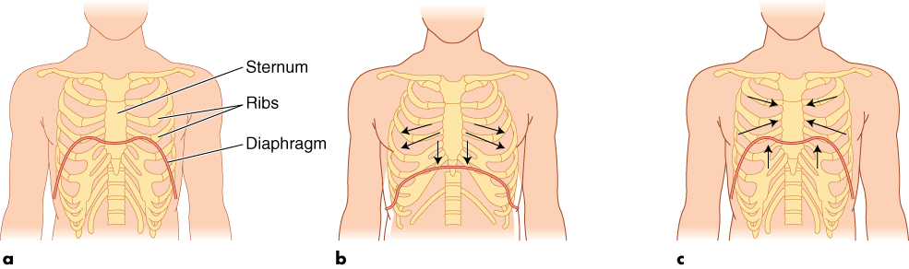
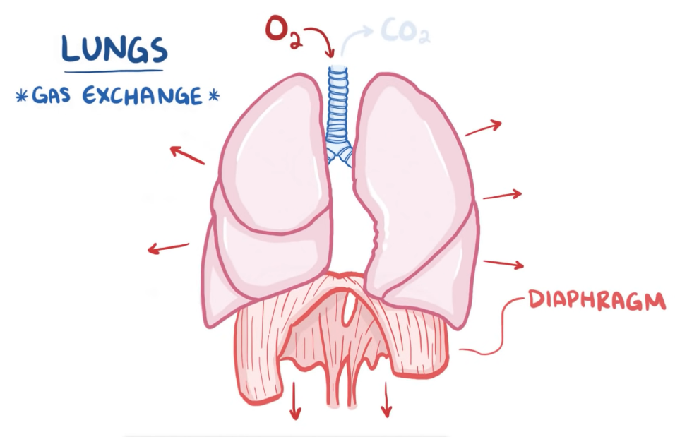
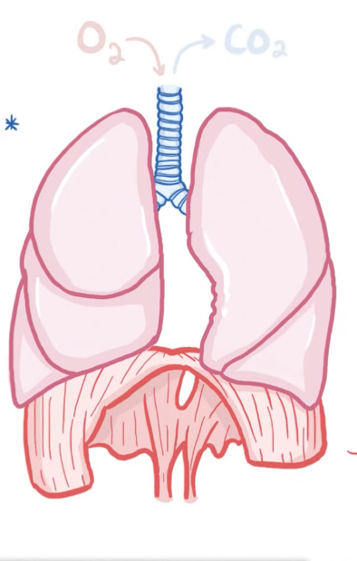
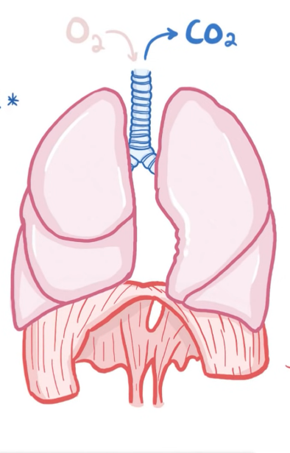
External respiration
Rest
Inspiration
Expiration
The diaphragm contracts to pull downwards and chest muscles contract to pull open the chest
The diaphragm and the chest muscles relax allowing the lungs to spring back to normal relaxed size – this pushes the air out
Notes:
What muscles help us with breathing?
Hypotonic environment

Slide 4
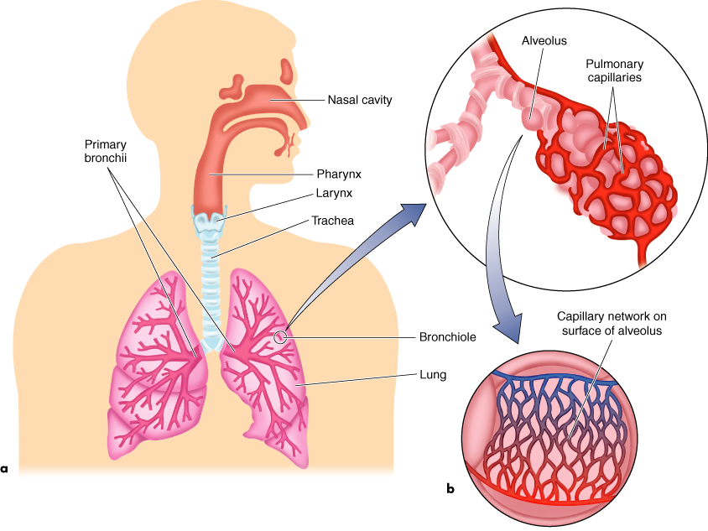
Pulmonary ventilation
Nasal cavity – lined by cells that release mucus
Mucus – sticky and salty, contains lysozymes
Nasal hair covered in mucus catch large particles, dust, pollen etc.
Paranasal sinuses – help the air to circulate to get warm and moist
Air flow
Notes:
As you breathe in the air goes to the nasal cavity
Filled with mucus
Lysozymes – help fight bacteria

Slide 5
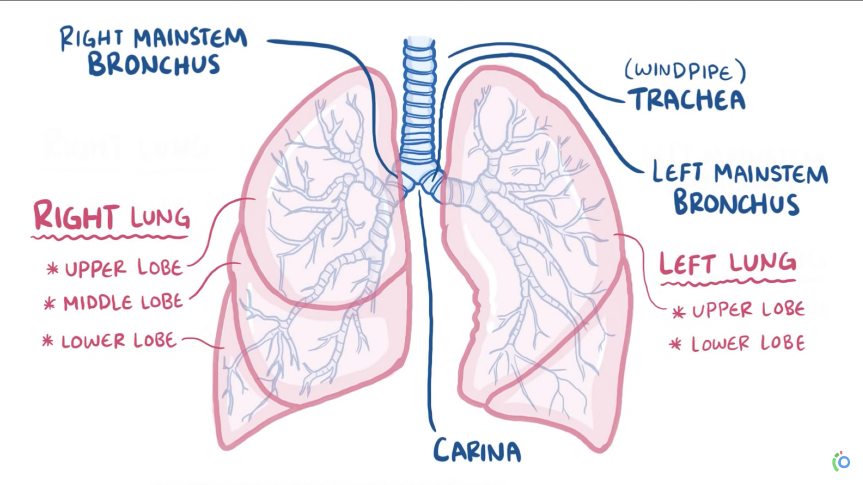
Pulmonary ventilation
Lungs' lobes
Trachea and the first
three generations of
bronchi use cartilage rings
for support
Then the bronchi narrow
down to bronchioles
  No cartilage
  15-20 generations
Notes:
The air goes into your lungs
Branch out
https://www.youtube.com/watch?v=0fVoz4V75_E&ab_channel=Osmosis

Slide 6
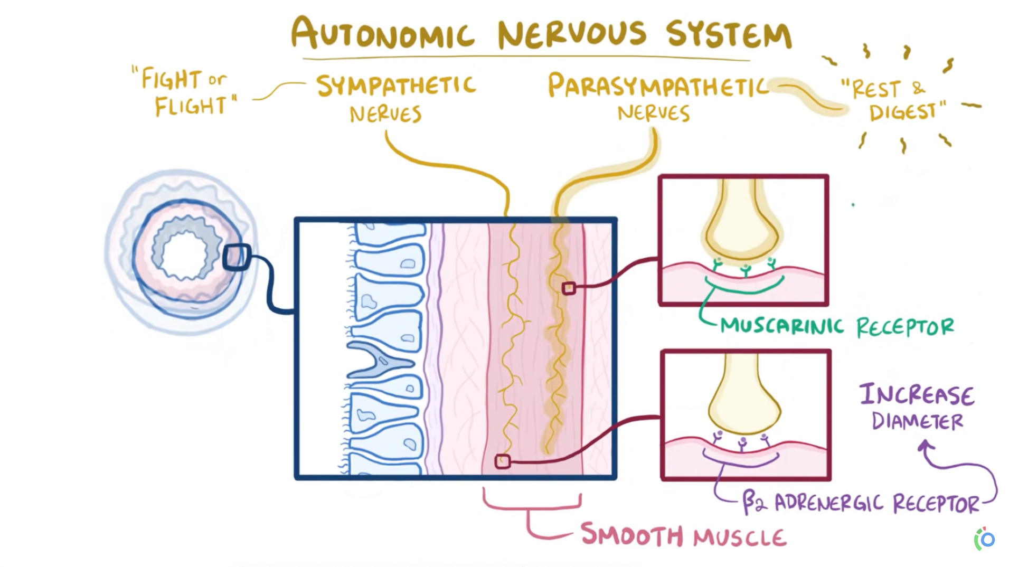
Respiration
Notes:
https://www.youtube.com/watch?v=0fVoz4V75_E&ab_channel=Osmosis

Slide 7
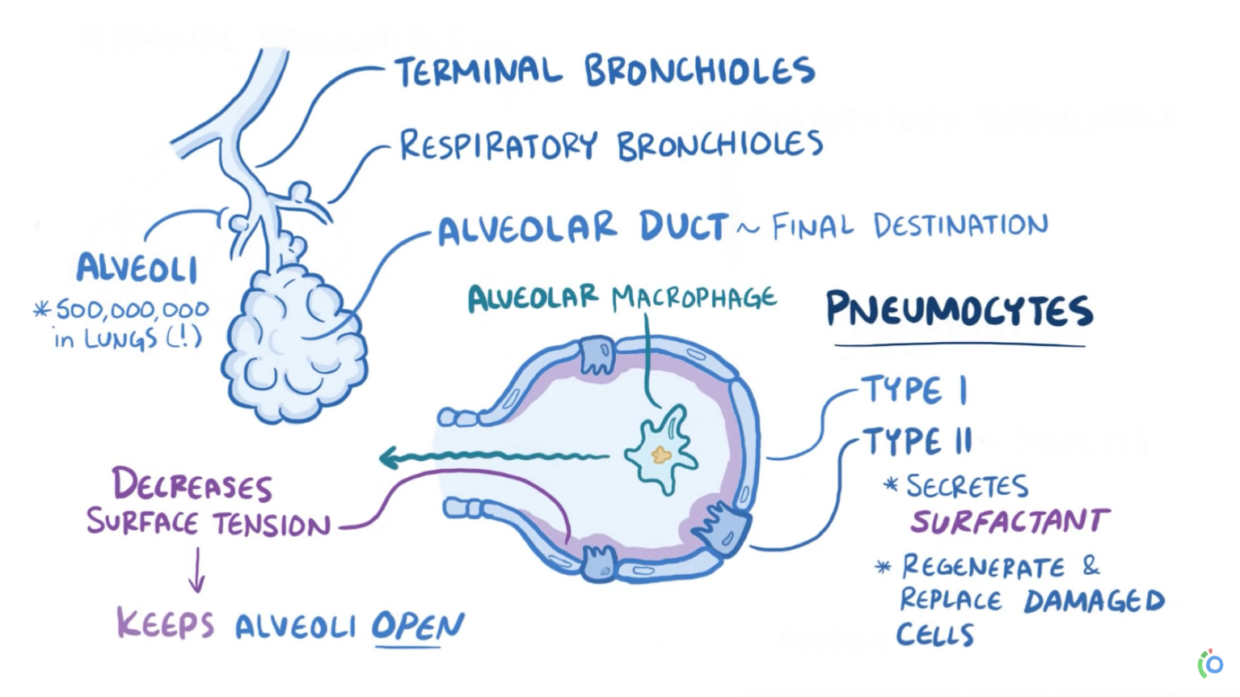
Pulmonary ventilation
Terminal bronchioles
Respiratory bronchioles
Alveoli – about 500 000 000
in the lungs
Alveolar duct – the destination
of the inhaled air
Pneumocytes
  Type I
  Type II - surfactant
Notes:
https://www.youtube.com/watch?v=0fVoz4V75_E&ab_channel=Osmosis

Slide 8
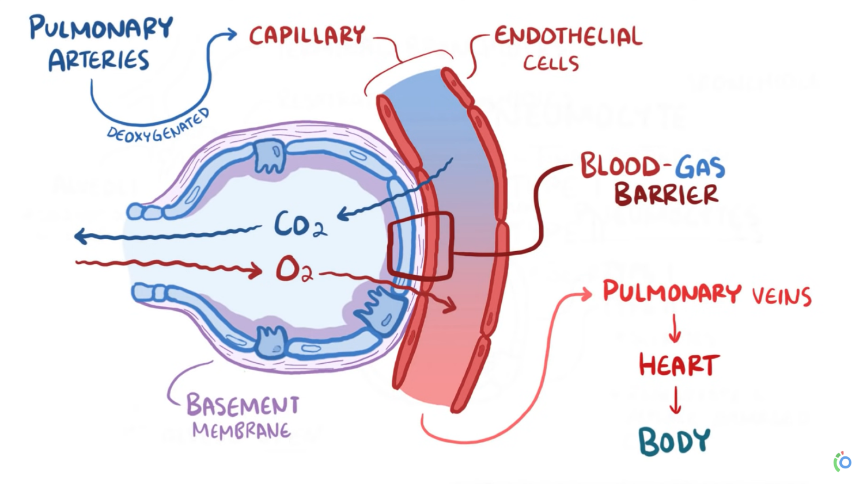
Pulmonary diffusion
BLOOD-GAS barrier: pneumocytes, endothelial cells and basement membrane
Deoxygenated blood arrives via pulmonary arteries
Replenishes blood's oxygen supply that has been depleted for oxidative energy production
Carbon dioxide is removed and breathed out
Oxygenated blood via pulmonary veins – to the heart – to the body
Notes:
What happens in the Alveoli?
Deoxygenated blood comes and meets the alveoli – gases can exchange
DIFFUSION – partial pressure helps diffusion
https://www.youtube.com/watch?v=0fVoz4V75_E&ab_channel=Osmosis

Slide 9
Gases – partial pressure and exchange
PV=nRT
Atmospheric air is a mixture of gases – each gas with its own partial pressure contributes to the total atmospheric pressure
Alveolar air differs from atmospheric air
The gas exchange occurs between the alveolar air and the blood in capillaries by diffusion – the flow down their concentration gradient or partial pressure gradient
The composition of alveolar air is closely monitored
Gas exchange depends on:
  The magnitude of partial pressure gradient (influenced also by altitude)
  Solubility (nitrogen is plentiful in the air but does not diffuse into the blood)
  Thickness of the pulmonary membrane
Notes:
Nitrogen, carbon dioxide, oxygen…
Https://www.youtube.com/watch?v=6qnSsV2syUE&ab_channel=AlilaMedicalMedia

Slide 10
KEY POINTS – Pulmonary diffusion
Pulmonary diffusion is the process by which gases are exchanged across the respiratory membrane in the alveoli to the blood and vice versa
The amount of gas exchange depends on the partial pressure of each gas, its solubility, and temperature
Gases diffuse along a pressure gradient, moving from an area of higher pressure to lower pressure
Oxygen diffusion capacity increases as you move from rest to exercise
The pressure gradient for CO2 exchange is less than for O2 exchange, but carbon dioxide’s diffusion coefficient is 20 times greater than that of oxygen’s, so CO2 crosses the membrane easily
Notes:
https://www.youtube.com/watch?v=6qnSsV2syUE&ab_channel=AlilaMedicalMedia

Slide 11
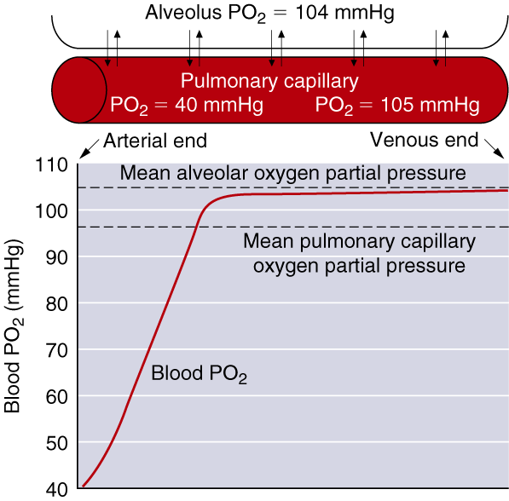
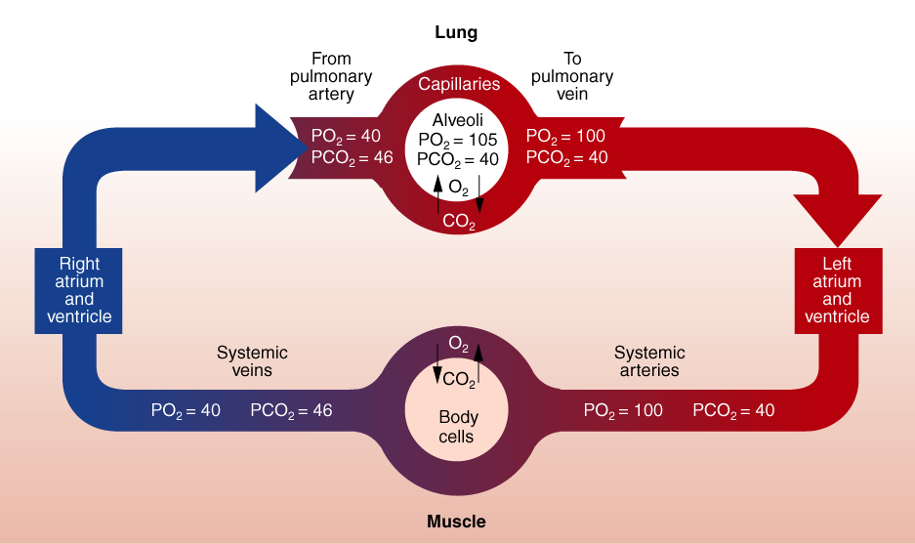
Po₂ AND Pco₂ IN BLOOD
Partial pressures in the blood do not change during exercise!
Notes:
Remind that the partial pressures of O2 and CO2 in the pulmonary arteries do not change with exercise! Just the process is speed up – due to increased blood flow and increased frequency in breathing the Exchange happens faster but the partial pressures do not change!

Slide 12
Partial Pressures of Respiratory Gases at Sea Level
Partial pressure (mmHg)
% in Dry Alveolar Arterial Venous Diffusion
Gas dry air air air blood blood gradient
Total 100.00 760.0 760 760 706 0
H₂O 0.00 0.0 47 47 47 0
O₂ 20.93 159.1 105 100 40 60
CO₂ 0.03 0.2 40 40 46 6
N₂ 79.04 600.7 568 573 573 0

Slide 13
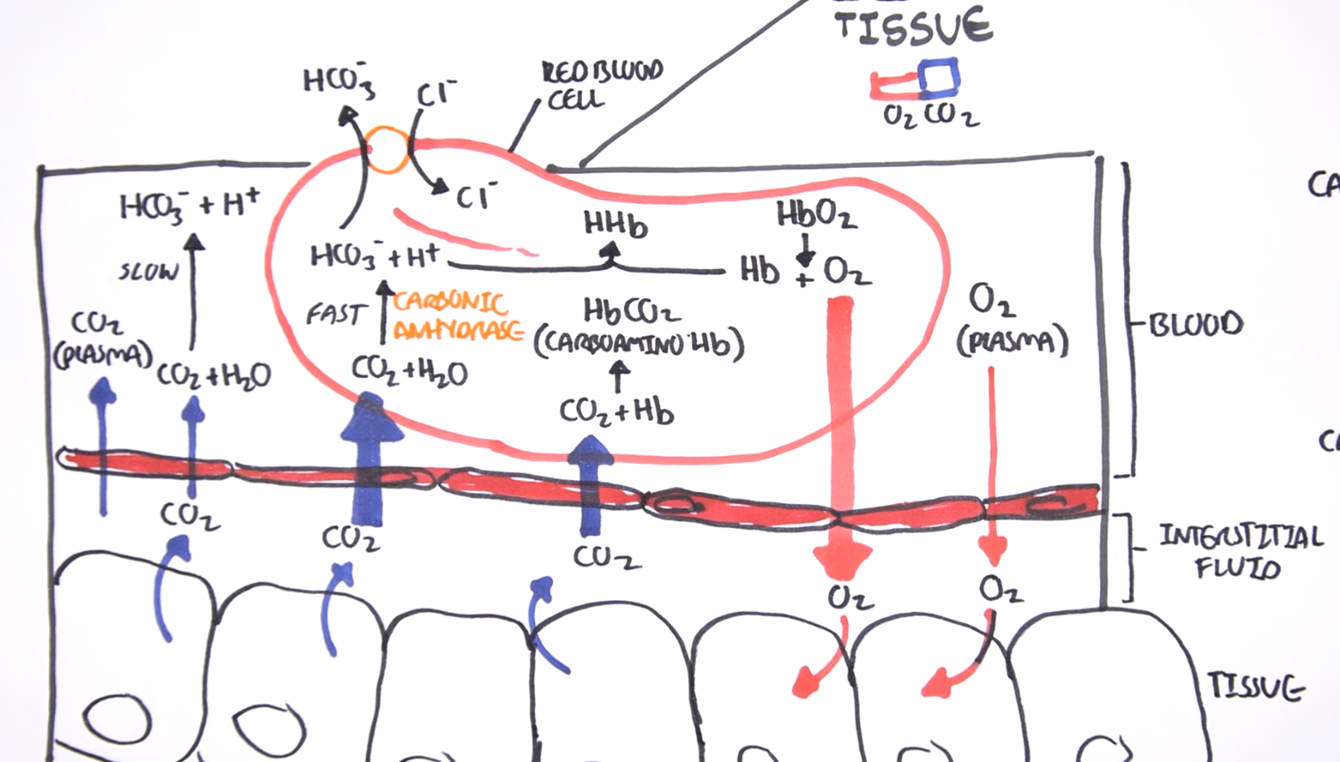
Oxygen Transport
Hemoglobin concentration largely determines the oxygen-carrying capacity of blood (>98% of oxygen transported)
Increased H+ (acidity) and temperature of a muscle
allows more oxygen
to be unloaded there
Training affects oxygen transport in muscle
Oxygen uptake and delivery is influenced by oxygen content
of the blood, amount of blood flow and conditions in the tissue.
Notes:
https://www.youtube.com/watch?v=qDrV33rZlyA&ab_channel=ArmandoHasudungan

Slide 14
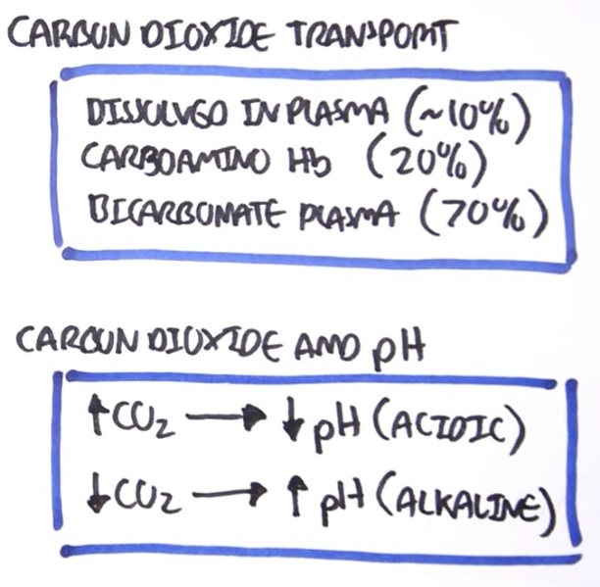
Carbon Dioxide Transport
Dissolved in blood plasma (7% to 10%)
As bicarbonate ions resulting from the dissociation of carbonic acid (60% to 70%)
Bound to hemoglobin (carbaminohemoglobin) (20% to 33%)
Notes:
https://www.youtube.com/watch?v=qDrV33rZlyA&ab_channel=ArmandoHasudungan

Slide 15
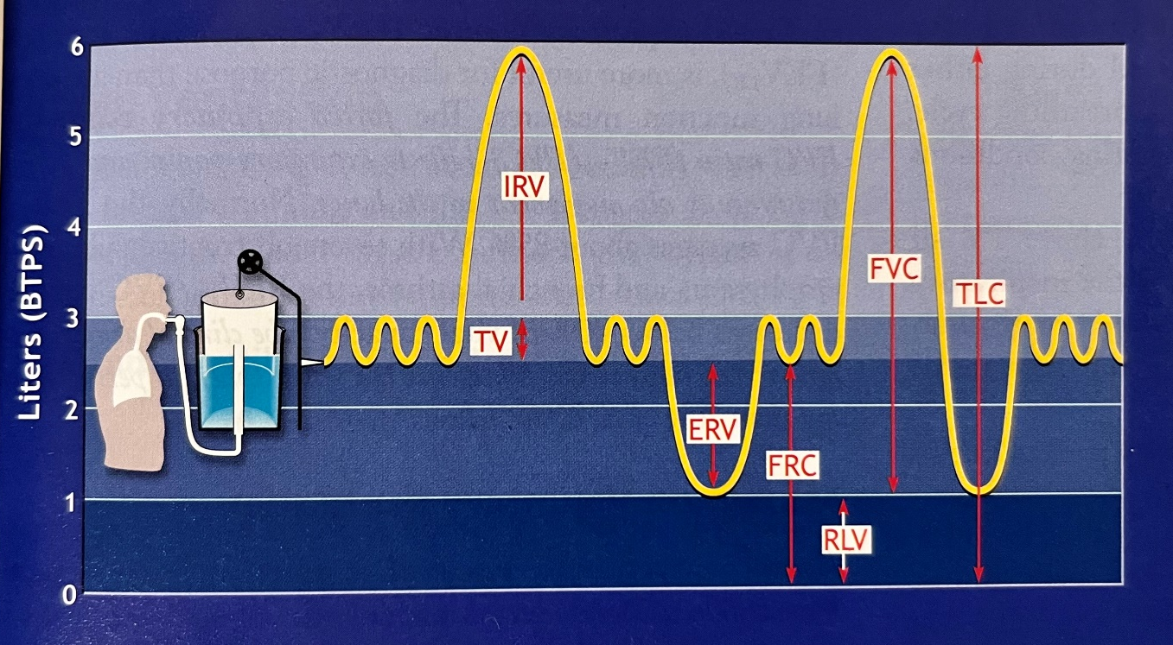
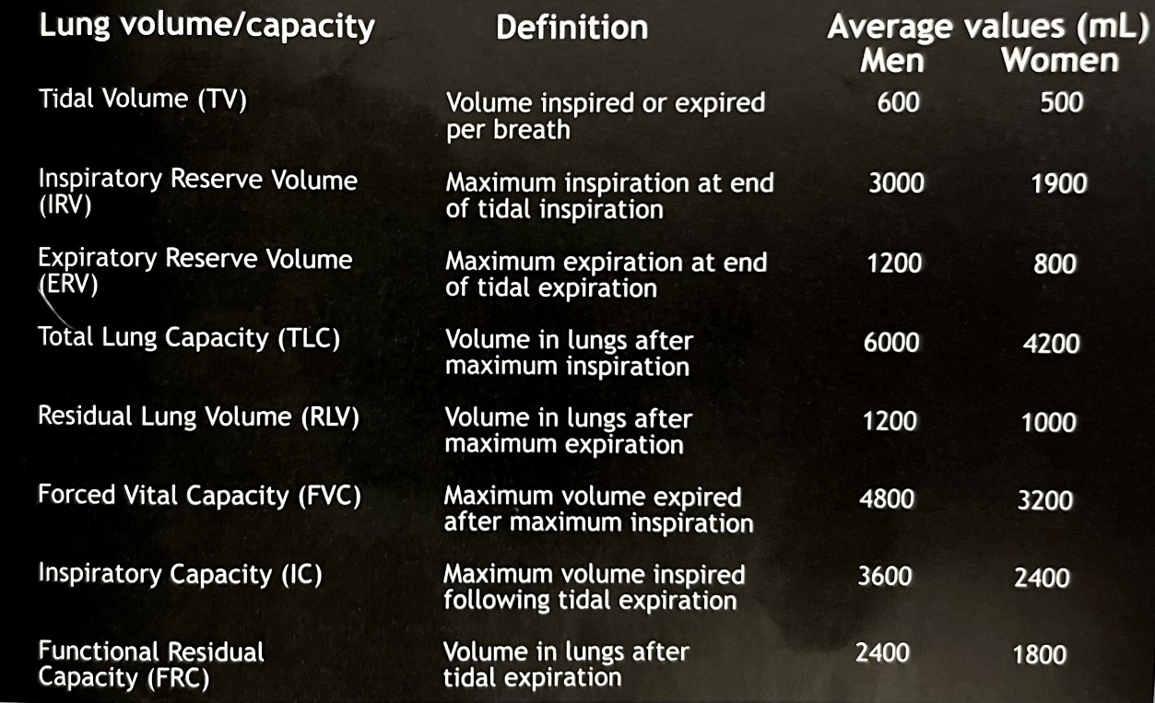
Vital Capacity
Vital capacity is the
maximum amount of air
that can be forcefully
expired after a maximum
inspiration
VC females = 3-4 l
VC males = 4-5.5 l
From the pulmonary function test the vital
capacity testing is the most frequently used.
It could be performed „slowly“ (VC)
and/or as fast and forced as possible
(forced vital capacity, FVC)

Slide 16
Vital Capacity
Calcultae your predicted value of the vital capacity:
Males:
Predict. VC (ml) = [27.63 – (0.112 x age (yrs)] x height (cm)
Females:
Predict. VC (ml) = [21.78 – (0.101 x age (yrs)] x height (cm)
Compare your measured values with the predicted values and express them as a percentage of the predicted values

Slide 17

Respiration and Exercise
More OXYGEN is needed in active muscles
More CARBON DIOXIDE needs to be removed from the active muscles
An increase of breathing rate
The depth of breathing increase up to our vital capacity
Alveolar ventilation increases with increased metabolic demands
An increase of blood flow through the lungs (cardiac output increase)
An increase in oxygen consumption (metabolic reactions) – up to 20 times higher compared with resting oxygen uptake
The arterial Po₂ and Pco₂ remail almost unchanged!
Notes:
Remind of how quickly the breathing frequency cames back at the resting breathing rate frequency – it might take up to two hours – depending on your cardio respiratory fitness
Cardiac output = stroke volume x heart rate

Slide 18
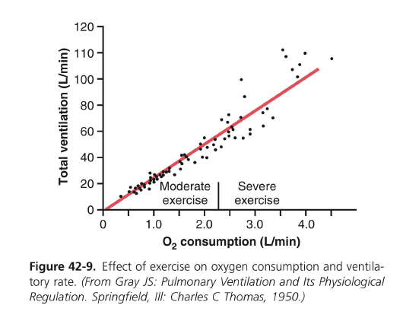

Signals for Ventilation Increase
The brain sends signals to active muscles, along with that it send signal to the brain stem to excite the respiratory system
An increase in ventilation occurs even before an increase of H+ in blood
Partial pressures of Po₂ and Pco₂ in the blood
Proprioceptors in joints
Increases in temperature (hypothalamus)
Stress (Adrenalin release)
Learned responses *
Respiratory control center
(brain stem)
* With repeated exercise the brain becomes more accurate at providing the right signal to keep Pco₂ at normal level.
Ventilatory muscles
Notes:
Remind of how quickly the breathing frequency cames back at the resting breathing rate frequency – it might take up to two hours – depending on your cardio respiratory fitness
Cardiac output = stroke volume x heart rate

Slide 19
Pulmonary Ventilation Control
The respiratory centres in pons and medulla oblongata control the movements of primary breathing muslces and set the rate and depth of breathing (involuntary breathing control)
Chemoreceptors respond to increases in CO2 and H+ concentrations or to decreases in blood oxygen levels by increasing respiration
Ventilation increases at the initiation of exercise due to inspiratory stimulation from muscle activity. As exercise progresses, increase
in muscle temperature and chemical changes in the arterial blood further increase ventilation

Slide 20
Signals for Ventilation Increase
The diffusing capacity for oxygen increases almost three fold during exercise – mainly due to an increased number of active capillaries
Blood flow at rest – blood stays in the capillaries longer than necessary – shortened time during exercise in sufficient for oxygenation
 | O₂ Diffusing Capacity | CO₂ Diffusing Capacity | O₂ Consumption
AT REST | 21 ml/min/mmHg | 21x20 ml/min/mmHg | 250 ml/min on average
DURING EXERCISE | 65 ml/min/mmHg * | 65x20 ml/min/mmHg | 3600 ml/min untrained up to 5000 ml/min marathon runner
* Due to increased number of open pulmonary capillaries (increased surface area for diffusion), increased alveolar ventilation

Slide 21
A) Breathing frequency (BF) or Respiratory Rate (RR)
Breathing frequency is the number of breaths taken within a set
amount of minute:
BF rest = 16 (breaths per minute) (10 in endurance) (12-15 on average)
BF (light exercise) = 20-30
BF (moderate exercise) = 30-40
BF (heavy exercise) = 50-60
Notes:
Remind of how quickly the breathing frequency caomes back at the resting breathing rate frequency – it might take up to two hours – depending on your cardio respiratory fitness

Slide 22
B) Tidal volume (TV)
Tidal volume (TV [l]) is the amount of air inspired or expired during normal quiet respiration.
V_{T} rest = 0,5 l (1 l in endurance)
V_{T} (light exercise) = 1-1,5 l
V_{T} (moderate exercise) = 1,5-2 l
V_{T} (heavy exercise) = 2-3 l
Notes:
It varies for men and women
Can increase up to vital capacity

Slide 23
C) Pulmonary ventilation (Minute Ventilation)
Minute Ventilation (V_{E}) is the product of tidal volume (TV) and breathing frequency (f):
V_{E} rest = 8 l (e.g.: 0.5l x 15s⁻¹ = 7.5l/min)
V_{E} (light exercise) = 40 l
V_{E} (moderate exercise) = 80 l
V_{E} (heavy exercise) = 120l (180l in endurance) (e.g.: 2.5l x 50s⁻¹ = 125l/min)

Slide 24
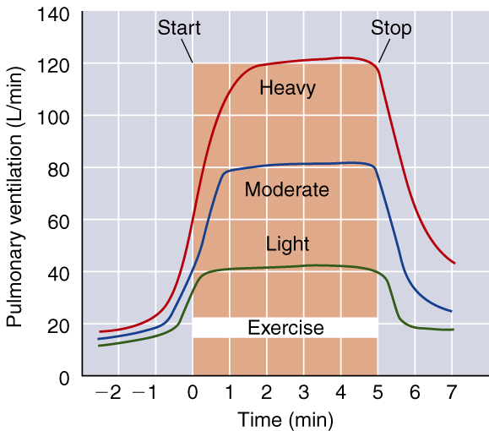
Ventilatory Response to Exercise

Slide 25
Breathing Terminology
Dyspnea = shortness of breath
Hypervetilation = increase in ventilation that exceeds the metabolic need for oxygen. Voluntary hyperventilation, as is often done before underwater swimming, reduces the ventilatory drive by increasing blood pH

Slide 26
D) Ventilatory Equivalent for Oxygen
The ratio between volume of oxygen expired per minute and consumed per minute
or V_{e} and VO₂ in a given time frame
Indicates breathing economy
At rest — V_{E}/VO₂ = 23 to 28 L of air breathed per L VO₂ per minute
At max exercise—V_{E}/VO₂ = 30 L of air per L VO₂ per minute
Generally V_{E}/VO₂ remains relatively constant over a wide range of exercise levels

Slide 27
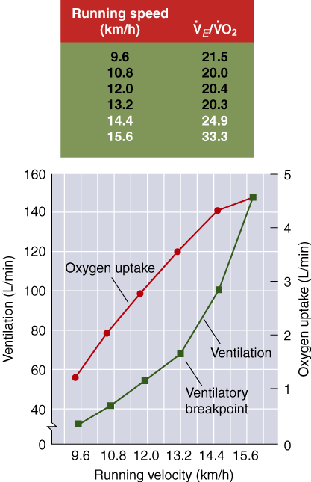
E) Ventilatory Breakpoint
The point during intense exercise at which ventilation increases disproportionately
to the oxygen consumption
When work rate exceeds 55% to 70% VO₂max, oxygen delivery can no longer match the energy requirements so energy must be derived from anaerobic glycolysis
Anaerobic glycolysis increases lactate levels, which increase CO₂ levels (buffering)
– detected by chemoreceptors
– triggering a respiratory response and increased ventilation

Slide 28
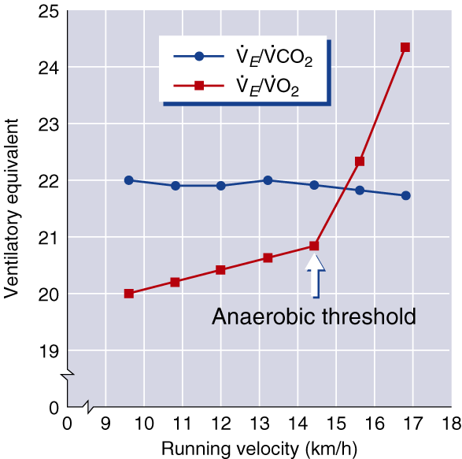
F) Anaerobic Threshold
The point during intense exercise at which metabolism becomes increasingly more anaerobic
Glycolysis as the main source of ATP
Reflects the lactate threshold under most conditions, though the relationship is not always exact
An increase in V_{E}/VO₂ without an concomitant increase in the ventilatory equivalent for carbon dioxide (V_{E}/VCO₂)

Slide 29
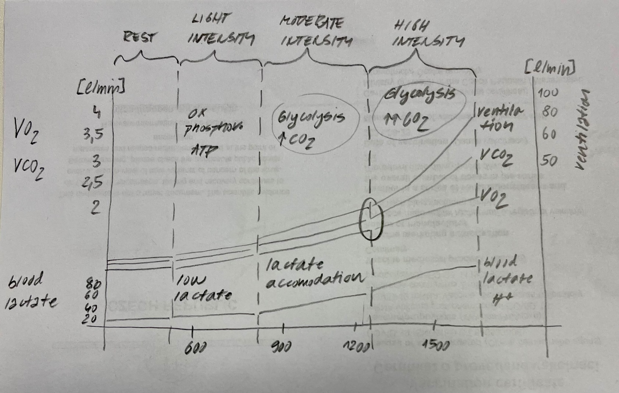
F) Anaerobic Threshold
Different exercise intensities
Different source of ATP
  oxidative phosphorylation; glycolysis
Reducing the CO2 levels
Lactate levels (low; accommodation; high)
Ventilation increase

Slide 30
Ventilatory Breakpoint, Anaerobic Threshold
During mild, steady-state exercise, ventilation parallels oxygen uptake
The ventilatory breakpoint is the point at which ventilation increases disproportionately to the increase in oxygen consumption
The anaerobic threshold is identified as the point at which V_{E}/VO₂ shows a sudden increase, while V_{E}/VCO₂ stays stable. It generally reflects lactate threshold

Slide 31
VO₂ Adaptations to Training
Oxygen consumption (VO₂) is
unaltered or slightly increased at rest
unaltered or slighted decreased at submaximal rates of work
increased at maximal exertion (VO₂max—increases range from 0% to 93%)

Slide 32
Factors Affecting VO₂max
Level of conditioning — the greater the level of conditioning the lower
the response to training
Heredity — accounts for slightly less than 50% of the variation as well
as an individual’s response to training
Age — decreases with age are associated with decreases in activity levels as well as decreases in physiological function
Sex — lower in women than men (20% to 25% lower in untrained women; 10% lower in highly trained women)
Specificity of training — the closer training is to the sport to be performed, the greater the improvement and performance in that sport

Slide 33
Responses to Exercise – Overview
Responses – short term change in physiological function
Sympathetic nervous system responses:
Increase in breathing rate (respiratory rate RR) – after exercise remains elevated up to 2 hours post exercise (depending on cardiovascular fitness)
Increase in Tidal Volume (TV; amount of air inhaled per one breath) up to vital capacity
Results in increased Minute Ventilation (V_{E})

Slide 34
Adaptations to Training – Overview
Adaptations – long term changes in anatomical structure
Increased Vital Capacity of lungs (minimal and limited due to genetic factors)
Stronger Respiratory Muscles – diaphragm, intercostal muscles (internal and external) – greater pressure gradient makes the air to flow faster;
Faster O₂ and CO₂ diffusion – increased capillarization of alveoli (angiogenesis)

Slide 35
Thank You!
Questions?

