Slide 1
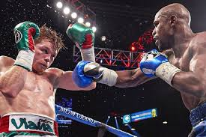
STRENGTH TRAINING AND CONDITIONING IN BOXING
Álvaro Donate Devés

Slide 2
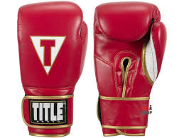
CHARACTERISTICS OF BOXING
Physicality.
Technique.
Weight classes.
Rules and regulations.
Mental toughness.

Slide 3
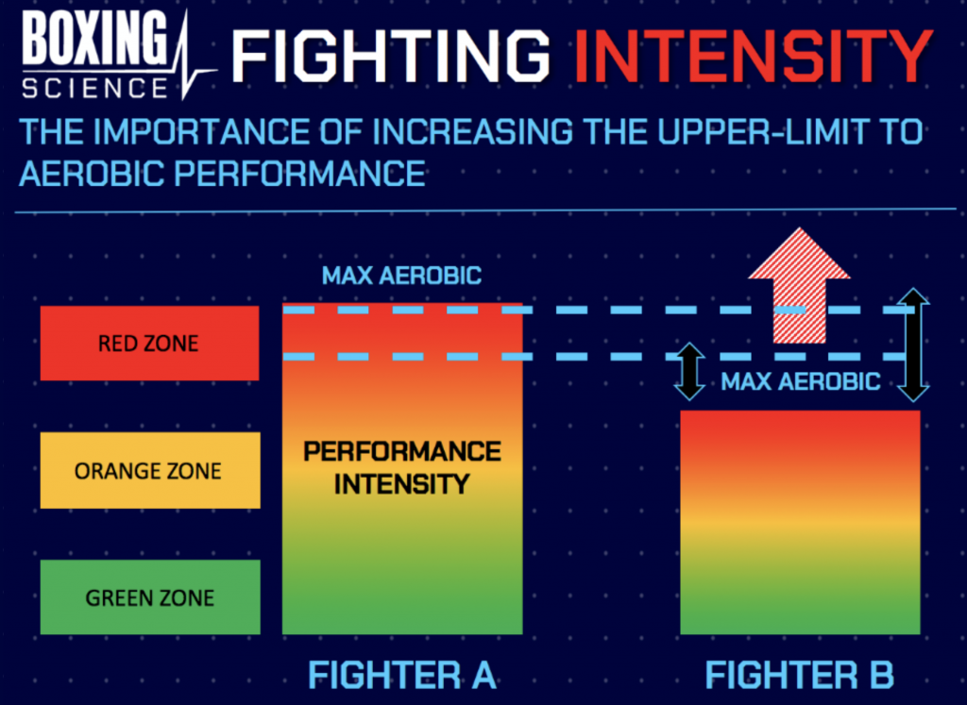
PHYSICAL DEMANDS
High VO2 max levels.
Strength and power.
Speed and agility.
Flexibility and mobility.
Coordination and mobility.
Balance and stability.

Slide 4
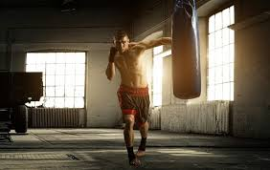
PREPARATION OFF-SEASON
Cardiovascular conditioning.
Strength training.
Exercises to improve reaction speed, agility and hand-eye co-ordination.
Boxing technique.
Stretching and mobility exercises

Slide 5
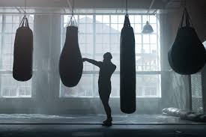
TRAINING DURING COMPETITION
Skills sharpening.
Controlled sparring.
Specific cardiovascular conditioning exercises.
Maintaining strength and power.
Tactical and strategic work.
Mental training and focus.

Slide 6
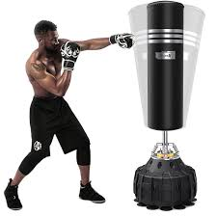
SOME OF THE BESTS EXERCISES FOR BOXERS
Skipping rope.
Climbing up and down stairs.
Punching bag.
Chest openings.
Shadow boxing.

Slide 7
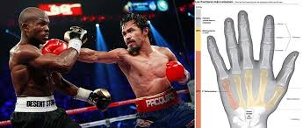
MOST COMMON BOXING INJURIES
Finger and wrist injuries.
Injuries to the mouth and teeth.
Bruises.
Bone fractures.
Facial and eye injuries.
Muscle and joint injuries.

Slide 8
HOW TO PREVENT INJURIES
Good warm-up, not only for wrist and hand, but also for upper and lower limbs.
A good physical preparation before starting this sport.
Hand wrapping is fundamental and essential when it comes to preventing carpal injuries.
Gloves, it is important to put yourself in the hands of specialists to see the impact absorption.
Wear a mouth guard and helmet when sparring.
Shoes to avoid ankle sprains, and to be able to work on the toes.

Slide 9
REFERENCES
Marisol. (2018, 1 enero). Los Ejercicios para Boxeo más Eficaces | Superprof. We Love Prof | el Blog de Superprof España. https://www.superprof.es/blog/ejercicios-de-boxeo/
Hernán, V. (2022, 15 septiembre). Boxeo, las lesiones más frecuentes. Fisiolution. https://fisiolution.com/boxeo-las-lesiones-mas-frecuentes/
Caracterización del boxeo profesional. (s. f.). Grupo Sobre Entrenamiento (G-SE). https://g-se.com/caracterizacion-del-boxeo-profesional-bp-O5e0515de365cd
Guterman, T. (s. f.). El boxeo: sistema de competición, características fisiológicas, antropométricas y hábitos dietético-nutricionales. https://www.efdeportes.com/efd167/el-boxeo-habitos-dietetico-nutricionales.htm
Guterman, T. (s. f.-b). La preparación física general de los boxeadores de Ciudad de la Habana en la categoría 15-16 años. https://www.efdeportes.com/efd146/la-preparacion-fisica-general-de-los-boxeadores.htm

