Slide 1
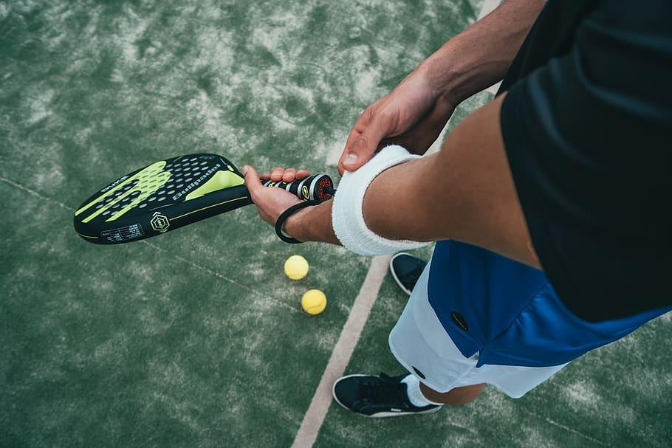
STRENGTH TRAINING AND CONDITIONING IN PADEL
Isabel Soriano Rocamora

Slide 2
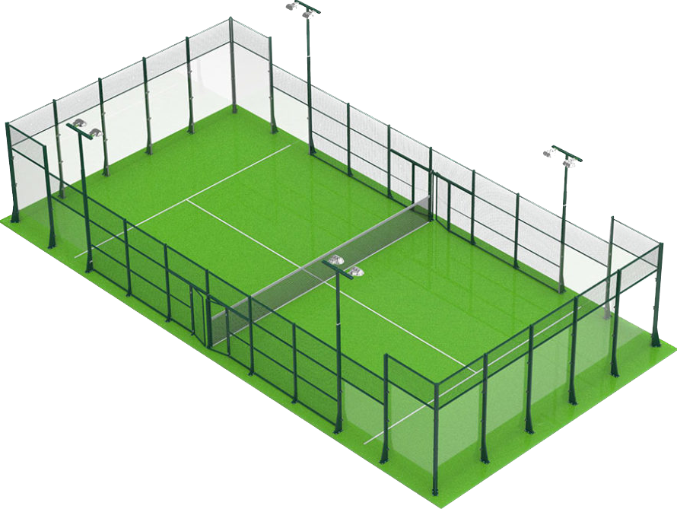
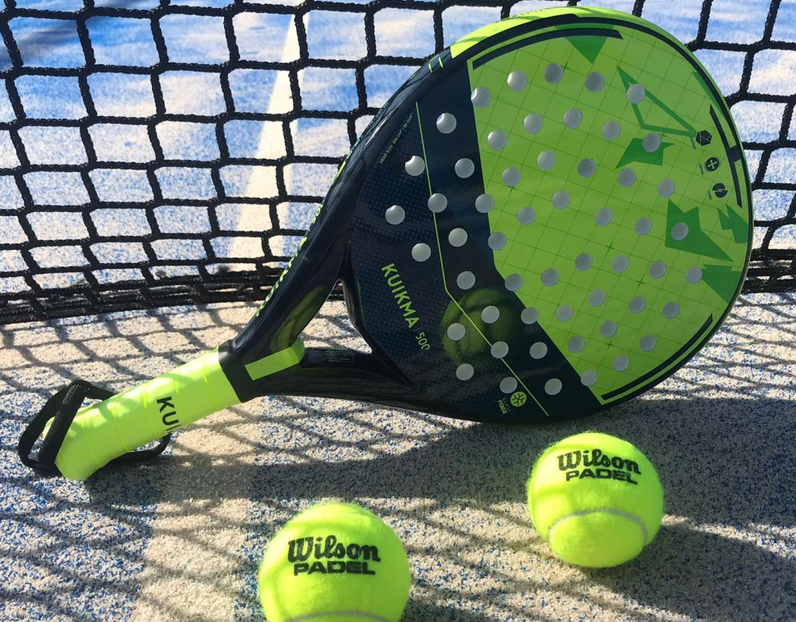
INTRODUCTION
Racket sport that combines elements of tennis and squash
Played in pairs and consists of three fundamental elements: the ball, the racket and the playing field
Played on a 20x10m court enclosed by transparent glass walls
México, Argentina, Brasil, Spain… are countries where paddle tennis has had great development
Popularity can be attributed to its easy learning curve

Slide 3
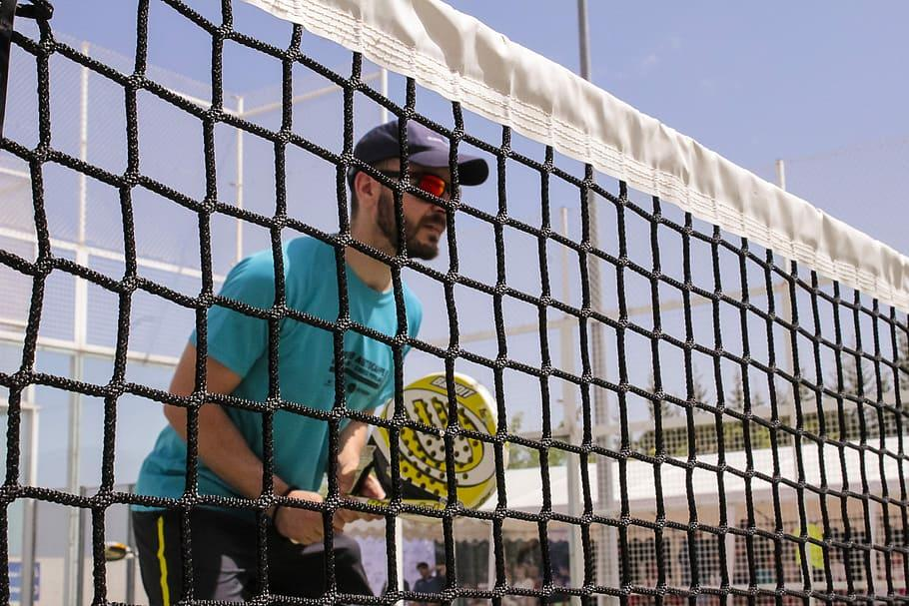
PADEL MATCHES
-Played in the best of 3 sets→ who has won 2 sets wins.
-Each set is made up of 6 games→ at least 6 games must be won.
-Each game lasts an average of 5 minutes→ a set could last 30 minutes, although this time will also depend on whether the couple ties and has to play the Tie Break or instead they manage to win the three sets from the beginning.
-Length of a paddle tennis match can reach 90 minutes, but this can last up to 2 hours.
-According to the padel regulations, each break can last 120 seconds, and is taken at the end of the set.
-There is no right to rest at the beginning of the tie break.
-90 seconds rest are also allowed when players change sides.

Slide 4
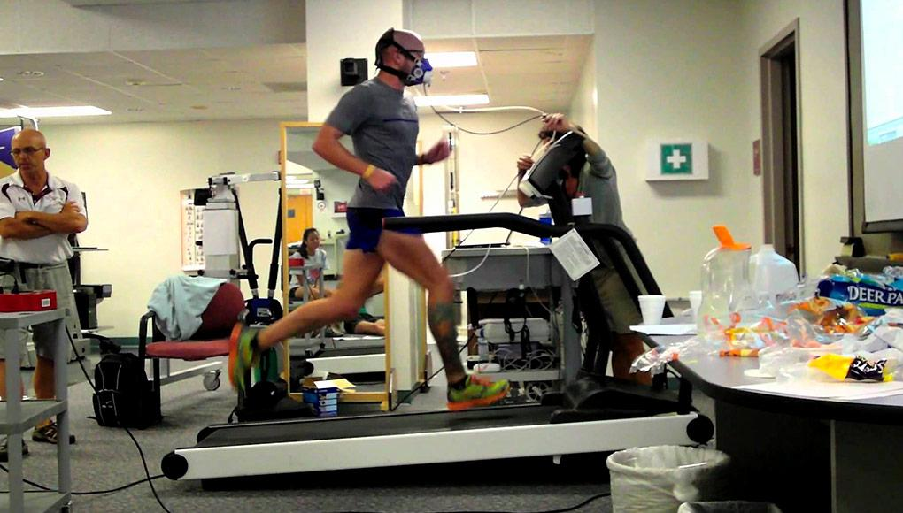
PHYSICAL DEMANDS OF PADEL
Padel players need to be able to do quick movements, pivot and make shots with speed and precision, which demands:
Speed abilities
Hand-eye coordination
Endurance
Flexibility
Muscular strength
Also, padel involves a combination of aerobic and anaerobic energy system, so requires high-intensity activity, which demands:
Cardiovascular endurance
Power
Agility

Slide 5
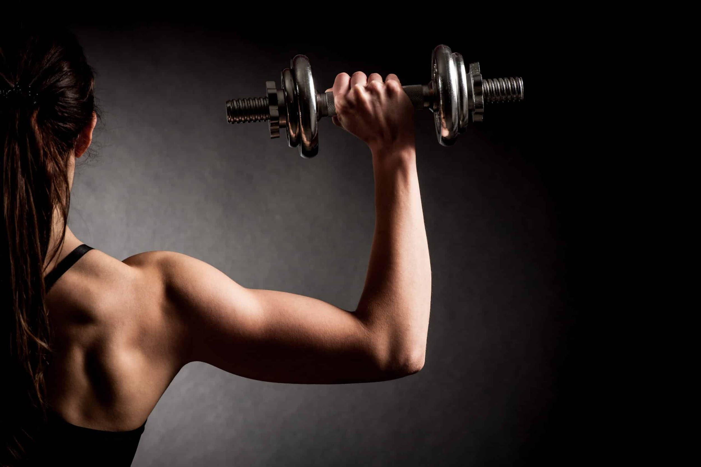
WHY STRENGTH TRAINING IS IMPORTANT IN PADEL PLAYERS?
Improve performance
Produces improvements in resistance to central and muscular fatigue
In padel the movements must be fast and precise, so we must improve the increase in our maximum strength and explosive strength
Enhance stability and balance, essential for executing precise shots
Increase anaerobic capacity
Prevents possible injuries

Slide 6
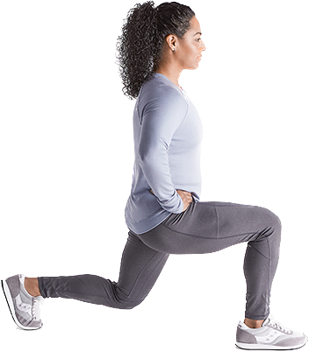
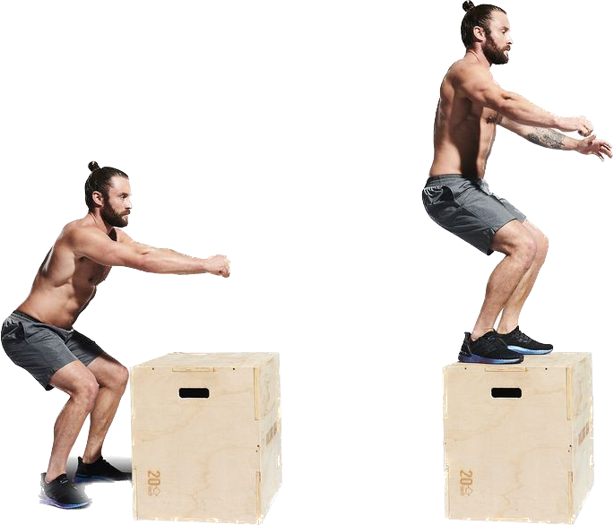
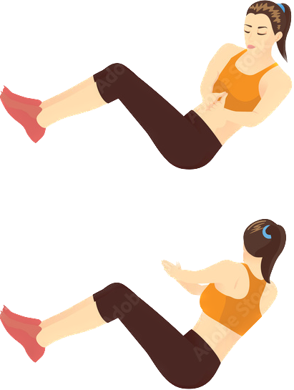
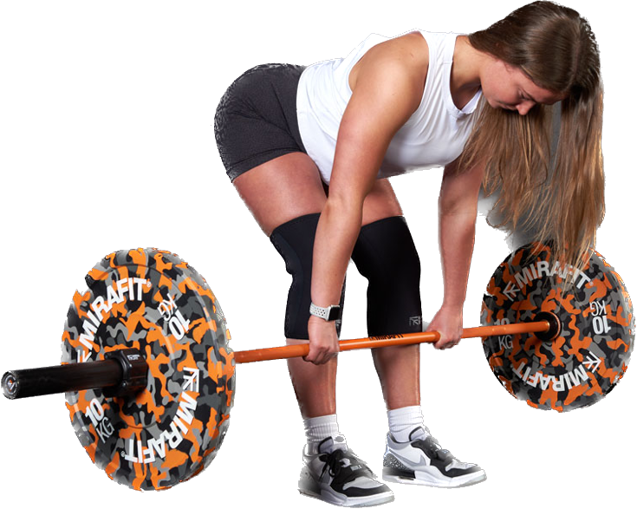
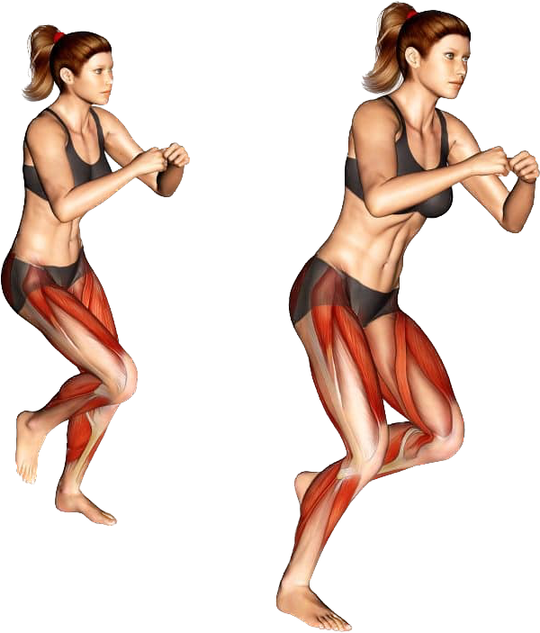
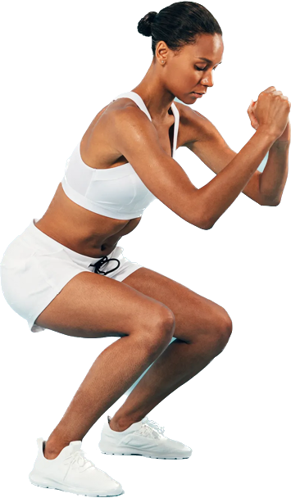
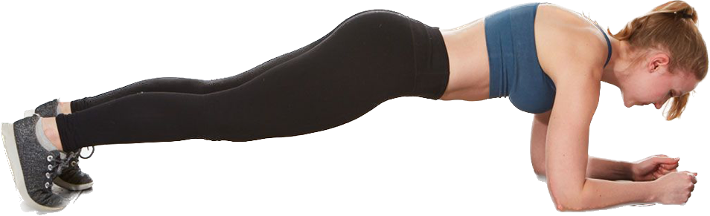
STRENGTH AND CONDITIONING EXERCISES FOR PADEL
Lunges
Squats
Romanian deadlift
Planks
Medicine ball throws
Box jumps
Lateral bounds
Russian twists
Resistance band exercises

Slide 7
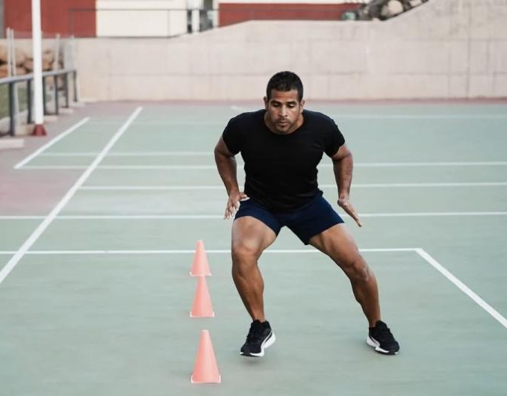
PREPARATION PRE-SEASON
6-8 weeks
The first week is dedicated exclusively to gym sessions and fitness training
Priority is given to physical fitness work
90 minutes - 2 hours and are usually in the morning
Focus on develop strength, power, endurance and technique
Weightlifting exercises, high-intensity interval training, and functional resistance work
Involve tactical work as well
Adjust the intensity and volume of exercises based on individual fitness levels
Ensure proper hydration, nutrition, and sleep throughout the week to support recovery and performance
Psychological preparation

Slide 8
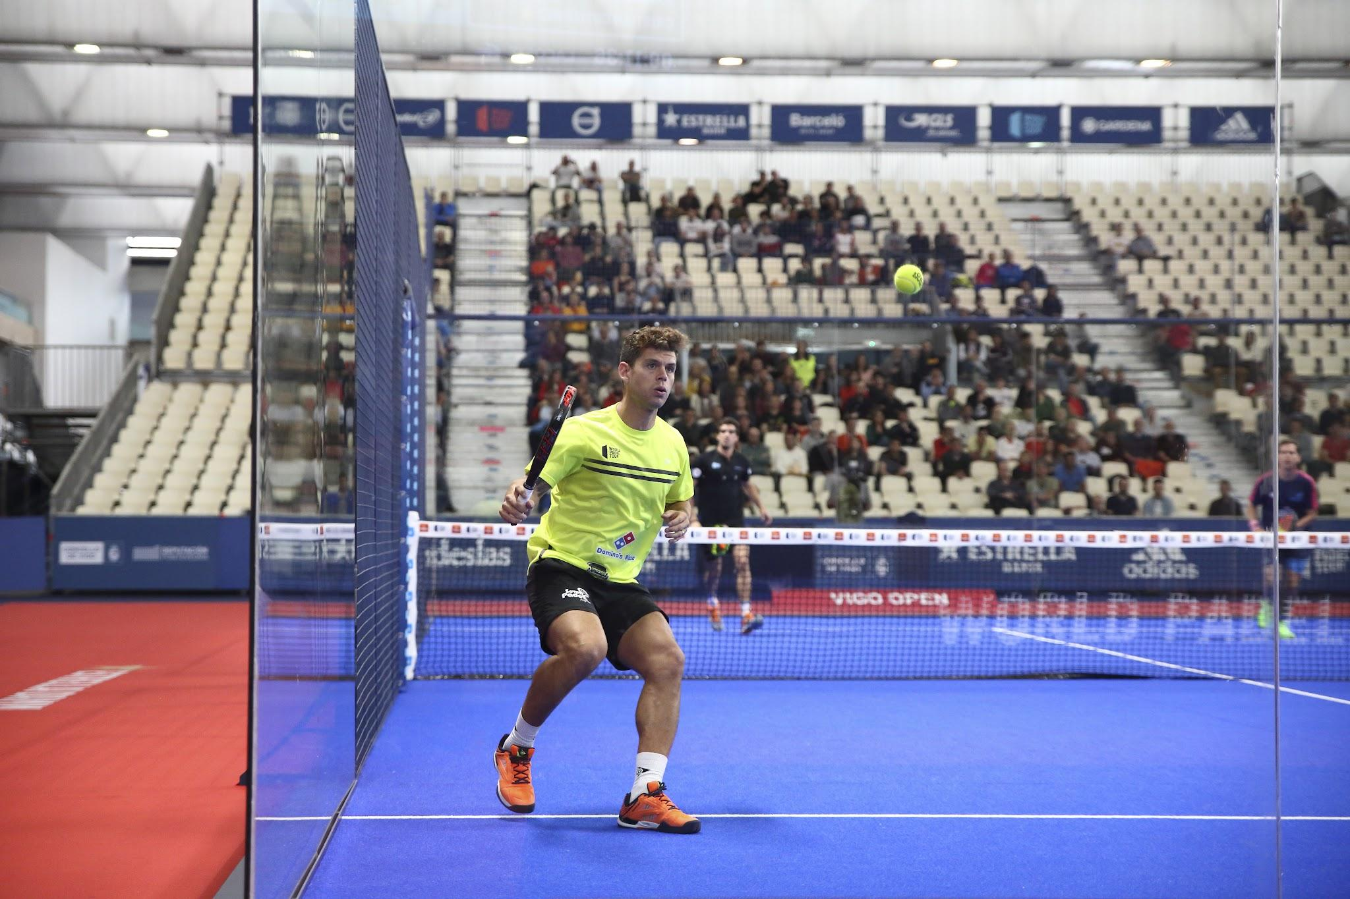
COMPETITION PERIOD
Maintaining peak performance
Enhancing specific skills
Minimizing the risk of injury
Typical training include→
On-court practice
Strength exercise
Match simulation
Injury prevention

Slide 9
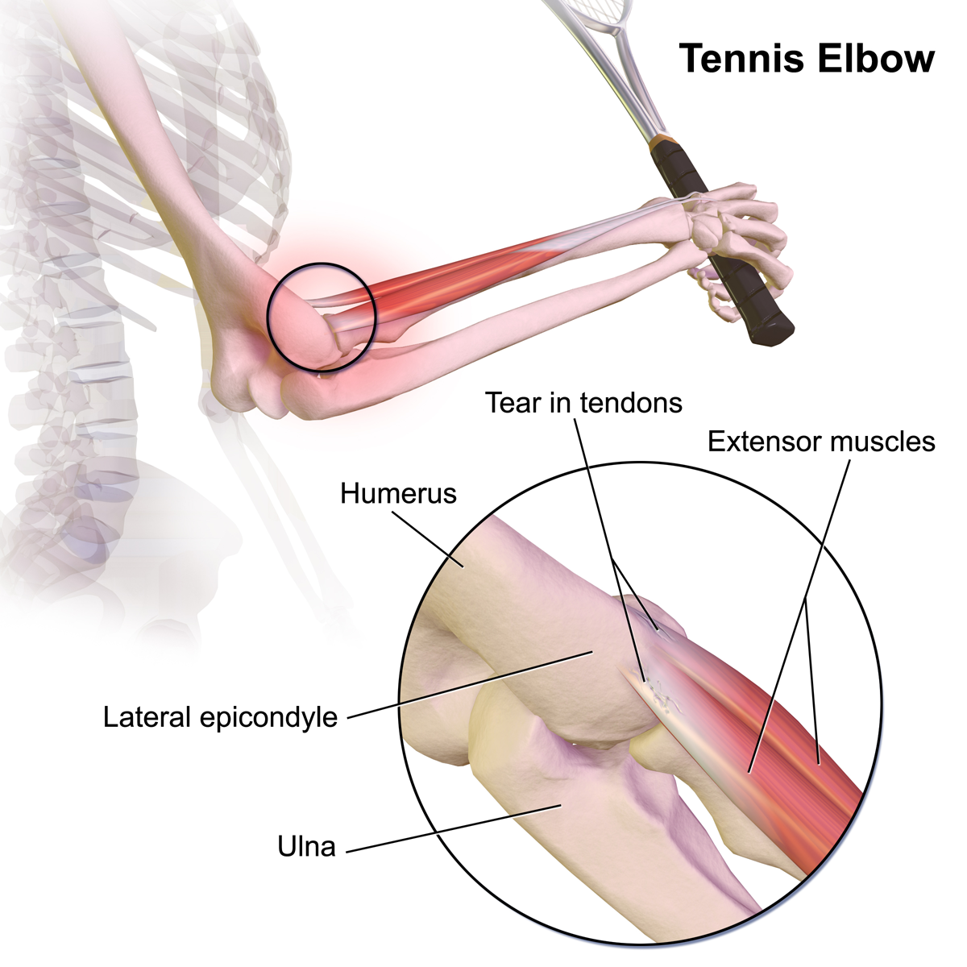
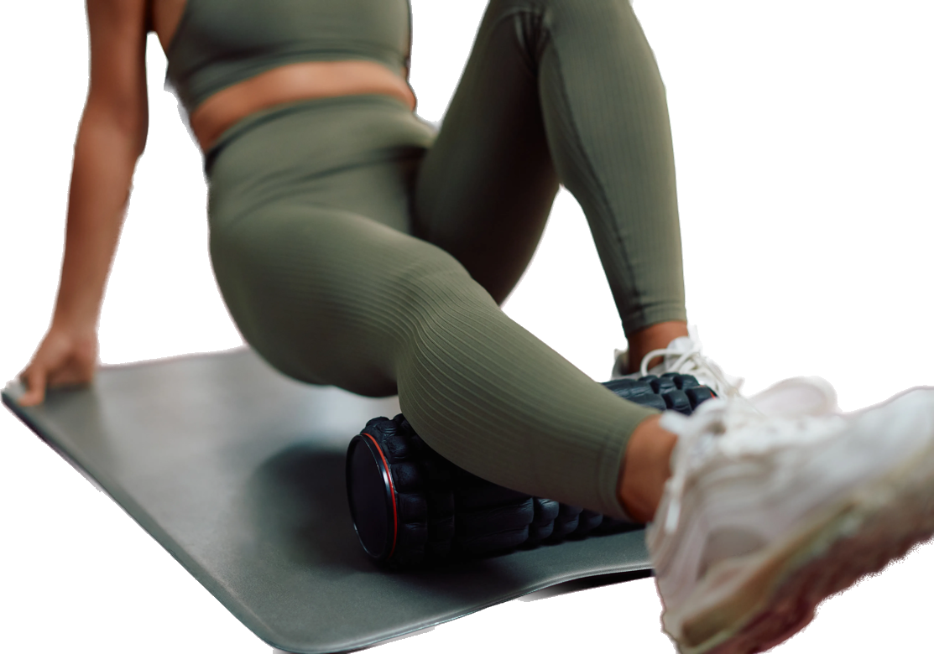
FREQUENT INJURIES AND PREVENTION
Frequent injuries:
Tennis elbow
Ankle sprain
Achilles tendonitis
Rotator cuff tendonitis
Prevention of injuries:
Proper warm-up
Proper technique and stretching
Progressive intensity
Rest and recovery

Slide 10
SOURCES
Amieba, C., & Salinero, J.J. (2013). Aspectos generales de la competición de pádel y sus demandas fisiológicas. [General aspects of padel competition and its physiological demands.] AGON: International Journal of Sport Sciences, 3(2), 60-67.
Baiget, E., Fernandez-Fernandez, J., Iglesias, X., & Rodriguez, F.A. (2015). Tennis play intensity distribution and relation with aerobic fitness in competitive players. PLoS One, 10(6), e0131304. doi: 10.1371/journal.pone.0131304
Baiget, E., Iglesias, X., Fuentes, J.P., & Rodríguez, F.A. (2019). New approaches for on-court endurance testing and conditioning in competitive tennis players. Strength and Conditioning Journal, 41(5), 9-16. doi: 10.1519/ ssc.0000000000000470
Carrasco, L., Romero, S., Sañudo, B., & de Hoyo, M. (2011). Game analysis and energy requirements of paddle tennis competition / Analyse du jeu et exigences physiologiques dans la pratique du padel en competition. Science and Sports, 26(6), 338-344.
Sánchez-Alcaraz Martínez, B.J., Courel-Ibáñez, J., & Cañas, J. (2018). Estructura temporal, movimientos en pista y acciones de juego en pádel: revisión sistemática. [Temporal structure, court movements and game actions in padel: A systematic review.] Retos: Nuevas Perspectivas de Educación Física, Deporte y Recreación, (33), 308-312.

