Slide 1
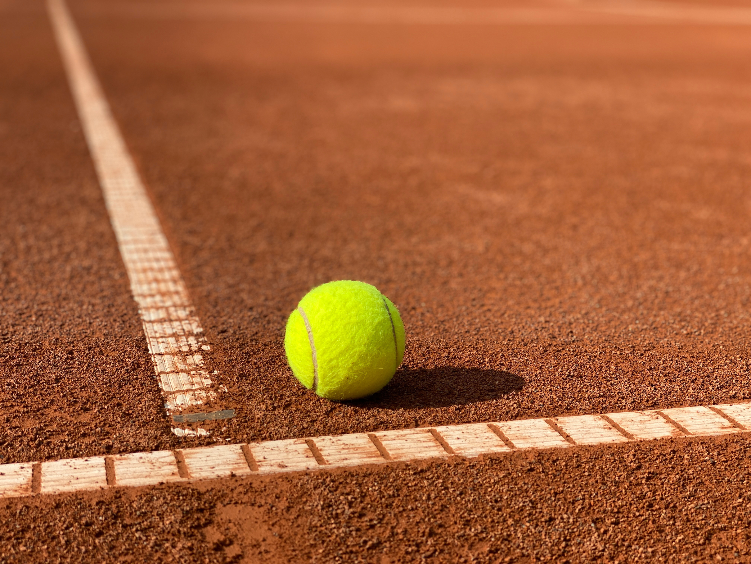
STRENGTH AND CONDITIONING - TENNIS
DANIELA RODRIGO

Slide 2



PHYSICAL DEMANDS
HR values range between 60-80% of HR max
Long and intense rallies with values over 85% HR max
Percentage of playing time
21% attacking players
29% whole court players
39% baseline players
Intermittent play
Work periods 4-10’’
10-20’’ pauses
60-90’’ rest
Unpredictability
Match duration
Point length
Shot selection
Opponent

Slide 3



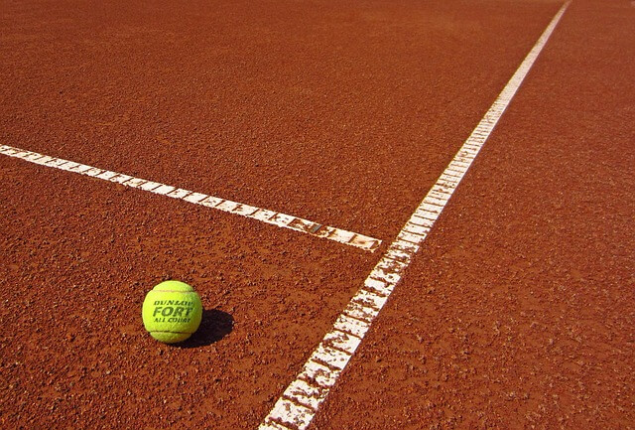
PHYSICAL DEMANDS
SPEED AND AGILITY
STRENGTH AND POWER
Every shot is different -> React quickly
Velocity
Type and rate of spin
Change of directions
Multidirectional movement
Cover de court with precision
In muscles and joints
Ball velocity
Powerful serves and precise strokes
Quality and speed of movement
Explosive movements
Grip
- Improve strokes

Slide 4
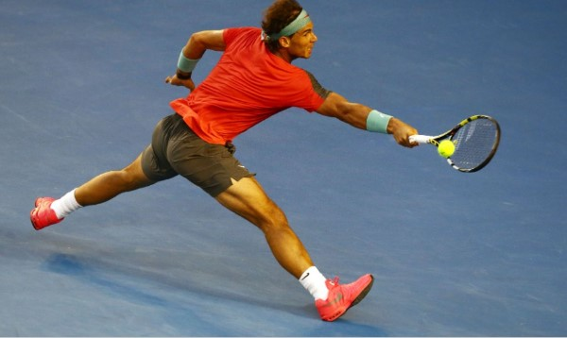


PHYSICAL DEMANDS
ENDURANCE
FLEXIBILITY AND MOBILITY
MENTAL THOUGHNESS
High intensity
Focus during hours
Dynamic movements
Reaching of shots
Lunging
Twisting the torso
Stay focused after many hours

Slide 5

PREPARATION: Off-season and competition
JANUARY
Australian Open
Roland Garros
Wimbledon
US Open
December
MAY
June
JULY
February
AUGUST

Slide 6

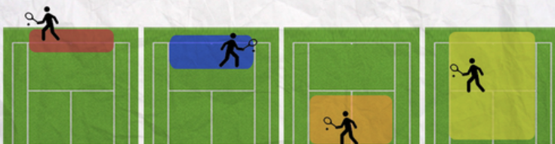
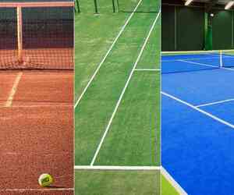
PREPARATION
Game style
Surface
Aggressive baseliner
All court player
Serve & volley
Counter-punchers
Clay
Grass
Hard court

Slide 7
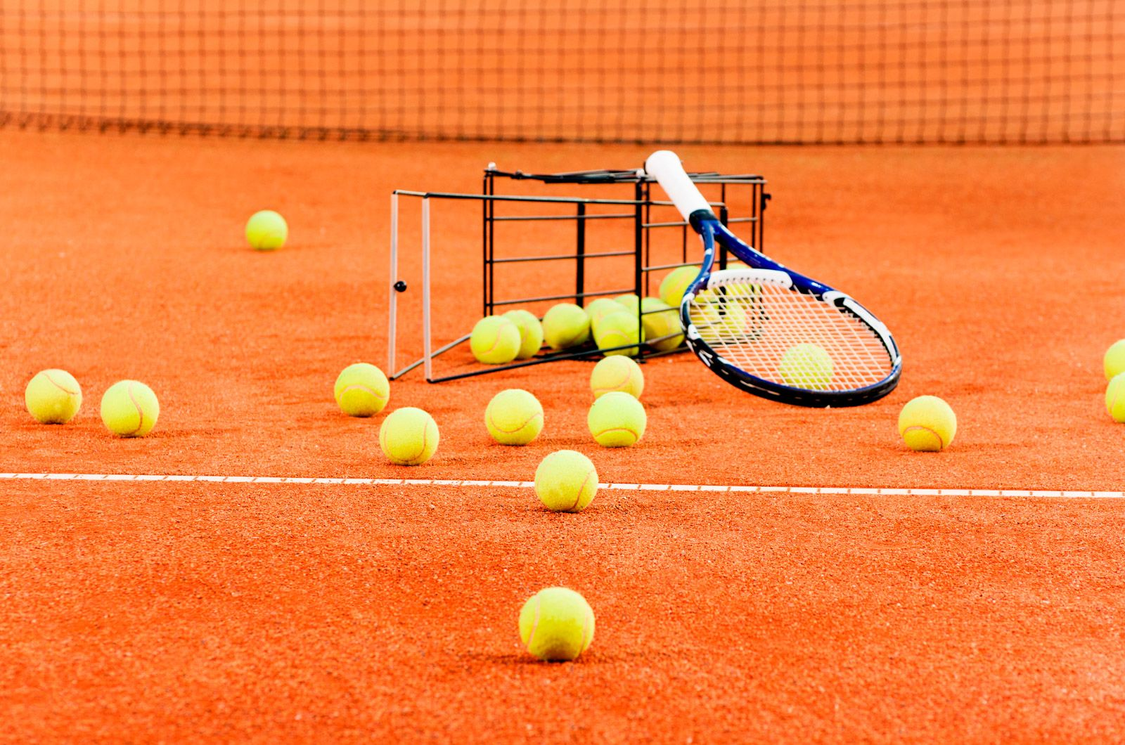
PREPARATION: Competition and ‘off-season’
General phase
Build off court fitness
Specific
On court
Court drills simulating
Competition
Match preparation
Strength
Power
Speed/agility
Strength
Power
Speed/agility
Competition
Competition
Transition / off-season
1-2 days
3-4 days
1-2 weeks
Active rest
2-4 weeks

Slide 8


INJURIES AND PREVENTION
Overload and overuse
Incorrect techniques
Improper grip
Shoulder, elbow, wrist, hand
Correct technique
Correct equipment
Warm-up properly
Muscle strengthening exercises
Shoulder
Forearm
Grip (wrist)
Functional exercises
Core stability
Tennis elbow
Rotator cuff tears
Back pain/ stress fractures
Ankle sprains
Jumper’s knee

Slide 9

SOURCES
Tennis Strength & Conditioning | Injuries | Gym - Tennis Fitness. (s. f.). https://www.tennisfitness.com/tennis-injury-causes-prevention
Anane, S. (2023, 7 noviembre). Overcoming Common Tennis Injuries Through Strength and Conditioning. https://www.linkedin.com/pulse/overcoming-common-tennis-injuries-through-strength-soumeya-anane-7cwcf
Common Tennis Injuries & Prevention | Mass General Brigham. (2022, 6 octubre). https://www.massgeneralbrigham.org/en/about/newsroom/articles/tennis-injuries
Smith, B. J. (2012). Periodization and resistance training in the elite female tennis player: The WTA perspective. Journal of Medicine and Science in Tennis, 17(2), 55-63.
Human Kinetics. (s. f.). Physical Demands of Tennis. https://us.humankinetics.com/blogs/excerpt/physical-demands-of-tennis
Review: Physical demands of tennis. (s. f.). https://supertrening.si/review-tennis-si/

