Slide 1
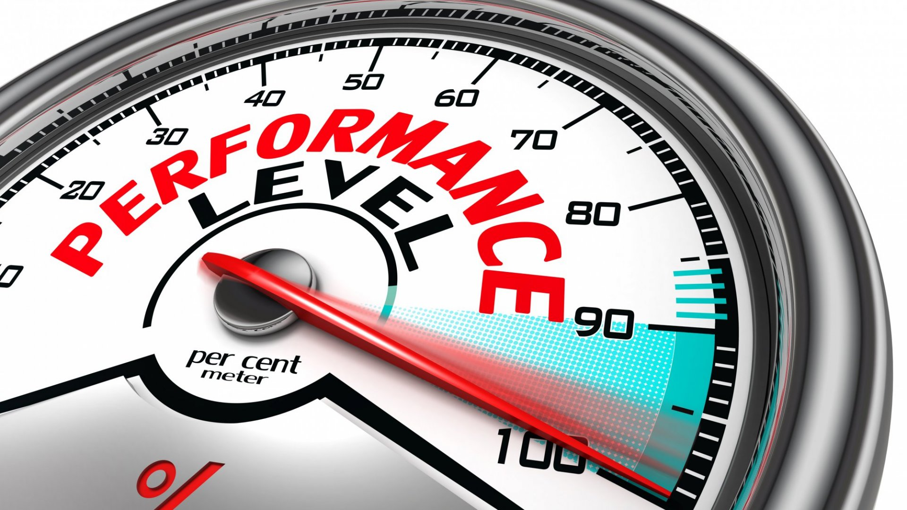
Hacking the stress system: the stress response as an adaptive trait that can work for or against you
X - Optimising the stress response for greater performance

Slide 2
The three major ways to manipulate the stress response
Stress reduction
Habituation
Modulation

Slide 3
The most effective mechanisms to reduce or control the acute stress response all involve feedback loops
It is hard to control
  Thoughts
  Emotions
  Physiological states
Behaviour is much easier and that will alter all the above
Stress often requires an expression to movement (be that physiological or psychological – behaviour is the key!)

Slide 4
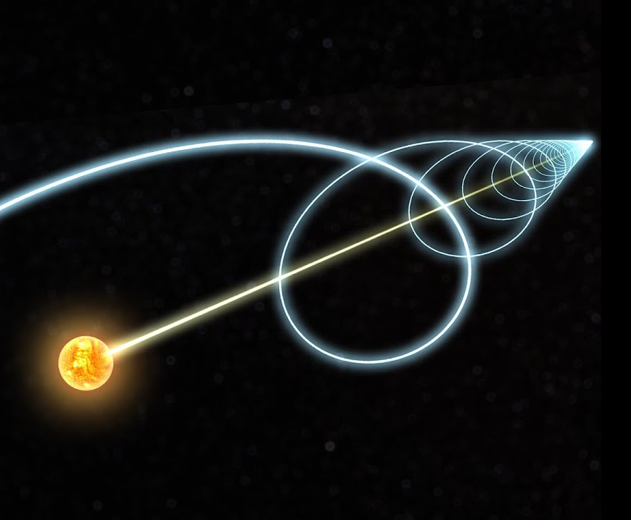
Forward movement: The nucleus reuniens
A small nucleus in the thalamus
Secretes dopamine in response to forward movement
Behaviour effects
  In rats it increases willingness to fight harder
  In people… (we are not sure yet. Running or going for a walk seem to calm people down, but I am not aware of any studies which confirm this mechanism. We are awaiting data from a current project though. So, I hope I can confirm this hypothesis soon)
Zimmerman, E. C., & Grace, A. A. (2016). The nucleus reuniens of the midline thalamus gates prefrontal-hippocampal modulation of ventral tegmental area dopamine neuron activity. Journal of Neuroscience, 36(34), 8977–8984. https://doi.org/10.1523/JNEUROSCI.1402-16.2016

Slide 5
Acute stress reduction
Breath work
Eyes
Left-brain / right-brain cross talk
Relaxation practices
  Meditation
  Yoga
  Sports

Slide 6

Breath work
Double sigh
  Off load much more carbon dioxide
Respiratory sinus arrhythmia
  Inhales: diaphragm moves down, more space for the heart, brain sends a signal to speed up to keep blood pressure steady.
  Basis for Heart Rave Variability (HRV)
Feldman JL. Neurobiology of breathing control. Where to look and what to look for.. Advances in experimental medicine and biology, 1995.

Slide 7
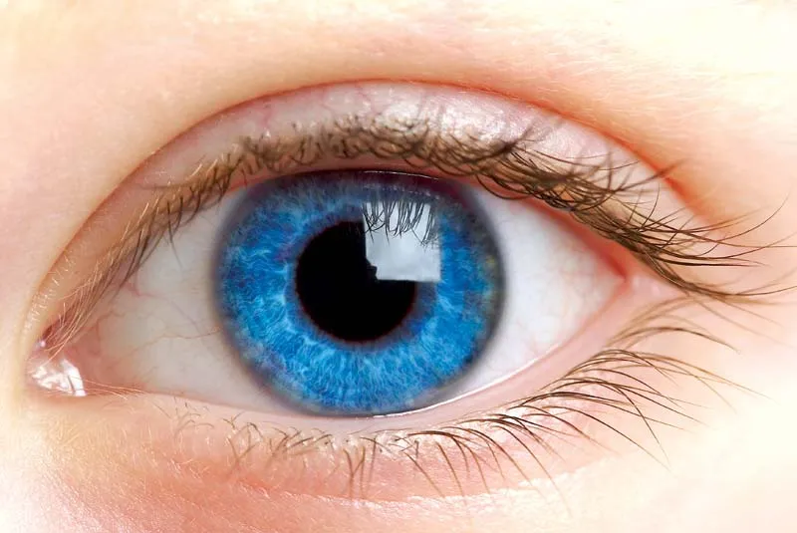
Visual control: Can you use the eyes to control stress?
Eyes – 2 functions
  Detecting shapes, colours, etc. (vision)
  Communicate to the brain – active or inactive (Cues about time of day, stressors, etc.) (YES! Another feedback loop!!)
    Relaxed (panoramic vision)
    Stressed (focussed vision)

Slide 8
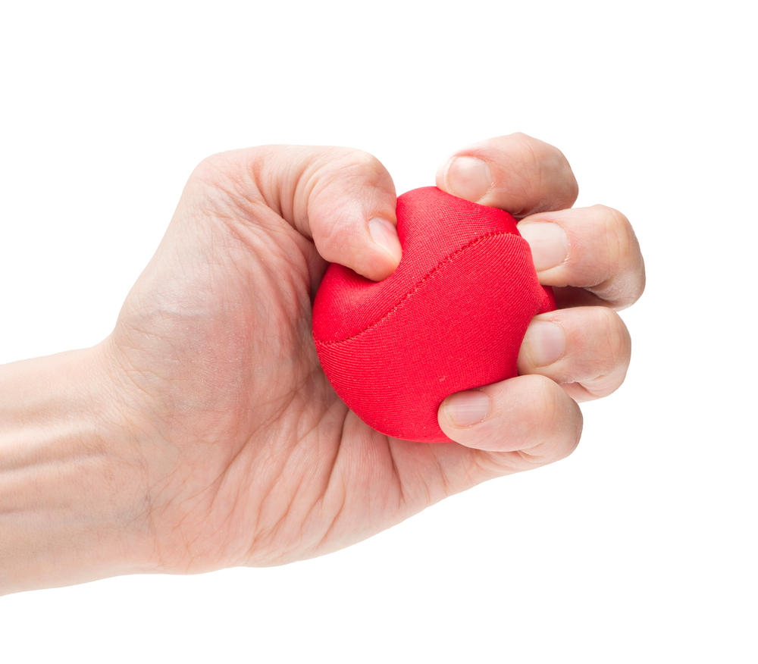
Left-brain / right brain cross talk
Over activity in the left side of the brain may lead to overthinking
Activity with the left hand, which cross talks to the right hemisphere, leads to an overall downregulation of brain activity
Mesagno, C., Beckmann, J., Wergin, V. V., & Gröpel, P. (2019). Primed to perform: Comparing different pre-performance routine interventions to improve accuracy in closed, self-paced motor tasks. Psychology of Sport and Exercise, 43(January), 73–81. https://doi.org/10.1016/j.psychsport.2019.01.001
Mesagno, C., & Beckmann, J. (2017). Choking under pressure: theoretical models and interventions. Current Opinion in Psychology, 16(June), 170–175. https://doi.org/10.1016/j.copsyc.2017.05.015

Slide 9
Meditation (a great feedback loop?)
Breath work
Deliberate focus on slowing down mental function
Focus of the mind
  Calm
  Present
  Positive aspects of one’s life

Slide 10
Habituation

Slide 11
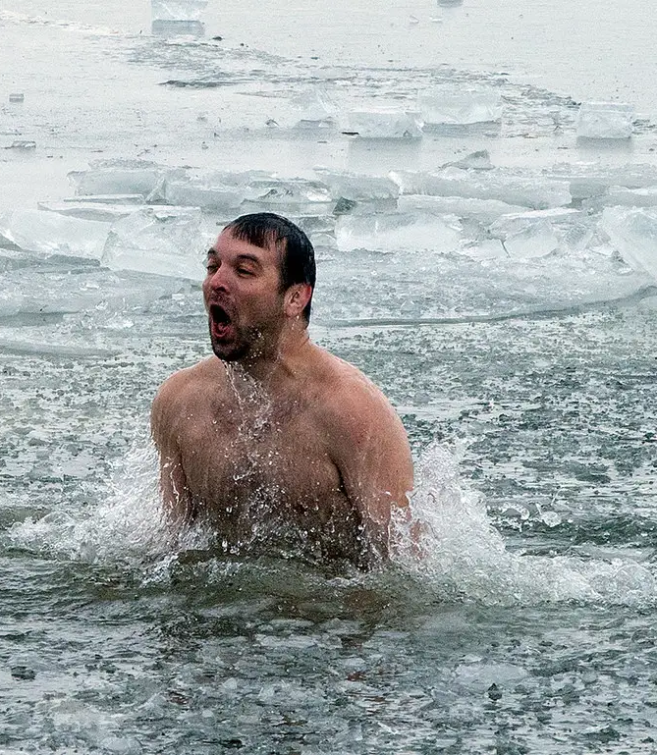
Cold exposure: Acute response to cold
Stress response
  Vasoconstriction
  Hyperventilation
  Shivering
  Sympathetic activation
    Immune system
  Noradrenaline
Šrámek, P., Šimečková, M., Janský, L., Šavlívková, J., & Vybíral, S. (2000). Human physiological responses to immersion into water of different temperatures. European Journal of Applied Physiology, á+, 436–442.
Søberg, S., Lo, J., Philipsen, F. E., Pedersen, B. K., Karstoft, K., Philipsen, F. E., … Ahrens, E. (2021). Article Altered brown fat thermoregulation and enhanced cold-induced thermogenesis in young , healthy , winter-swimming men ll Altered brown fat thermoregulation and enhanced cold-induced thermogenesis in young , healthy , winter-swimming men. https://doi.org/10.1016/j.xcrm.2021.100408

Slide 12
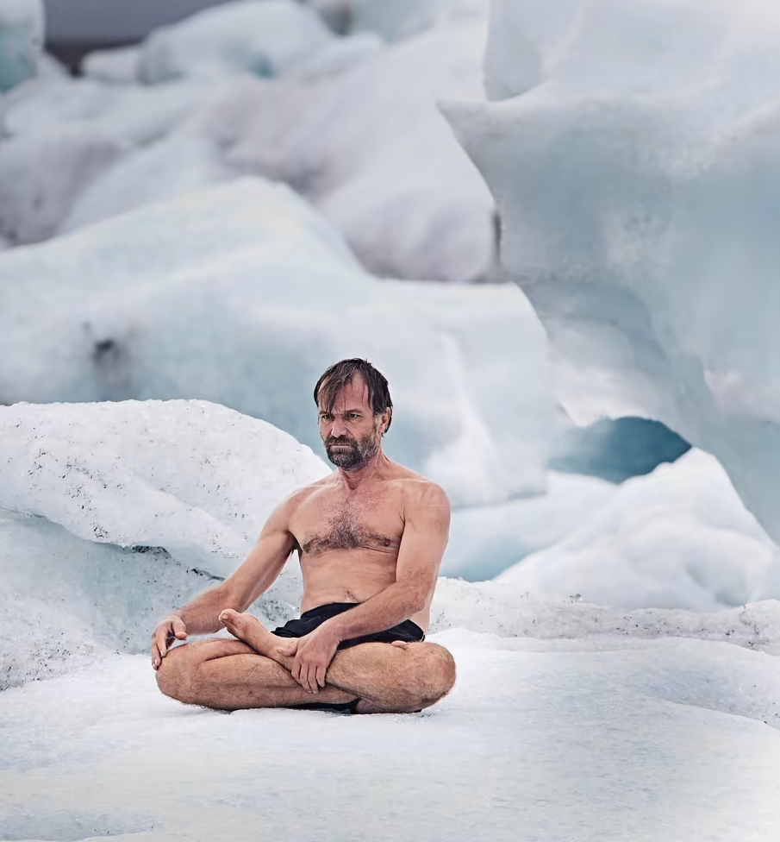
Cold Exposure: Secondary response to cold
Vasodilation
Thermogenesis (shivering)
Parasympathetic activation
Anti-inflammatory Cytokines
Mood enhancement (probably in response to dopamine outflow)

Slide 13

Cold exposure: Repeated cold exposure
Brown fat activation and production
Non-shivering thermogenesis
Improved insulin sensitivity
Weight loss
Immune activation

Slide 14
Physical exercise (stress) – see lecture IX

Slide 15
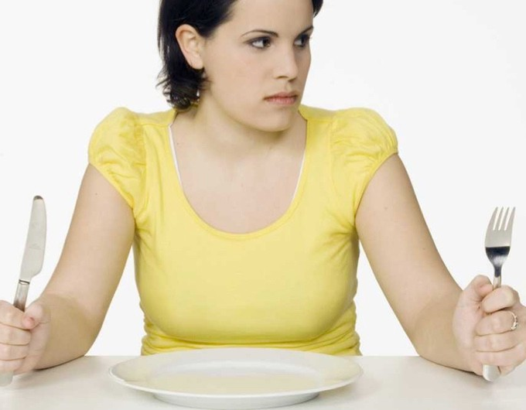
We evolved for hunger
For most of evolutionary history we went through regular short periods of food deprivation.
  Storing excess energy
    Insulin
  Cleaning out the system

Slide 16
What happens when you stop eating?
The first 24 hours
  You burn through your glycogen stores
After 2/3 days you switch from burning glucose to fat and protein
  The more fat adapted you are the easier this transition will be
  Enhanced mood and cognitive function (due to ketone metabolism)

Slide 17
Autophagy: the medicinal qualities of consuming nothing
During hunger, the body gets a chance to burn off a lot of cells, which do not function optimally.
During refeeding these cells are reconstituted if necessary
Taylor, P., Alirezaei, M., Kemball, C. C., Flynn, C. T., Wood, M. R., Lindsay, J., … Whitton, J. L. (2014). Short-term fasting induces profound neuronal autophagy. (November), 37–41. https://doi.org/10.4161/auto.6.6.12376
Pietrocola, F., Pol, J., & Prof, G. K. (2016). Fasting improves anticancer immunosurveillance via autophagy induction in malignant cells. Cell Cycle, 15(24), 3327–3328. https://doi.org/10.1080/15384101.2016.1224797

Slide 18
Modulation

Slide 19
Much less is known about the manipulation of the acute stress response for optimal performance
Internal reward generation
  Small milestones (micro-slicing activities)
The effects of altruism
  We handle so much more if we can find the strength to care for others while we struggle
    (Oxytocin?)

