Slide 1
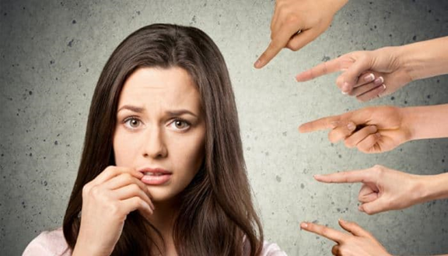
Hacking the stress system: the stress response as an adaptive trait that can work for or against you
II - Social stress, reproduction and hierarchy

Slide 2
Stress and the social
Stress in a social context is a double edged sword.
Social connection buffers the negative effects of stress
Social connections can themselves be incredibly stressful

Slide 3
Hans Selye – The Granddaddy of stress science
Stress as a physiological reaction to general unpleasantness.
Seyle assumed that the negative effects of stress are the result of stress hormones running out. This is not the case. Rather, at a certain point we invest so much in the stress response that other processes become neglected.
Selye, H. (1936). A Syndrome Produced by Diverse Nocuous agents. Nature.
Szabo, S. (2017). “Stress” is 80 Years Old: From Hans Selye Original Paper in 1936 to Recent Advances in GI Ulceration. (December). https://doi.org/10.2174/1381612823666170622110046

Slide 4
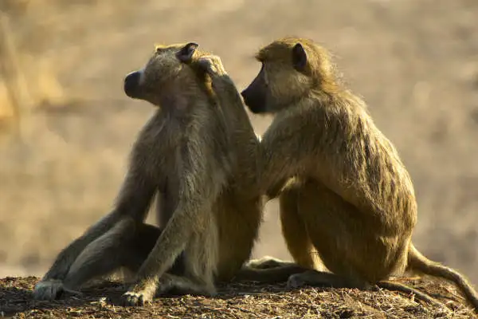
Do you have support?
Social grooming as a predictor of mental and physical health
Social support in post-traumatic stress disorder
Shared hardship
Olff, M., Koch, S. B. J., Nawijn, L., Frijling, J. L., Van, M., Veltman, D. J., … Veltman, D. J. (2014). Social support , oxytocin , and PTSD Social support , oxytocin , and PTSD. 8198, 9–10. https://doi.org/10.3402/ejpt.v5.26513
Sapolsky, R. M. (2004). Why zebras don’t get ulcers: A guide to stress, stress related diseases, and coping. In Natural History. https://doi.org/10.1002/cir.3880060119

Slide 5
How love and oxytocin and buffer against stress (the acute “superman” neuromodulator)
In-group investment
Ethnocentrism
Proactive coping
Post-traumatic stress disorder
De Dreu, C. K. W., Greer, L. L., Handgraaf, M. J. J., Shalvi, S., Van Kleef, G. A., Baas, M., … Feith, S. W. W. (2010). The neuropeptide oxytocin regulates parochial altruism in intergroup conflict among humans. Science, 328(5984), 1408–1411. https://doi.org/10.1126/science.1189047
de Dreu, C. K. W., Shalvi, S., Greer, L. L., van Kleef, G. A., & Handgraaf, M. J. J. (2012). Oxytocin Motivates Non-Cooperation in Intergroup Conflict to Protect Vulnerable In-Group Members. PLoS ONE, 7(11). https://doi.org/10.1371/journal.pone.0046751
De Dreu, C. K. W., Greer, L. L., Van Kleef, G. A., Shalvi, S., & Handgraaf, M. J. J. (2011). Oxytocin promotes human ethnocentrism. Proceedings of the National Academy of Sciences, 108(4), 1262–1266. https://doi.org/10.1073/pnas.1015316108
Nawijn, L., Zuiden, M. Van, Koch, S. B. J., Frijling, J. L., Veltman, D. J., & Olff, M. (2017). Intranasal oxytocin increases neural responses to social reward in post-traumatic stress disorder. (October 2016), 212–223. https://doi.org/10.1093/scan/nsw123

Slide 6
Example I: Chris Hickman. The fire fighter who lifted a car (2008)
https://www.firehouse.com/home/news/10502584/florida-firefighter-lifts-car-rescues-pinned-woman

Slide 7
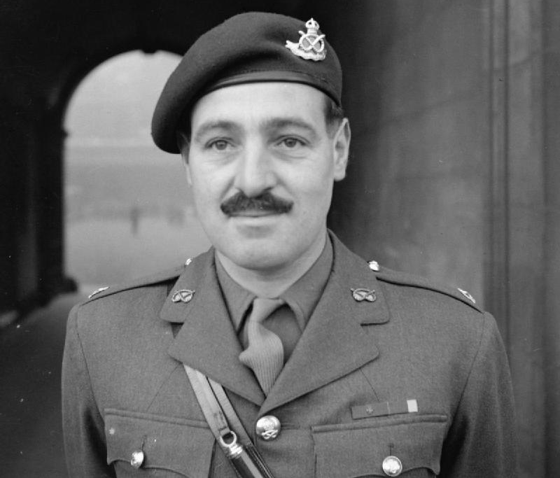
Example II: Mjr. Robert Cane

Slide 8
The follower neuromodulator: β-endorphin
µ-Opioid agonist
Opiate drugs act upon this receptor
Trauma in heroin addicts
Opiate abuse among PTSD sufferers
Morphine & PTSD susceptibility
Social connection as a treatment option for PTSD
µ-Opioid receptor / Galanin 1 receptor heteromers in the tail of the ventral tegmental area.
Analgesia
Passive coping
Serafini, R. A., & Zachariou, V. (2019). Opioid-galanin receptor heteromers differentiate the dopaminergic effects of morphine and methadone. Journal of Clinical Investigation, 129(7), 2653–2654. https://doi.org/10.1172/JCI128987
Ullrich, D., & Mac Gillavry, D. W. (2021). Mini-review : A possible role for galanin in post-traumatic stress disorder. Neuroscience Letters, 756(May), 135980. https://doi.org/10.1016/j.neulet.2021.135980

Slide 9
How to increase β-endorphin
Collective exercise and hardship
Sports
Struggle
Collective rituals
Uniforms & behaviours
Religious ritual
Unity with God
Pain
Harber, V. J., & Sutton, J. R. (1984). Endorphins and Exercise. Sports Medicine: An International Journal of Applied Medicine and Science in Sport and Exercise, 1(2), 154–171. https://doi.org/10.2165/00007256-198401020-00004
Lang, M., Bahna, V., Shaver, J. H., Reddish, P., & Xygalatas, D. (2017). Sync to link: Endorphin-mediated synchrony effects on cooperation. Biological Psychology, 127(June), 191–197. https://doi.org/10.1016/j.biopsycho.2017.06.001
Corder, G., Castro, D. C., Bruchas, M. R., & Scherrer, G. (2018). Endogenous and Exogenous Opioids in Pain. Annual Review of Neuroscience, 41(1), 453–473. https://doi.org/10.1146/annurev-neuro-080317-061522

Slide 10
Act out!!!!

Slide 11
Social hierarchy and the dynamics of acting out
We mainly act out down the social hierarchy
In a stable social hierarchy, stress and its negative health outcomes accumulate at the bottom.
In an unstable social hierarchy, stress effects most members equally
Poverty, social strata and the meritocracy
Testosterone, competition and your place on the hierarchy
Sherman, G. D., & Mehta, P. H. (2020). Stress , cortisol , and social hierarchy. Current Opinion in Psychology, 33, 227–232. https://doi.org/10.1016/j.copsyc.2019.09.013
Bernal, D. R., Ho, K., Johanna, M., & Niki, A. (2022). Second ‑ class citizens ? Subjective social status , acculturative stress , and immigrant well ‑ being. SN Social Sciences, 2(7), 1–18. https://doi.org/10.1007/s43545-022-00371-2

Slide 12
Social stress: the dark side of social interaction
Testosterone (in males)
Serotonin
Dopamine
Sapolsky, R. M. (2017). Behave! The biology of humans at our best and worst. In Penguin Press (1st ed.). https://doi.org/10.1111/1467-8357.00356

Slide 13
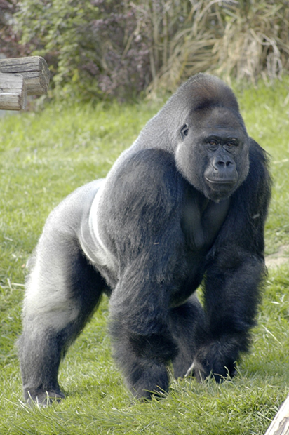
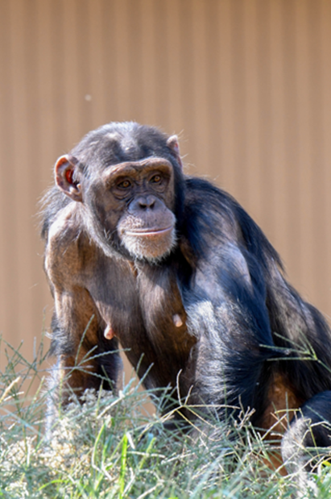
Stress, reproduction and social status
Who leaves the pack
Stress downregulates reproductive function
Stress influences access to reproduction

