Slide 1
Hacking the stress system: the stress response as an adaptive trait that can work for or against you
V – Why stress makes you stupid, most of the time

Slide 2
The focus of stress: speed!

Slide 3
What does the stress response do? And is it useful in an argument?
Increased blood pressure and heart-rate to increase the transportation of
Fuel (glucose)
Oxygen
Increased focus on speed (fight or flight
Mild stress
Enhanced cognitive function; implicit memory & declarative tasks
Enhanced task oriented focus
High acute or chronic stress
Impairs the formation of complex memories: enhances implicit memory
Repetitive tasks
Increased immune system reactivity
Sandi, C. (2013). Stress and cognition. WIREs Cogn Sci, 4(June). https://doi.org/10.1002/wcs.1222

Slide 4
Calm down; the time to allow the system to return to baseline
It takes time for neurotransmitters to be metabolised.
Continuation of conflict after resolution
Gender differences
Perceptions of stress

Slide 5
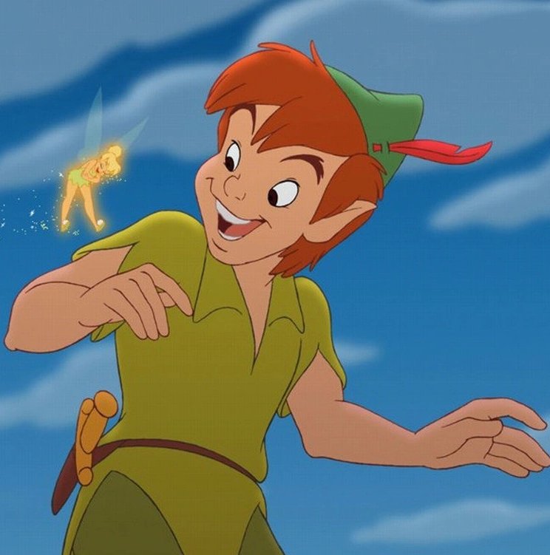
Downregulated functions
Growth
Reproduction
Digestion
Yamamora, D. L. R., & Reid, R. L. (1990). Psychological stress and the reproductive system. Seminars in Reproductive Endocrinology, 8(1), 65–72. https://doi.org/10.1055/s-2007-1021424
Toyoda, A., Iio, W., Matsukawa, N., & Tsukahara, T. (2015). Influence of chronic social defeat stress on digestive system functioning in rats. Journal of Nutritional Science and Vitaminology, 61(3), 280–284. https://doi.org/10.3177/jnsv.61.280
Oroian, B. A., Ciobica, A., Timofte, D., Stefanescu, C., & Serban, I. L. (2021). New Metabolic, Digestive, and Oxidative Stress-Related Manifestations Associated with Posttraumatic Stress Disorder. Oxidative Medicine and Cellular Longevity, 2021. https://doi.org/10.1155/2021/5599265

Slide 6
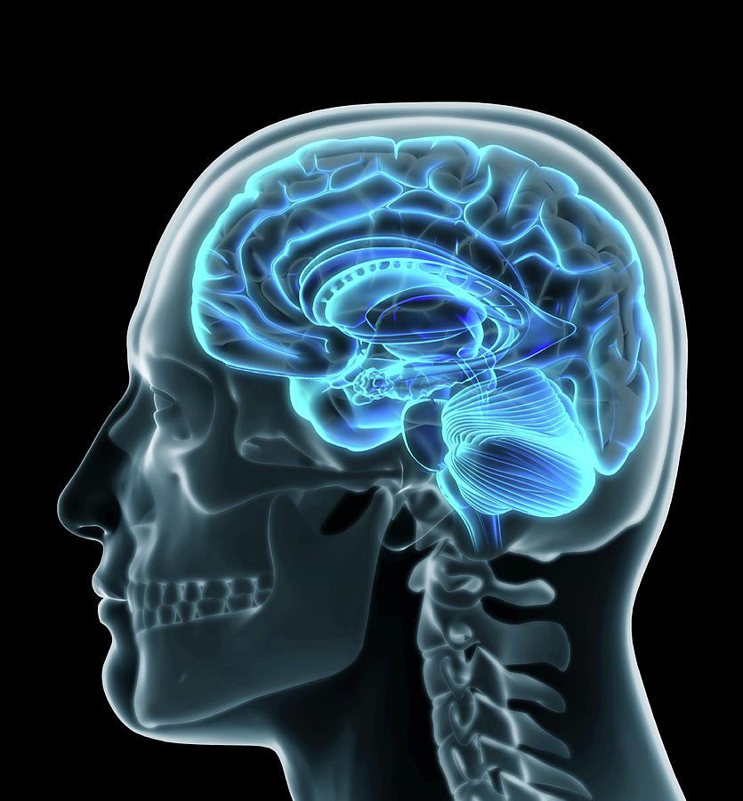
Processing stimuli; the hardware
A stimulus is detected by one of our senses
The amygdala relays signals if the stimulus is threatening
Locus coeruleus (Norepinephrine)
Hypothalamic adrenal axis (Cortisol)
Ventral tegmental area (Dopamine)
Medial prefrontal cortex

Slide 7
Autonomic nervous system
Sympathetic nervous system
Parasympathetic nervous system

Slide 8
(nor-)adrenaline / (nor-)epinephrine
Setting the system up for movement
Blood pressure / heart-rate
Respiration rate
Task related focus and memory
Heightened alertness & stressor related memory
Three behavioural stages of nor-adrenaline
Movement
Erratic movement (panic)
Shutdown
Ross, J. A., & Van Bockstaele, E. J. (2021). The Locus Coeruleus- Norepinephrine System in Stress and Arousal: Unraveling Historical, Current, and Future Perspectives. Frontiers in Psychiatry, 11(January), 1–23. https://doi.org/10.3389/fpsyt.2020.601519

Slide 9
Cortisol
Release glucose (fuel) from glycogen stores
Highest in the morning
Nightmares
Interaction with nutrition
Suppress inflammation
Blood pressure

Slide 10
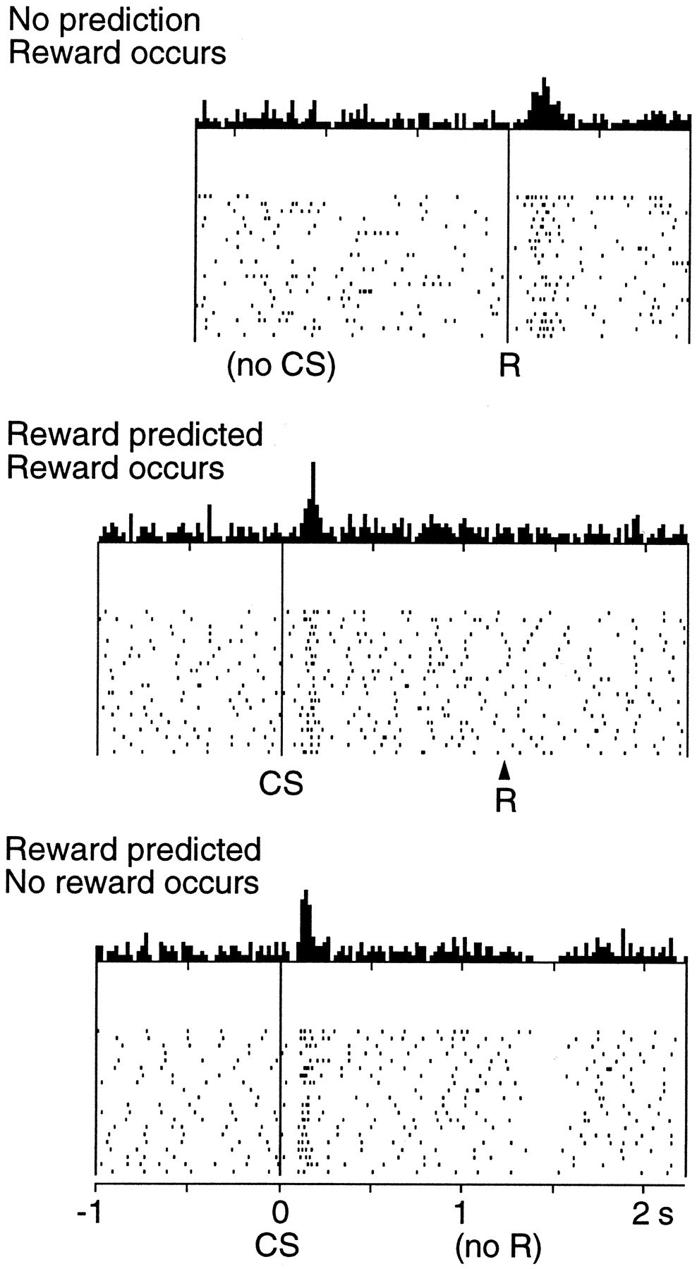
What does dopamine do to the stress response
Dopamine: the great motivator (NO, it does not do reward!!)
Training
Uncertainty
Schultz, W. (2002). Getting formal with dopamine and reward. Neuron, 36(2), 241–263. https://doi.org/10.1016/S0896-6273(02)00967-4

