Slide 1
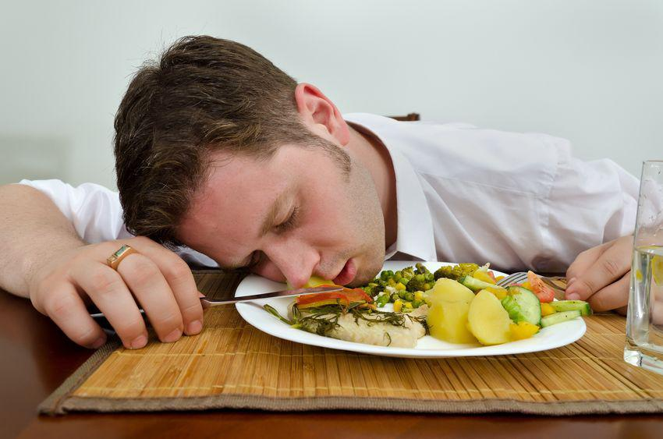
Hacking the stress system: the stress response as an adaptive trait that can work for or against you
VIII - Lifestyle and stress I: Nutrition & Sleep

Slide 2
Nutrition

Slide 3
On the chaos that is Nutrition Science
Everyone has their favourite diet and tests it against the standard American diet (MacDonald’s, Burger king and worse).
  Very few randomised trails
    Extremely complicated to get people to follow a diet
    Animal studies usually do not translate well
  Mostly self-report data (highly unreliable)
Mostly aimed at the treatment of disease rather than optimum function
  Heart disease, obesity, diabetes
  With the exception of sport’s science, longevity research

Slide 4
What do we actually know about prehistoric diet?
Atkins, paleo, raw, vegan, carnivore, keto … ????
We actually know surprisingly little
  Generalist (all types of food stuffs)
  An aim at digestibility
But!!!! This diet was consumed in a highly physically active context!
  Nutrition is partially about what else we are willing to do

Slide 5
Key nutrients
Macronutrients
Carbohydrates (4cal/gram)
Protein (4cal/gram)*
Fat (9cal/gram)*
Micronutrients
Vitamins
Minerals

Slide 6
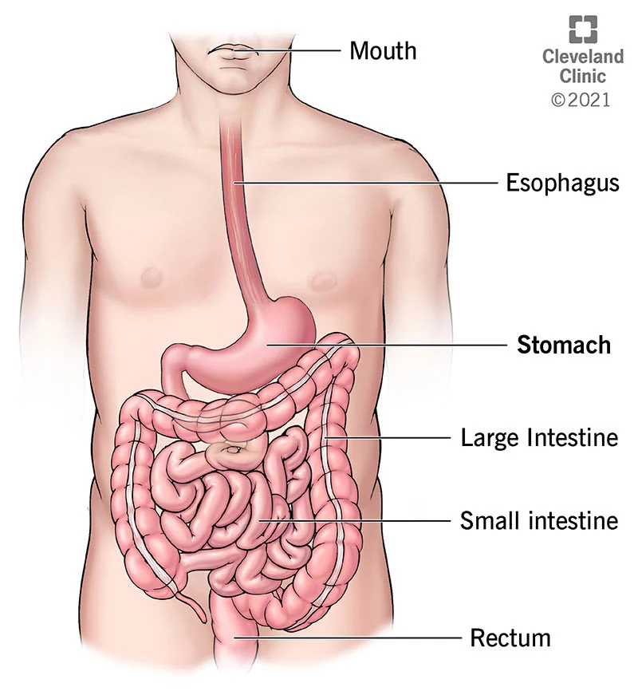
The digestive system has specific sensors for different nutrients
Sugars
  We like sweet things even if you numb taste buds
  Stimulates endorphin secretion
Amino acids (building blocks of protein)
  We will eat until we have enough, not until we are full
    L-tyrocine (dopamine precursor)
      Chicken, turkey, fish, milk, yoghurt and almonds
Fats (lipids)

Slide 7
The system simplified
What you do not use, you store. But, not all macronutrients are stored the same way.
  Insulin
  Fat metabolism
Stress releases stored energy
  Cortisol
Stress for no real reason
  You dump a lot of energy on the system, remove it, dump it back in, remove it, etc.

Slide 8

Fasting
Autophagy
  ketosis
Longevity
Regulation of insulin levels
Neurogenesis
Mattson, M. P., Longo, V. D., & Harvie, M. (2017). Impact of intermittent fasting on health and disease processes. Ageing Research Reviews, 39, 46–58. https://doi.org/10.1016/j.arr.2016.10.005
Longo, V. D., Mitteldorf, J., & Skulachev, V. P. (2005). Opinion: Programmed and altruistic ageing. Nature Reviews Genetics, 6(11), 866–872. https://doi.org/10.1038/nrg1706

Slide 9
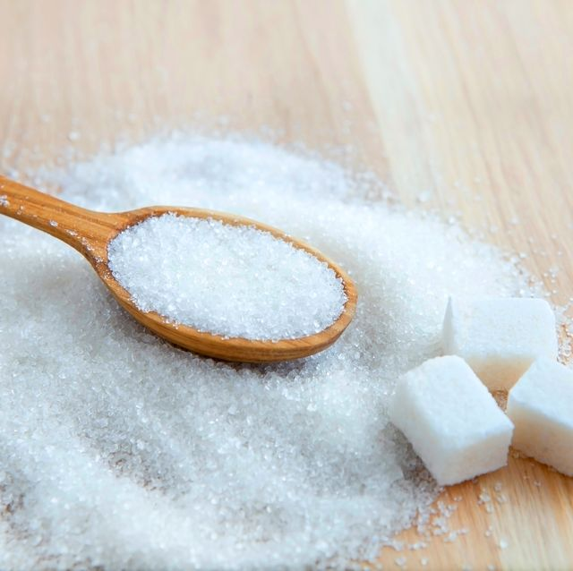
Sugar & insulin resistance a curse or an adaptive trait gone wrong
Diabetes type 2
Fatty liver disease
Obesity
Cognitive downregulation
Lustig, R. H. (2014). Fat Chance: The Hidden Truth About Sugar, Obesity and Disease. London: Fourth Estate Ltd.

Slide 10
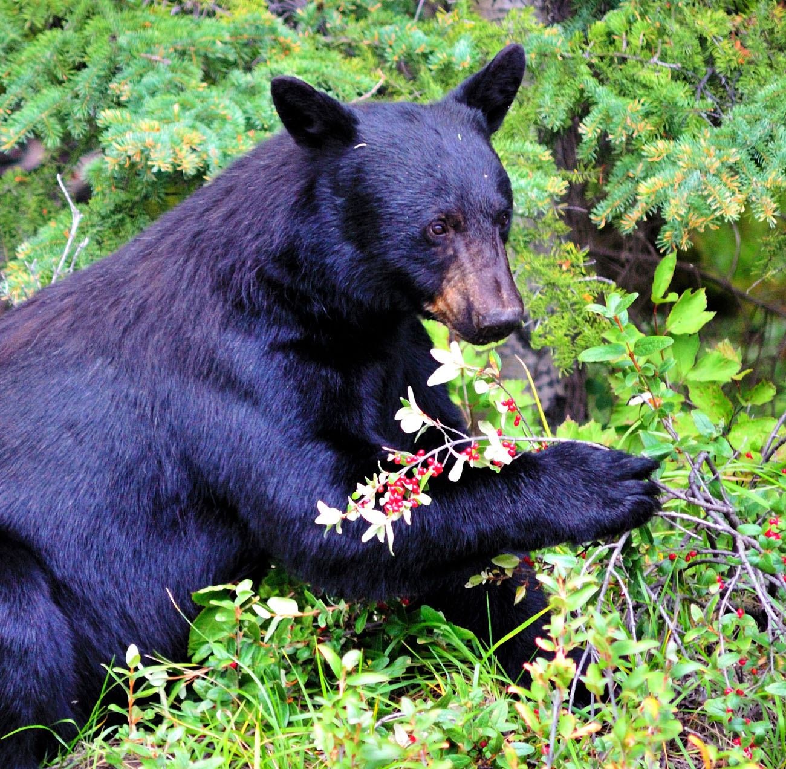
Could insulin resistance be an adaptive trait?
Many animals do not only start eating much more in preparation for winter but also change diet.
  Fructose trigger
    Higher consumption
    Insulin resistance
    Fat production
    Cognitive downregulation
  A response to prolonged periods of food shortage aimed at securing core functions
Johnson, R. (2022). Nature Wants Us to Be Fat_ The Surprising Science Behind Why We Gain Weight and How We Can Prevent–and Reverse–It-BenBella Books (2021). Dallas: Ben Bella Books, inc.

Slide 11
Sleep

Slide 12
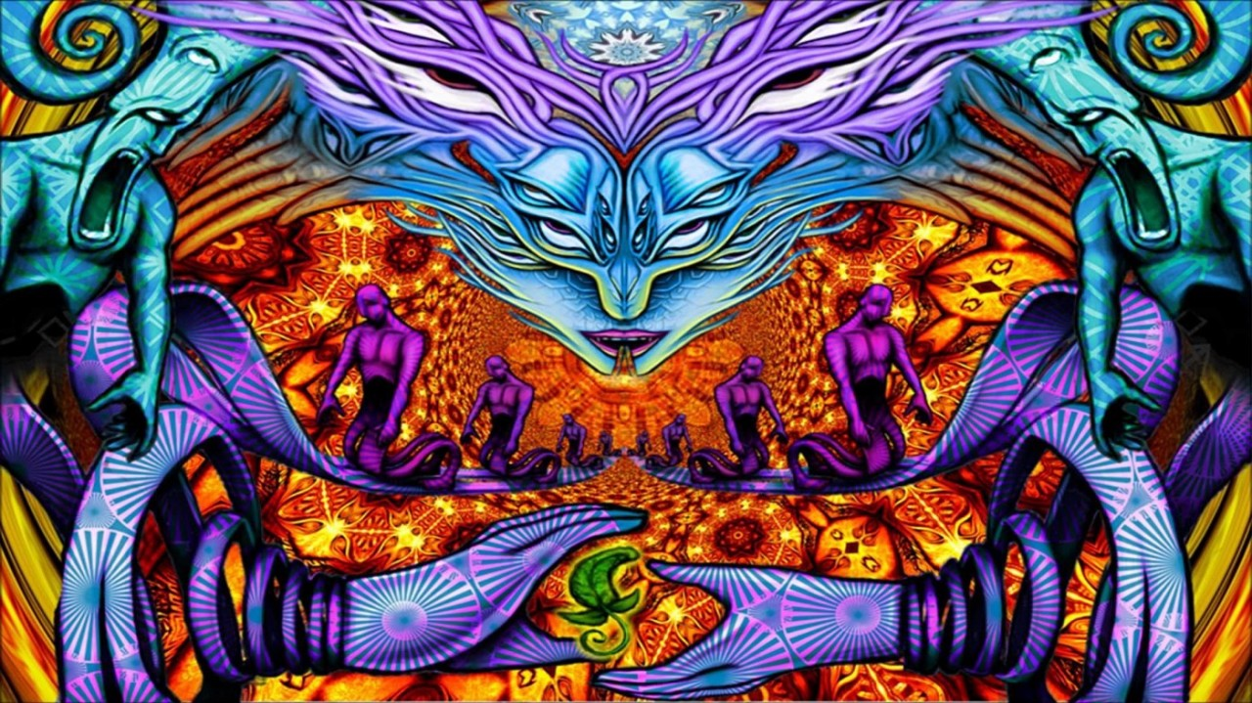
When was the last time you were delusional?

Slide 13
On the importance of sleep
Nature has not provided us with a means to store sleep. The sleep we do not get is lost.
  Immune system
  Sex hormones
  Cognitive function
Almondes, K. M. de, Marín Agudelo, H. A., & Jiménez-Correa, U. (2021). Impact of Sleep Deprivation on Emotional Regulation and the Immune System of Healthcare Workers as a Risk Factor for COVID 19: Practical Recommendations From a Task Force of the Latin American Association of Sleep Psychology. Frontiers in Psychology, 12(May), 1–10. https://doi.org/10.3389/fpsyg.2021.564227
Garbarino, S., Lanteri, P., Bragazzi, N. L., Magnavita, N., & Scoditti, E. (2021). Role of sleep deprivation in immune-related disease risk and outcomes. Communications Biology, 4(1). https://doi.org/10.1038/s42003-021-02825-4
Lateef, O. M., & Akintubosun, M. O. (2020). Sleep and reproductive health. Journal of Circadian Rhythms, 18(1), 1–11. https://doi.org/10.5334/jcr.190
Su, L., Zhang, S. zheng, Zhu, J., Wu, J., & Jiao, Y. zheng. (2021). Effect of partial and total sleep deprivation on serum testosterone in healthy males: a systematic review and meta-analysis. Sleep Medicine, 88, 267–273. https://doi.org/10.1016/j.sleep.2021.10.031
Csipo, T., Lipecz, A., Owens, C., Mukli, P., Perry, J. W., Tarantini, S., … Yabluchanskiy, A. (2021). Sleep deprivation impairs cognitive performance, alters task-associated cerebral blood flow and decreases cortical neurovascular coupling-related hemodynamic responses. Scientific Reports, 11(1), 1–13. https://doi.org/10.1038/s41598-021-00188-8

Slide 14
Stages of sleep: and their importance
Deep sleep
  Delta waves / slow waves
  Memory consolidation
Rapid Eye Movement sleep
  Dream state
  Memory contextualisation

Slide 15
Why sleep is so important
Acute extreme sleep deprivation can
  Be fatal
  Lead to exacerbation of mental issues
  Will lead to psychotic symptoms while sleep deprived
Chronic sleep deprivation
  Testosterone (a few nights of 4-5 hours – drop to levels of someone 10 years older)
  Blood sugar dysregulation
  Immune system failure
  Effect on gene-expression
  1 night of 4 hours – a 70 % drop in natural killer cells
  Alzheimer's
Walker, M. (2017). Why We Sleep: Unlocking the Power of Sleep and Dreams. Retrieved from https://www.ptonline.com/articles/how-to-get-better-mfi-results

