Slide 1
Volleyball
doc. PaedDr. Jan Štumbauer, CSc.

Slide 2
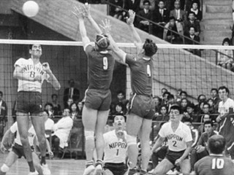
History of Volleyball
Written sources from different continents (North and South Americas, Asia and Europe) state that the creator of volleyball is the director of Holyoke College, physical education instructor, W. G. Morgan. He wanted to replace less emotional gymnastic exercises with an undemanding and attractive form of physical activity. He divided the gym into two halves by a tennis net (in the height of approx. 183 cm) and let students to volley a basketball ball from one half to the other.
Volleyball originated in 1895 in Springfield, Massachusetts (USA). The original name “mintonette” was changed in 1896 when the game was presented to YMCA directors into to volley the ball.

Slide 3
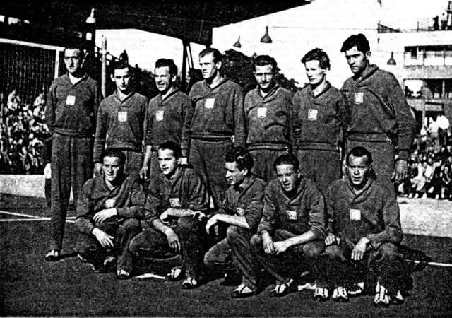
History of Volleyball in the Czech Republic
In Czech lands, volleyball started to develop only after World War One. Thus it is a relatively new sport. One of the most important promoters of volleyball was J. A. Pipal who worked as Prague YMCA (Young Men’s Christian Association) director from 1919. In 1921, YMCA founded the first volleyball organization in the Czech lands – the Volleyball Association (Kaplan, 1987).

Slide 4
Game Characteristics
Volleyball is a non-invasive sports game of a net type where there are two competing teams of six members who control the ball with parts of their body. There are both offensive and defensive tasks and one game event may result in both winning and losing points. The duration of the match depends on gaining a given number of points in sets and winning a certain number of sets.

Slide 5
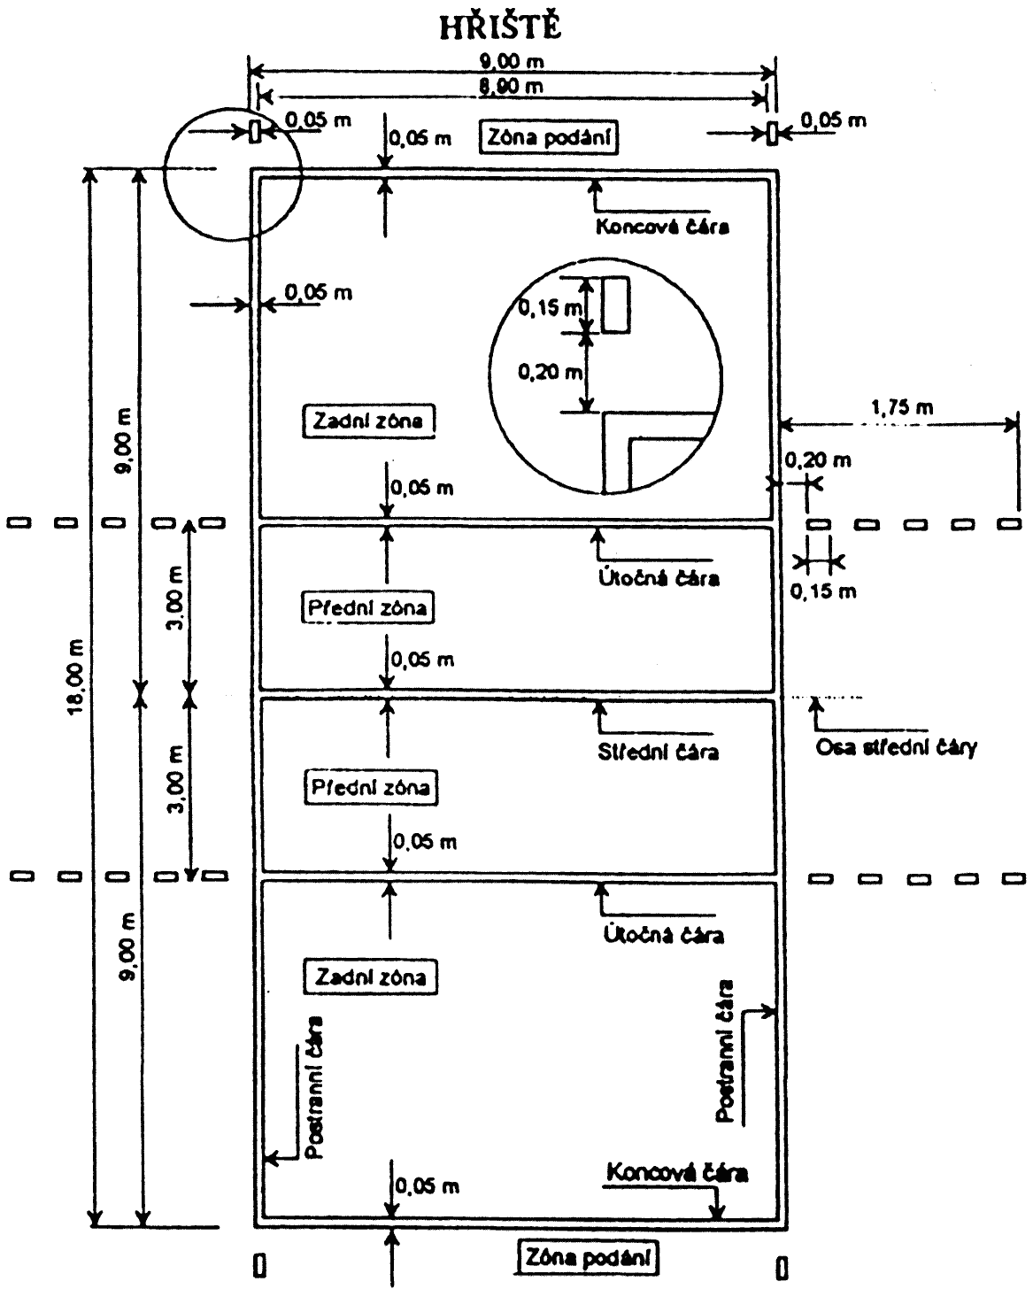
Basic Rules of Volleyball
The match is played for 3 winning sets
Sets are played for 25 points (except for 5th set which is played only for 15 points)
The court is a rectangular with the dimenstions of 18 x 9 m
The net is in the height of 2.43 m for men and 2.24 m for women
The aim is to drive the ball over the net towards the ground in the opponent team’s field.
The ball must be round.

Slide 6
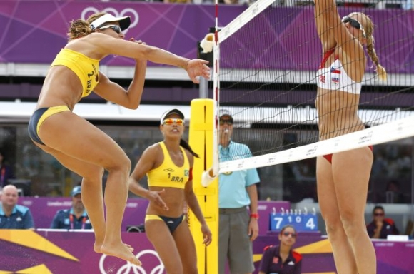
Beach Volleyball
Beach volleyball is an attractive ball game which developed from classic six-player volleyball. Since it appeared, it has attracted many fans; therefore it has been included among the sports within summer Olympic Games. The majority of the rules has been adopted from the rules of classic volleyball, however, there are also some differences. For example, the team is composed of two players only and the dimensions of the court are smaller.

Slide 7
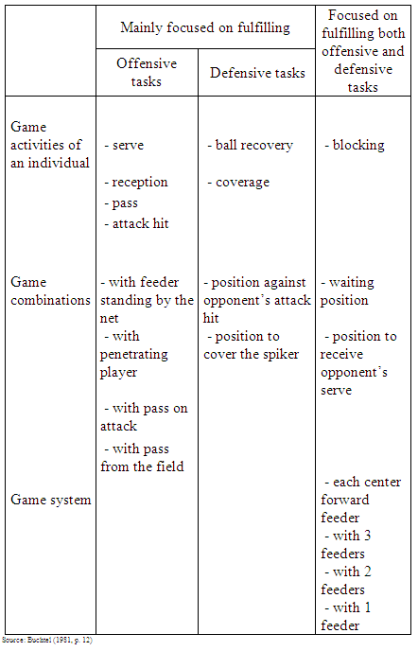
An Overview of Game Activities, Combinations and Game Systems in Volleyball.

Slide 8
Thank you for your attention.

