Slide 1
Basketball
doc. PaedDr. Jan Štumbauer, CSc.

Slide 2
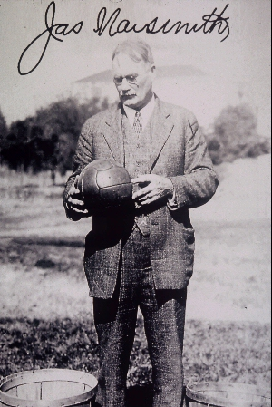
History of Basketball
The game was created in 1891 by Dr. James Naismith who worked as an instructor at YMCA Sports School in Springfield, Massachusetts. James Naismith was born on November 6, 1861 in Almont, Canada. In 1891, he was encouraged by the school principle, Dr. Luther Gulick, to design a new game which could be played in a gym when the weather was bad. The result was the game of basketball which has become one of the most popular games in the world over the next century.
Later, Naismith created five basic principles which he included in 13 basic rules:
The game is played with a round ball and is played with hands.
The player cannot run with the ball.
Any player can take any position in the court at any time.
There cannot be any physical contact among the players.
The basket must be placed horizontally above the court ground. (Smith, 1998)

Slide 3
Rules of Basketball
There are 2 teams of 5 players
The aim is to throw the ball into the opponent team’s basket and prevent the opponent to control the ball or hit the basket.
The ball can be controlled only with a hand (or hands) and it can be passed, thrown, tapped, rolled or dribbled with restrictions stated by the rules.
The player is allowed to move with the ball only while continuously dribbling.
The duration of a match consists of 4 periods, each lasting 10 minutes of actual time.
The court – length 28 m and width 15 m
        The dimensions of the board are 1.80 m horizontally and 1.05 vertically
The ball must be inflated with air in such a way that when dropped on the floor from 1.8 m bounces and jumps 1.2-1.4 m high
A hit can be worth a different number of points:
• A free throw is equal to one point.
• A hit from two-point area counts for two points.
• A hit from three-point area means three points (cabr.cbf.cz)

Slide 4
The Court

Slide 5
Game activities of an individual in basketball
Offensive game activities of an individual
Clearing with the ball
Clearing without the ball
Passing
Shooting
Screening
Rebounding
Defensive activities of an individual
Guarding a player without the ball
Guarding a player with the ball
Guarding a player after shooting and defensive rebounding

Slide 6
Thank you for your attention.

