Slide 1
Gymnastics
Doc. PaedDr. Jan Štumbauer, CSc.

Slide 2
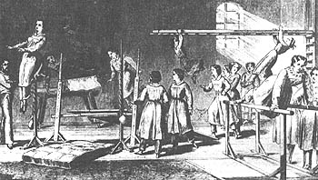
History of Gymnastics
The term gymnastics was used as early as in ancient Greece. The word was formed by joining the words gymnos=naked and gymnaszein=to exercise. It however cannot be understood literally as mere exercising using one’s naked body. Gymnastics meant much more in ancient Greece. It was an overall cultivation of the body. It developed harmony between physical athleticism and mental balance. There was the ideal of “kalokagathia – the harmony of body and mental beauty” (Grexa, 2007).

Slide 3
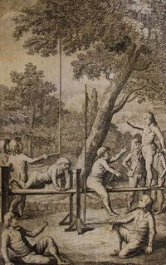
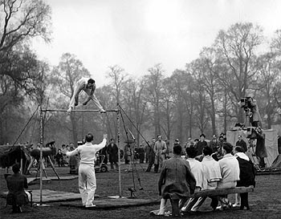
At the turn of the 18th and 19th Centuries, Christian GutsMuths, a German philanthropist, laid the foundation of international gymnastics. His set of exercises included also apparatus gymnastics. Turner system has later developed from his understanding of physical exercise. J. H. Pestalozzi dealt with floor exercises. Miroslav Tyrš – the founder of Sokol Organization – also drew on Turner system. He focused on apparatus gymnastics, resistance exercises and other exercises with emphasis on aesthetic expression. The founder of Physical Exercise Organization of Prague Ladies, Mrs. Klemeňa Hanušová, elaborated
a general system of physical education of girls
and women
(Krištofič a kol., 2003).

Slide 4
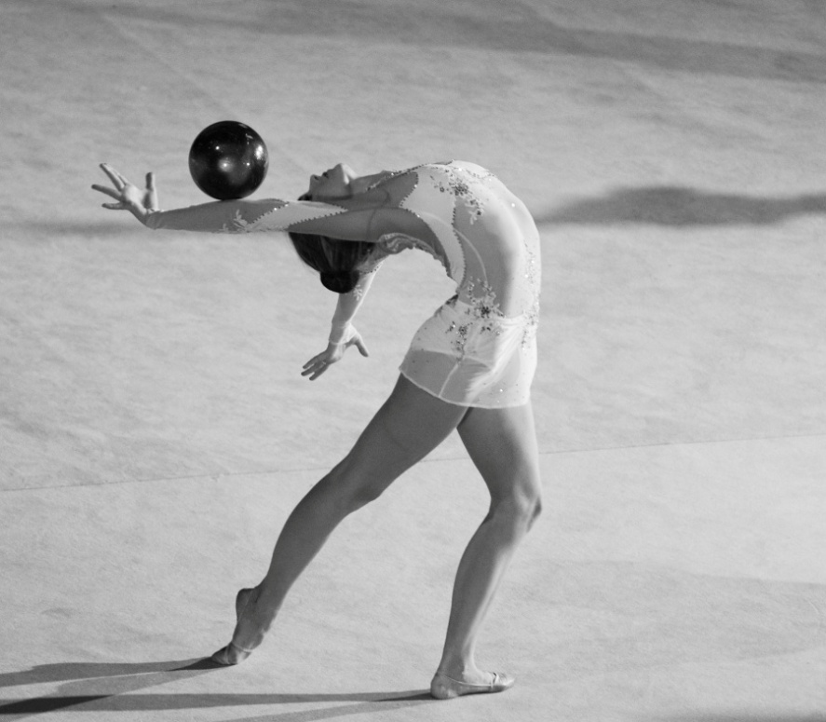
Characteristics of Modern Gymnastics
Modern gymnastics can be included among aesthetic-coordinative or technical-aesthetic sports. The aim of all gymnasts is flawless presentation of the exercise. These exercises are mainly of acyclic character. In order to increase the difficulty of exercises, basic motor skills must be highly automated.

Slide 5
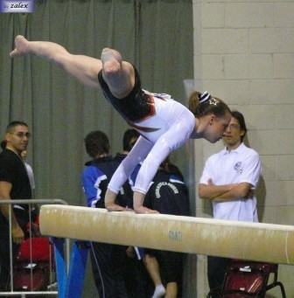
Characteristics of Sports Gymnastics
Sports gymnastics is a sport in which individual athletes present strength or swing gymnastic elements on individual apparatus. Both men and women compete in sports gymnastics but their disciplines are different. Sports gymnastics is a part of the Olympic program.

Slide 6
Differentiation of Gymnastic Disciplines
In 1881, Nicolas J. Cuper founded the FEG federation Fédération Européenne de Gymnastique). He became the director of FIG (Fédération Internationále de Gymnastique) for 43 years. As an official federation responsible for gymnastics throughout the world, FEG took part the Olympic Games only in 1908 in London. On April 7, 1921 FEG became FIG and consists of 16 members. As of 2009 the federation comprised 129 member federations.
FIG and UEG (Union Europénne de Gymnastique) supervise both Olympic and non-Olympic branches of gymnastics.

Slide 7
Among the Olympic disciplines there are the following:
1. Men Sports Gymnastics (Gymnastique artistique masculine)
Men compete in hexathlon which includes parallel bars, floor, rings, wide horse, vault and bar.
2. Women Sports Gymnastics (Gymnastique artistique féminine)
Women compete in quadrathlon which includes floor, vault, balance beam and parallel bars.
3. Modern Gymnastics
According to international rules, gymnasts compete in stage compositions which include duathlon and another discipline is a competition of individual women in quadrathlon.
4. Trampoline Jumping
The disciplines are synchronized pairs and individuals.

Slide 8
Among non-Olympic disciplines there are the following:
1. Sports Acrobatics
The disciplines are mixed pairs, groups of three women and groups of four men.
2. Acrobatic Rock and Roll
Mixed pairs.
3. Sports aerobics and fitness
These sports include many disciplines, the basic division includes competition of individuals, pairs or teams.
4. Euroteam
This form of gymnastics covers competitions of teams of women or men and mixed teams.
5. Aesthetic Group Gymnastics
Women teams comprising six to ten gymnasts.

Slide 9
Thank you for your attention.

