Slide 1
The Theory of Sport Training Basic Principles
LESSON 2
Structure of Sport Performance

Slide 2
The kinds of sports
Racing, competitive sport (children, youth, adults, recreational, second level performance sport, top sport…)
Sport for health
Sport of disable people

Slide 3
Structure of Sport Performance

Slide 4
Somatic factor
Physique – external appearance of athlete (somatotyp), anthropometric dimension – H, W, Length of extremities - composition of body – internal environment

Slide 5
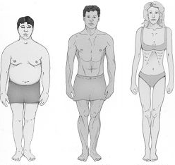
Type of body
Picknic
Athletic
Asthenic

Slide 6
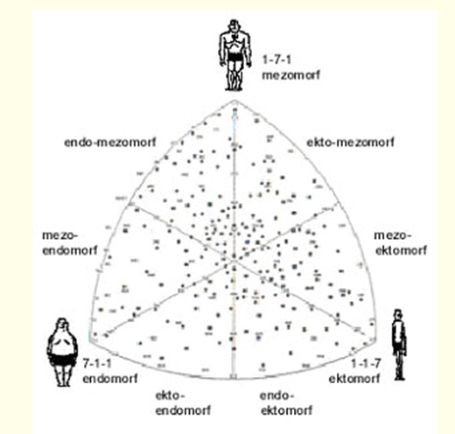
Sheldon somatograf

Slide 7
Somatic factor
Internal environment - composition of body
The quality of systems – cardiovascular - respiratory - neural system - hormonal
Precondition to the performance start with rate of tissue

Slide 8
Factor of technique
The ability to learn new movement structure and use its during competition
Condition factor
Precondition to carry out the movement, motor abilities

Slide 9
Tactical factor
The ability to use the experience and knowledge to gain advantage over opponent
Psychological factor
The development of individuality, social abilities etc.

Slide 10
Classification of the SP
Speed – strength performance
Aesthetic – technical performance
Endurance performance
Games
Combat sports
The sport performance connected with the handling of some apparatus, animal or sport equipment
Sensorimotor performance

Slide 11
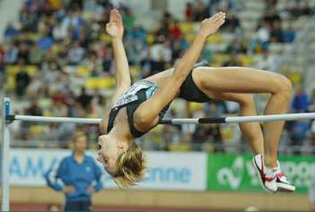
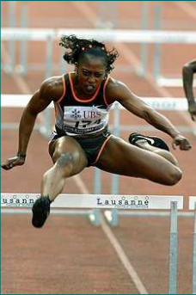
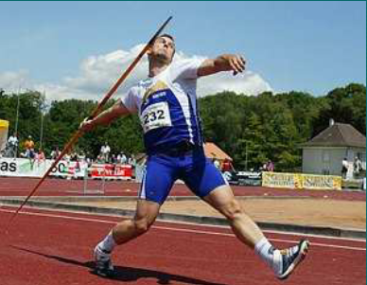
Speed – strength performance

Slide 12
Speed – strength performance
Sports ?
The aim: get over the distance as fast as possible, take the highest, longest jump, lift the heaviest barbell
Motor abilities – strength, speed, co-ordination
Motor skills – simple structure, locomotion, (cyclic, acyclic, combined), the number of skills- small, variability ???
Physiology – great energy cost during short time, nBM – 10 – 30000%
Psychology – big concentration of volitional effort in short time

Slide 13
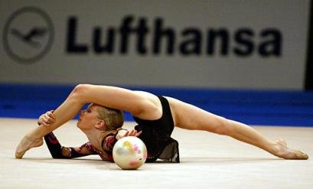
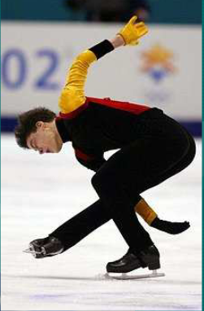
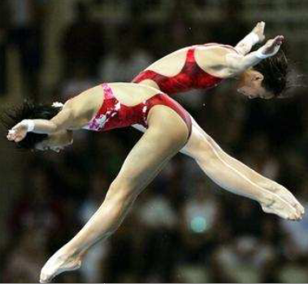
Aesthetic – technical performance

Slide 14
Aesthetic – technical performance
Sports ?
The aim: solution of difficult movement task
Motor ability: co-ordination, flexibility, strength, speed,
Motor skills: great number of skills with difficult structure, variability ???
Physiology: not very high energy cost, aer-anaer. metabolism, load – middle, nBM – 2 – 5000%
Psych. –creativity, courage

Slide 15
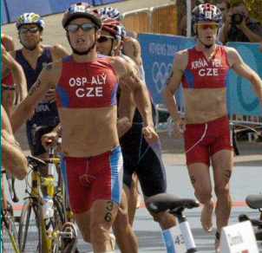
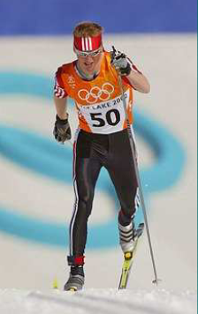
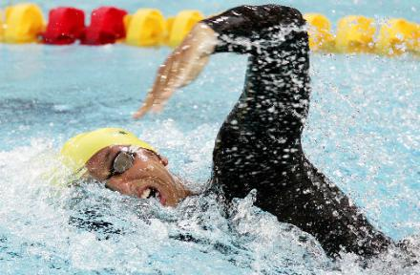
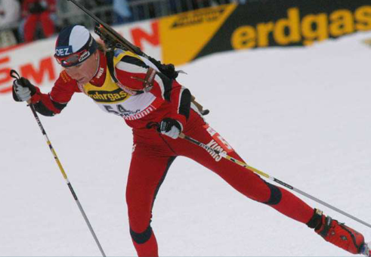
Endurance performance

Slide 16
Endurance performance
Sports?
The aim: get over the given distance in shortest time
Motor ability: endurance, strength
Motor skills: small number, structure simple , variability ???
Physiology: middle energy cost per minute, but total cost during the whole time of race is enormous 2-5000% nBM, aer. metabolism,
Psych: long term volitional effort and concentration, get over fatigue, persistence of effort

Slide 17
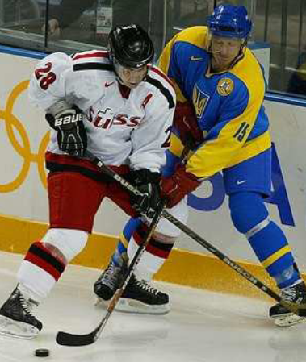
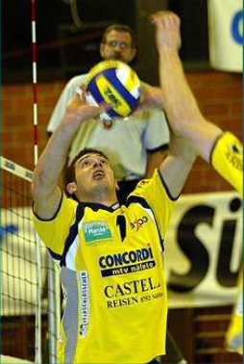
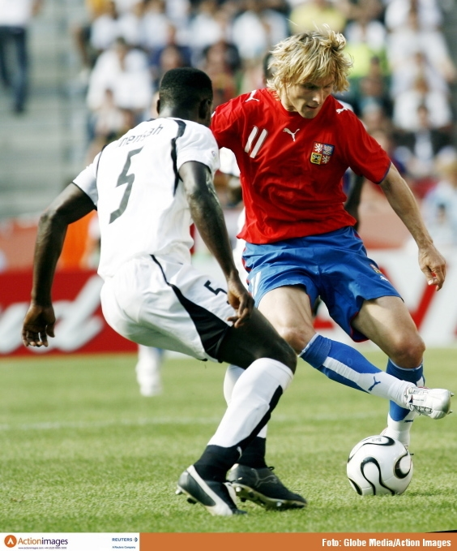
Games, collectives sport performance

Slide 18
Games, collective sport performance
Games??
The aim: get over active opponent
Motor ability: all
Motor skills: high number, structure – very complicated, variability ???
Physiology: load middle and changing, aerobic-anaerobic metabolism, 1 – 2000% nBM
Psych: creative tactical thinking, team motivation (team spirit), anticipation, accept the social rule of team

Slide 19
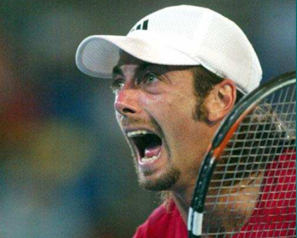
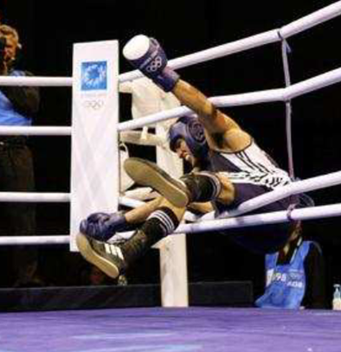
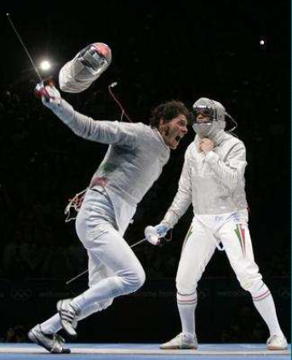
Combat sports, individual sports

Slide 20
Combat sports, individual sports
Sports ?
The aim: get over active opponent
Motor ability: all
Motor skills: great number, structure – very complicated, variability ???
Physiology: small to high energy cost, 400-1500%nBM, aer- anaer. metabolism
volitional activity, the ability get over pain, control of aggression, decision under deficit of time, anticipation

Slide 21
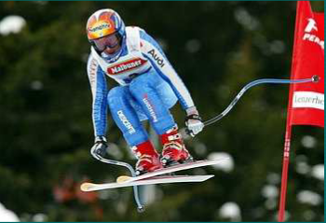
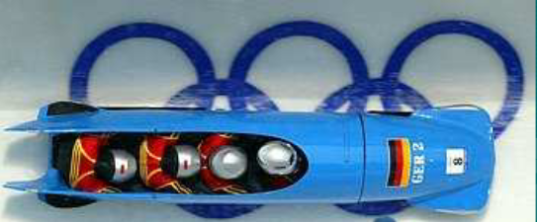
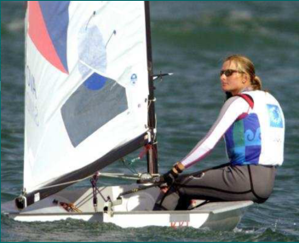
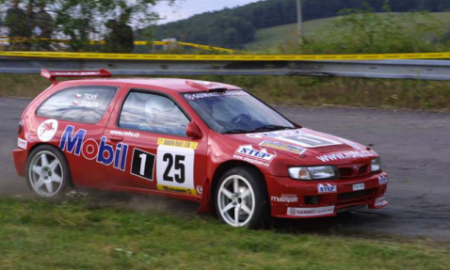
The sport performance connected with the handling of some apparatus, animal or sport equipment

Slide 22
The sport performance connected with the handling of some apparatus, animal or sport equipment
Sports ?
The aim: get over distance, optional exercise in shortest time
Motor ability: all
Motor skills: from low to very high number, structure – very various, variability ?
Physiology: energy cost 500-1000% nBM, rather aer. than anaer. met.
Psych: decision under time deficit, get over the fear, scare, courage, risk, danger, solve the unexpected problems

Slide 23
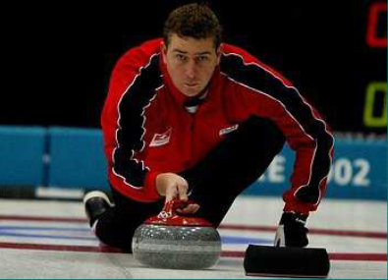
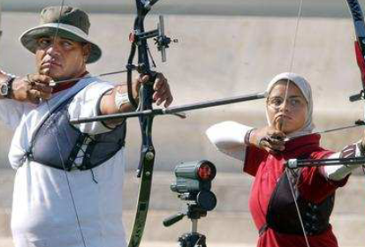
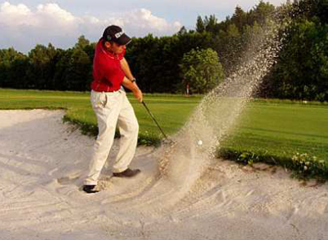
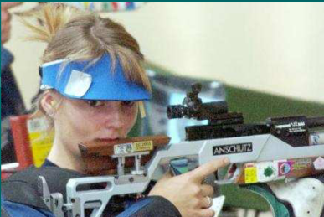
Sensorimotor performance

Slide 24
Sensorimotor performance
Sports ?
The aim: the most accurate hit of the target
Motor ability: co-ordination
Moto skills: small number, structure simple, variability???
Physiology: energy cost low, 400-700% nBM,
Psych: high level of concentration,

