Slide 1
Disorders of the respiratory system

Slide 2
Respiratory structures such as the airways, alveoli and pleural membranes may all be affected by various disease processes
These respiratory diseases include:
Infections such as pneumonia.
Obstructive disorders that obstruct airflow into and out of the lungs such as asthma, bronchitis and emphysema.
Restrictive disorders are conditions that limit normal expansion of the lungs such as pneumothorax, atelectasis, respiratory distress syndrome and cystic fibrosis.
Cancers or exposure to Inhaled particles alter the pulmonary function.

Slide 3
General symptoms of respiratory disease
Hypoxia : Decreased levels of oxygen in the tissues
Hypoxemia : Decreased levels of oxygen in arterial blood
Hypercapnia : Increased levels of CO₂ in the blood
Hypocapnia : Decreased levels of CO₂ in the blood
Dyspnea : Difficulty breathing
Tachypnea : Rapid rate of breathing
Cyanosis : Bluish discoloration of skin and mucous membranes due to poor oxygenation of the blood
Hemoptysis : Blood in the sputum

Slide 4
Respiratory infections
Infections of the respiratory tract can occur in:
The upper respiratory tract or
The lower respiratory tract, or
Both.
Organisms capable of infecting respiratory structures include:
bacteria.
viruses: the majority of upper respiratory tract infections are caused by viruses as rhinovirus and parainfluenza virus.
fungi.
Depending on the organism and extent of infection, the manifestations can range from mild to severe and even life threatening.

Slide 5
Obstructive Respiratory Disorders
Bronchial asthma
Asthma is a condition characterized by reversible bronchospasm and chronic inflammation of airway passages.
The incidence of asthma has been steadily increasing in recent years.
Although the exact etiology is still uncertain, there appears to be a definite genetic predisposition to the development of asthma.
A key component of asthma appears to be airway “hyper reactivity” in affected individuals. Exposure to certain “triggers” can induce marked bronchospasm and airway inflammation in susceptible patients

Slide 6
Obstructive Respiratory Disorders
Bronchial asthma
Individuals with asthma appear to produce large amounts of the antibody IgE that attach to the mast cells present in many tissues.
Exposure to a trigger such as pollen will result in the allergen-binding mast cell-bound IgE, which in turn causes the release of inflammatory mediators such as Histamine , Leukotrienes and Eosinophilic Chemotactic factor.
The response of a patient with asthma to these triggers can be divided into an “early phase” and a “late phase.”

Slide 7
Obstructive Respiratory Disorders
Bronchial asthma
**Some Potential Asthma Triggers**
Allergens — Pollen, pet dander, fungi, dust mites
Cold air
Pollutants
Cigarette smoke
Strong emotions
Exercise
Respiratory tract infections

Slide 8
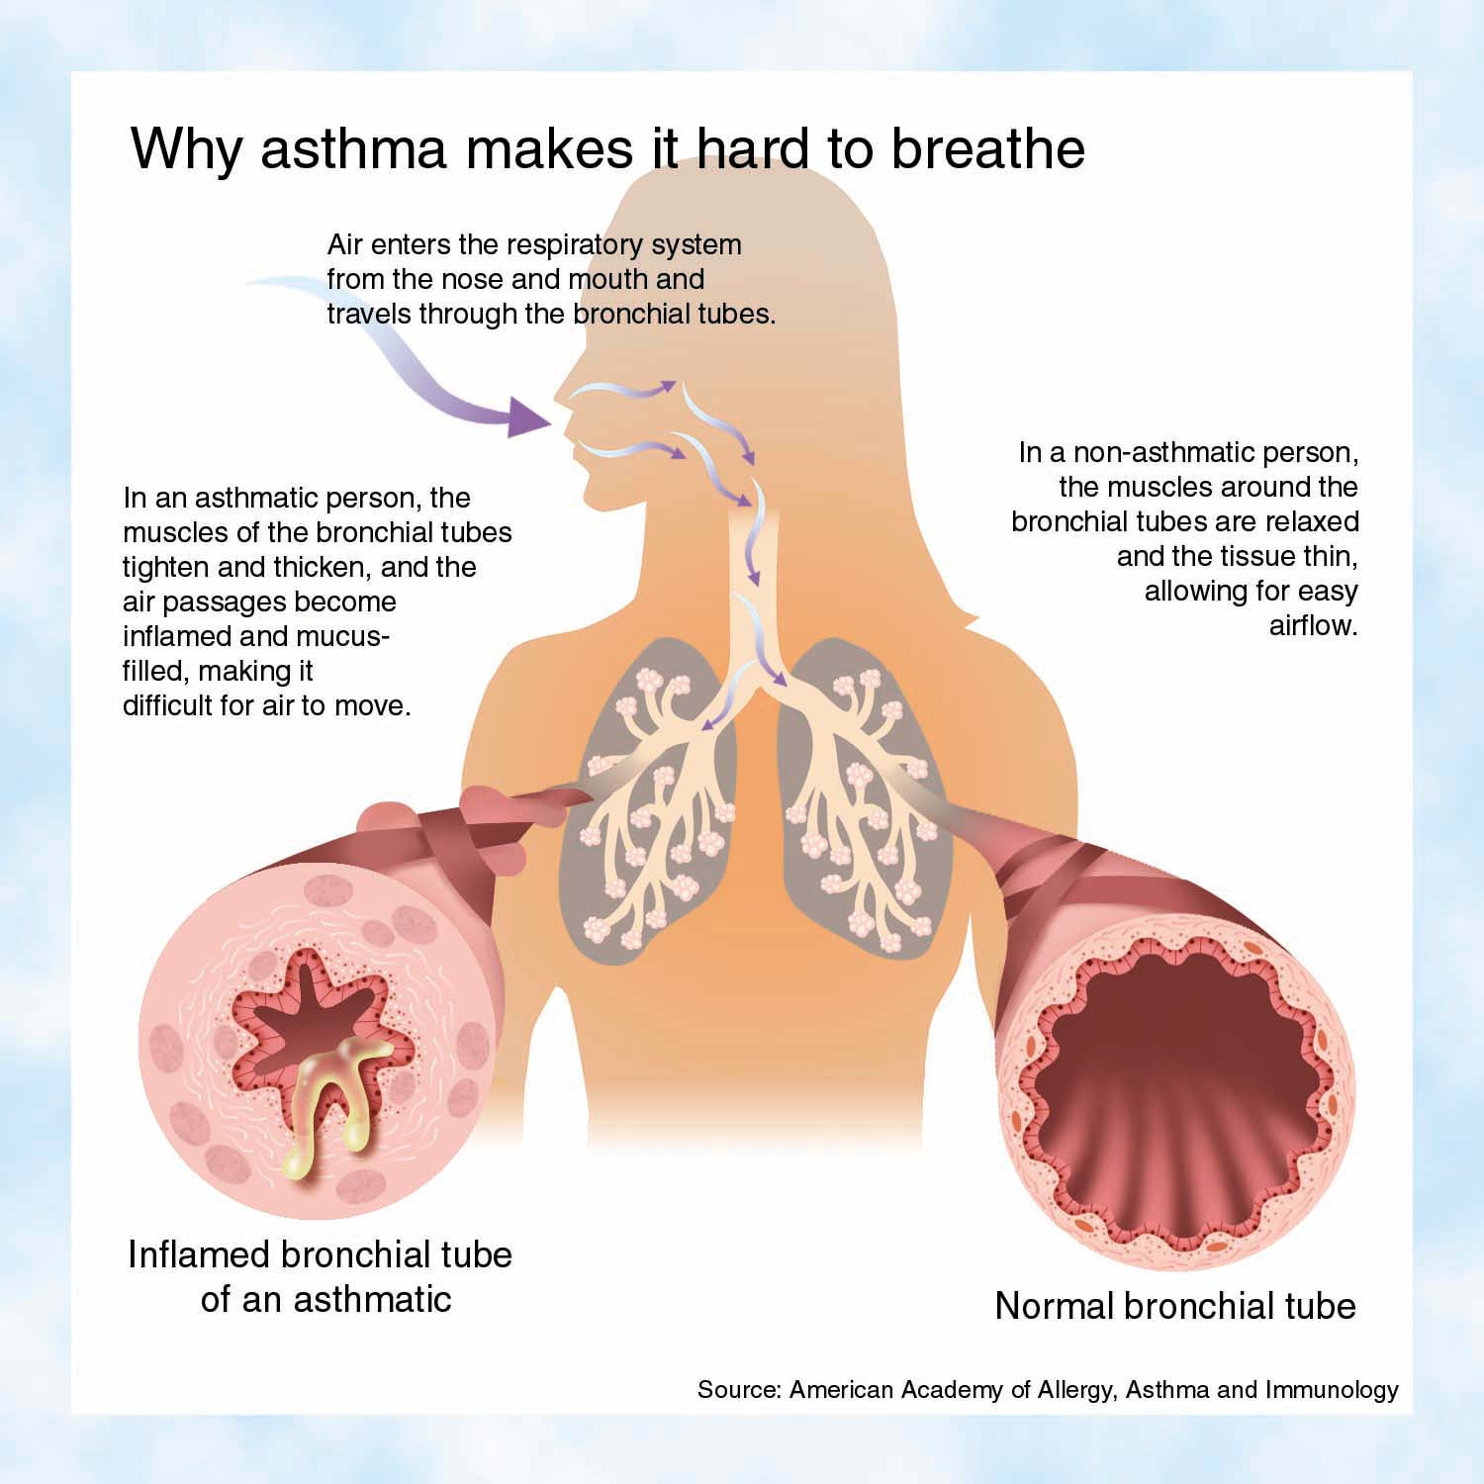

Slide 9
Obstructive Respiratory Disorders
Bronchial asthma
Clinical Classification of Asthma
Mild intermittent : Attacks occur 2 times per week or less
Mild persistent : Attacks occur more than 2 times per week
Moderate persistent : Attacks occur daily or almost daily and are severe enough to affect activity
Severe persistent : Attacks are very frequent and persist for a long period of time; attacks severely limit activity

Slide 10
Obstructive Respiratory Disorders
Bronchial asthma
Manifestations of asthma :
  Coughing, wheezing
  Difficulty breathing
  Rapid, shallow breathing
  Increased respiratory rate
  Excess mucus production
  Significant anxiety

Slide 11
Obstructive Respiratory Disorders
Bronchial asthma
Treatment of asthma:
The appropriate drug treatment regimen for asthma is based on the frequency and severity of the asthma attacks and may include the following:
1. Avoidance of triggers, and allergens. Improved ventilation of the living spaces, use of air conditioning.
2. Bronchodilators (examples: albuterol, terbutaline): Short acting β-Adrenergic receptor activators. May be administered as needed in the form of a nebulizer solution using a metered dispenser or may be given subcutaneously. These drugs block bronchoconstriction but do not prevent the inflammatory response.

Slide 12
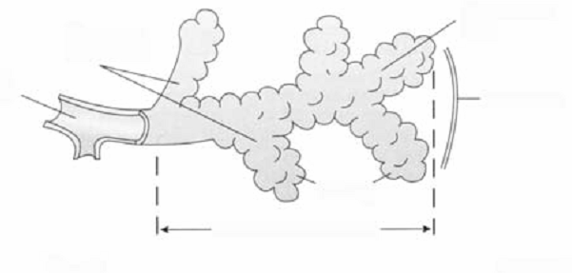
Obstructive Respiratory Disorders
Emphysema
Emphysema is a respiratory disease that is characterized by destruction and permanent enlargement of terminal bronchioles and alveolar air sacs
Alveolar
duct
Respiratory
bronchioles
Terminal
bronchiole
septum
alveoli
NORMAL ACINUS

Slide 13
Obstructive Respiratory Disorders
Emphysema
Well over 95% of all patients with emphysema were chronic cigarette smokers. Although the exact etiology of emphysema is still uncertain,
Chronic exposure to cigarette smoke causes chronic inflammation of the alveolar airways, which results in infiltration by lymphocytes and macrophages.
Excess release of protease enzymes such as trypsin from lung tissues and leukocytes can digest and destroy the elastic walls of the alveoli.
Levels of a protective enzyme α-1-antitrypsin have been shown to be lacking in certain individuals who are chronic cigarette smokers. This enzyme inactivates destructive protease enzymes (trypsin) in lung tissue.
In fact, a rare form of emphysema occurs in individuals who are not cigarette smokers but who have a genetic lack of α-1-antitrypsin.

Slide 14
Physical activity in asthma
Breathing exercises
  Breathing against resistance,
  Diaphragmatic breathing
  Stretching (trunk and neck region)
    Mm. Pectorales
    M. trapezius
    Mm.scaleni
    M. sternocleidomastoid
Strengthening exercises
  Mm. Rhomboidei
  Deep flexors of neck
Aeorbic exercises (become less sensitvite to dyspnea)
Interval exercises
Relaxation techniques

