Slide 1
Harmonization exercises
The Five Tibetan Rites

Slide 2
The Five Tibetan Rites is a yoga routine based on a ritual of exercises discovered in the early 1900's, by a British army colonel, Colonel Bradford, who was living in a Himalayan monastery.
They are practiced around the world and are said to prevent aging.
In 1939, Peter Kelder published "The Original Five Tibetan Rites of Rejuvenation," which helped spread the rites in the western world.

Slide 3
The rites are comprised of five different movements (with a sixth added for good measure), with each movement performed up to 21 times (Tibetans believe 21 is a perfect, mystical number).
It is best to start with 3 repetitions of each exercise and gradually increase the repetitions.
The entire routine can be completed in less than 10 minutes.

Slide 4
For thousands of years, medical practitioners have maintained that the body has seven principal energy centers which correspond to the seven endocrine glands, also known as chakras.
Chakras are essentially energies within spinning vortexes. As a vortex is increased, the life force becomes stronger and more directed.

Slide 5
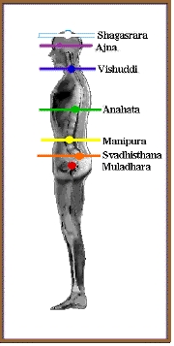
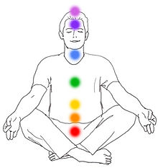

Slide 6
- Muladhara: The Root Chakra
- Swadhisthana: The Sacral Chakra
- Manipura: The Solar Plexus Chakra
- Anahata: The Heart Chakra
- Vishuddha: The Throat Chakra
- Ajna: The Brow Chakra - the third eye chakra
- Sahasrara: The Crown Chakra

Slide 7
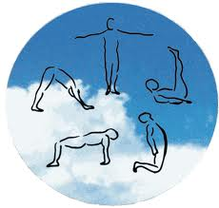
Here are the Five Tibetan Rites and how they work on the body (remember to breathe deeply using the diaphragm during the movements):

Slide 8
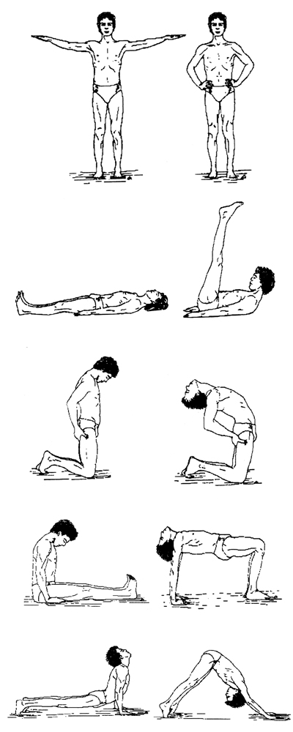

Slide 9
Do only what you feel comfortable doing!!
The "Five Rites" may stimulate detoxification and often creates many unpleasant physical symptoms. This is why it's recommended to increase the number of each exercise gradually on a weekly basis.
For maximum benefit, do the exercises before breakfast in the morning, if at all possible. If this is not possible do them anytime during the day.

Slide 10
Rite 1
Stand erect with arms outstretched horizontal to the floor, palms facing down. Your arms should be in line with your shoulders. Spin around clockwise until you become slightly dizzy. Gradually increase number of spins from 1 spin to 21 spins.
Breathing: Inhale and exhale deeply as you do the spins.

Slide 11
Rite 2
Lie flat on the floor, face up. Fully extend your arms Along your sides and place the palms of your hands against the floor. Then raise your head off the floor tucking your chin into your chest. As you do this, lift your legs, knees straight, into a vertical position. If possible, extend the legs over the body towards your head. Do not let the knees bend. Then slowly lower the legs and head to the floor, always keeping the knees straight. Allow the muscles to relax, and repeat.
Breathing: Breathe in deeply as you lift your head and legs and exhale as you lower your head and legs.

Slide 12
Rite 3
Kneel on the floor with the body erect. The hands should be placed on the back. Incline the head and neck forward, tucking your chin in against your chest. Then throw the head and neck backward, arching the spine. Your toes should be curled under through this exercise. As you arch, you will brace your arms and hands against the thighs for support. After the arching return your body to an erect position and begin the rite all over again.
Breathing: Inhale as you arch the spine and exhale as you return to an erect position.

Slide 13
Rite 4
Sit down on the floor with your legs straight.
With the trunk of the body erect, place the palms of your hands on the floor alongside your buttocks. Then tuck the chin forward against the chest. Now drop the head backward as far as it will go. At the same time raise your body so that the knees bend while the arms remain straight. Then tense every muscle in your body. Finally let the muscles relax as you return to your original sitting position. Rest before repeating this Rite.
Breathing: Breathe in as you raise up, hold your breath as you tense the muscles, and breathe out fully as you come down.

Slide 14
Rite 5
Lie down with your face down to the floor. You will be supported by the hands palms down against the floor and the toes in the flexed position. Throughout this rite, the hands and feet should be kept straight. Start with your arms perpendicular to the floor, and the spine arched. Now throw the head back as far as possible. The bending at the hips, bring the body up into an inverted "V".
Breathing: Breathe in deeply as you raise the body, and exhale fully as you lower the body.

Slide 15
After Exercise 5, lay flat on your stomach with your arms stretched out from side to side.
Keep your chin on the ground and close your eyes.
Feel you heart pumping and blood circulating through your body.
Wait until your hearth beat and breath returns to normal.
Turn your head to once side and take a few deep breaths.
Relax for 1 minute.

Slide 16
Begin your day or continue with your morning yoga routine or physical work out.
You should have more energy.
If you perform the 5 Tibetans before bed , make sure you have 30 or 45 minutes to relax after Rejuvenation your energy.
„I've spent time laying in bed afterward and felt like I had drank a pot of coffee“
Christopher S. Kilham (The Five Tibetans: Five Dynamic Exercises for Health, Energy, and Personal Power)

