Slide 1
d048 ACADEMIC WRITING
FACULTY OF SPORTS STUDIES
FALL 2016

Slide 2
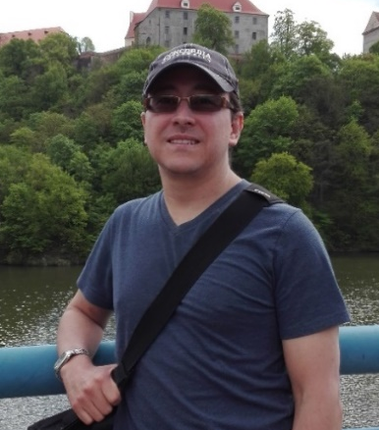
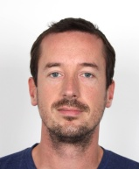
Instructors:
David Vargas
Joe Lennon
Born in Colombia, South America but emigrated to Canada in 2000
I have lived in Spain
B.A. in Geography and Political Science with Concentration in International Relations from Carleton University in 2015.
Worked as Research Assistant at Carleton University (2014-2015)
Topics of Interest: human geography, hydrology, climate change, cities and planning, human displacement, human development.
Other fascinating topics: photography, art, cooking, reno projects, travel, science
From Atlanta, Georgia, USA, but I've lived and taught on three continents.
Brno (2006-2009): teaching General and Business English,
China (two years):Academic Writing
PhD in Creative Writing from the University of Denver in 2015.
Academic Writing at the University of Colorado (2015)
Back in Brno: Assistant Professor in the Language Centre at Masarykova (2016).
When I teach writing, I focus on process over product--if you learn how to think openly and critically as you write and revise, you can apply those skills to any form, and your writing will contribute to a larger conversation.

Slide 3
Schedule
David Vargas
Joe Lennon
Month | Day | Time
October | 6 | 16.15-18:30
 | 13 | 16.15-18:30
November | 10 | 16.15-18:30
December | 15 | 14.30-16.45
Month | Day | Time
October | 27 | 15:00-17:15
November | 24 | 16:00-18:15

Slide 4
Goal of the Course
“The goal of this course is to familiarize doctoral candidates with different approaches to scientific writing”
To take your academic writing skills in English to a higher level
To offer you a range of tools to adapt your focus of language
To address your target readers at specific, multi-disciplinary and general levels.

Slide 5
Teaching Methods
The course will be organised around group and individual writing tasks, problem-solving and discussion activities in intensive block seminars. It will also include peer review and consultation on writing with text analysts and publication professionals.
Assessment Methods
A model text of an article / a section of an article that is suitable to be submitted to an ISI/Scopus journal.

Slide 6
BY THE END OF THE COURSE YOU WILL BE ABLE TO:
1. Understand and use both generic and subject specific academic vocabulary
2. Read and evaluate texts in appropriate ways to make use of them in writing
3. Understand different text styles / structures (thesis and journal article)
4. Know how to write successfully titles, abstracts, paragraphs, and introduction, method, results, discussion, conclusion and recommendations sections of a journal article
5. Evaluate strengths/weaknesses of written work

Slide 7
Writing Tips for Academic Journals
1. Have a strategy:
Why do you want to do it?
What is your purpose? e.g. research assessment, to make a difference, to have an impact factor or to have an impact, develop a professional profile.
When do you want to do it? Deadline?
Who? Research team, independent research, etc.
How? Supporting data: primary or secondary sources, citations, data from experiments, key words, definitions
Which journal?
Rowena Murray. (2013) “Writing for Academic Journals” 3rd Ed. Open University Press-McGraw-Hill.
Professor in education and director of research at the University of the West of Scotland

Slide 8

2. Analyze writing in journals in your field
Take couple of journals in your field (may be your present or future target)
Look closely – first and last sentences –
Rationale for the search (usually first sentence)
Any new knowledge?
How to put together a new form of contribution from the work you did?
Think on two sentences to start and finish your abstract
Structure
Components of the argument
Highlight all the topic sentences (main and supporting ideas)
Identify a style that you like and use it as a model for yours
https://vincekotchian.com/gre-for-high-scorers-reading-comprehension/

Slide 9

3. Do an outline and just write
Make a very detailed outline (main sections mirroring those of an article you liked)
Heading types
Length of the sections
Set word limits for your sections, sub-sections or sub-sub-sections (set time frame for it and for feedback)
Do you write to develop your ideas or are you writing to document your work?
Is your outline a sort of agenda for writing sections of your article?
Define tasks by thinking about verbs: summarise, overview, critique, define, introduce, conclude, etc. – these define your purpose.
https://www.goconqr.com/en/examtime/blog/how-to-answer-exam-questions/

Slide 10
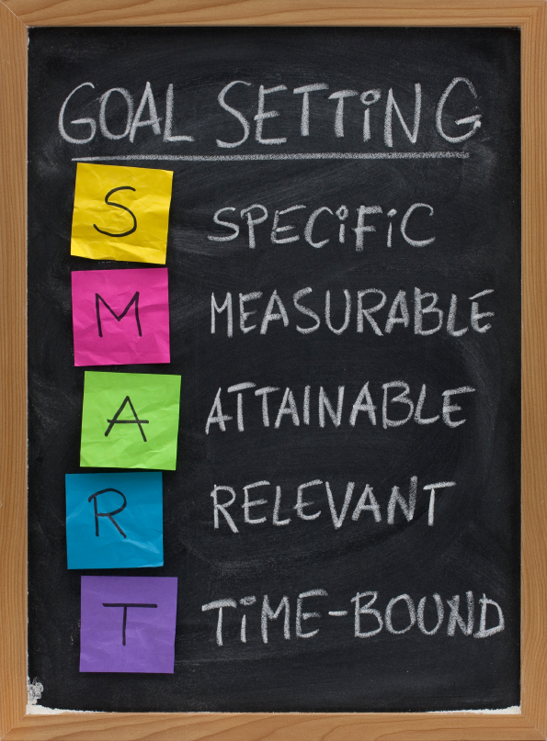
4. Get feedback from start to finish
  From first sketch of it: discuss it with a handful of people
  Get feedback on your draft abstract from these people
  Do multiple revisions before submission of it
5. Set specific writing goals and sub-goals
  Writing goals: (Decisions about content, sequence, and proportion)
    Content
    Verb and word length for the section
Example: “Next writing goal: summarise and critique ten articles for literature review section in 800 words on Monday between 9 am and 10:30 am” instead of “I plan this article to be ready by the end of the year”
https://www.google.cz/url?sa=i&rct=j&q=&esrc=s&source=images&cd=&cad=rja&uact=8&ved=0ahUKEwjBpNHL28TPAhXKExoKHVZBAr0QjRwIBw&url=http%3A%2F%2Fsvsaibaba.blogspot.com%2F2016%2F02%2Fgolden-rules-of-goal-setting.html&psig=AFQjCNEtWDaFBfU3oPiyOhfx6I5mKXLNUw&ust=1475792998096838

Slide 11
6. Write with others
From solitary to communal activity. This helps develop confidence, fluency and focus
Key: time allowance on exclusive writing periods: 90 min. (that means putting away emails, internet and all other devices or distractions)
7. Do a warm up before you write
Write for five min: What writing for publications have you done? What do you want to do in the long, medium, short term?
Once you have started writing your article do a variation: What writing for this project have you done? What do you want to do in the long, medium, short term?
End each session of writing with a writing instruction for yourself to use in your next session e.g. “on Wednesday from 11 am to 12 noon, I will draft conclusion section in 500 words
Goals need to be specific so use numbers for it (this is how you will learn to set realistic targets)

Slide 12
8. Analyze reviewers’ feedback on your submission
What exactly are they asking you to do?
Are they asking you to cut or add something?
How much?
Where?
Write out a list of revision actions
When you resubmit your article include this in your report to the journal, specifying how you have responded to reviewers’ feedback
In case article is rejected is still useful to look at the feedback. Ask yourself why and revise it for somewhere else
Keep in mind that most feedback is aimed at improving your paper/ article writing but it may seem overheated, personalised, even vindictive or unprofessional. Discuss reviews with others. You may find that other people also get rejections and negative reviews.
Revise and resubmit as soon as you can

Slide 13
9. Be persistent, tick-skinned and resilient
You may develop these qualities over time
It is easier to do it when you discuss it with other journal writing peers
10. Take care of yourself
Highly competitive field
Can be extremely stressful
Health risk too i.e. writing for long periods of time
Celebrate thoroughly when article is accepted

Slide 14
Last but not least: PLAGIARISM
“an act or instance of using or closely imitating the language and thoughts of another author without authorization and the representation of that author's work as one's own, as by not crediting the original author”
http://www.dictionary.com/browse/plagiarism
Failure to use standard academic conventions when paraphrasing or directly quoting information or using graphics from sources is unacceptable in academic work; any or all of the following:
  No in-text citation
  No quotation marks
  No reference list
Copying information from sources and presenting as your own ideas is plagiarism; any or all of the following:
  No attempt to paraphrase/ only a few words changed/ order of information unchanged
  No quotation marks
  No in-text citation
  No reference list
https://carleton.ca/slals/credit-esl/plagiarism-cheating/

Slide 15
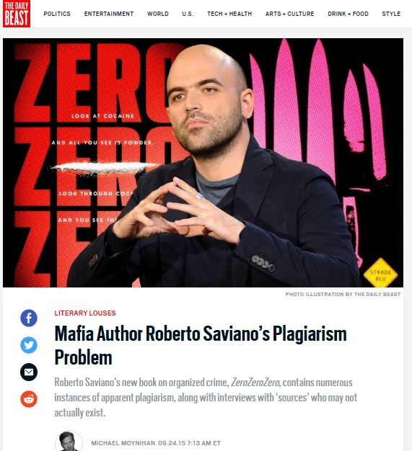
And here are some of the consequences:
http://www.thedailybeast.com/articles/2015/09/24/mafia-author-roberto-saviano-s-plagiarism-problem.html

Slide 16
Conclusion:
Writing is hard work:
  Self discipline
  Self denial
  Rejection is high

