Slide 1
Compensatory Exercises and Regeneration
Mgr. Lenka Beránková, Ph.D.
Department of Health Promotion, Faculty of Sports studies MU

Slide 2
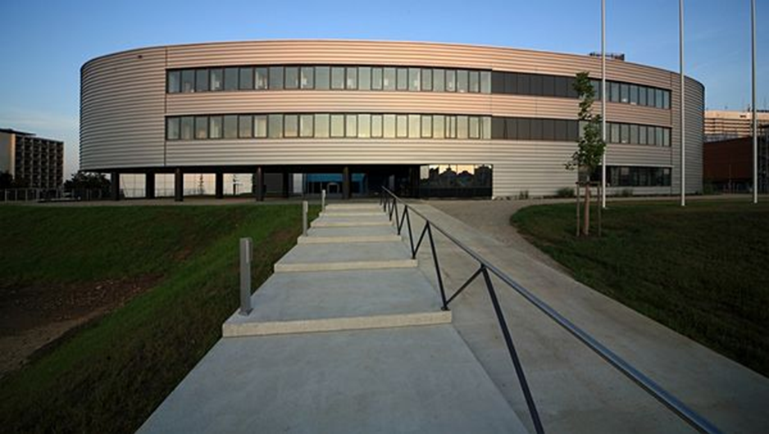


Slide 3
Why Compensate
Periodic compensation significantly reduces
  Muscle imbalances
  Chronic musculoskeletal injuries
  Nonspecific pain of locomotor apparatus
  Acute musculoskeletal injuries
Significantly increases
  Neuromuscular coordination
  Power endurance
  Felxibility
  Proprioception

Slide 4
Scheme of Compensatory Exercises
Warming Up
Releasing Exercises
Stretching
Sensomotoric training
Strengthening exercises
Relaxation

Slide 5
Releasing exercises
Releasing exercises are always directed to a particular joint or motion segment. It allows better blood flow to soft tissues around the joint.
Improved blood circulation and circulation of synovial liquid has generally positive efect on the mechanical features of soft tissues and cartilage.
When making releasing exercises the movement is passive rather than active. Range of motion should correspond to the current functional capabilities of the joint.

Slide 6
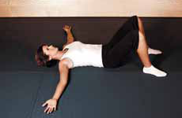
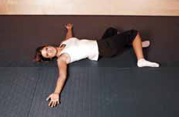
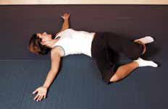
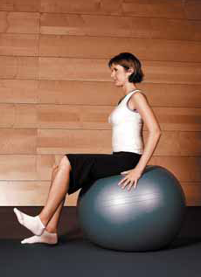
Releasing Exercises

Slide 7
Scheme of Stretching
Stretching
Dynamic
Static
Pasive
PIR

Slide 8
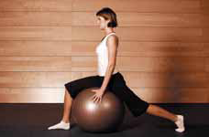
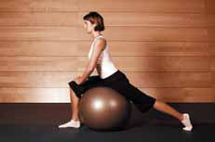
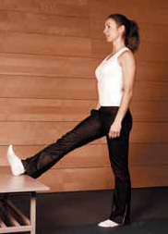
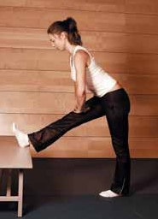
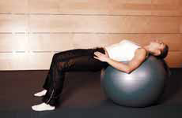
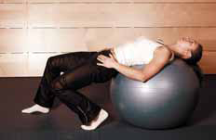
Stretching

Slide 9
Scheme of Strengthening Exercises
Strengthening
Static
Dynamic
quick
slow

Slide 10
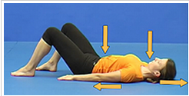
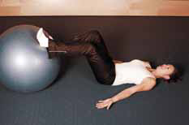
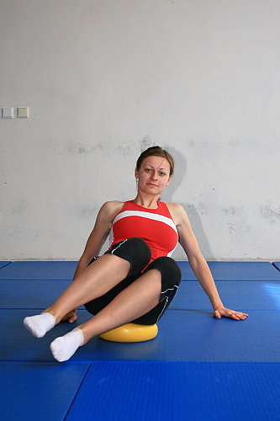
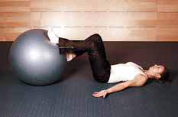
Strengthening exercises

Slide 11
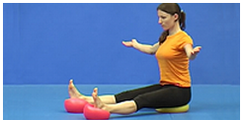
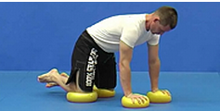
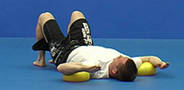
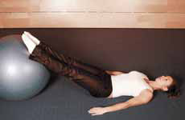
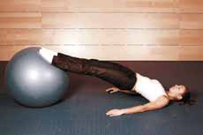
Balance and Sensomotoric Exercises

Slide 12
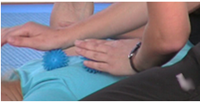
Relaxing exercises
https://is.muni.cz/auth/do/fsps/e-learning/ztv/pages/09-kardiovas.html

Slide 13
Principles of compensatory exercises
Keep right sequence of exercises
Proceed from the lightest to the heaviest exercises
Comply strictly correct starting position and course of movement
Correct breathing (diaphragmatic breathing, exhale during the contraction)
Sufficient frequency and intensity of exercise
Stretching exercises every 24 to 48 hours / length of extension at least 30 seconds.
Strengthening exercises at least 2 times a week (optimum 3 times a week) 2-4 sets of 10 -20 repetitions per exercise based on an individual abilities of the individual
To vary exercises for each muscle group
Sometimes less is more!

Slide 14
Regeneration
Regeneration is a biological and social process, which aims to restore balance and reversible decrease in functional abilities and individual body organs.
This is manifested by fatigue
  Physical
  Mental
  Physiological (local, general)
  Pathological (acute, chronic)

Slide 15
Regeneration
Passive
  Sleep (and most effective natural method of regeneration)
Active
  Other than the physical activity of sports (eg swimming, cycling, yoga ...)
  Drinking regime
  physical therapy
  Thermotherapy (sauna, cryotherapy)
  Massage (sports, regeneration, relaxation)

Slide 16
Thank you for attention

