Slide 1
Diagnostics of musculoskeletal system
Mgr. Lenka Beránková, Ph.D.
Faculty of Sports Studies
Department of Health Promotion

Slide 2
Evaluation of posture and functional stage of musculoskeletal system
Determination of posture
  Traditional posture standards for male and female according to Klein, Thomas, and Mayer.
  The methods recognize different criteria for the evaluation of posture in male and female according to silhouette images and classify postures into 4 different categories (excellent, good, weak, bad). Clinical examination is performed to independently evaluate the position of head, shoulders, and scapular bones; chest and abdominal profile; spine curvature; pelvic inclination; and position of lower extremities, including the foot arch.

Slide 3
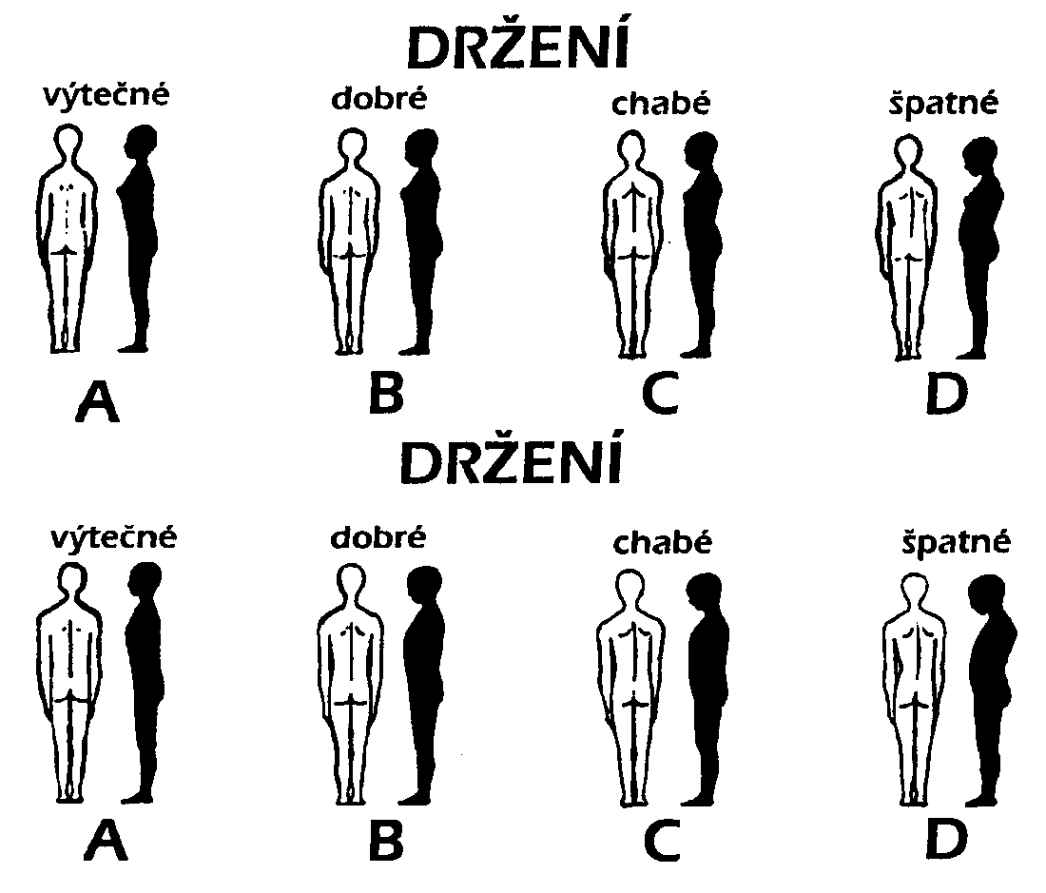
Postural patterns (excelent, good, week, bad)

Slide 4
Evaluation of spinal curve with plumb line
The head should align directly over the sacrum, and any deviation from midline may reflect a spinal deformity. The examiner can detect deformity by dropping a plumb line from the spinous process of C7 or occipital bone down to the level of the gluteal cleft. The deviation of spine from plumb line and number of centimeters of the plumb line from the gluteal cleft is noted.
We can measure the depth of spinal curve in cervical (normality= 2,5cm) and lumbar (normality= 4cm) region.

Slide 5
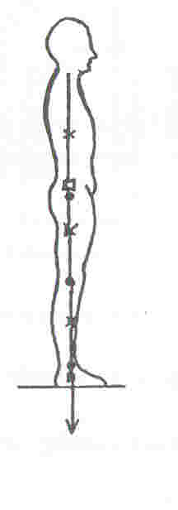

Slide 6
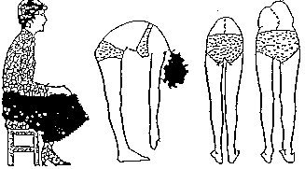
Another tests
Adam's forward bending test
Thomayer test- deep forward bend
  Evaluation of length of hamstrings, erector of spine, unwinding of spine. Normality=third finger touching floor

Slide 7
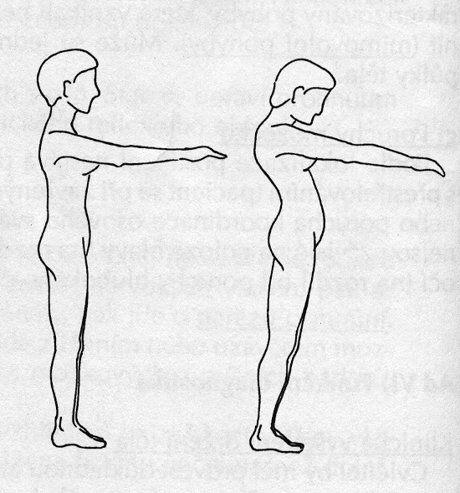
Mathyas test

Slide 8
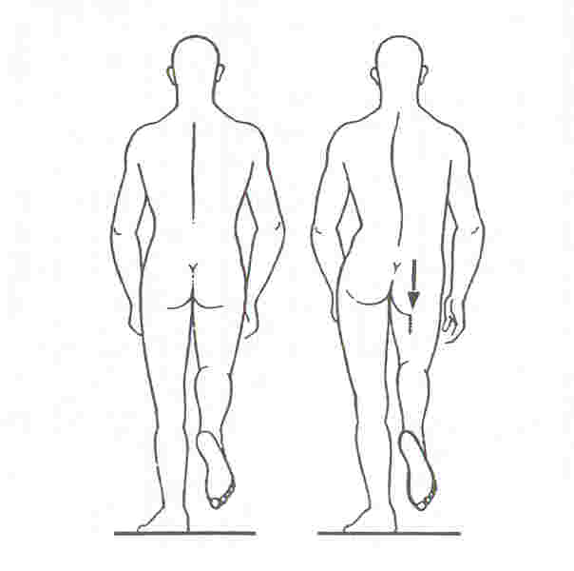
Trendelenburg-Duchen test

Slide 9
Muscle test – postural muscles
With qualitative scale we are measuring:
Muscles with tendency to be shorted (postural muscles)
Evaluation:
without shortening,
moderate shortening,
pathological shortening
  Calf (m. gastrocnemius, m. soleus)
  Hamstrings (m. semitendinosus, m. semimembranosus, m. biceps femoris, m. gracilis)
  Adductor muscles
  Flexors of hip joint (m. iliopsoas, m. rectus femoris, m. tensor fascie latate)
  Extensor of spine (paravertebral muscels)
  Pectoral muscles
  Muscles in nape region (m. trapezius pars descendens, m. levator scapulae, sternocleidomastoid)

Slide 10
Muscle test – weakness
Muscles with tendency to be weak together with motion stereotypes
Evaluation: motion stereotype: 1. good
2. poor
muscle weakness: 1. good,
2. moderate weakness,
3. pathologically weak
  Motion stereotype of extension of lower extremity +power of gluteal muscles
  Motion stereotype of flexion of trunk + power of abdominal muscles
  Motion stereotype of abduction of arm + power of deltoid muscle
  Motion stereotype of flexors of neck + power of deep flexors of neck and head

Slide 11
Hypermobility
Rotation of head
Internal rotation of upper ext.
Extention of elbows (110 dgr.)
Deep forwarded bending

