Slide 1
Data in Sports
Brenda Li

Slide 2
Outline
Why surveys?
Surveying in sports
  Sponsorships
  Challenges with surveying
Setting up a survey
Examples

Slide 3
Why survey?
Easiest form of wide-scale information gathering
  No limit on how many people receive the survey
Cost-effective
  Can be internally produced and managed
Various ways of distribution
  In – person
  Email
  App
Precise results for analysis

Slide 4
Surveys in Sports
Typically used for customer satisfaction
  How do consumers feel about the experience?
  What are areas of improvement?
  Who is in the building?
Sponsorships (pre and post)
  Benchmarking for engagement level at the start of sponsorship
    App question example: Have you heard of this brand?
  How has the sponsorship increased brand awareness?
  Are people more likely to purchase a sponsor brand?
  Who is in the building?

Slide 5
League reports
Every league sends out a report to its fans to understand their reactions to the league and to sponsors
Awareness of the league
Awareness of leagues sponsors
Affinity to sponsors
Likelihood to purchase (consideration) from sponsors
Why spend here instead of elsewhere?

Slide 6
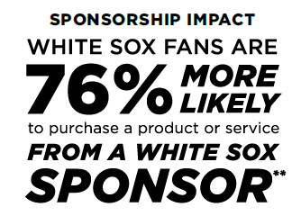
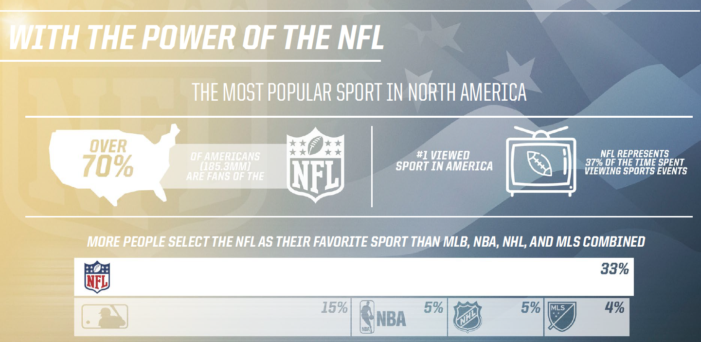
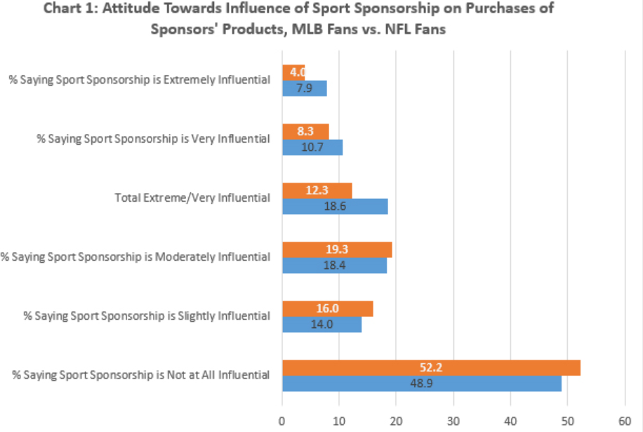

Slide 7
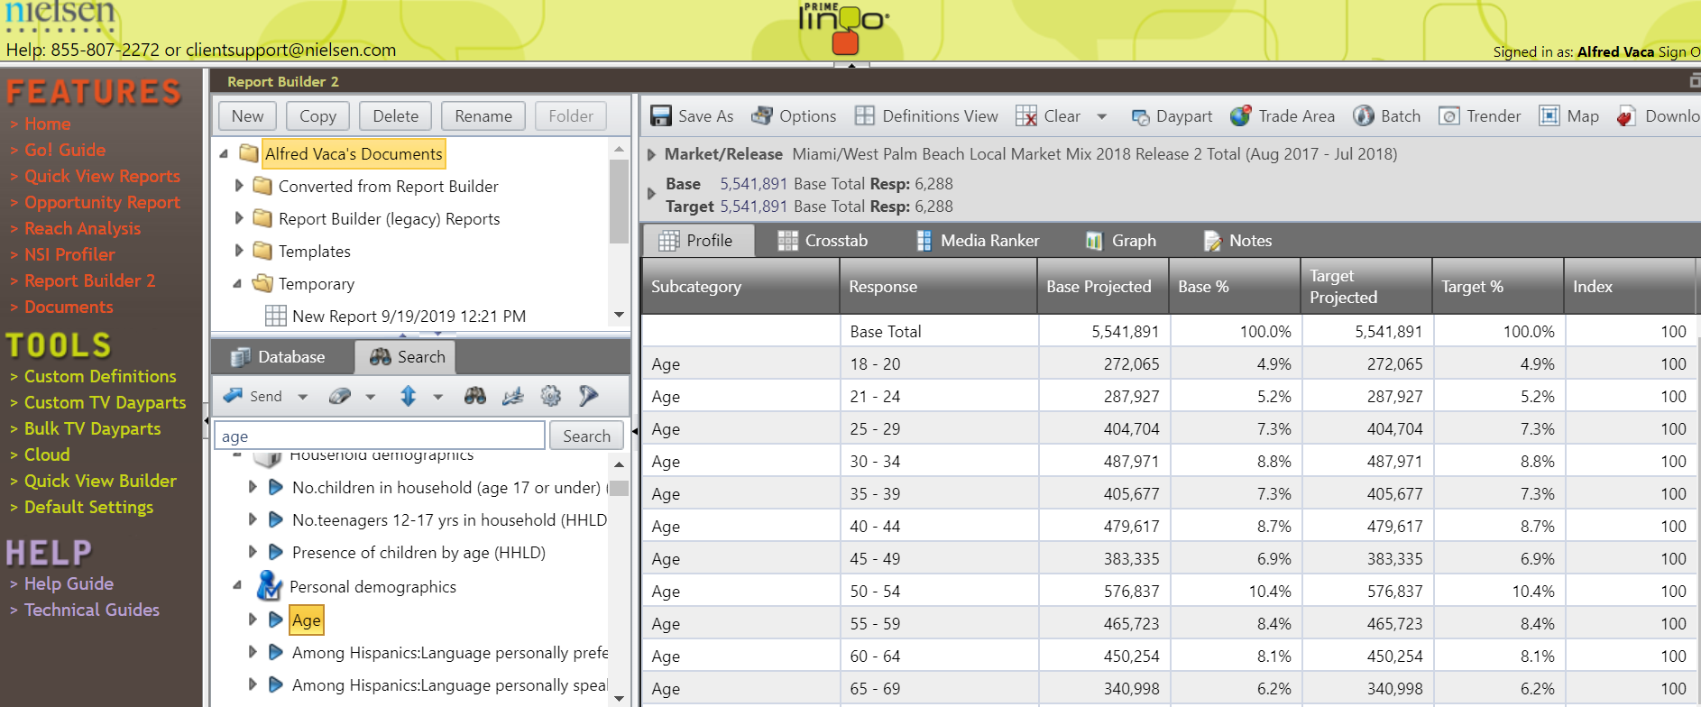
Example: Popular survey tool

Slide 8
demographic Questions
Used both from a customer experience perspective and a sponsorship side
Teams need to know who is in the building
Brands want to know who they’re communicating to through the partnership
Are there specific subsets that can be targeted?

Slide 9
Challenges to surveying
Survey fatigue
  Consumers are over-communicated to by every brand
Lack of responses
  Response rates can fluctuate from 40% of members to only 10% of single-ticket buyers
  Respondents may start to answer then drop out
Biased questions

Slide 10
Setting up a survey

Slide 11
Survey Question Set-Up
Surveying should be unbiased
  Leading questions
  Loaded questions
  Two questions at once
  Absolute answers
  Accurate scales

Slide 12
Common Types of Questions
Yes/No (Are you currently a season ticket holder?)
Multiple Choice (Where did you buy your tickets from?)
  Should always include an other selection
  Can we only one selection or multi-selection
Ranking (Please rank the following brands on their product durability with 1 being the highest, and 5 being the lowest.)
  Scale explanation extremely important
Rating Scale (How likely are you to purchase a sponsor product vs a non-sponsor product?)
  Answers should be evenly spaced – likely, neutral, unlikely
Open-ended questions

Slide 13
Demographic Questions
Brands might be interested in knowing the following
  Age
  Household income
  Consumption habits
  Marital status
  Leisure activities
What other things might a brand want to know?

Slide 14
Sponsor Questions
Aided vs non-aided (brand awareness)
Aided example
  Which of the following brands are car sponsors of the team?
Unaided example (stronger awareness)
  Please list all hospital sponsors of the team
Likelihood to purchase
Are you more or less likely to consider the brand if it is a sponsor?

Slide 15
Sample Survey Questions
How likely are you to purchase a sponsor product vs. a non-sponsor product?
Which of the following are automobile partners of the team?
Please list all sponsors of the team you can recall.

Slide 16
Sample Survey Questions
How great have Toyota’s on-site activations been this past season?
Vs.
How do you feel about Toyota’s activations this past season?

Slide 17
Sample Survey Questions
Do you always visit our on-site activation space?
Vs.
How many times have you stopped at the activation space?

Slide 18
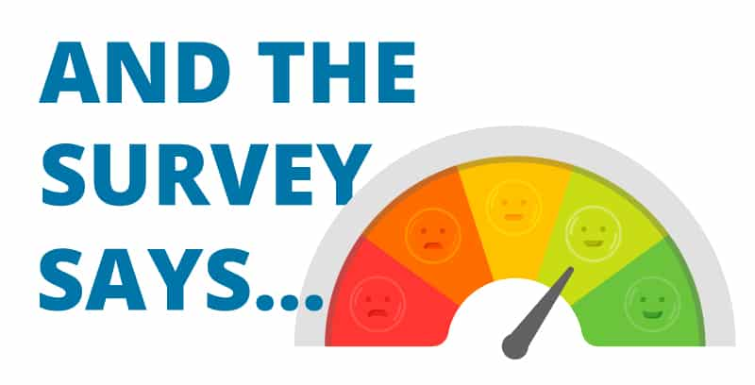
Questions?

