Slide 1
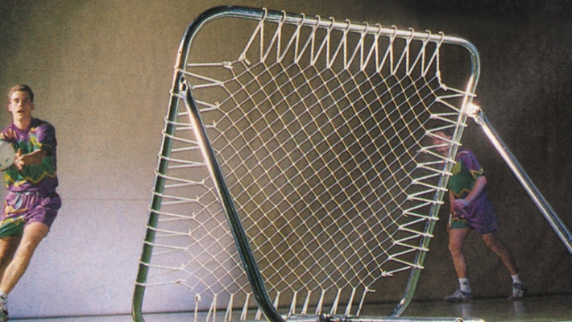




TCHOUKBALL
Francisco Javier Jiménez Lozano / 77390579H
UCO 504915

Slide 2
Table of Contents
TCHOUKBALL
Table of Contents
What is Tchoukball?
History
Material
Court
Players
Game
Scoring
Defending
Highlights
Rules
General Rules
Ball Handling
International Tchoukball Federation (FITB)
Competitions
Best Team
Injuries
Spirit, Philosophy and Values
Tchoukball Charter
Fun Fact
Beach Tchoukball
Summary – Tchoukball in 10 tips
My Opinion of Tchoukball
Webgraphy

Slide 3
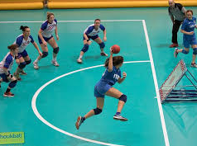
What is Tchoukball?
It’s an indoor team sport based on handball (played with hands and the balls used are similar), volleyball (as the defending team must prevent the ball from falling) and squash (as there is a rebound).

Slide 4
History
Tchoukball was developed in the 1970s by Hermann Brandt, a Swiss biologist who was concerned about the numerous serious injuries among athletes resulting from sports prone to aggression and physical contact. He believed that sport should not only be for champions, but also contribute to the creation of a better and more humane society. In this way, tchoukball born a sport that would reduce injuries, do not be aggressive among players and allow people of all shapes, sizes, genres, cultures and backgrounds to play together.

Slide 5

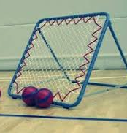
Material
Ball (handball):
58-60cm circumference for men (size 3)
54-56cm circumference for women (size 2)
Frame: Metallic box of 100 cm side. Variable inclination. Reference angle between 50º and 60º. (More angle, more difficulty).
Something to mark the forbidden zone (lines).

Slide 6
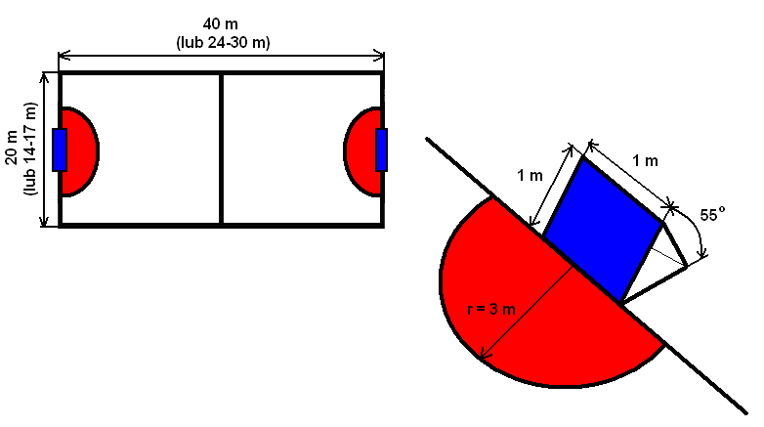
Court

Slide 7

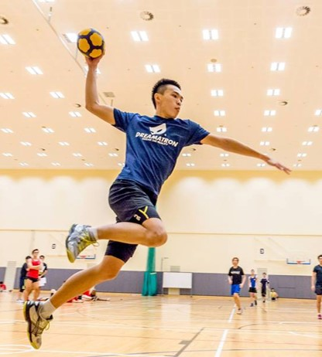
Players
10 players per team (7 players and 3 substitutes).
Although there are specialised positions in attack and defence, players are allowed to do either. Players fall into three categories; 'shooters' whose main aim is to score points, 'defenders' whose job it is to stop points being scored, and a 'centre', who spends most of their time in the centre of the court distributing play and also defending in case of a higher shot.

Slide 8
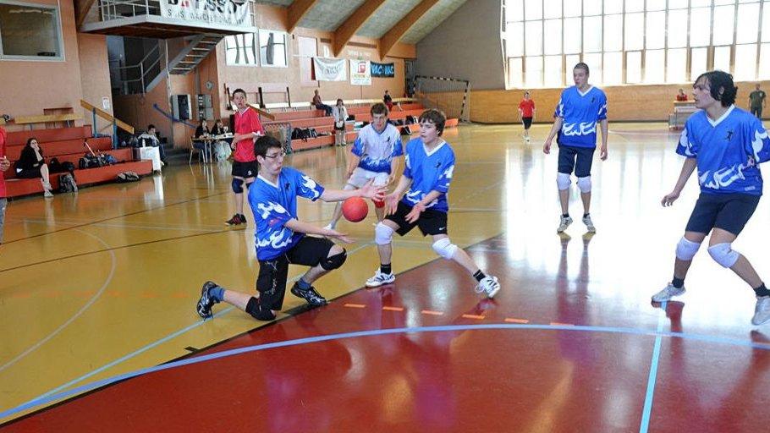
Game
Put quite simply, the object of tchoukball is to throw or 'shoot' the ball at the frame, so that it rebounds and lands over the line of the D in the court. The opposition's job is to catch the ball to prevent their opponents scoring and then shoot it themselves. This sequence continues until a point is scored.
Everything works in 3s. You have 3 seconds with the ball, 3 steps with the ball, and 3 passes with the ball before it has to be shot at the frame. Tchoukball is a non-contact sport. There is no tackling involved and the only time possession switches from one team to the other is when the ball is caught by a defending player after the opposition shoots or the ball is dropped during play.
To shoot the ball at the frame you have to jump from outside the forbidden zone and release it before you land.
When the ball is shot by a team, the opposing team has to defend around the line. Typically (as shown here on the left) the ball comes out very low and hard so the defenders will be on their knees to catch the ball. The two other players behind the defence are known as 'second line defenders'. They are defenders from the other end of the court who are there in case the ball is deflected upwards and behind the 'front line' of defence.

Slide 9
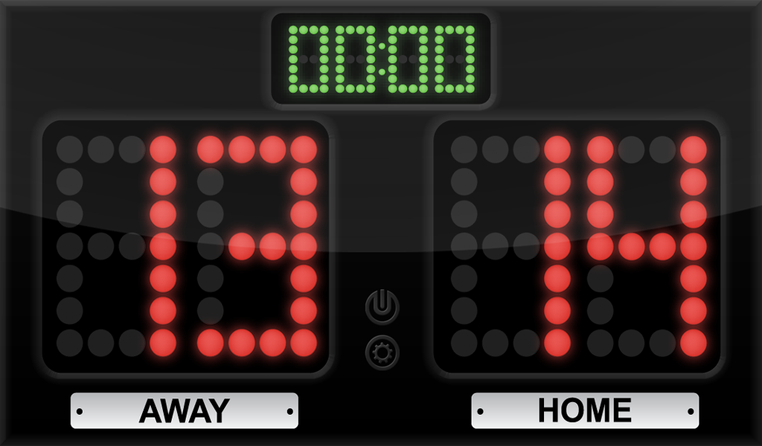
Scoring
In order to score a point the ball must be thrown from outside of the crease, bounce off of the frame and land on the ground outside of the crease.
Points can be scored on either frame.
If the ball is bounced off of the frame and then caught by the opposing team, no point is scored and the opposing team can attack immediately.
After a point is scored the opposing team get possession of the ball beside the frame outside of the crease.
Players cannot attempt to interfere with the attacking player or with the non-attacking team when trying to catch the ball.

Slide 10
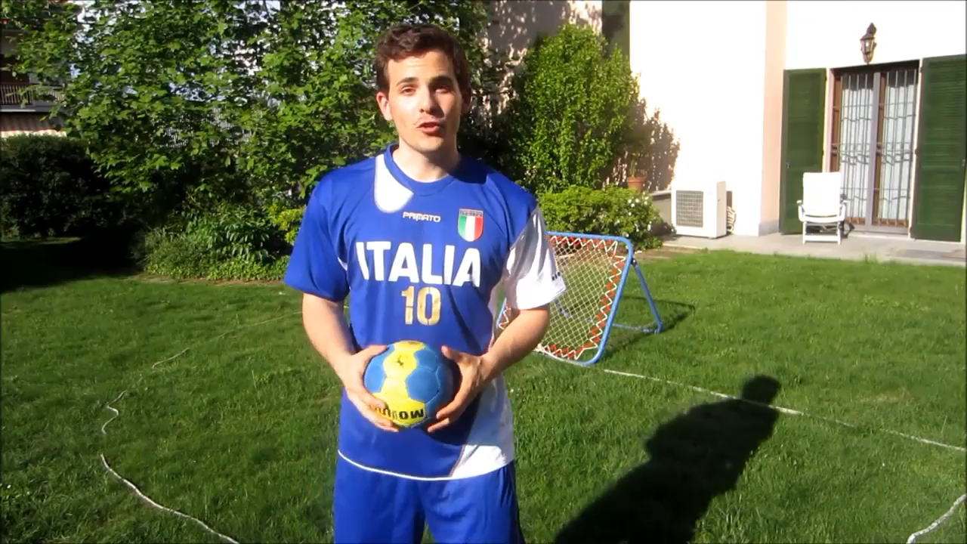
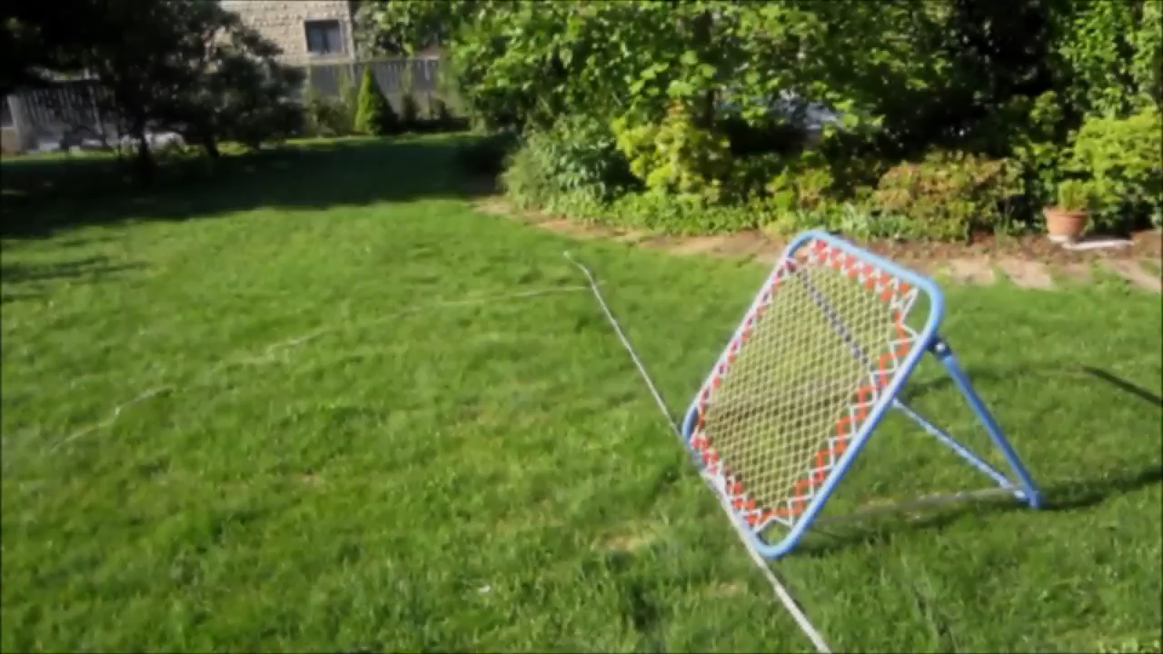

Slide 11
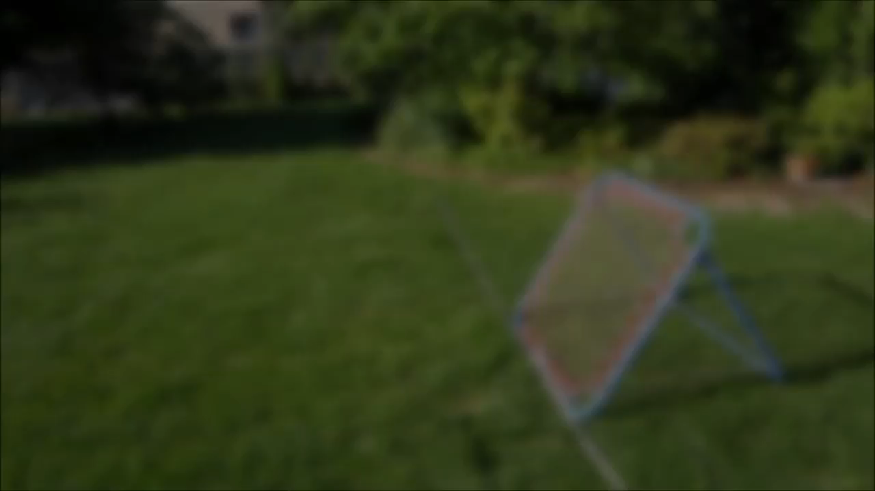
Defending

Slide 12
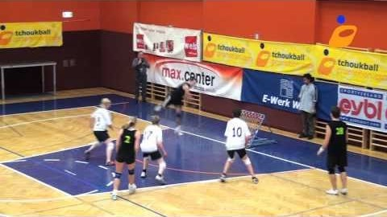
Highlights

Slide 13

Rules

Slide 14
General Rules
The game will start with a jump ball at centre court.
Games will consist of two 20 minute halves, with a short half time.
There are no time outs permitted, exclusion: personal injury or playoffs.
Substitutions can be made on the fly at the teams bench and are unlimited.

Slide 15
Ball Handling
3-3-3 rule:
-Players are allowed to move with the ball for a maximum of 3 steps and then must pass to another teammate or attempt a shot on goal. (a step is considered when a player lifts any foot off of the ground and places it back down, even if it is in the same spot) .
-Players are only allowed to hold the ball for 3 seconds without moving when closely guarded by a defender (defender must be counting).
-Players can throw the ball at one rebounder a maximum of 3 times. After the third time, the ball must be thrown at the opposite rebounder.
Players may use their hands (open or closed) to catch, push or hit the ball. Use of the chest, head and knees are also permitted. However use of leg below the knee is not permitted.
A player may not touch the ball more than once (not allowed to pass to one’s self) unless the ball is defected or hit from the hands of the defender from the opposing team.
If a player misthrows the ball the first player to get to the ball get possession, unless the ball goes out, in that case the ball goes to the other team.

Slide 16

International Tchoukball Federation (FITB)
The FITB, founded in 1971, has its headquarters in Geneva. It currently comprises 13 member associations and 22 affiliated associations (meaning that it has relations with 35 countries). Despite limited financial and human resources, it has developed numerous contacts around the world. It supports and advises national associations and individuals willing to implement tchoukball in new areas. For example, Tchoukball has recently been integrated into the school curriculum in some regions of Senegal

Slide 17
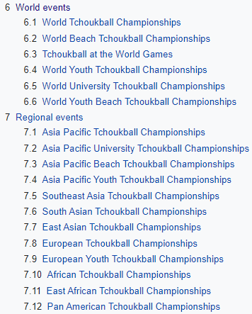

Competitions

Slide 18
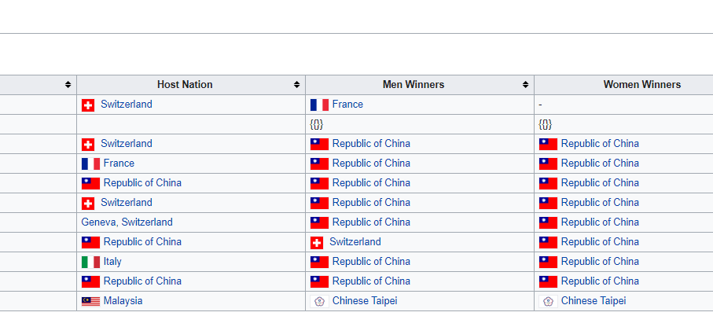
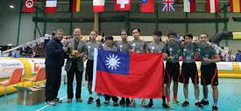
Best Team
We can conclude from this table that Taiwan (Republic of China) is the best national team of Tchoukball (with 15 victories of the world championship, adding the female and male categories).

Slide 19
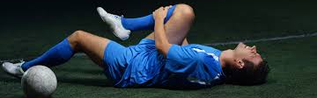
Injuries
During a community match in Kingston, Ontario, Canada on February 8, 2015, tchoukball player Arthur Freitas sustained serious facial injuries. His team would go on to win the match. This is the first and only reported tchoukball-related injury.
ONLY 1 SEVERAL INJURY IN THE ENTIRE HISTORY!!!
We could say that Thouckball is the less harmful sport.

Slide 20
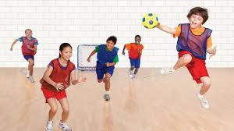
Spirit, Philosophy and Values
“The objective of human physical activities is not to make champions, but rather to help construct a harmonious society.” — Dr. Hermann Brandt.
Brandt worked to develop a team sport that would:
Be competitive without encouraging aggression
Avoid violent confrontations
Increase self-confidence and the ability to concentrate
Reward problem-solving and anticipation as well as physical ability
Teach teamwork and positive social behavior
Teach principles of physics

Slide 21
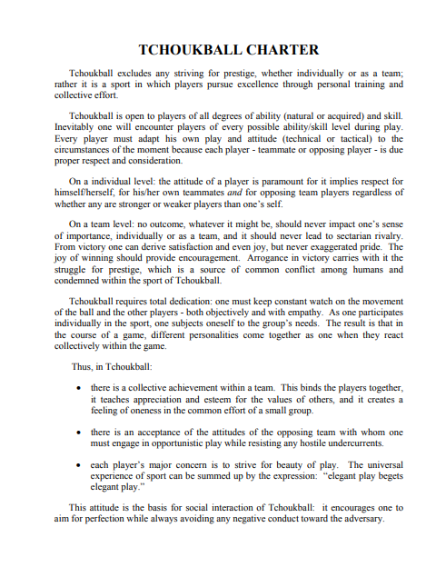
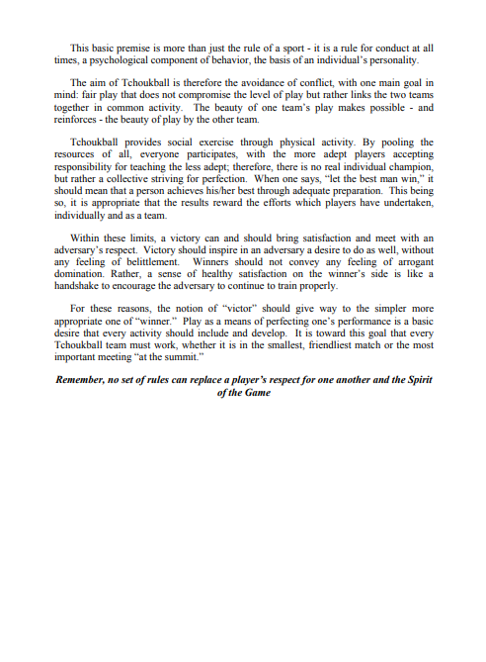
Tchoukball Charter
Dr. Hermann Brandt also carefully wrote the Tchoukball Charter.
“Remember, no set of rules can replace a player's respect for one another and the Spirit of the Game”

Slide 22
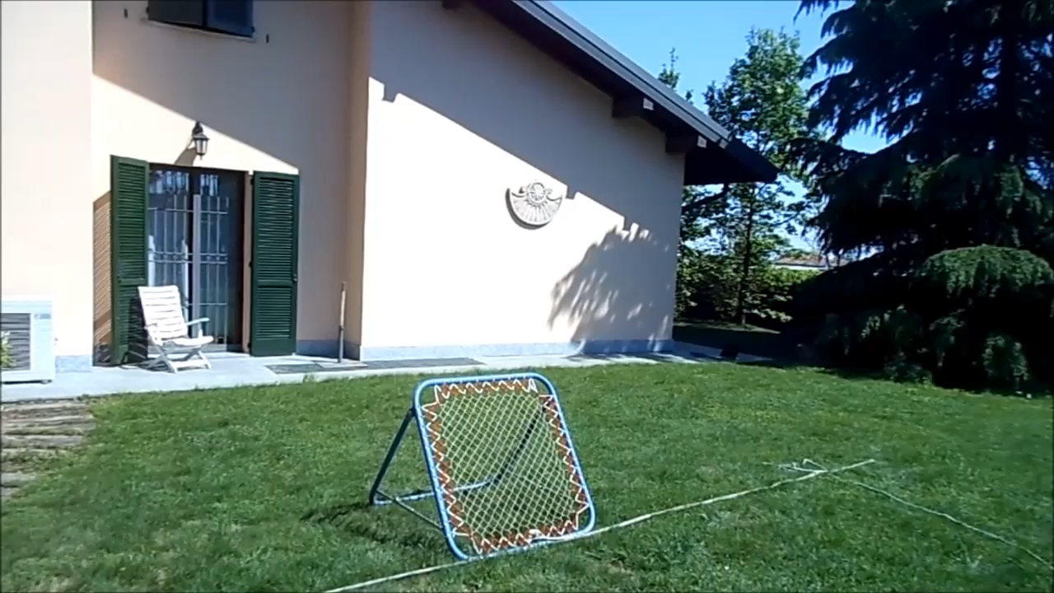
Fun Fact

Slide 23
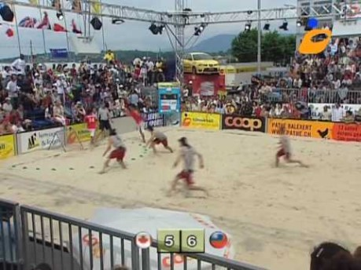
Beach Tchoukball

Slide 24
Summary – Tchoukball in 10 tips
History: Developed in 1970s as a non-agressive and inclusive sport, which would reduce injuries and would be appropiate for everyone.
Material: Handball ball and an inclinated goal.
Court: 40 x 20 m (like handball)
Players: 10 players per team (7 players and 3 substitutes)
Game: The object of tchoukball is to throw or 'shoot' the ball at the frame, so that it rebounds and lands over the line of the D in the court. The opposition's job is to catch the ball to prevent their opponents scoring and then shoot it themselves. This sequence continues until a point is scored.

Slide 25
6. Scoring: To score a point the ball must be thrown from outside of the crease, bounce off of the frame and land on the ground outside of the crease.
7. Rules: Two 20 minute halves, no time outs permitted, substitutions on the fly and unlimited. Players can move with the ball for a maximum of 3 steps, hold the ball for 5 seconds, touch the ball with any part of the body above the knees, not touch the ball more than once (unless the defenders touch it).
8. Competitions and Best Teams: 6 World Events (the most important is the World Thoukball Championship) and 12 Regional Events (7 Asian, 2 European, 2 African and 1 American).
9. Injuries: Only 1 severe injury in the entire history!
10. Spirit, Philosophy and Values: Competitive without agression, self-consciousness, involvement of problem-solving, anticipation, physical ability, teamwork and positive social behavior.

Slide 26

My Opinion of Tchoukball
It is really interesting and impressive for me in the sense of being a sport similar to handball and some more, but without physical contact. This is very good to avoid injuries! Remember, only ONE severe injury in the entire history!
It is also very surprising that both teams can score goal in both frames. This sounds like a little chaotic at first, no?
Finally, I appreciate very much the idea and performance of the creator Brandt, who seeing a problem (a lot of aggression and injuries in sports), had the magnificent idea of creating a revelation sport, similar to the popular ones of the moment, but that would avoid such a problem.

Slide 27


Slide 28
Webgraphy
https://en.wikipedia.org/wiki/Tchoukball
https://elksport.com/blog/conoces-el-tchoukball/
https://www.tchoukball.org.uk/beginners-guide#:~:text=Put%20quite%20simply%2C%20the%20object,until%20a%20point%20is%20scored.
https://brocku.ca/recreation/intramurals/rules/tchoukball/#:~:text=Players%20can%20throw%20the%20ball,defender%20from%20the%20opposing%20team
https://www.tchoukballpromo.com/spirit-of-the-game/
https://www.youtube.com/watch?v=o7SFVgHWhU8 (video tutorial)

