Slide 1
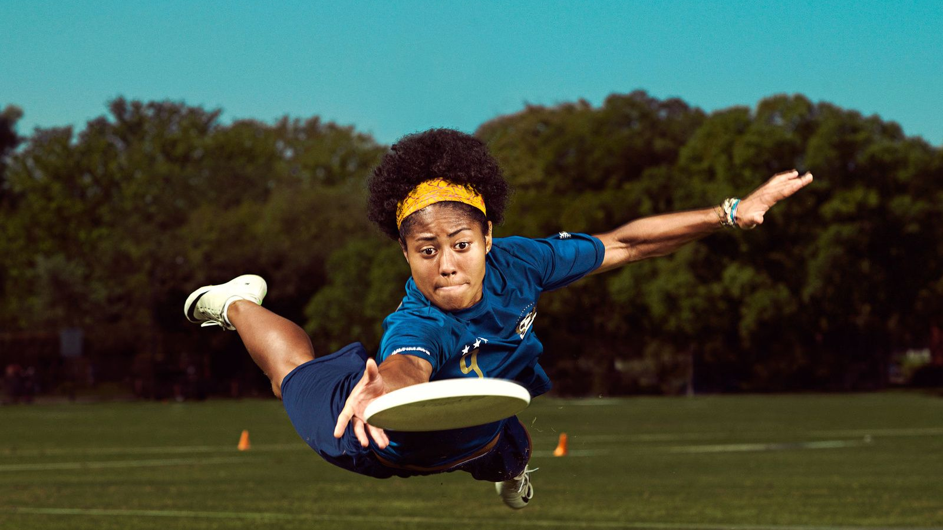
ULTIMATE
(ULTIMATE FRISBEE)
Mia Gugec
Ana Mišetić

Slide 2
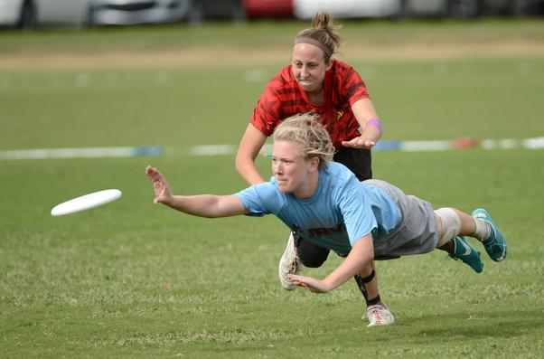
What is Ultimate?
Ultimate, also and originally known as ultimate Frisbee, is a low-contact team sport played with a flying disc (Frisbee)
Points are scored by passing the disc to a teammate in the opposing end zone

Slide 3
What is frisbee?
A frisbee (pronounced FRIZ-bee, origin of the term dates to 1957, also called a flying disc or simply a disc) is a gliding toy or sporting item that is generally made of injection molded plastic and roughly 8 to 10 inches (20 to 25 cm) in diameter with a pronounced lip
It is used recreationally and competitively for throwing and catching, as in flying disc games.
The term frisbee is often used generically to describe all flying discs, but Frisbee is a registered trademark of the Wham-O toy company. This protection results in organized sports such as Ultimate or disc golf having to forgo use of the word "Frisbee".

Slide 4
The shape of the disc is an airfoil in cross-section which allows it to fly by generating lift as it moves through the air
Spinning the disc imparts a stabilizing gyroscopic force, allowing it to be both aimed with accuracy and thrown for distance.

Slide 5
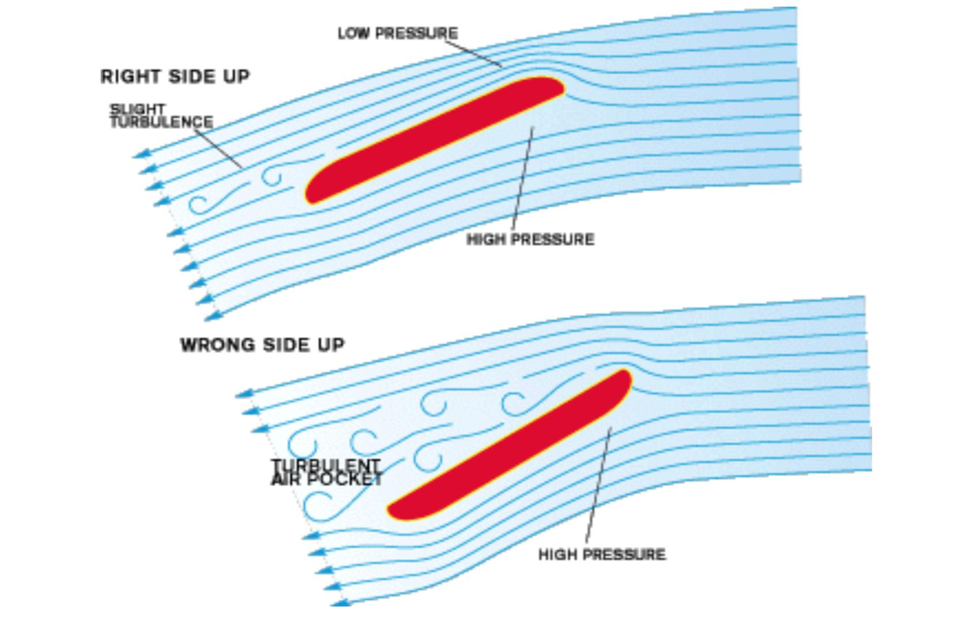
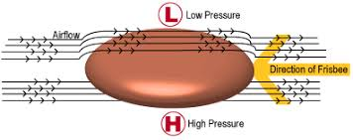
Background of the frisbee
Two key forces are : lift and drag
Lift is the force that allows the Frisbee to stay airborne, and in flight it opposes the force of gravity on the disk's mass. The Frisbee itself creates this lift force as it flies through the air.
Because of the Frisbee's curved shape, the airflow above it must travel at a higher velocity than that underneath, thereby creating low pressure above and high pressure below the disk. This pressure difference provides the lift.
Drag is a resistant force on the Frisbee, perpendicular to the lift, and it acts against the disk's movement through the air. The angle at which the Frisbee is thrown, which we'll call the "launch angle" (aka the angle of attack), affects both lift and drag

Slide 6
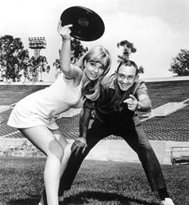
HISTORICAL FUN FACT
Walter Frederick Morrison and his future wife Lucile had fun tossing a popcorn can lid after a Thanksgiving Day dinner in 1937.
They soon discovered a market for a light duty flying disc when they were offered 25 cents for a cake pan that they were tossing back and forth on a beach near Los Angeles, California.
"That got the wheels turning, because you could buy a cake pan for five cents, and if people on the beach were willing to pay a quarter for it, well—there was a business,"

Slide 7
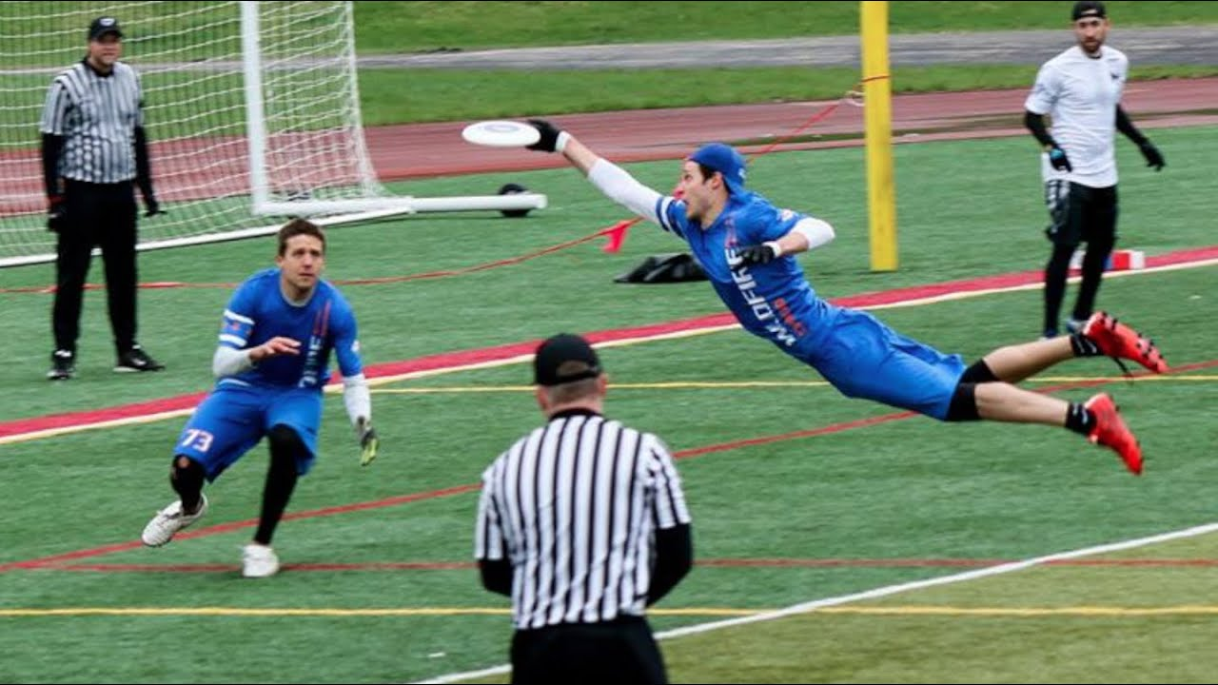
ULTIMATE
The most widely played disc game began in the late 1960s with Joel Silver and Jared Kass
In the 1970s it developed as an organized sport with the creation of the Ultimate Players Association by Dan Roddick, Tom Kennedy and Irv Kalb
The object of the game is to advance the disc and score points by eventually passing the disc to a team member in the opposing team's end zone.
Players may not run while holding the disc

Slide 8
TEAMS
2 teams of 7 players ( grass) – indoor 2 teams of 5 players
2 teams of 5 players (beach)
Male , female and mixed Ultimate
In mixed ultimate, usually it is 4-3, meaning either 4 men and 3 women at a time or 4 women and 3 men on the line
The offensive end zone dictates whether there are more men or women. This end zone is called the 'gen-zone', short for gender zone.

Slide 9
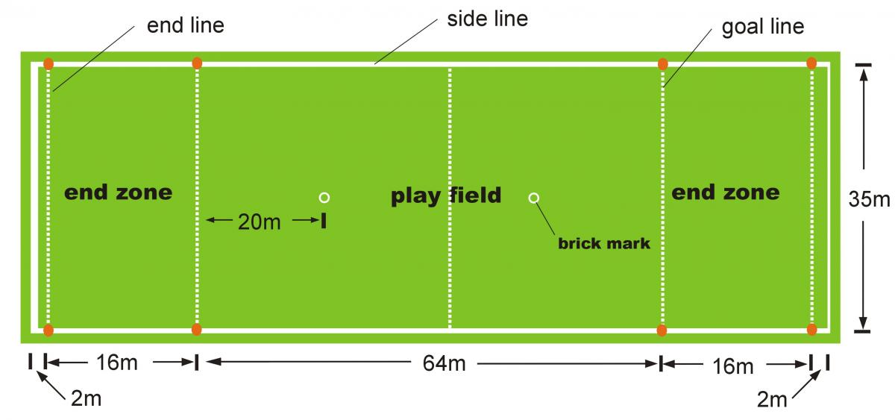
FIELD
playing field is about the same length as a football field, but narrower
At each end of the playing field there is an end zone
Each team defends one endzone
They score a goal if one of their players catches the disc in the opposite end zone

Slide 10
The player with the disc is called the thrower. The thrower may not run with the disc. Instead they move the disc by passing to team-mates in any direction
The defensive team gets possession of the disc if an offensive team’s throw is not caught by a player of the same team. Then the defensive team becomes the offensive team and can try to score in the opposite end zone

Slide 11
The player holding the disc establishes a pivot point. They have up to three steps to slow down after cching a disc, without changing direction, to establish that pivot point. A violation of this is called a "travel"
If a pass is incomplete, it is a "turnover" and the opposing team immediately gains possession, playing to score in the opposite direction
Passes are incomplete if they are caught by a defender, touch the ground or touch an out-of-bounds object
If a player jumps from in bounds, catches, and then throws the disc while in the air and technically out of bounds, the disc is still in play and can be caught or defended by players on the field

Slide 12
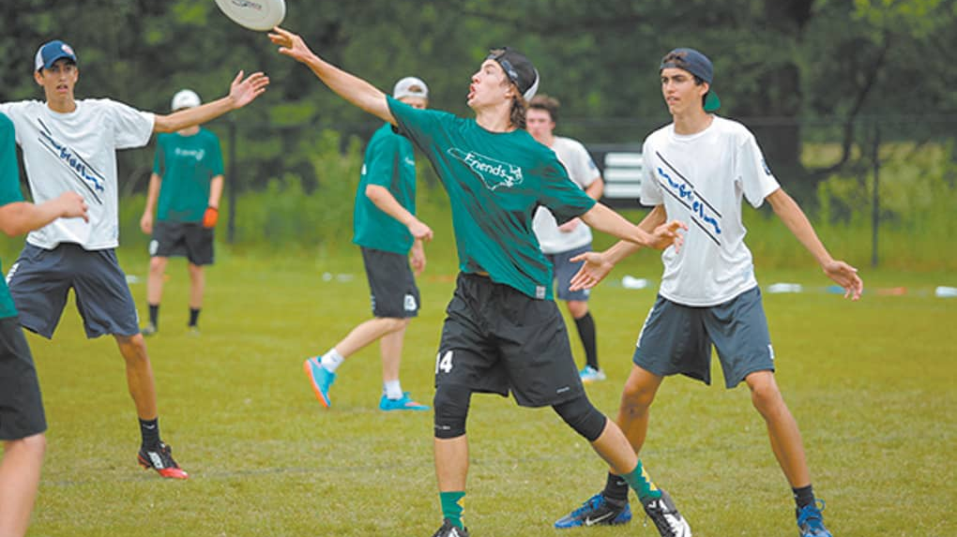
GAME
A regulation outdoor game is played 7 vs. 7, with substitutions allowed between points and for injuries
Games are typically played to a points limit of 13/15/17 and/or a time limit of 75/90/100 minutes
There is usually a halftime break and an allowance of a 2 timeouts per team each half

Slide 13
Types of Throws
There are three types of throws that are mainly used in an Ultimate game
the backhand
the forehand
the overhead throw(hammer throw)-> which is considered to be more advanced.

Slide 14
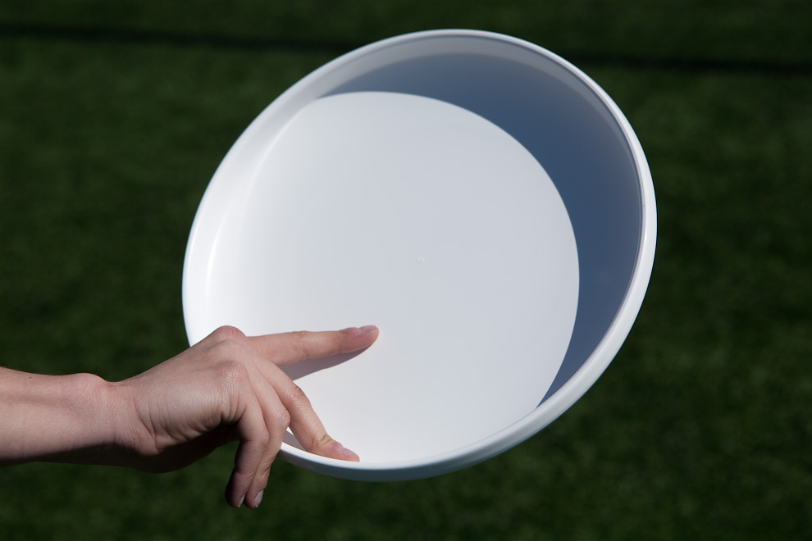
FOREHAND

Slide 15
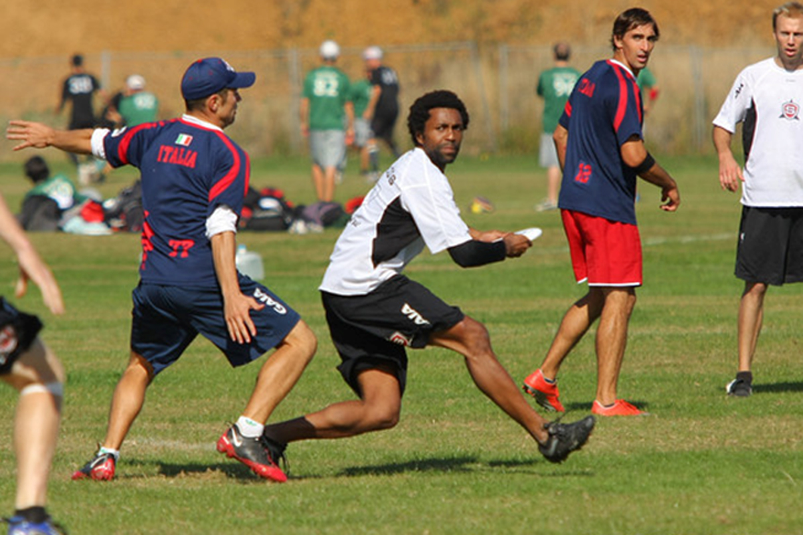
BACKHAND

Slide 16
HAMMER
The grip for the hammer is similar to that of the forehand throw, but instead of holding the disc parallel to the ground, it should be held slightly above the head and angled slightly

Slide 17
Advanced Ultimate Throws
High Release Backhand
Low Release Backhand
High Release Flick
Low Release Flick
Chicken wing
Elevator Pass
Push pass
Roller Throw
Scoober (Scuber)
Thumber
Wheeler (Wheel of death)
https://ultimatefrisbeehq.com/ultimate-frisbee-throws/

Slide 18
Types of Catching
There are two basic ways to catch a flying disc. Both techniques are similar as they require both hands to execute, but the method for each is different.
the pancake
the two-hand grab

Slide 19
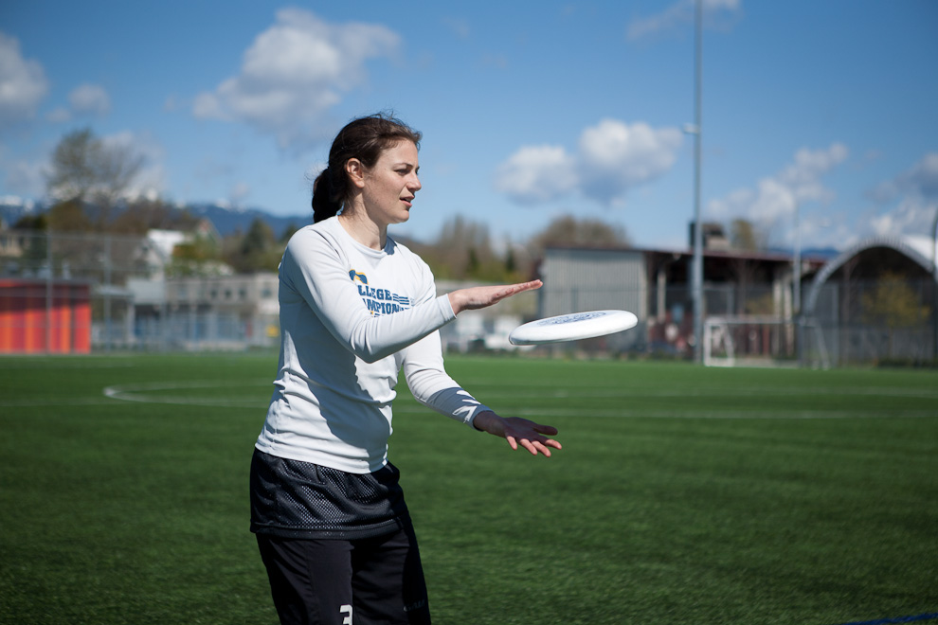
PANCAKE

Slide 20
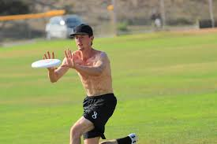
TWO HAND GRAB

Slide 21
Advanced Ultimate Catches
Crocodile Catch
Rim Catch
One-handed catch
https://windsorultimate.com/page/how-to-catch-a-frisbee

Slide 25
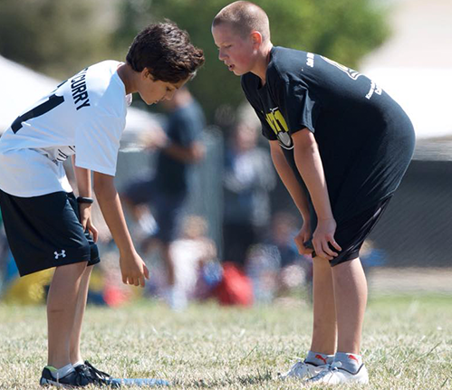
SPIRIT OF THE GAME
Ultimate relies upon a Spirit of the Game that places the responsibility for fair play on every player.
There are no referees; the players are solely responsible for following and enforcing the rules, even at World Championship.
Competitive play is encouraged, but never at the expense of respect between players, adherence to the rules, and the basic joy of play.

Slide 26
SUMMARY:
Ultimate in 10 Simple Rules
1. The Field: A rectangular shape with end zones at each end. A regulation field is 70 yards long by 40 yards wide, with end zones 20 yards deep.
2. Starting Play: Each point begins with both teams lining up on the front of opposite end zone lines. The defense throws ("pulls") the disc to the offense. A regulation game has seven players per team.
3. Scoring: Each time the offense catches a pass in the defense's end zone, the offense scores a point. The teams switch direction after every goal, and the next point begins with a new pull by the team that just scored.
4. Movement of the Disc: The disc may be advanced in any direction by completing a pass to a teammate. Players may not run with the disc. The person with the disc ("thrower") has ten seconds to throw the disc. The defender guarding the thrower ("marker") counts out the stall count.

Slide 27
5. Change of Possession: When a pass is not completed (e.g. out of bounds, drop, block, interception, stalled), the defense immediately takes possession of the disc and becomes the offense.
6. Substitutions: Players not in the game may replace players in the game after a score and during an injury timeout.
7. Non-contact: Players must attempt to avoid physical contact during play. Picks and screens are also prohibited.
8. Fouls: When a player initiates contact that affects the play, a foul occurs. When a foul causes a player to lose possession, the play resumes as if the possession was retained. If the player that the foul was called against disagrees with the foul call, the play is redone.
9. Self-Officiating: Players are responsible for their own foul and line calls. Players resolve their own disputes.
10. Spirit of the Game: The foundation of the rules in ultimate is Spirit of the Game, which places the responsibility for fair play on the player. Competitive play is encouraged, but never at the expense of respect between players, adherence to the rules, and the basic joy of play.

Slide 28
WEBGRAPHY
https://en.wikipedia.org/wiki/Ultimate_(sport)
http://www.wfdf.org/sports/ultimate
https://www.usaultimate.org/rules/
https://www.scientificamerican.com/article/bring-science-home-frisbee-aerodynamics/
https://www.myactivesg.com/read/2013/8/ultimate-frisbee-101-basics-of-throws-and-catches
https://www.myactivesg.com/sports/frisbee/how-to-play/ultimate-for-beginners/basic-catching-techniques

Slide 29
Thanks for watching!

