Slide 1
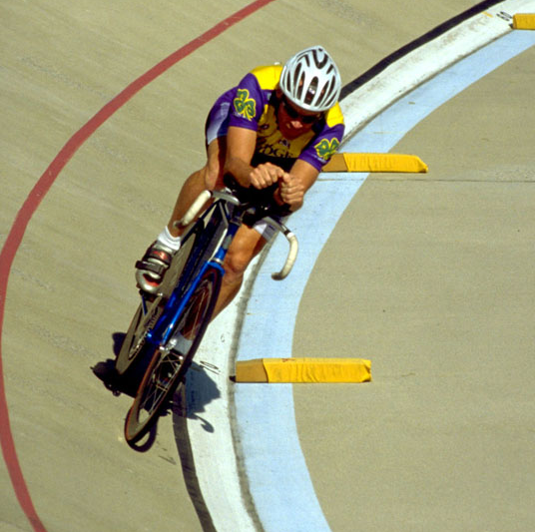
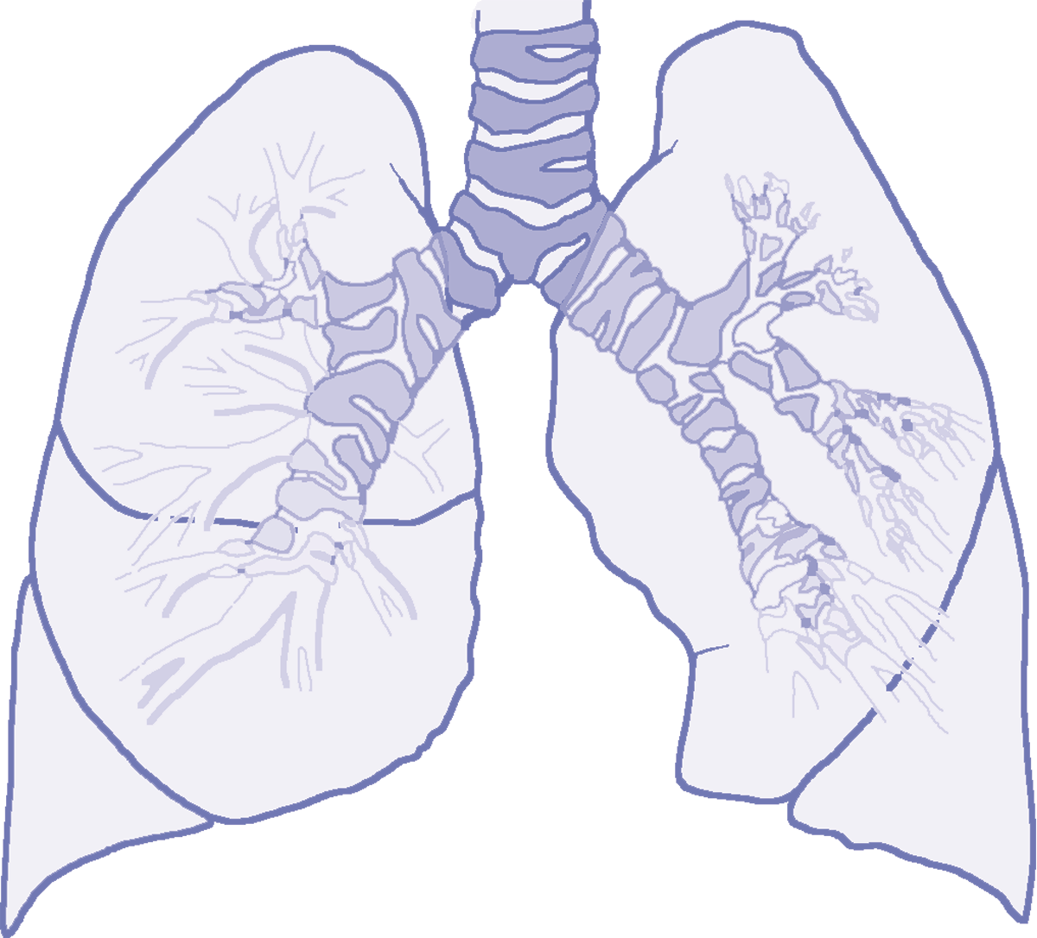
C H A P T E R 8
RESPIRATORY REGULATION DURING EXERCISE

Slide 2
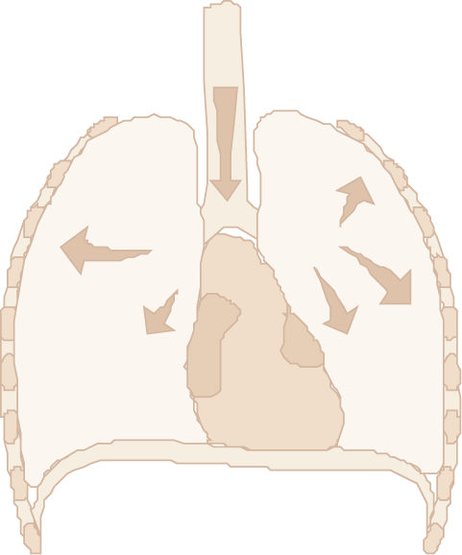
Respiration
Respiration—delivery of oxygen to and removal of carbon dioxide from the tissue
External respiration—ventilation and exchange of gases in the lung
Internal respiration—exchange of gases at the tissue level (between blood and tissues)

Slide 3
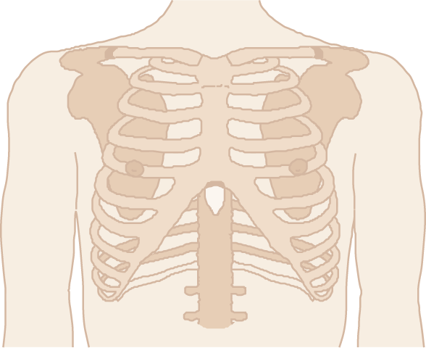
External Respiration
Pulmonary ventilation—movement of air into and out of the lungs—inspiration and expiration
Pulmonary diffusion—exchange of oxygen and carbon dioxide between the lungs and blood

Slide 4
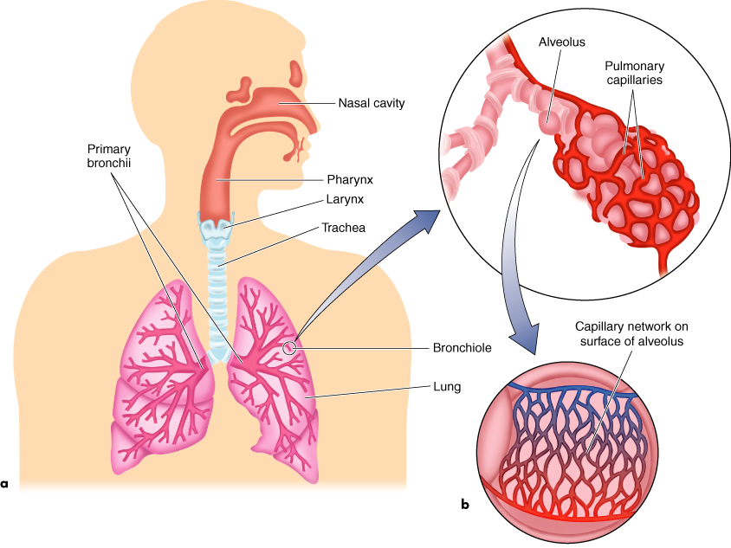
RESPIRATORY SYSTEM

Slide 5
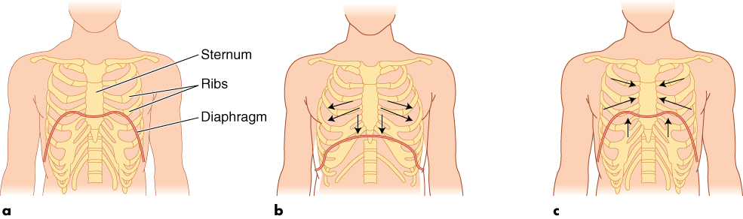
INSPIRATION AND EXPIRATION
Rest
Inspiration
Expiration

Slide 6
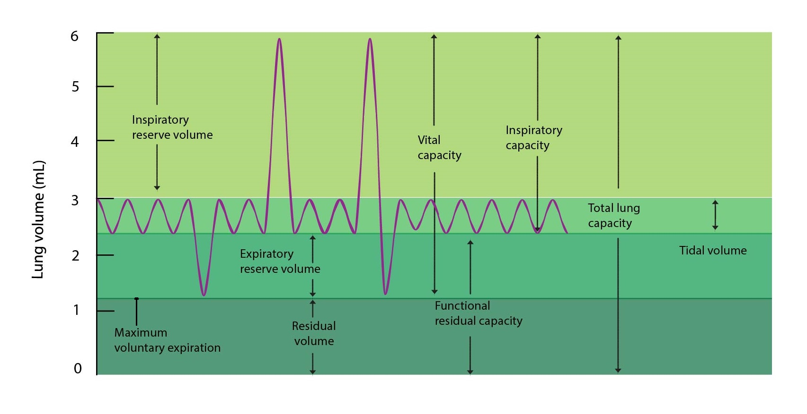
Lung Volumes
http://fblt.cz/wp-content/uploads/2013/12/objemy-a-kapacity-plic-ENG-01.jpg

Slide 7
Pulmonary Diffusion
w Replenishes blood's oxygen supply that has been depleted for oxidative energy production
w Removes carbon dioxide from returning venous blood
w Occurs across the thin respiratory membrane

Slide 8
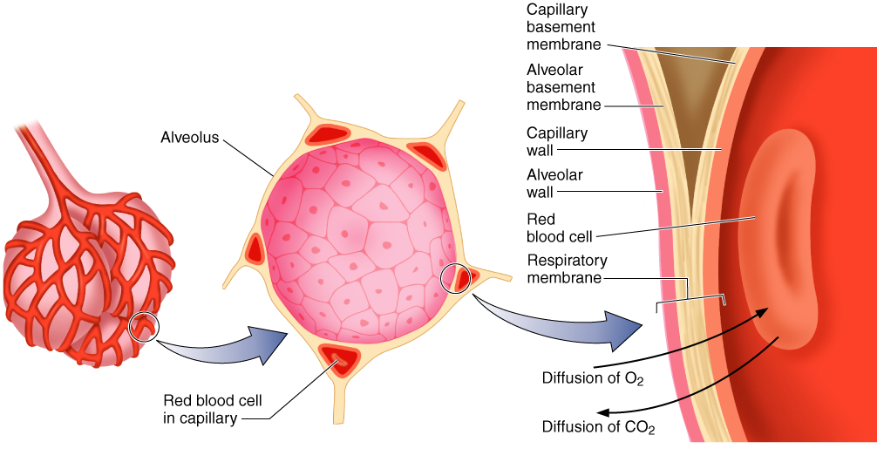
RESPIRATORY MEMBRANE

Slide 9

Laws of Gases
Dalton's Law: The total pressure of a mixture of gases equals the sum of the partial pressures of the individual gases in the mixture.
Henry's Law: Gases dissolve in liquids in proportion to their partial pressures, depending on their solubilities in the specific fluids and depending on the temperature.

Slide 10
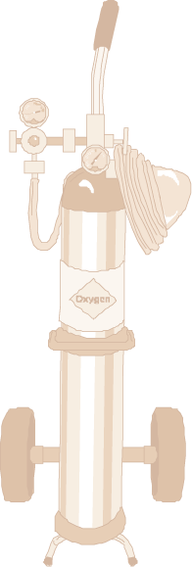
Partial Pressures of Air
w Standard atmospheric pressure (at sea level) =
760 mmHg (= Torr)
w Nitrogen (N₂) is 79.04% of air; the partial pressure of nitrogen (PN₂) = 600.7 mmHg
w Oxygen (O₂) is 20.93% of air; PO₂ = 159.1 mmHg
w Carbon dioxide (CO₂) is 0.03%; PCO₂ = 0.2 mmHg

Slide 11


Did You Know…?
Differences in the partial pressures of gases in the aveoli and in the blood create a pressure gradient across the respiratory membrane. This difference in pressures leads to diffusion of gases across the respiratory membrane. The greater the pressure gradient, the more rapidly oxygen diffuses across it.

Slide 12
Partial Pressures of Respiratory Gases at Sea Level
Partial pressure (mmHg)
% in Dry Alveolar Arterial Venous Diffusion
Gas dry air air air blood blood gradient
Total 100.00 760.0 760 760 706 0
H₂O 0.00 0.0 47 47 47 0
O₂ 20.93 159.1 105 100 40 60
CO₂ 0.03 0.2 40 40 46 6
N₂ 79.04 600.7 568 573 573 0

Slide 13
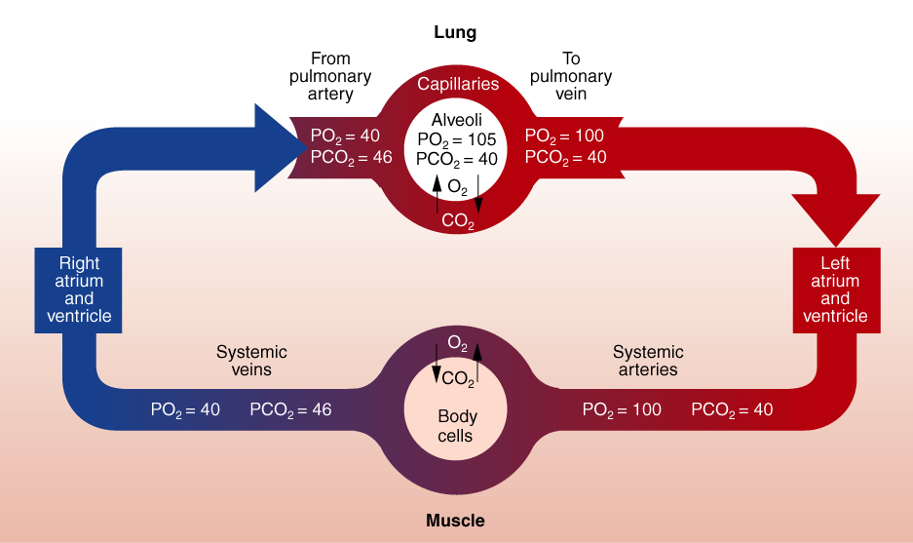
PO₂ AND PCO₂ IN BLOOD

Slide 14
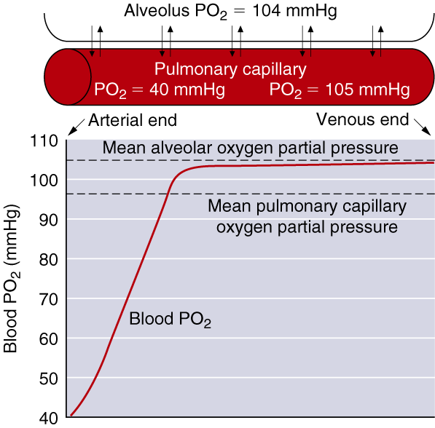
UPTAKE OF OXYGEN INTO PULMONARY CAPILLARY

Slide 15
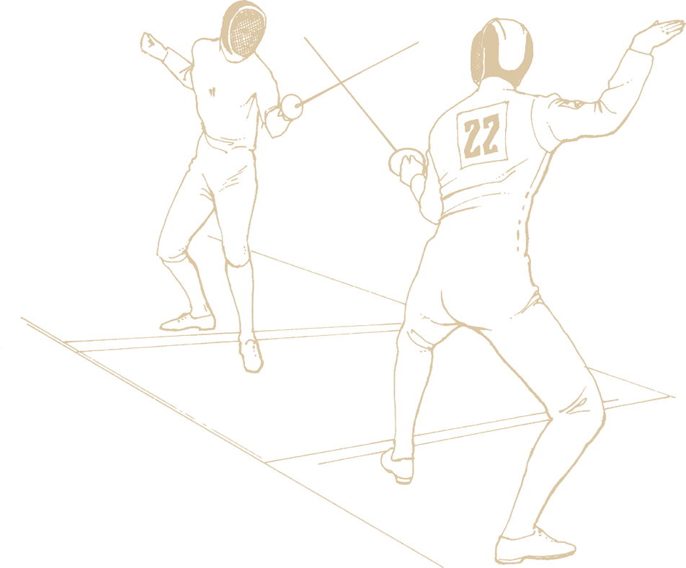
Oxygen Transport
w Hemoglobin concentration largely determines the oxygen-carrying capacity of blood (>98% of oxygen transported).
w Increased H⁺ (acidity) and temperature of a muscle allows more oxygen to be unloaded there.
w Training affects oxygen transport in muscle.

Slide 16
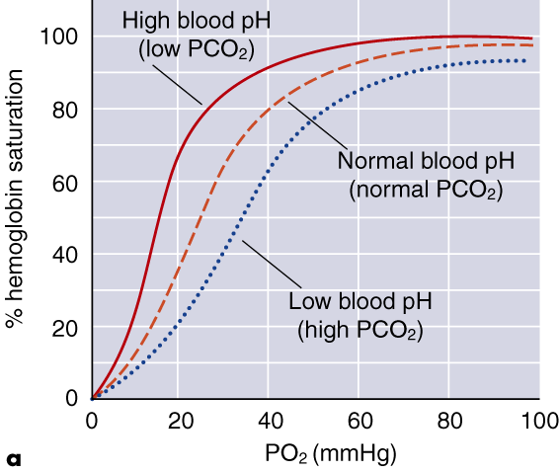
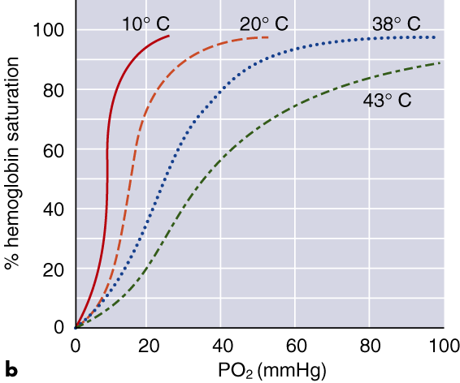
OXYGEN-HEMOGLOBIN DISSOCIATION CURVE

Slide 17
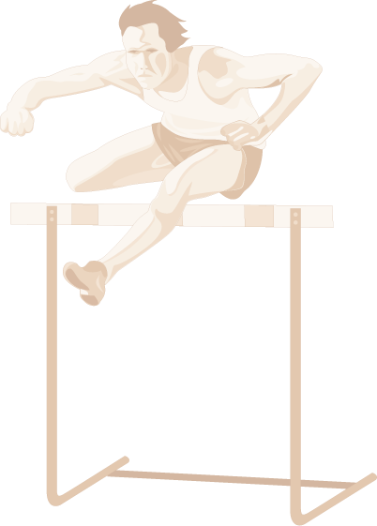
Carbon Dioxide Transport
w Dissolved in blood plasma (7% to 10%)
w As bicarbonate ions resulting from the dissociation of carbonic acid (60% to 70%)
w Bound to hemoglobin (carbaminohemoglobin)
(20% to 33%)

Slide 18
–
The a-vO₂ diff—Arterial O₂ Content
Hemoglobin (Hb)—1 molecule of Hb carries 4 molecules of O₂, and 100 ml of blood contains ~14–18 g of Hb in men and ~12–14 in women.
(1 g of Hb combines with 1.34 ml of oxygen.)
w There are ~20.1 ml of O₂ per 100 ml of arterial blood in men and ~17.4 ml of O₂ per 100 ml of arterial blood in women.
w Low iron leads to iron-deficiency anemia, reducing the body’s capacity to transport oxygen—this is more of
a problem in women than men.

Slide 19
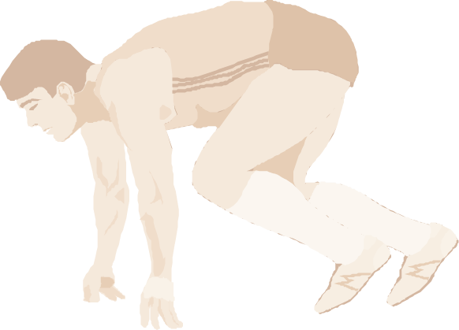
Did You Know…?
–
The increase in a-vO₂ diff (difference between arterious and venous vO₂) during strenuous exercise reflects increased oxygen use by muscle cells. This use increases oxygen removal from arterial blood, resulting in a decreased venous oxygen concentration.

Slide 20
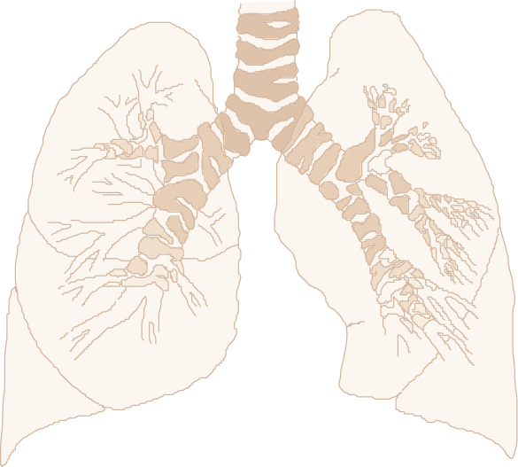
Regulators of Pulmonary Ventilation at Rest
w Higher brain centers
w Chemical changes within the body
w Chemoreceptors
w Muscle mechanoreceptors
w Hypothalamic input
w Conscious control

Slide 21
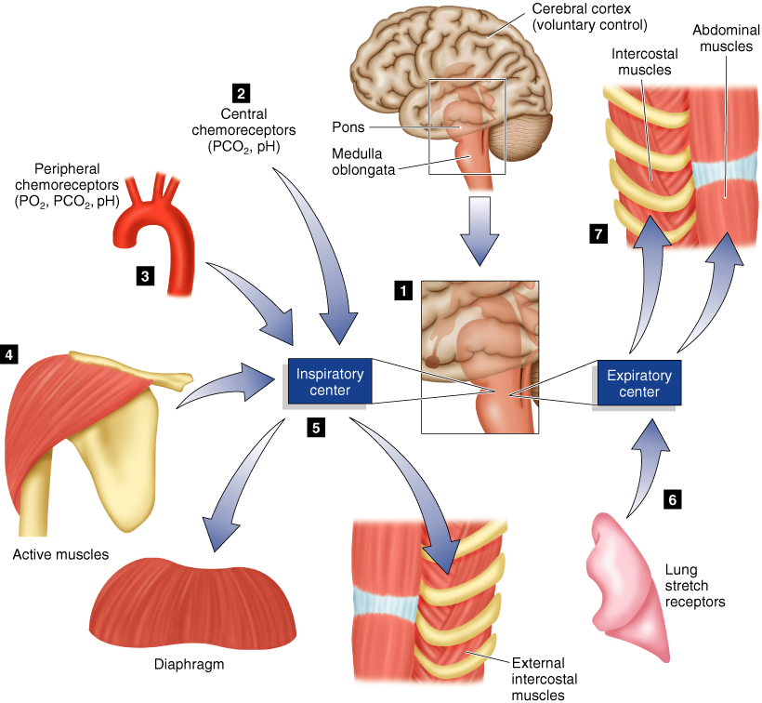
RESPIRATORY REGULATION

Slide 22
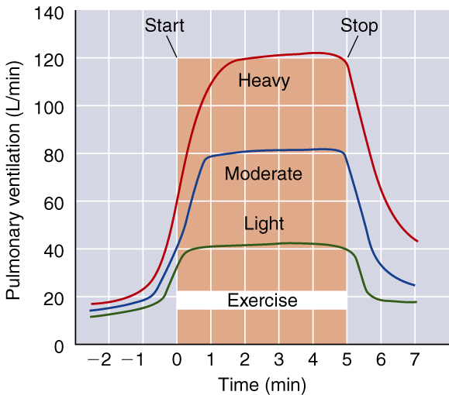
VENTILATORY RESPONSE TO EXERCISE

Slide 23
Breathing Terminology
Dyspnea—shortness of breath.
Hyperventilation—increase in ventilation that exceeds the metabolic need for oxygen. (Voluntary hyperventilation, as is often done before underwater swimming, reduces the ventilatory drive by increasing blood pH.)
Valsalva maneuver—a breathing technique to trap and pressurize air in the lungs to allow the exertion of greater force; if held for an extending period, it can reduce HR (by vagal tone). This technique is often used during heavy
lifts.

Slide 24

Pulmonary Ventilation
.
Ventilation (V_{E}) is the product of tidal volume (TV) and breathing frequency (f):
.
V_{E} = TV × f

Slide 25
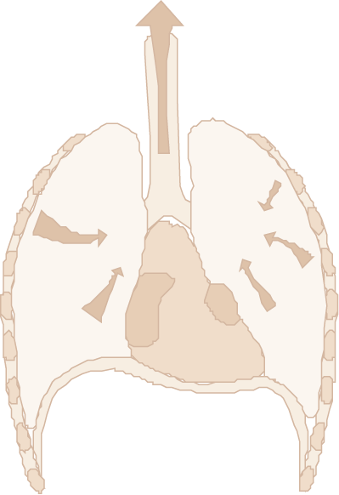
Ventilatory Equivalent for Oxygen
.
.
w The ratio between V_{E} and VO₂ in a given time frame
w Indicates breathing economy
.
.
.
w At rest—V_{E}/VO₂ = 23 to 28 L of air breathed per L VO₂
per minute
.
.
.
w At max exercise—V_{E}/VO₂ = 30 L of air per L VO₂
per minute
.
.
w Generally V_{E}/VO₂ remains relatively constant over a wide range of exercise levels

Slide 26

Ventilatory Breakpoint
w The point during intense exercise at which ventilation increases disproportionately to the oxygen consumption.
.
w When work rate exceeds 55% to 70% VO₂max, oxygen delivery can no longer match the energy requirements so energy must be derived from anaerobic glycolysis.
w Anaerobic glycolysis increases lactate levels, which increase CO₂ levels (buffering), triggering a respiratory response and increased ventilation.

Slide 27
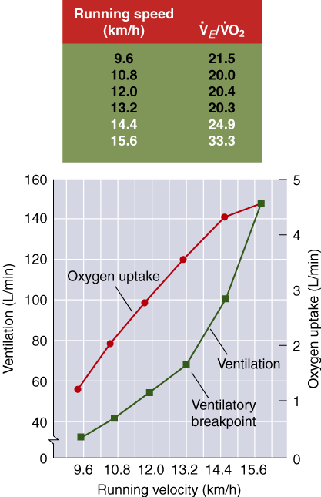
.
.
V_{E} AND VO₂ DURING EXERCISE

Slide 28

Anaerobic Threshold
w Point during intense exercise at which metabolism becomes increasingly more anaerobic
w Reflects the lactate threshold under most conditions, though the relationship is not always exact
.
.
w Identified by noting an increase in V_{E}/VO₂ without
a concomitant increase in the ventilatory equivalent
for carbon dioxide (V_{E}/VCO₂)
.
.

Slide 29
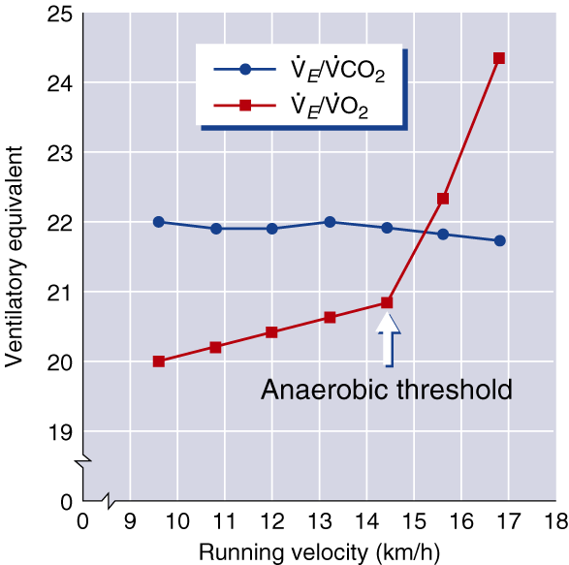
.
.
.
.
V_{E}/VCO₂ AND V_{E}/VO₂

Slide 30
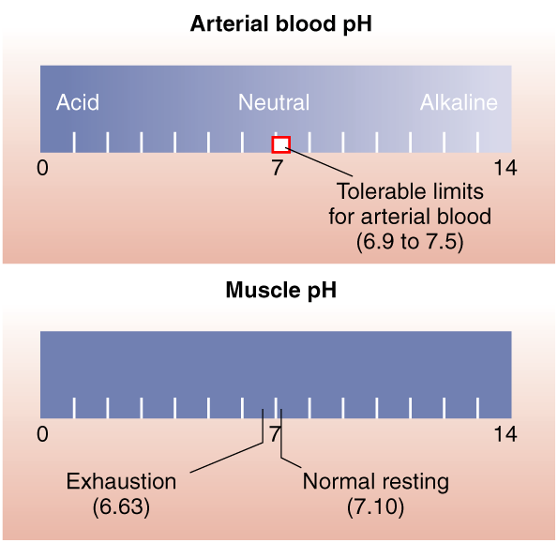
ARTERIAL BLOOD AND MUSCLE pH

