Slide 1
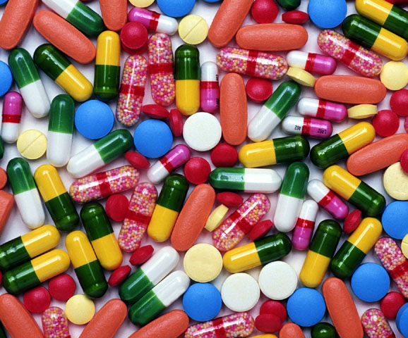
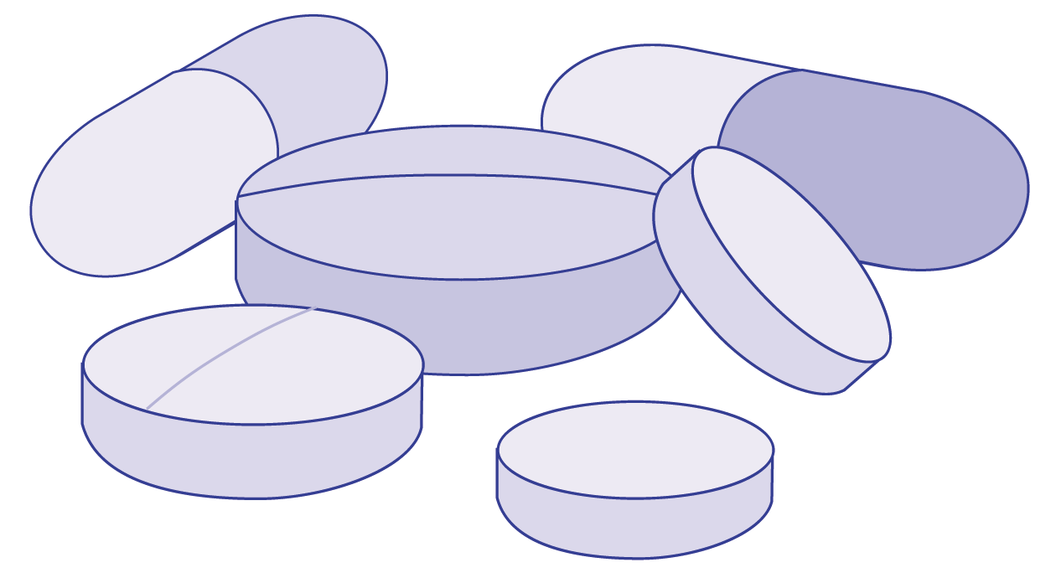
C H A P T E R 15
ERGOGENIC AIDS
AND SPORT

Slide 2

Examples in Sports
w Football—anabolic steroids
w Cycling—blood doping; amphetamines
w Weight category athletes—diuretics, amphetamines
w Distance running—carbohydrate loading
Note: Scientific studies are limited by the accuracy of measurements and individual day-to-day variability. Events are won by hundredths of seconds or by centimeters.

Slide 3
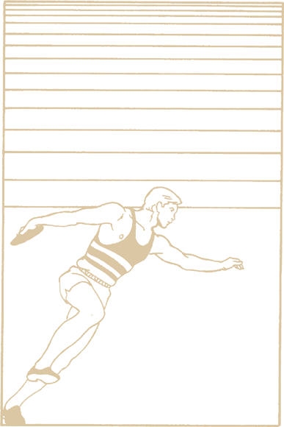
Did You Know…?
The placebo effect refers to when your body’s expectations of a substance determine your body’s response to it. While the effect is psychological in origin, the body’s physical response to the substance is real.

Slide 4
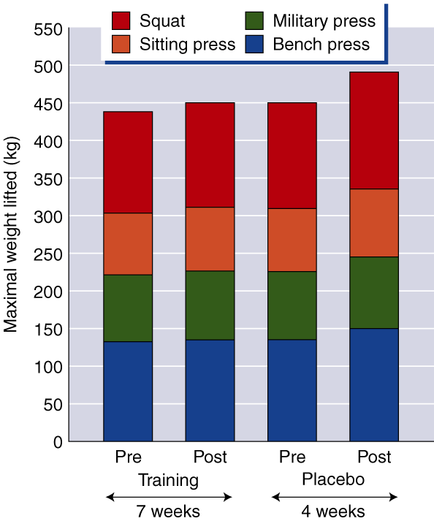
PLACEBO EFFECT
ON STRENGTH GAINS

Slide 5

Pharmacological Agents
w Amphetamines
w Beta blockers
w Caffeine
w Diuretics
w Recreationally used drugs (e.g., alcohol, cocaine, marijuana, nicotine)

Slide 6

Amphetamines
w Increase mental alertness, blood pressure, heart rate, blood glucose and FFA levels, and muscle tension
w Decrease sense of fatigue
w Redistribute blood flow to skeletal muscles
w May enhance speed, power, endurance, concentration, and fine motor coordination
w May be addictive (metamphetamine) and can trigger cardiac arrhythmia or death

Slide 7
Beta Blockers
w Prevent the binding of norepinephrine to its receptor, thus decreasing sympathetic nervous system effects
w May improve accuracy (for shooting sports)
w Decrease aerobic capacity but have no effect on strength, power, or muscular endurance
w Prolonged use can cause bradycardia, heart blockage, hypotension, bronchospasm, fatigue, and decreased motivation

Slide 8

Caffeine
w Increases mental alertness, concentration, catecholamine release, and mobilization and use of FFA by the muscles
w Decreases fatigue and lowers perception of effort
w Improves endurance performance; may improve sprint and strength performance
w Can cause nervousness, insomnia,
tremors, diuresis, and lead to dehydration

Slide 9
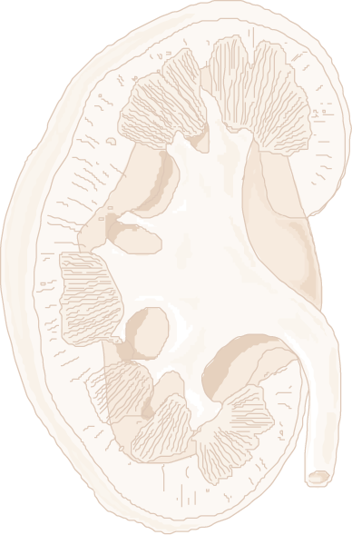
Diuretics
w Increase urine production and excretion
w Used for weight reduction and to mask other drugs during drug testing
w Cause weight loss (water loss)
w Can lead to dehydration, impaired thermoregulation, and electrolyte imbalances

Slide 10

Alcohol
w Provides energy (7 kcal/g) but inhibits metabolism
w Dulls pain sensation (increasing injury risk);
reduces anxiety
w Suppresses release of ADH which leads to dehydration
w Appears to impair psychomotor function
w Has no ergogenic effects on strength,
power, speed, or endurance

Slide 11
Cocaine
w Blocks reuptake of norepinephrine and dopamine by neurons
w Creates feelings of euphoria, alertness, and self-confidence
w Masks fatigue and pain
w Has no evidence of ergogenic properties; likely ergolytic
w Extremely addictive; can cause psychological problems and compromise heart function

Slide 12
Marijuana
w Acts as a stimulant and depressant of CNS
w Impairs performance requiring hand-eye and motor coordination, fast reaction times, tracking ability, and perceptual accuracy
w Can lead to personality changes, memory impairment, hallucinations, and psychotic-like behavior
w May pose same risks as cigarette smoking (if smoked)

Slide 13

Nicotine
w Increases alertness and may calm nervousness
.
w Lowers VO₂max values (when smoked) and peripheral circulation
w Increases heart rate, blood pressure, autonomic reactivity, vasoconstriction, ADH and catecholamine secretion, blood lipid levels, plasma glucose, glucagon, insulin, and cortisol
w Is addictive and causes various cancers and cardiovascular diseases

Slide 14
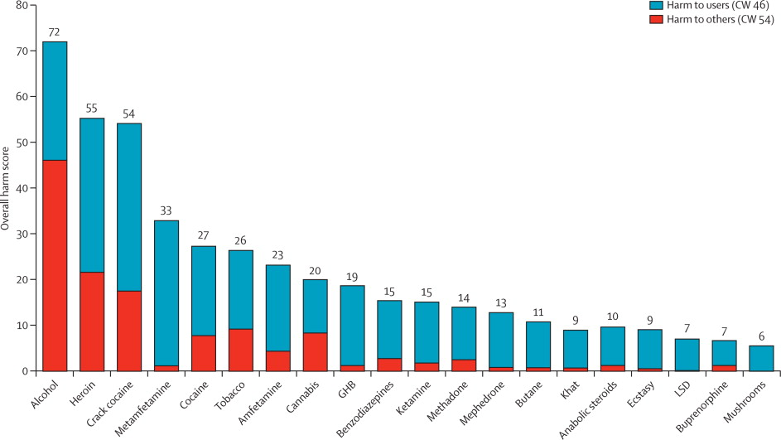

Slide 15
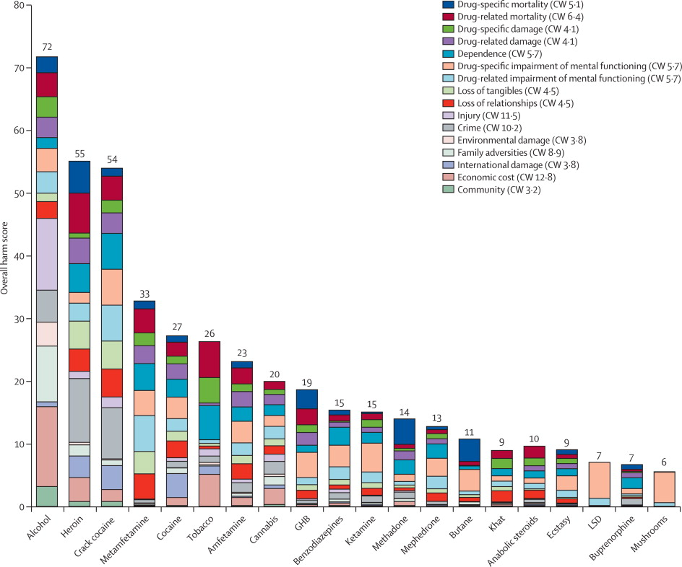

Slide 16
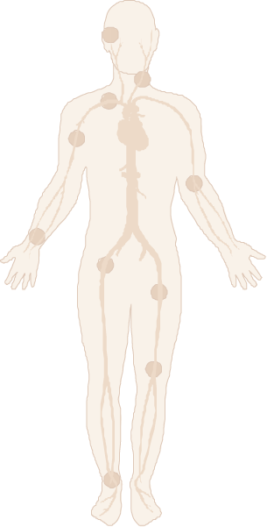
Hormonal Agents
w Anabolic steroids
w Human growth hormone
w Oral contraceptives

Slide 17
Anabolic Steroids
w Are nearly identical to male sex hormones; synthetic form maximizes anabolic effects
w Increase muscle mass (fat-free mass) and strength
w Can cause testicular atrophy, reduced sperm count, and prostate and breast enlargement in men
w Can cause breast regression, masculinization, and menstrual disruption in women
w Can cause personality changes, liver damage, and cardiovascular disease

Slide 18
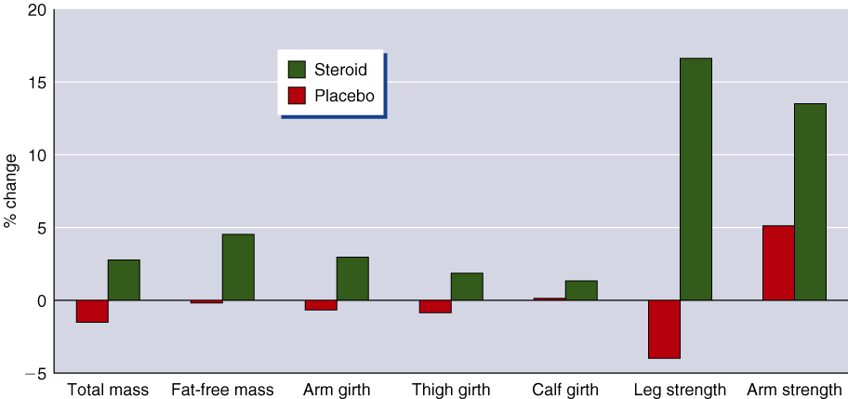
BODY CHANGES WITH ANABOLIC STEROIDS

Slide 19
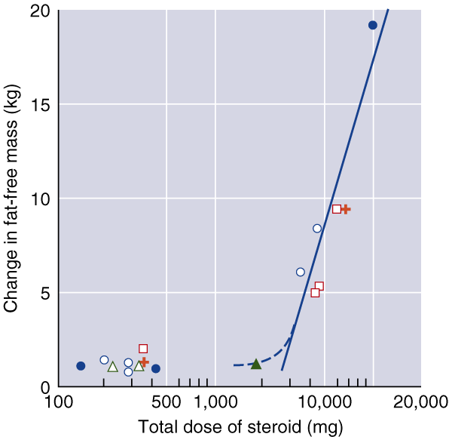
STEROIDS AND LEAN BODY MASS

Slide 20
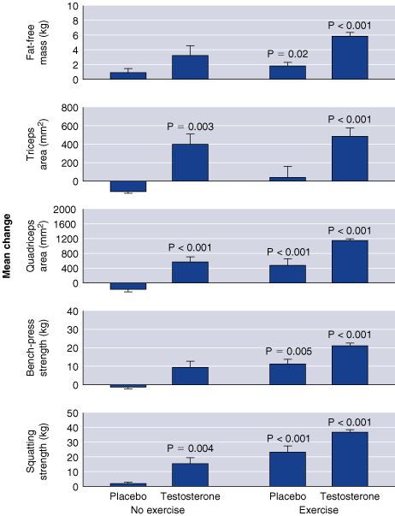
STEROIDS AND STRENGTH GAINS

Slide 21
Did You Know…?
Andro and DHEA, precursors of testosterone, have been proposed to have ergogenic properties—increased muscle mass and strength—but research has not supported the claims that have been made.

Slide 22
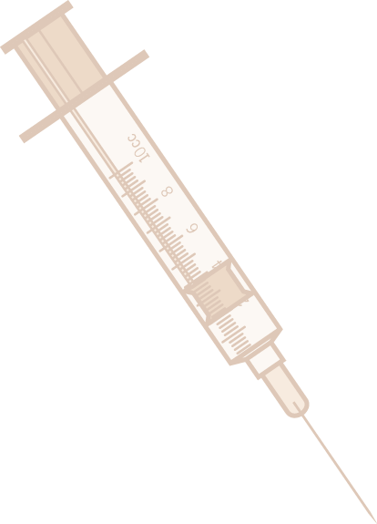
Human Growth Hormone
w Secreted naturally by pituitary; synthetic form used by some athletes
w Difficult to detect synthetic from natural in drug testing
w Proven to increase lipolysis and blood glucose levels; changes in muscle mass and strength are found in some studies, but not in the best controlled studies or studies with athletes
w Can cause acromegaly (bone thickening), enlargement of internal organs, muscle and joint weakness, diabetes, hypertension, and heart disease

Slide 23
Oral Contraceptives
w Control menstrual cycle
w Little research on ergogenic properties
w May delay PMS and dysmenorrhea, alleviating symptom on competition days
w Can cause nausea, weight gain, fatigue, hypertension, liver tumors, blood clots, stroke, or heart attack
w VS. abortion doping of Soviet females?

Slide 24
Physiological Agents
w Blood doping
w Erythropoietin
w Oxygen supplementation
w Bicarbonate loading
w Phosphate loading

Slide 25
Blood Doping
w Artificial increase in total volume of red blood cells (via transfusion)
w Improves endurance performance by increasing blood’s O₂-carrying capacity
.
w Increases VO₂max, time to exhaustion, and measurable performance
w Can cause blood clotting, heart failure, and transfusion complications

Slide 26
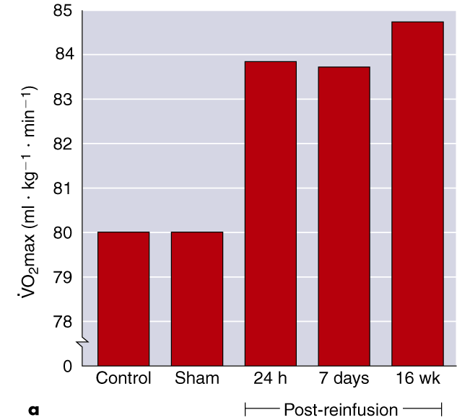
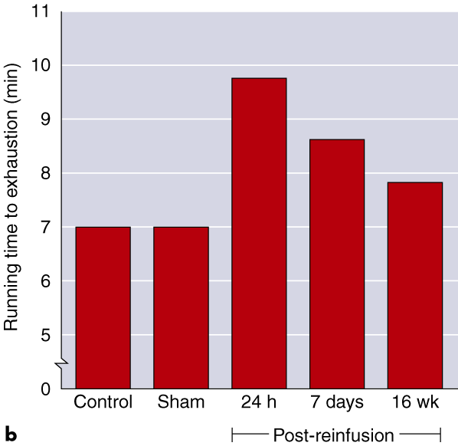
.
VO₂MAX AND FATIGUE AFTER BLOOD DOPING

Slide 27
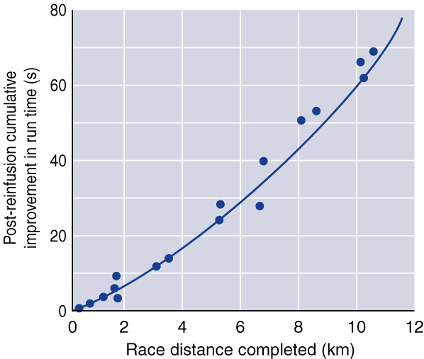
PERFORMANCE IMPROVEMENT AFTER BLOOD DOPING

Slide 28

Erythropoietin
w Natural hormone produced by the kidneys to stimulate red blood cell production
w Can be cloned and administered to increase red blood cell volume
.
w Increases VO₂max and time to exhaustion
w Can cause blood clotting and heart failure due to increased blood viscosity

Slide 29
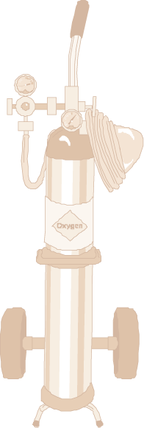
Oxygen Supplementation
w Breathed by athlete to increase oxygen content of blood
w Can improve performance if administered during exercise, but not before or after
w Too cumbersome to be practical
w No serious risks known
w Rapid oxygenation can induce free radicals?

Slide 30
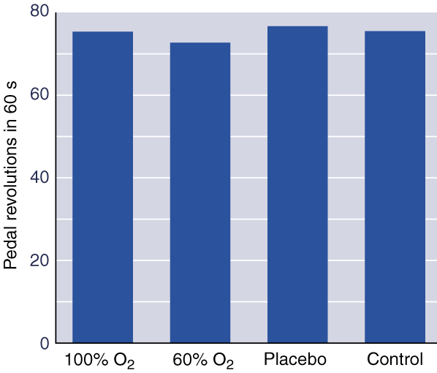
OXYGEN SUPPLEMENTATION AND PERFORMANCE

Slide 31
Bicarbonate
w Naturally part of body’s buffering system to maintain normal pH
w Loading increases blood alkalinity so that more lactate can be cleared (delay fatigue)
w Ingesting 300 mg per kg body weight can increase performance in all-out anaerobic exercise bouts between 1 and 7 minutes
w Can cause gastrointestinal cramping, bloating, and diarrhea

Slide 32
Phosphate Loading
Loading is thought to increase phosphate levels throughout body, which then
w Increase potential for oxidative phosphorylation and PCr synthesis
w Enhance oxygen release to the cells
w Improve cardiovascular response to exercise and buffering and endurance capacities
Studies are divided on results of phosphate loading.
No risks are yet known.

Slide 33
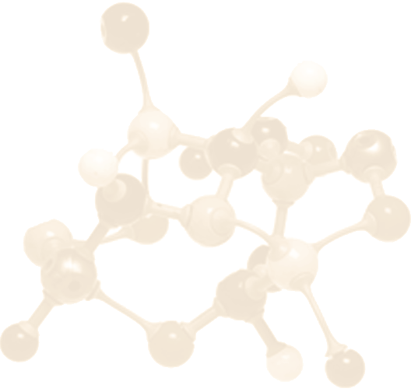
Nutritional Agents
w Amino acids
w L-carnitine
w Creatine
w Glycerol
w Pyruvate

Slide 34
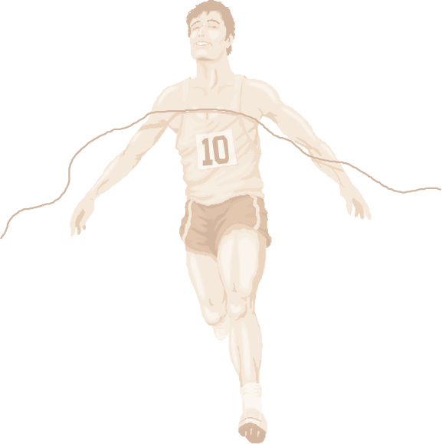
Amino Acids
w L-tryptophan and Branched Chain Amino Acids (BCAA)
w Proposed to increase endurance performance by delaying fatigue (delayed transformation to serotonin)
w Studies are inconclusive on effects on performance

Slide 35
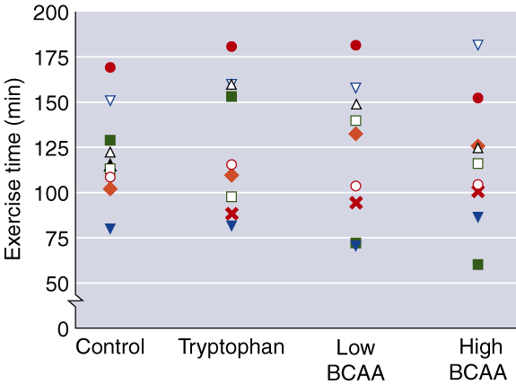
BRANCED CHAIN AMINO ACIDS AND PERFORMANCE

Slide 36
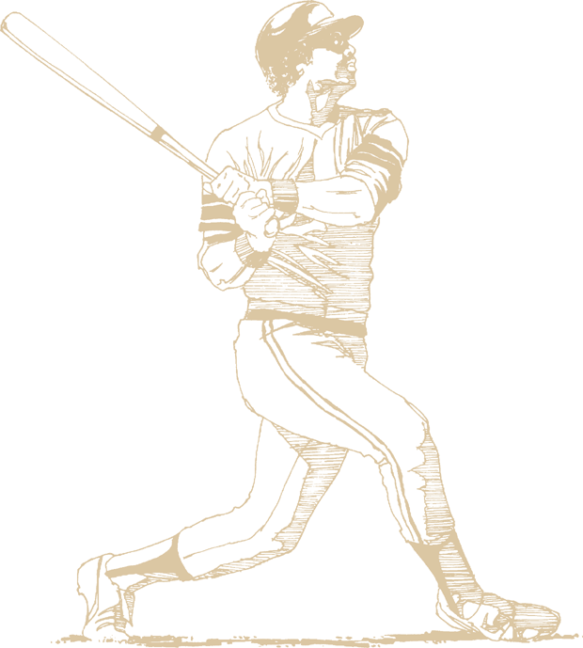
Creatine
w Supplement to better maintain muscle ATP levels
w Shown to increase anaerobic power, anaerobic endurance, and aerobic endurance-types of activities, and possibly fat-free body mass, although the results of these performance studies are mixed

Slide 37
Other Nutritional Agents
w Glycerol might have ergogenic properties facilitating water storage and improving exercise performance in the heat through improved thermoreulation and reduced dehydration
w Pyruvate supplementation has no proven benefits

Slide 38
What else?
Gene doping?
Eugenics?
...?

