Slide 1
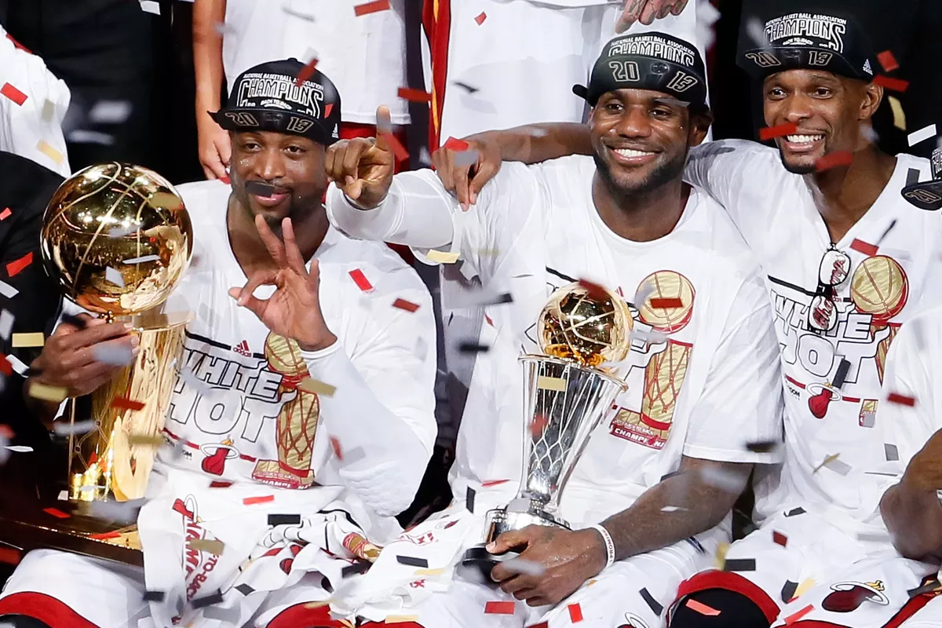
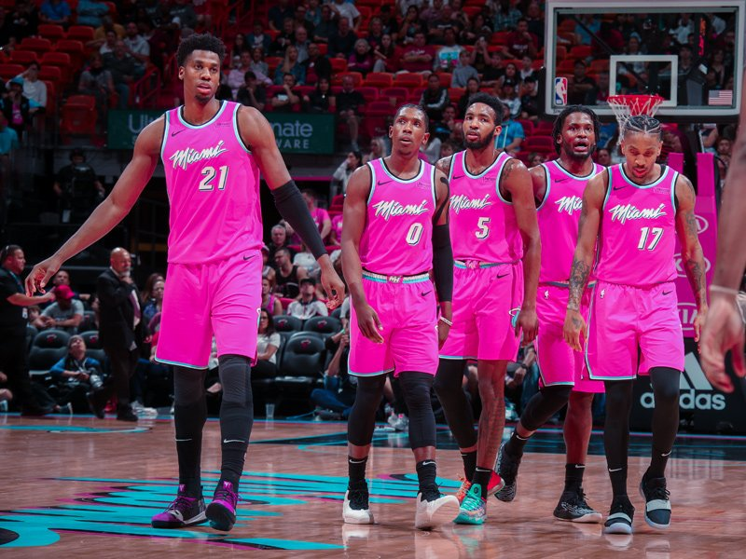
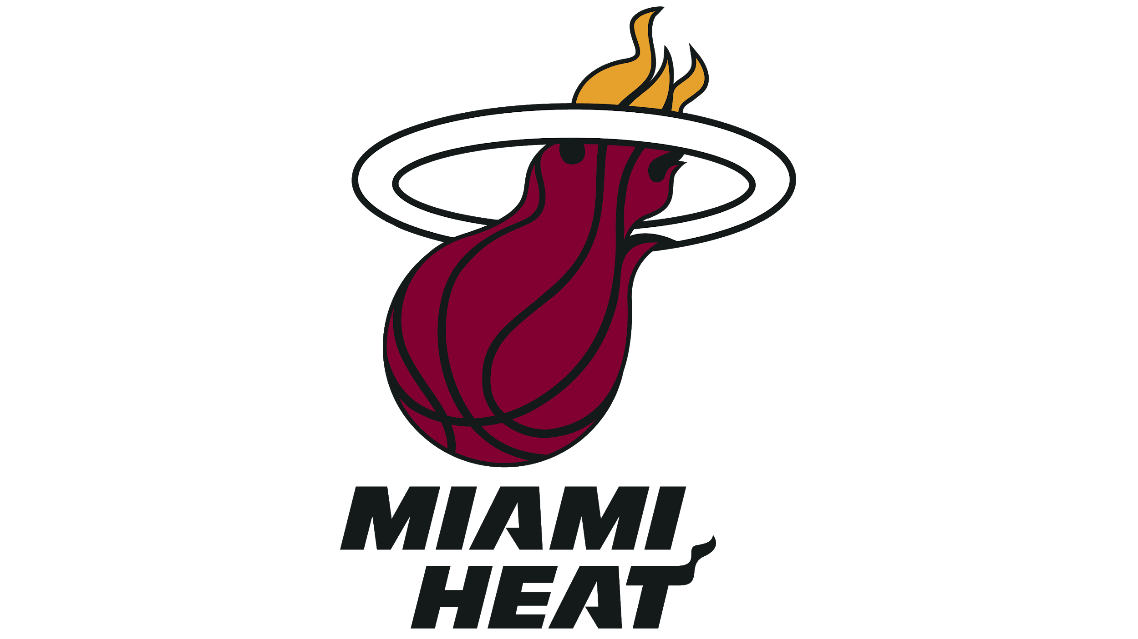
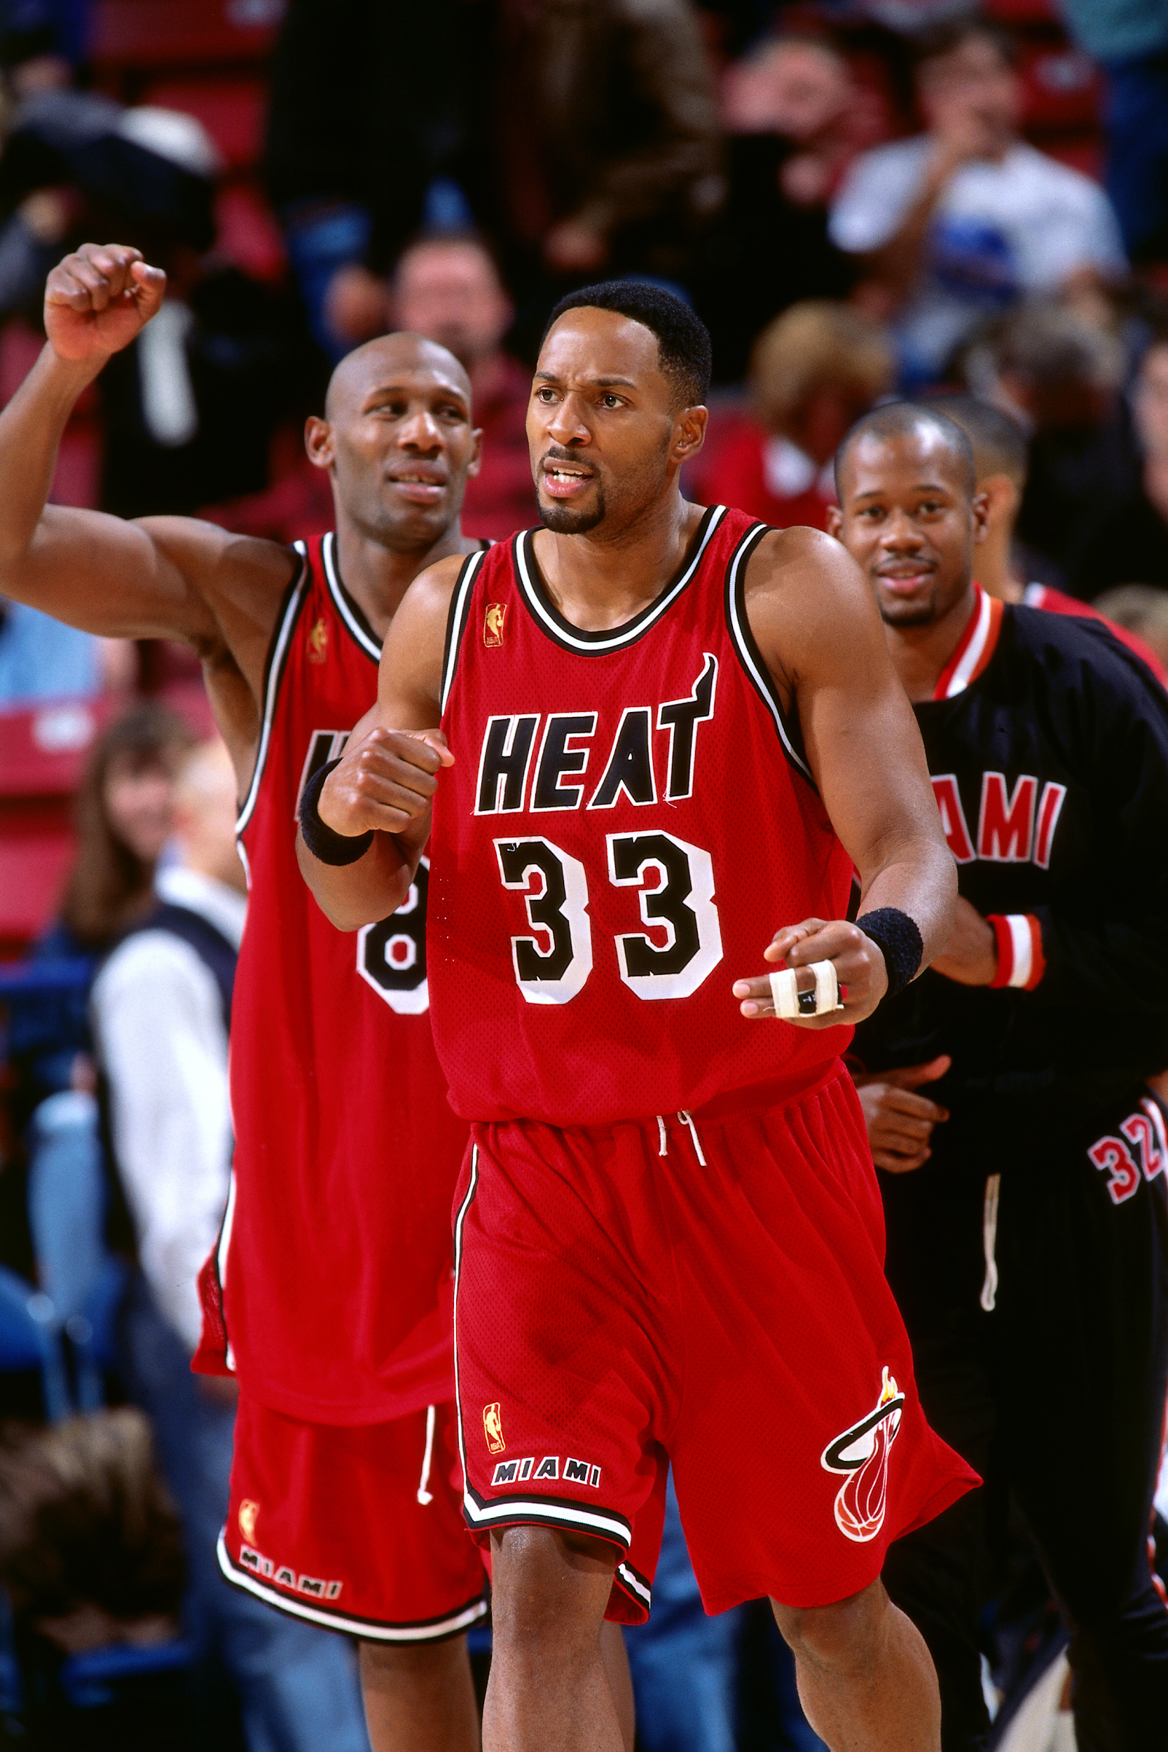
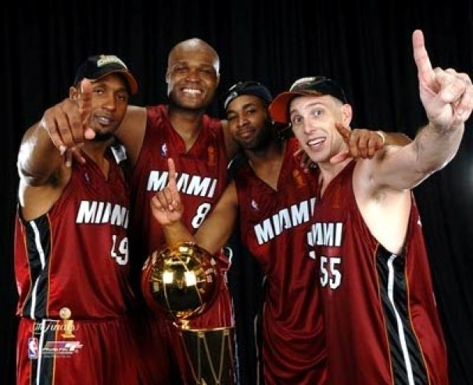
Miami HEAT
Allan Fegley

Slide 2

Presentation Contents
Introduction
  Mission Statement
  Background Information
  Brief History
  Timeline
Current Status
  Company Overview
  Players
  Coaching Staff and Executives
  Arena
  Promotions
  Stakeholders and Sponsors
Situational Analysis
  City Demographics
  Fan Demographics
  Income
  Attendance
Situational Analysis (cont.)
  Social Media
  Employees
  Budget and Finances
  Tickets
SWOT Analysis
  Internal and External Factors
  Competitors
Marketing Objectives
  Action Plan
  Target Audience
  Promotion Ideas
Conclusion
  Goals
  Executive Summary
Bibliography

Slide 3
Introduction

Slide 4
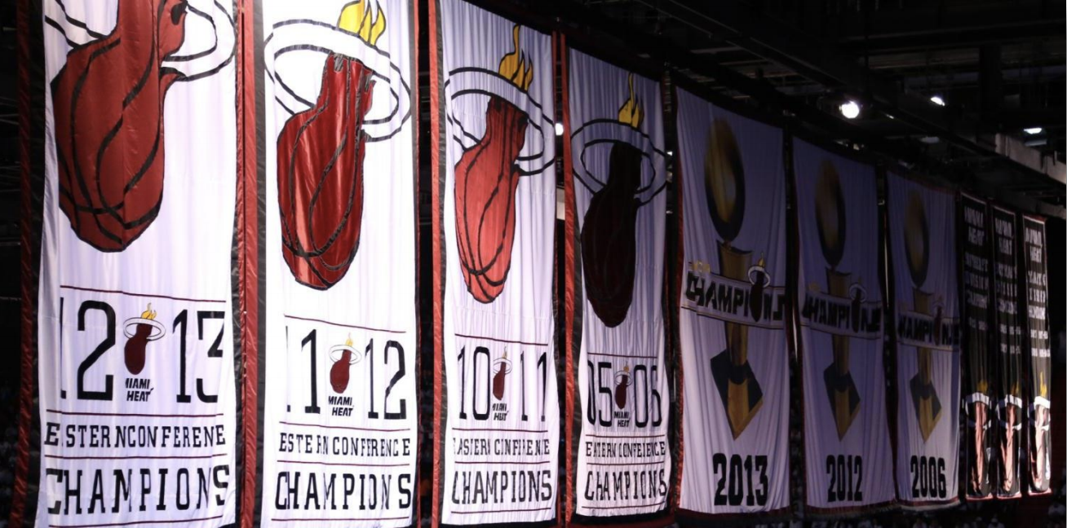
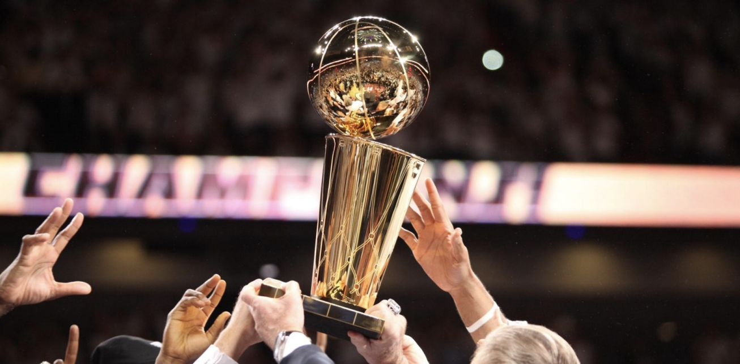
Mission Statement
The Miami HEAT are dedicated to delivering a championship experience to our fans, staff, and including our partners. Our pursuit and passion are to perform exceptionally in the arena, workplace, and in the community. We strive at this through premier customer and community service as we cultivate a spirit of innovation, integrity, and teamwork. Lastly, we stand as a cornerstone of pride and inspiration to Miami and the Southeast.

Slide 5
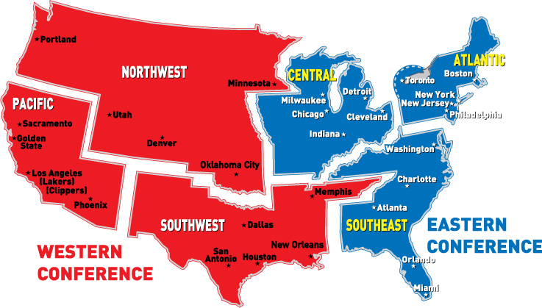
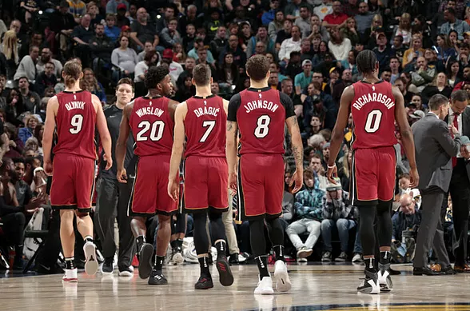
Background Information
NBA Team based in Miami, Florida
Season runs from October - April (till May for playoffs)
Plays 82 regular season (41 home, 41 away)
Arena: American Airlines Arena
Southeast Division in Eastern Conference

Slide 6





Brief History
The Miami HEAT were founded in 1988 along with three other expansion teams (Hornets, Timberwolves, Magic)
Miami was assisted on acquiring an expansion bid by Miami Sports and Exhibition Authority
  Billy Cunningham and Lewis Schaffel
  Received financial help from Carnival Cruise Lines founder, Ted Arison
Hornets and HEAT debuted on 1988-89 NBA Season
First Victory: December 14, 1988 vs Los Angeles Clippers 89-88
Have won three championships (2006, 2012, 2013)

Slide 7

Timeline
1988: Miami HEAT enters the NBA
1995: Hires Pat Riley as Head Coach
2000: Moves into new arena
2003: Drafts Dwyane Wade
2005: HC Pat Riley makes largest trade in NBA History (5 TEAM / 13 PLAYER DEAL)
2006: First Championship
2010: HEAT retains Dwyane Wade; HEAT acquires LeBron James and Chris Bosh
2012: Second Championship
2013: 27-Game Win Streak / Third Championship
2014: LeBron James leaves HEAT
2015: Drafts Justise Winslow and Josh Richardson
2016: Chris Bosh gets sidelined and never returns
Dwyane Wade leaves HEAT
2018: Dwyane Wade returns to HEAT
Both Wade and Bosh announce they
will retire at the end of the season

Slide 8
Current Status

Slide 9
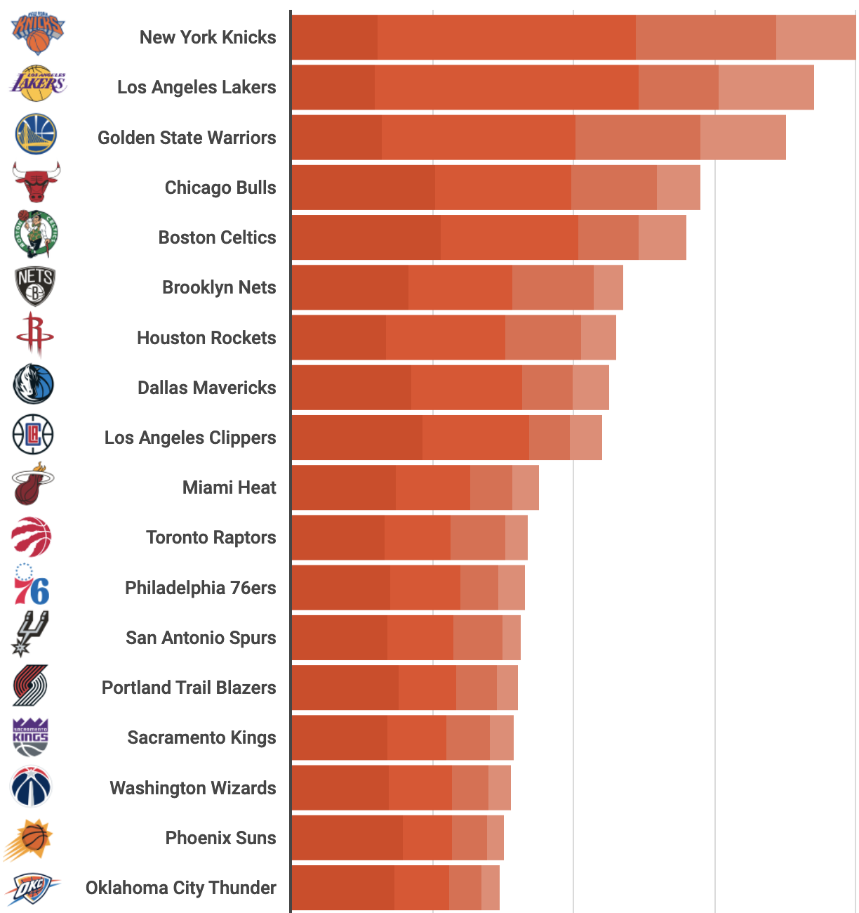
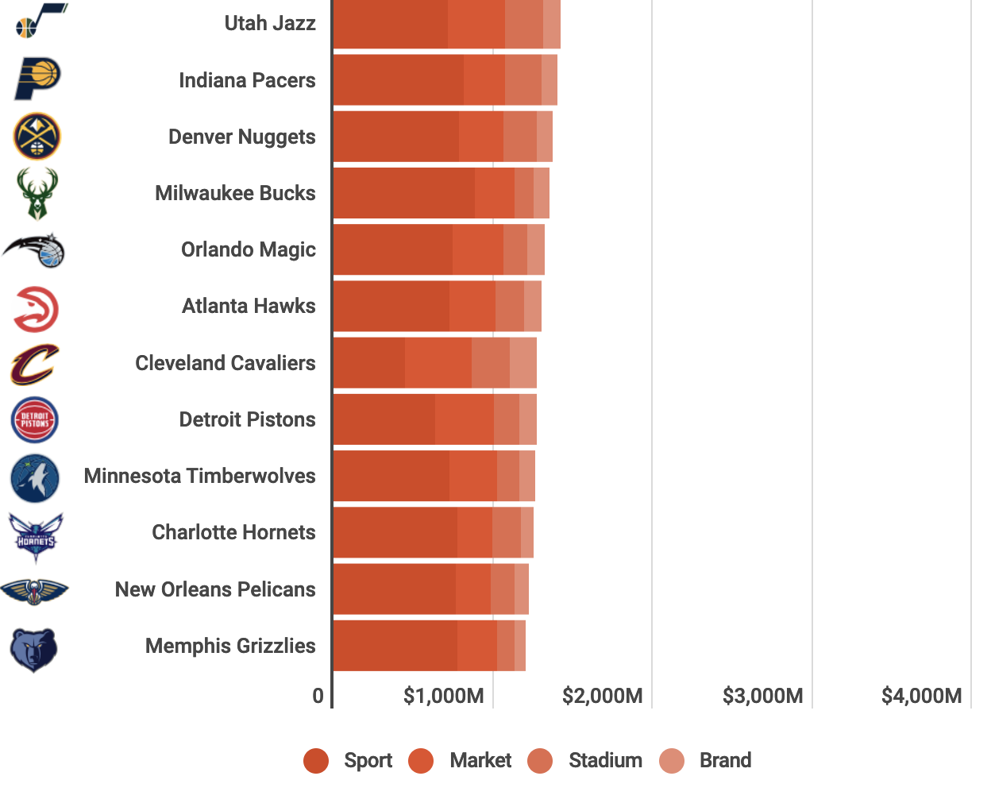
Company Overview
Miami Heat Limited Partnership
  Private Company
  Founded: 1986 | Incorporated: 1987
  NAICS: 711211 Sports Teams and Clubs
  64 employees
Revenue: $259M
Operating Income: $40M
Team Value: $1.75B (10th in Forbes NBA Team Valuations 2019)

Slide 10

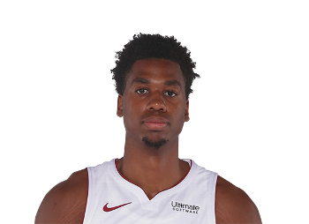
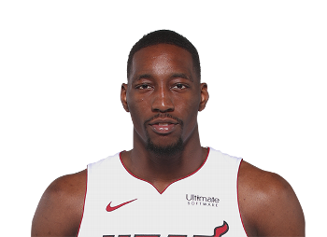
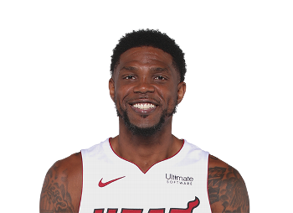
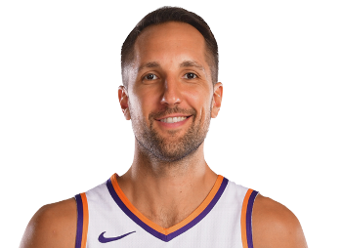
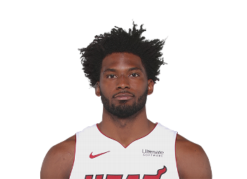
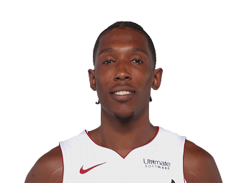
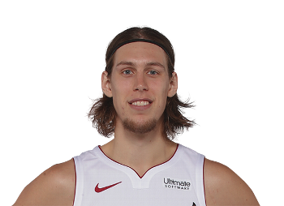
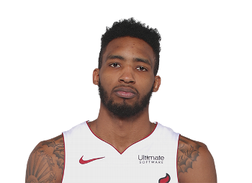
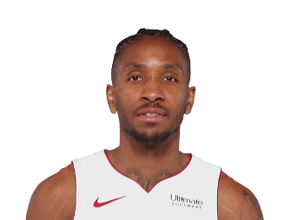
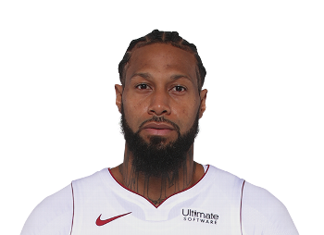
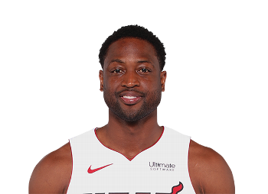
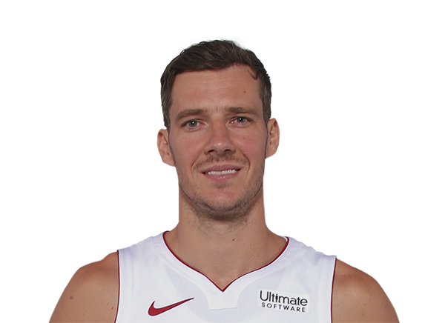
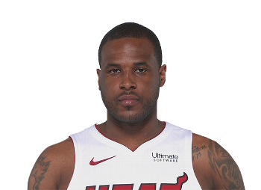
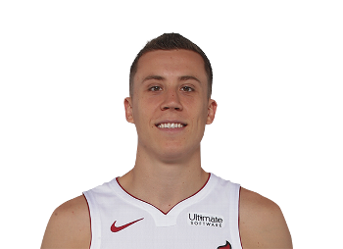
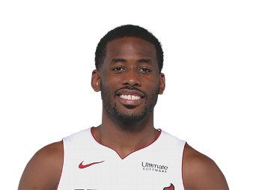
Players
CENTERS:
FORWARDS:
GUARDS:

Slide 11
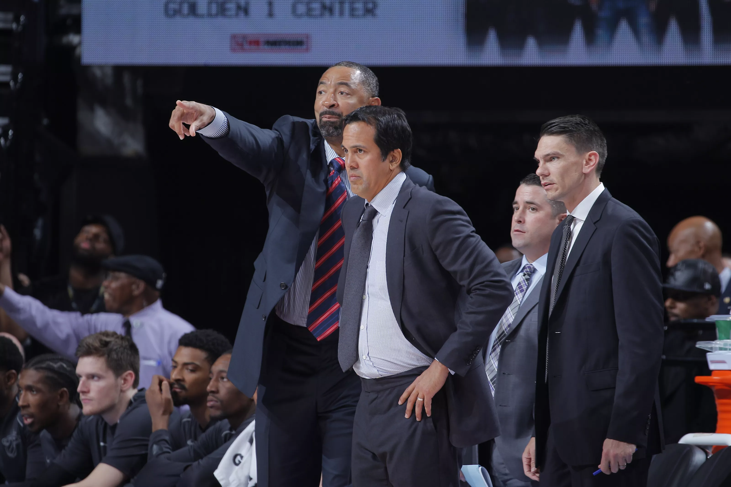
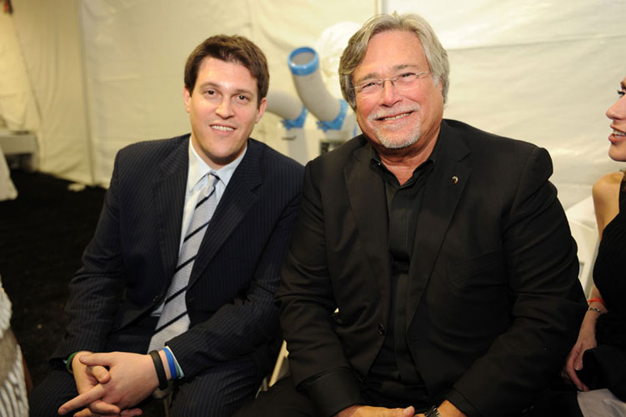
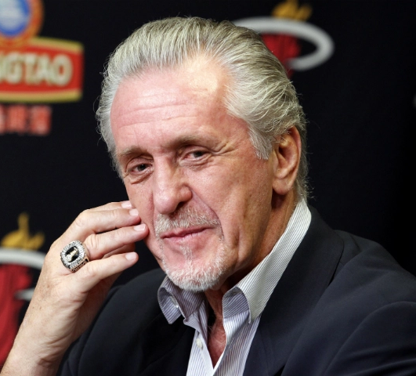
Coaching Staff and Executives
Head Coach - Erik Spoelstra
Assistant Coaches - Juwan Howard, Dan Craig
Assistant Coach for Player Development - Chris Quinn
Owner & Managing General Partner - Micky Arison
Chief Executive Officer - Nick Arison
President - Pat Riley

Slide 12
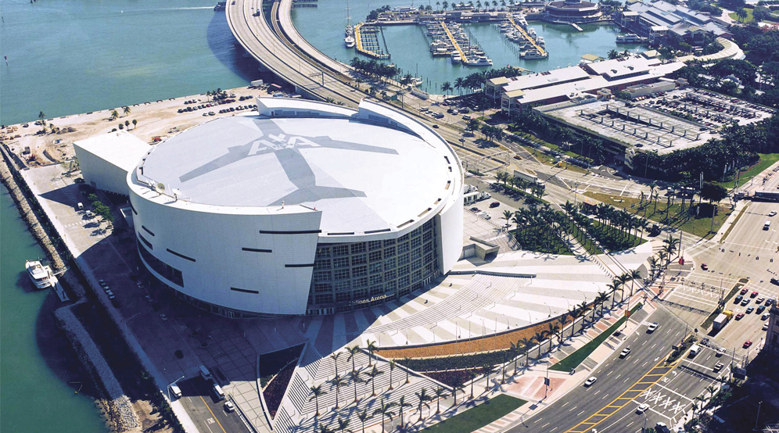
American Airlines Arena
Downtown Miami along Biscayne Bay
Holds 19,600 people at maximum capacity
  18,000 for concerts
Waterfront Theater can seat between 3,000 and 5,800 people
Opened on December 31, 1999, Construction cost was $213M
HEAT started playing in AAA on January 2, 2000
Approximately 120 events per year (HEAT Games, Concerts, Family Shows)
20-YR sponsorship deal; ends in 2019
  American Airlines pays HEAT $2.1M annually

Slide 13
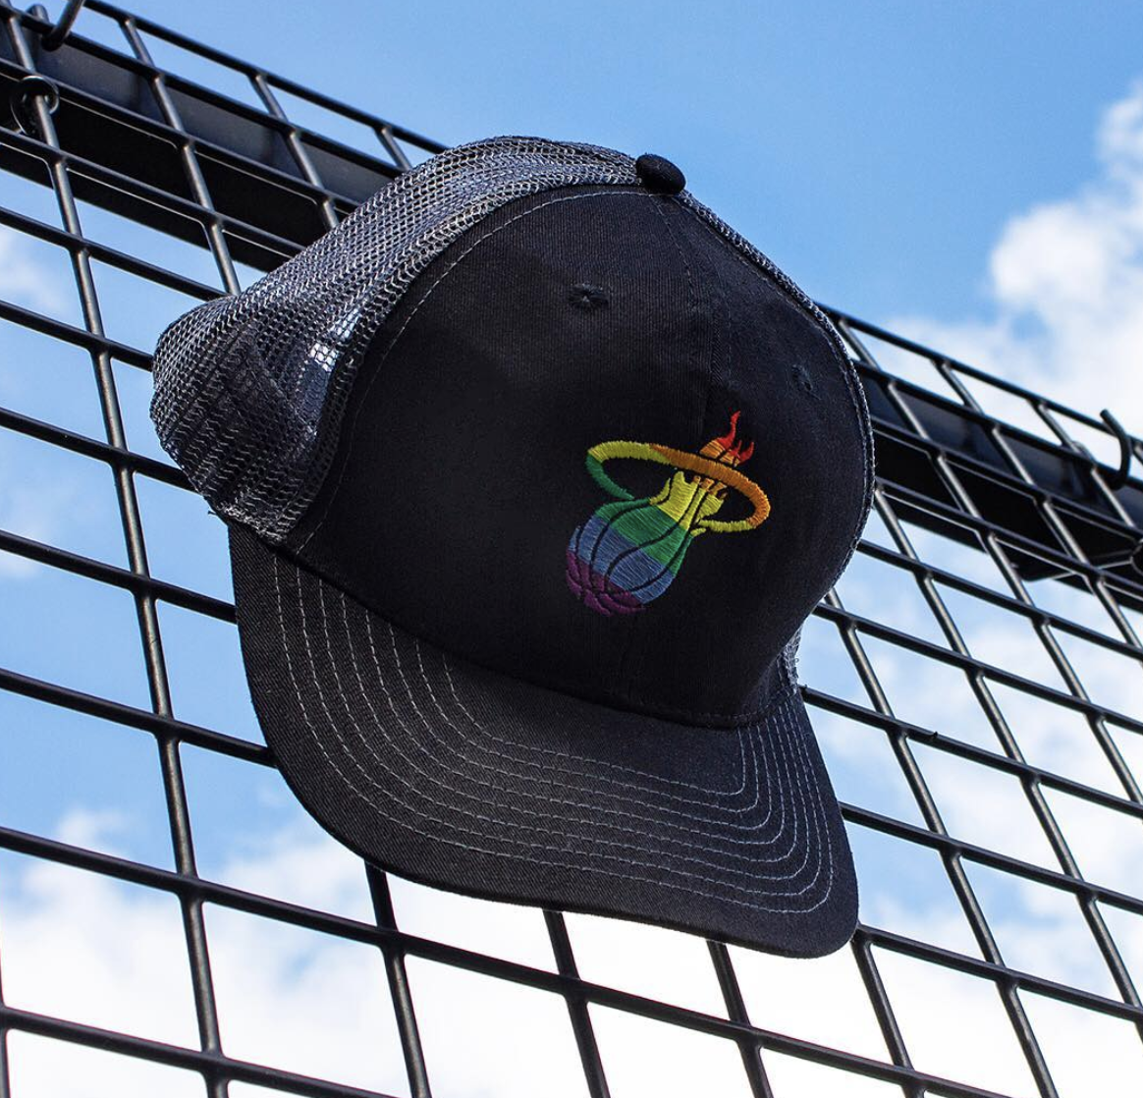
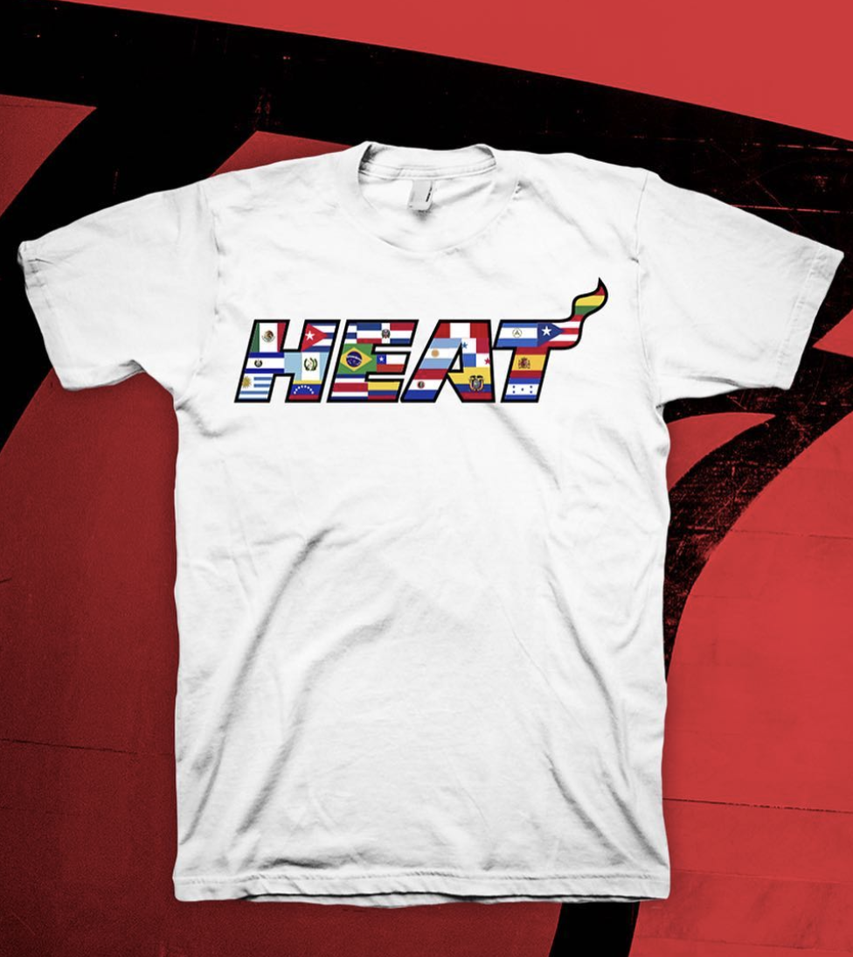

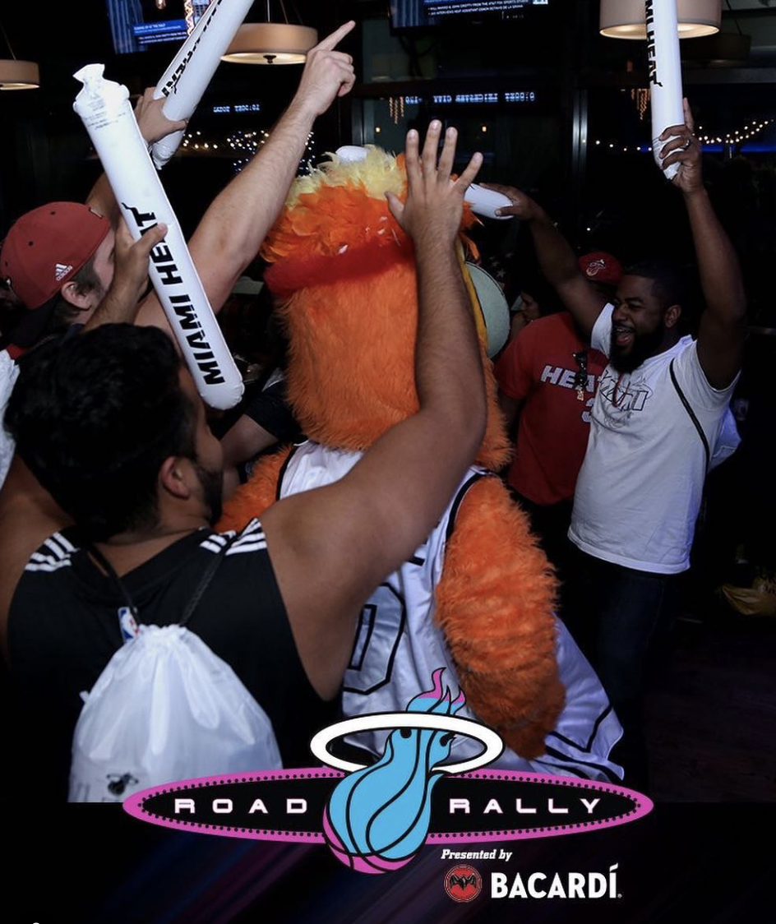
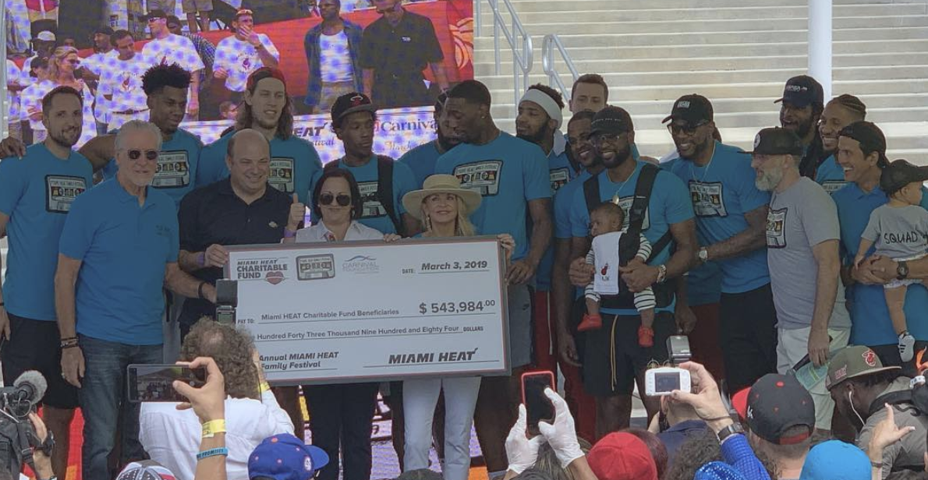
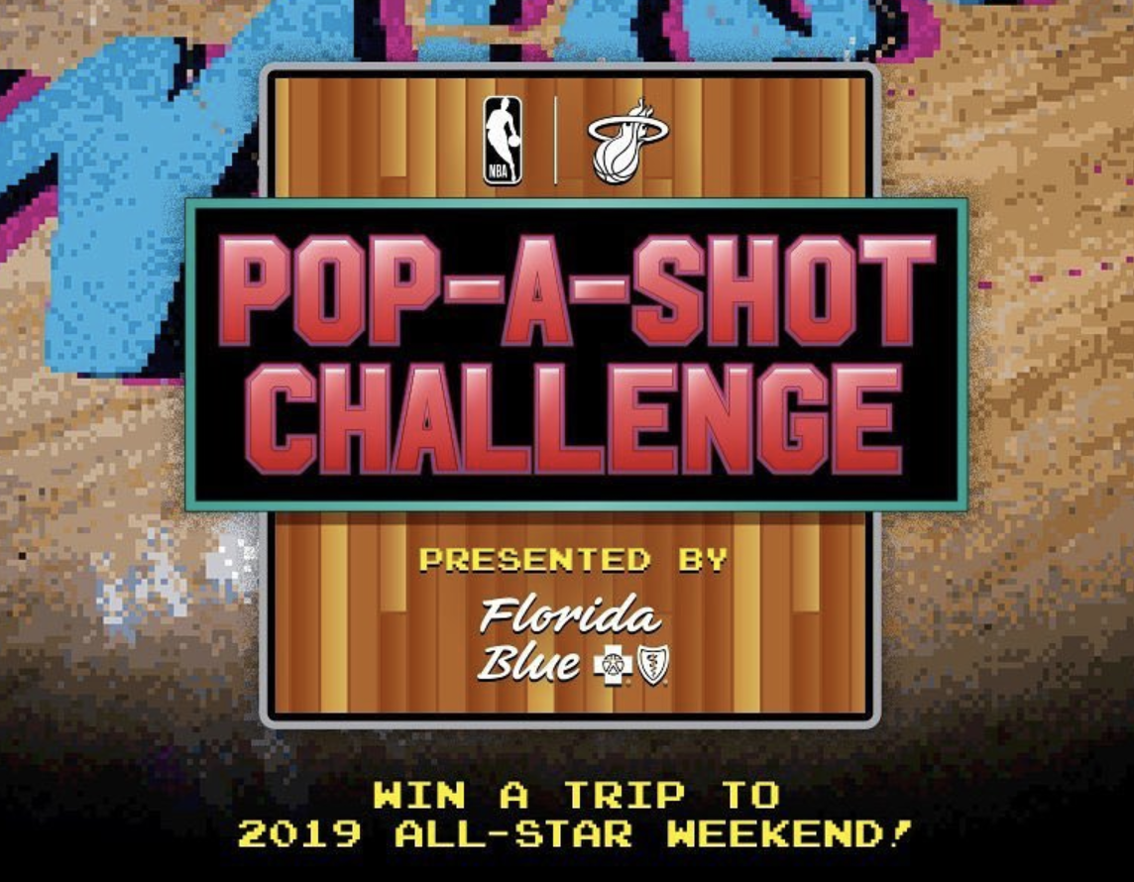
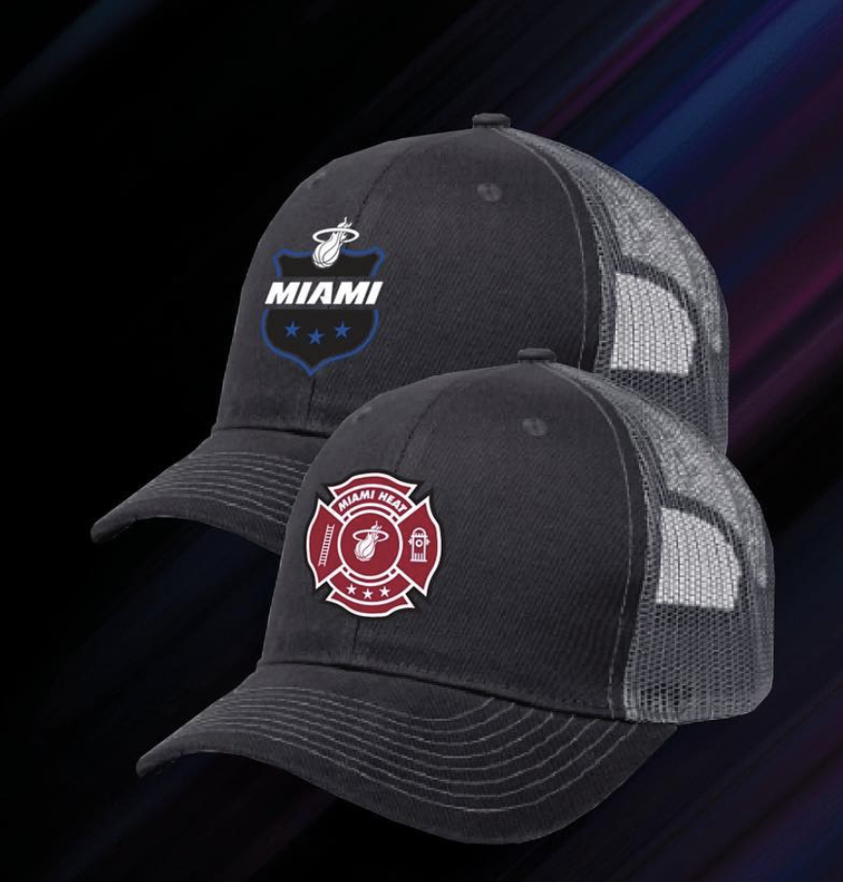

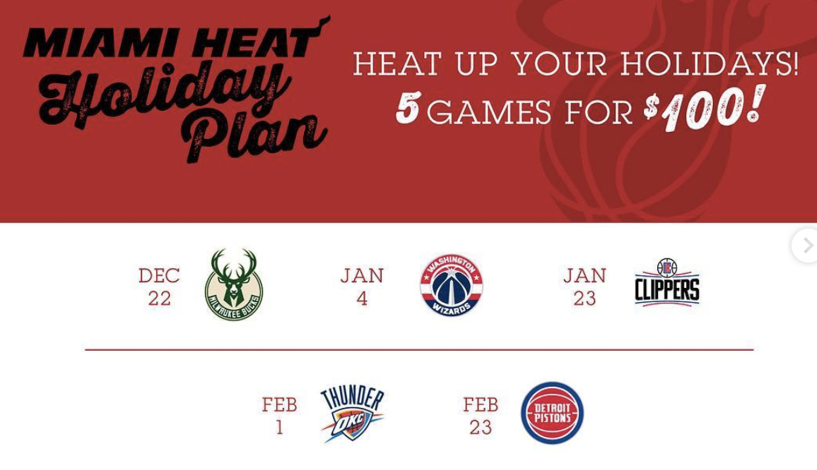
Promotions
Pride Night
Hispanic Heritage Night
Miami Heat Family Festival
Chinese Heritage Night
Road Rally
University Night
Pop-A-Shot Challenge with Alonzo Mourning
Holiday Plan
First Responders Night
Vice Nights

Slide 14

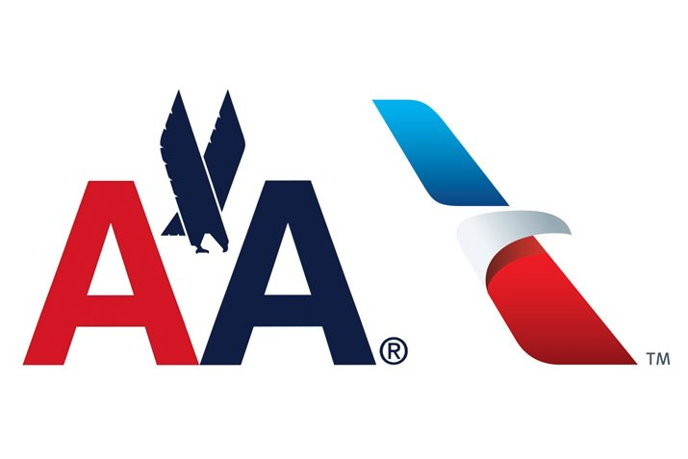






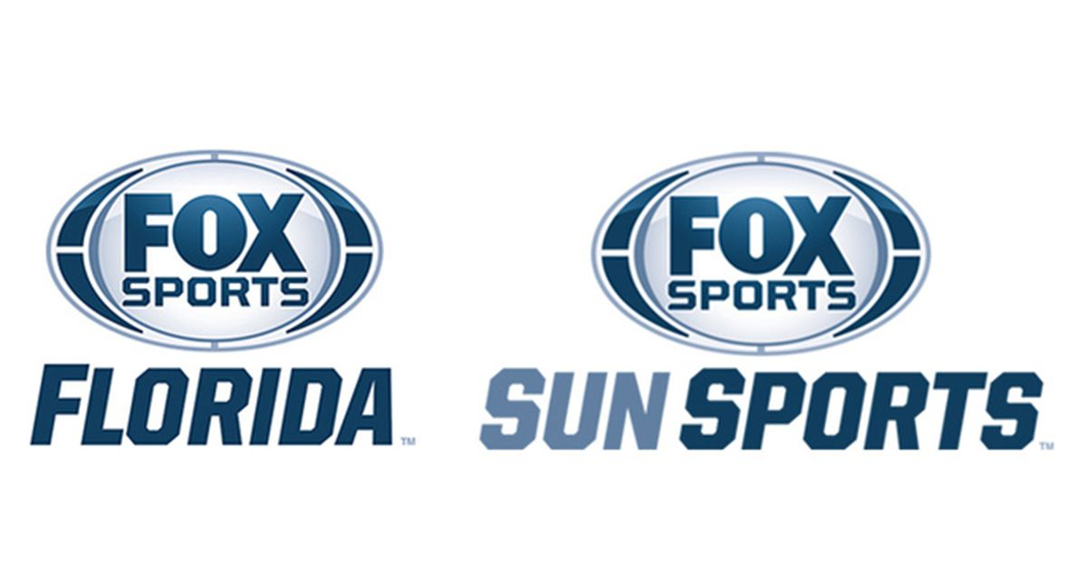




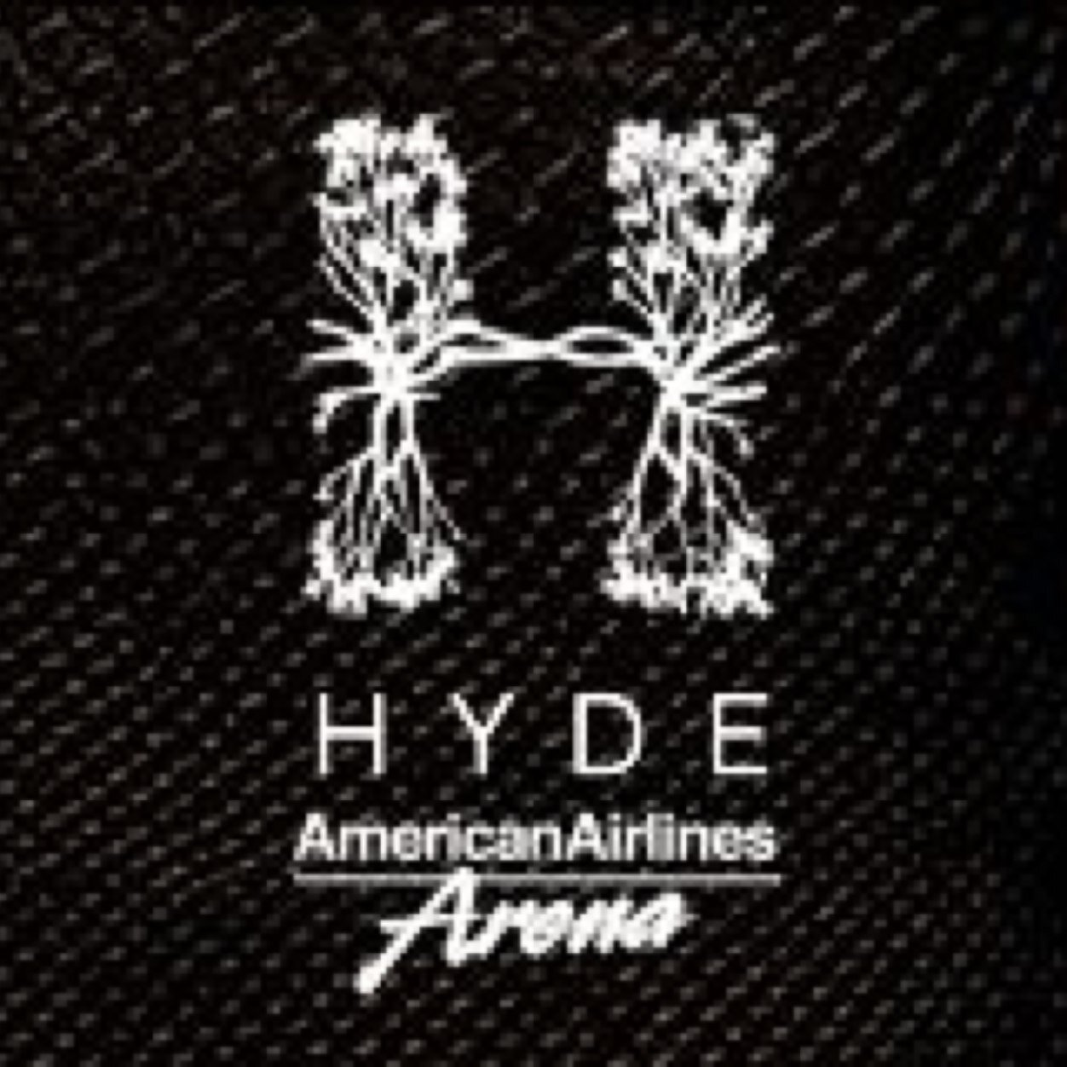
Stakeholders and Sponsors
Financial Stakeholders / Suppliers
  American Airlines, Coca-Cola, Papa Johns, Nike, Kia Motors, Carnival Cruise Line
Sponsors
  Ultimate Software
  Tissot
  Bacardi
  Fox Sun Sports
  T-Mobile
  Alienware
  Court Culture
  Moët & Chandon
  Hyde

Slide 15
Situational Analysis

Slide 16
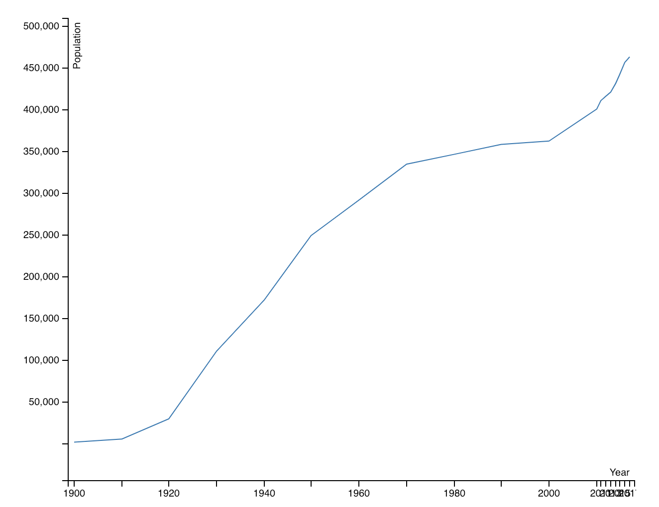
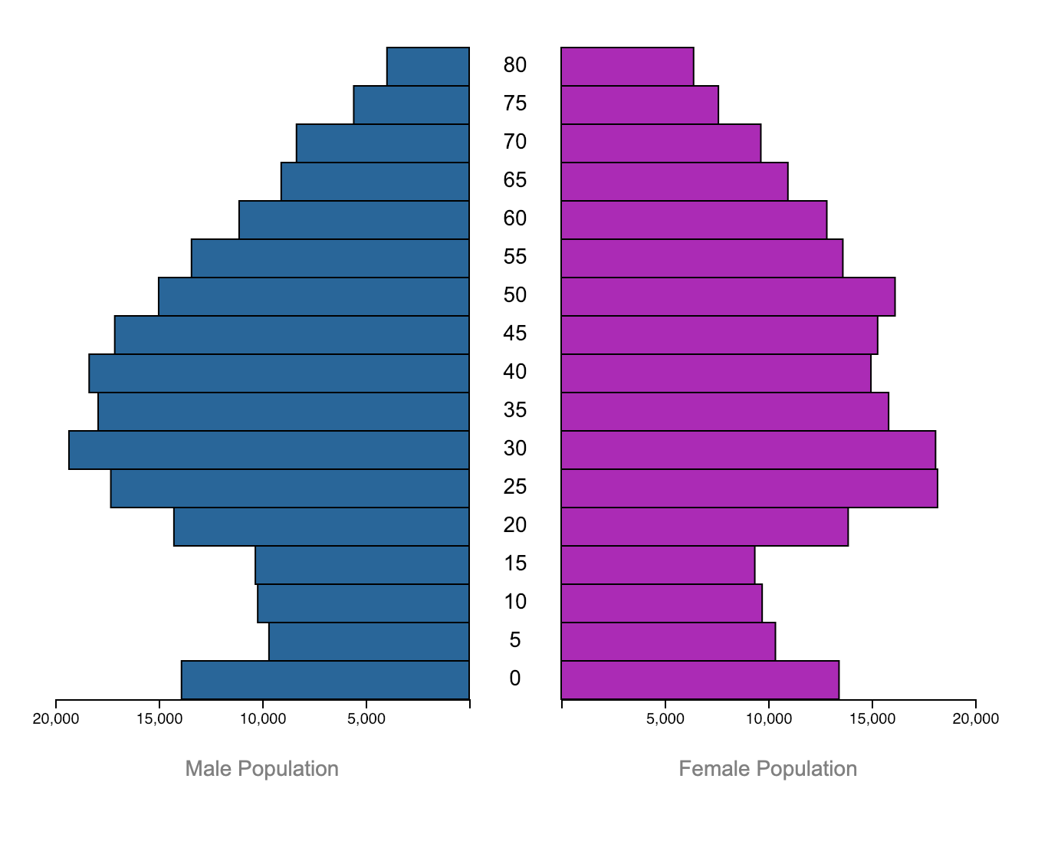
City Demographics
*AS OF 2017* - 463,347 individuals living in Miami
  Gender Breakdown: 50.56% Female, 49.44% Male
  Ethnic Breakdown:
    75.4% White (89.9% are of Hispanic descent)
    18.4% Black or African-American (3.6% are of Hispanic descent)
    3.3% Other Race
    1.7% Two or more Races
    0.9% Asian
    0.3% American Indian or Alaskan native

Slide 17
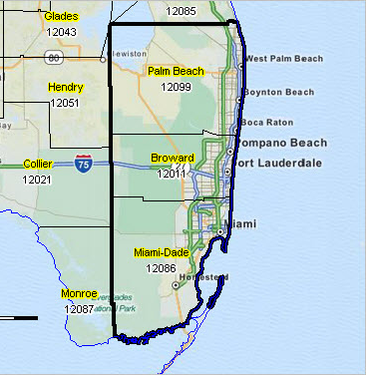
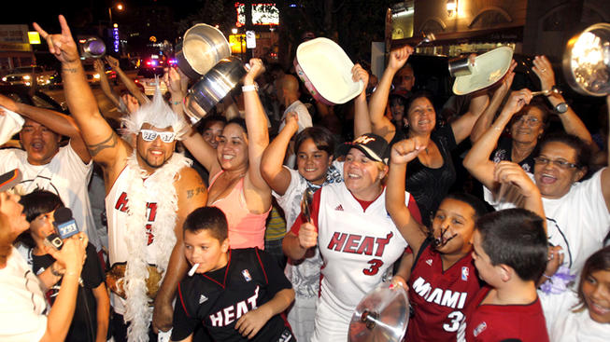
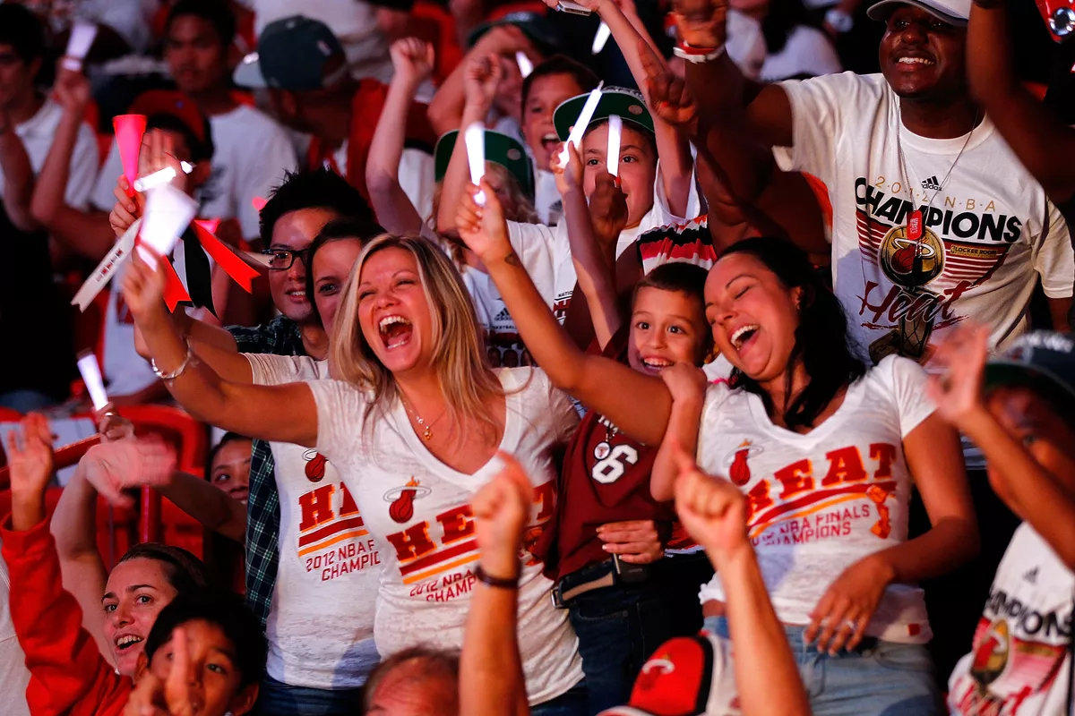
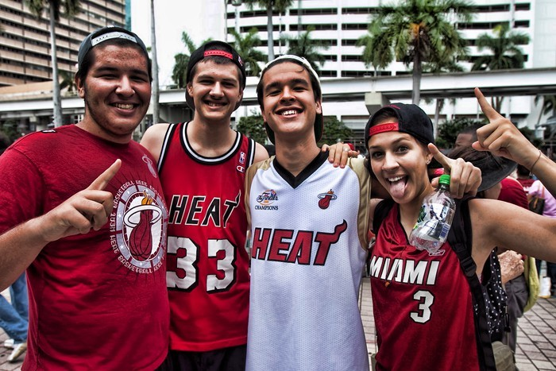
Fan Demographics
Address: 601 Biscayne Blvd, Miami, FL 33132
*AS OF 2015*
  Gender Breakdown: 55% Male, 45% Female
  Geographic Breakdown: 58% Miami-Dade, 24% Broward, 9% Palm Beach
  Ethnic Breakdown: 69% Hispanic, 19% Caucasian, 13% African-American
#2 among NBA teams in Hispanic attendance at 54.7%
The average age of an adult HEAT fan is 42, and 40 for HEAT attendees – younger than any other professional sports team in South Florida

Slide 18
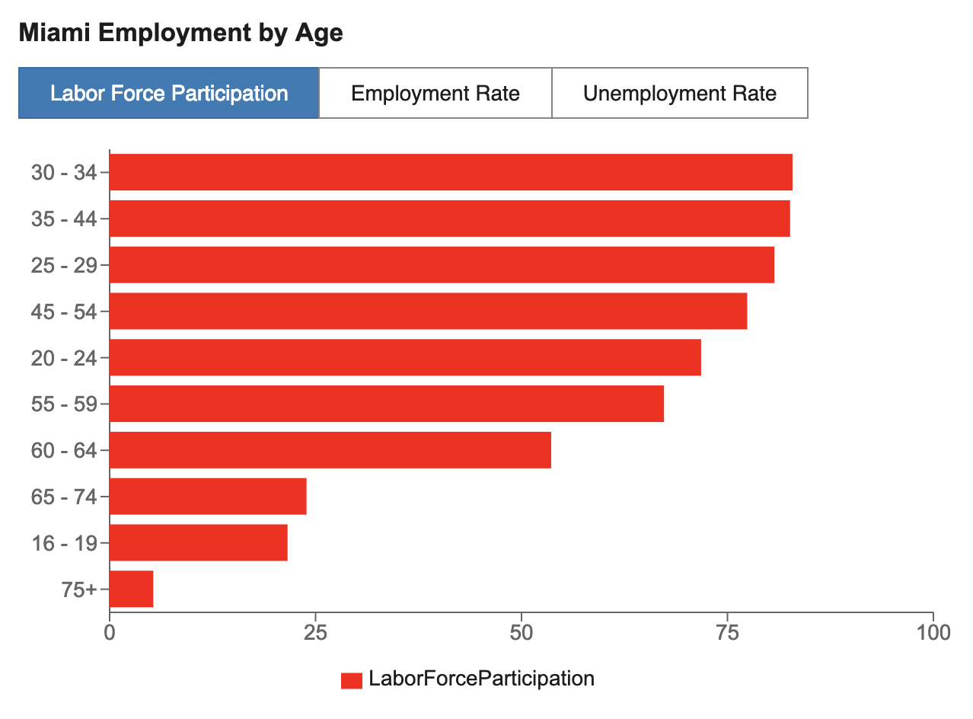
Income
The average income of a Miami resident is $26,282
  US average is $28,555
The median household income of a Miami resident is $33,999/year
  US average is $53,482/year
Unemployment Rate: 8.1%
  US average is 5.2%

Slide 19
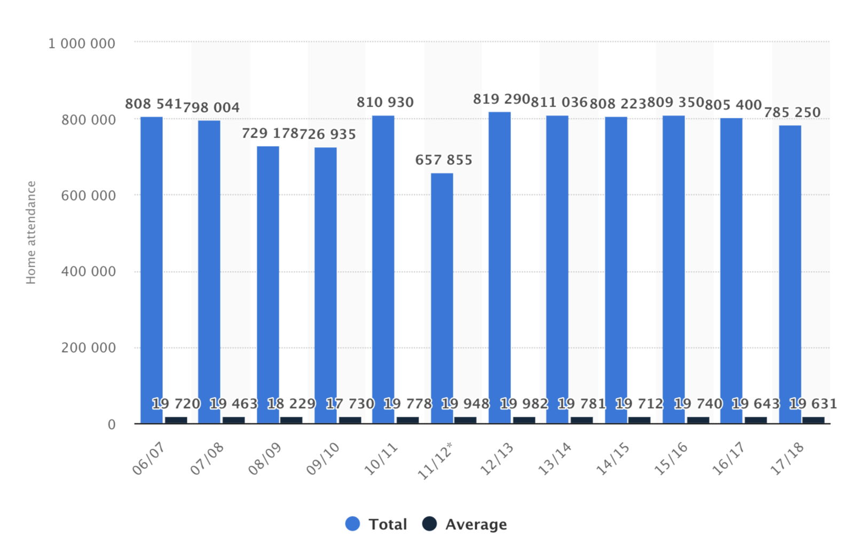
Attendance
2018-19 Season (still ongoing)
  Total Attendance: 666,852
  Average Attendance per game: 19,613
  5th in the NBA (more than the Warriors!!)
Past Attendances on graph shown

Slide 20
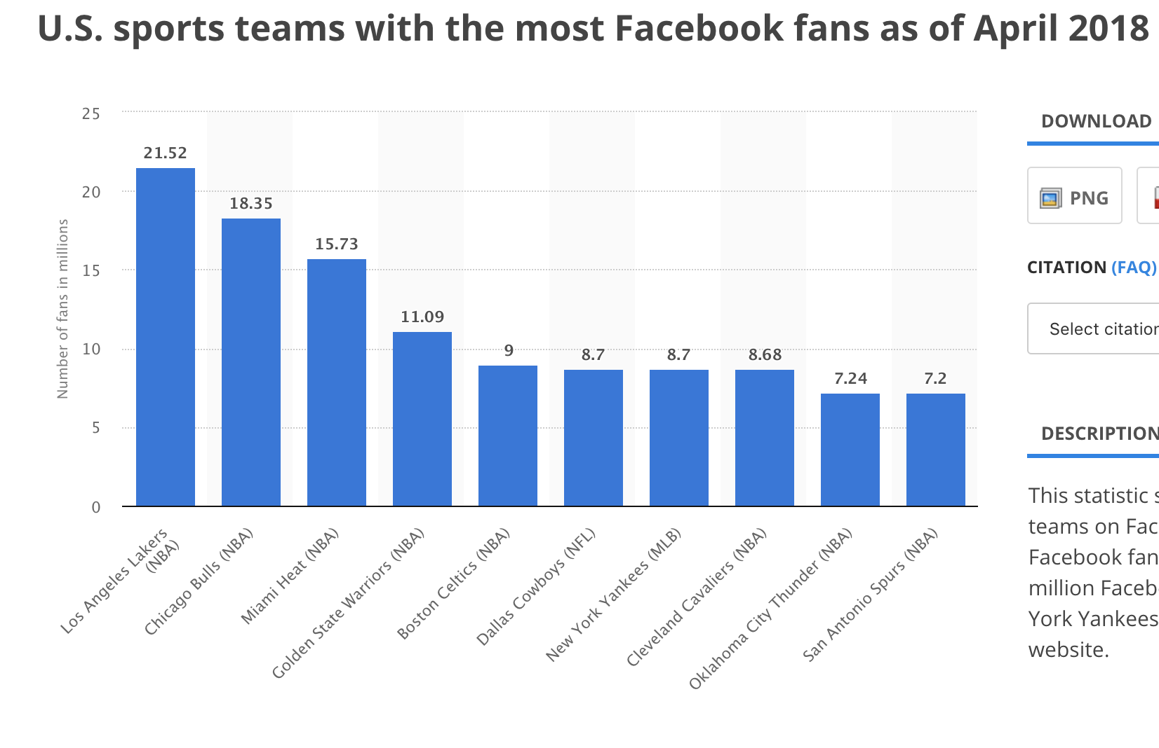
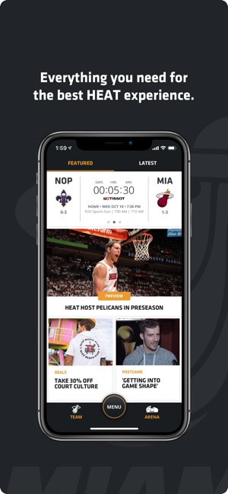



Social Media
Instagram: 3.2M Followers
  NBA is top leading brand in USA on Instagram user engagement
HEAT partnered with BeyondCurious and Built.io to create team’s mobile app
Delivers a more user-friendly, personalized experience pre-game, in-game and post-game

Slide 21

Employees
“Through our doors walk the hardest-working, most talented, professional, innovative, and creative people in the sports and entertainment business. We're a championship-level organization from the front office to the back of house – and everywhere in between.” (https://www.nba.com/heat/miami-heat-careers)
Competitive Industry; Employees are very dedicated

Slide 22


Budget and Finances
Team Value: $1.75B (3% increase = $50M )
  Each NBA teams are now valued at least $1B, thanks to the league’s growing economy and booming international exposure
2018-19 Player Expenses: $131M
Team Revenue: $259M
Revenue Per Fan: $24
HEAT have the NBA's highest-paid payroll at $158M (includes arena debts)
  Team gets $14M in insurance for Chris Bosh's contract
*numbers are according to Forbes and NBA Executives*

Slide 23

Tickets
Average Ticket Price: $85
  NBA Average ~ $56
Season Tickets: ?
  Benefits: Private event with players, exclusive in-game experiences, discounts at team store and concessions, etc.
When LeBron James left in 2014, demand for tickets to see the Heat on the road dropped by 196% relative to the league average
One of the least affordable teams to watch in person

Slide 24
SWOT Analysis

Slide 25




Internal and External Strengths
Marketing Dwyane Wade’s #OneLastDance
Young core of Justise Winslow, Josh Richardson, Bam Adebayo
Derrick Jones Jr’s resurgence
Top Management is world-class and has been with organization for many years
Company’s value continues to increase despite mediocrity since LeBron James left in 2014
Vice jerseys … mostly everybody loves them
Social Media Presence and Engagement

Slide 26




Internal and External Weaknesses
Lacking elite talent (Dragic’s old age, Whiteside’s decline)
Have not been a playoff contender since 2014
Currently not a big free agent destination due to second weakness
High Payroll (Chris Bosh’s contract, overpaid players)
Relatively high prices for tickets

Slide 27



Internal and External Opportunities
Acquire superstar talent in free agency (Kyrie Irving, Kemba Walker, Klay Thompson)
Trade Goran Dragic and Hassan Whiteside for other key players
Solidify Justise Winslow’s PG role
Lower ticket prices for more fans to attend
Attract more customers - whole state of Florida, not just city of Miami
Increase brand awareness - expand Miami Vice Jerseys

Slide 28




Internal and External Threats
One word. Injuries.
Dwyane Wade’s departure could lead to lower fan attendance and more mediocrity
Trading Wayne Ellington and Tyler Johnson
One year left on American Airlines’ sponsorship deal with the team
Pat Riley has traded a lot of future draft picks
Other professional teams in the area: Magic, Dolphins, Marlins, Panthers, etc.

Slide 29

SWOT Analysis: Orlando Magic
Strengths: Solid young core of Mo Bamba, Aaron Gordon, Jonathan Isaac / Currently 9th Seed in Eastern Conference / Sponsorship with Disney
Weaknesses: Last playoff appearance in 2009 / Have missed playoffs for 7 years / Management does not really stand out / 6 Different Head Coaches in past 7 years / Most people go to Orlando for their Theme Parks
Opportunities: Hire a better Head Coach (van Gundy, Thibodeau) / Free Agency this summer / Capitalize on sponsorship with Disney
Threats: Miami HEAT is main competitor / Orlando City SC / Potential departure of key players because Orlando is not a good player destination

Slide 30

SWOT Analysis: Miami Dolphins
Strengths: Passionate and loyal fanbase / Young players with high ceiling (Minkah Fitzpatrick, Albert Wilson, Xavien Howard) / Brian Flores / 2019 Case Study: Miami is sixth best city for football fans and spectators
Weaknesses: Only four playoff berths since 1999 and two in the past 10 years / Tourist Location / Smaller stadium than other NFL teams (26th by seating capacity)
Opportunities: 13th Pick in 2019 NFL Draft / Capitalize when Tom Brady retires / Attract more Hispanic fans and young kids to further improve fanbase
Threats: Other Miami teams have been more successful recently / Ryan Tannehill trade and Ryan Fitzpatrick signing

Slide 31

SWOT Analysis: Miami Marlins
Strengths: Young players to build around / New and improved ownership by CEO Derek Jeter / Team puts more emphasis on building a young farm system that can compete in a few years
Weaknesses: Only good hitter and player is Starlin Castro: most of team is mediocre / Paying $30M in sunk costs to NYY for Giancarlo Stanton / Rumored to be around $400M in debit with new ownership
Opportunities: Improve their farm system for a better future / New logo this season can provide better revenue sales from jerseys / Reach more Hispanic fans
Threats: Team does not have a star player like Bryce Harper / Every other team in their division as well as Tampa team is better / Marlins have a slight refusal to make operational decisions based on player performance analytics

Slide 32

SWOT Analysis: Florida Panthers
Strengths: Young great talent = Aleksander Barkov is a top 20 player / Team has improved over the past decade to contend for playoffs every year / Geographic Location is north of Miami and west of Ft. Lauderdale
Weaknesses: Hockey is not as popular in Florida / Small fanbase / Has never won the Stanley Cup / Has only made playoffs twice this decade / Shaky coaches in the past few years (5 in 8 yr)
Opportunities: Team looks more appealing to free agents due to better team performance / Team leadership of Barkov, Aaron Ekblad, etc. can also be used to attract other players
Threats: Tampa Bay Lightning is main competitor = they would be the NHL team to watch in Florida / Other entertainment destinations are better than to watch a Panthers game / Other NHL teams are more marketable

Slide 33
Marketing Objectives

Slide 34



Action Plan
Lower the costs of tickets for increased overall attendance
Take advantage of a female-majority demographic
Have kids turn into fans and also invite parents to games
More Hispanic-themed promotions
Utilize tropical surroundings to maintain fans
Attract more customers outside Miami
Enhance overall fan experience

Slide 35


Target Audience
Female Spectators
People traveling to beaches near Miami for Spring Break
Hispanic Fans
Kids and parents
HEAT Fans who have not attended games due to high ticket price

Slide 36



Ladies Night
40% off tickets for women
HEAT Cheerleaders get to bring their moms for free
Free hat for first 200 women that enter the game
Women’s T-Shirt giveaway
Ladies get discounts for food and beer
Players get to meet with those who bought a special post-game pass (only for women)

Slide 37



¡Noche de Comida Hispano!
HEAT players wear EL HEAT jerseys
Mariachi music played throughout the whole night
National Anthem will be played by a Hispanic artist
Halftime entertainment will feature Pitbull
New Hispanic food concession stands in the arena
Hispanic food trucks outside the arena
Select fans aged 21 and older will receive a voucher for special edition margaritas

Slide 38

Family Night
HEAT players will show up to select schools in Miami-Dade County
The players will do autographs and give out free tickets to some kids
ALTERNATIVE
Ticket Bundle: Family 4-Pack
4 Tickets, 4 Sodas, 4 Hot-Dogs starting at $99
Halftime: Select families participate in a Pop-A-Shot Challenge with other families ; Winner gets Papa Johns’ Gift Card

Slide 39


Spring Break Accommodations
Most March games will have tickets that have complimentary accommodations to select Spring Break destinations near Miami
South Beach, Ft. Lauderdale, Punta Cana, Cancun
Ticket holders must provide their own transportation
This tactic could also be used to retain season ticket holders

Slide 40




#HEATthrowbackNight
Players will wear Black Hardwood Classics Jerseys
Have old HEAT players like Alonzo Mourning, Gary Payton, and Jason Williams in attendance for the game
Will encourage fans to dress in throwback HEAT attire: Post on social media #HEATthrowbackNight
Retro Shirt Giveaway
Flo Rida concert after the game; free for those who attended the game

Slide 41
Conclusion

Slide 42
Goals
Short-Term
  Increase sales, profitability, and membership
  Utilize sponsors and surroundings more effectively
  Increase attendance and customer satisfaction
Long-Term
  Acquire new fans and customers
  Have HEAT fans experience an excellent gameday experience for every game
  Create an advantage in sales, marketing, etc. over competitors
  Further improve team’s annual income

Slide 43
Executive Summary
The Miami HEAT continue to be a little below average team in the NBA while the departure of Dwyane Wade is imminent. For that, they are in need of retaining and growing their casual fans while acquiring new ones. They must lower ticket prices and do more promotions that coordinate with the team’s specific fan and city demographics in order to complete all of these objectives.
The organization is doing mostly well financially with their budget and finances, but the team’s current payroll is a problem. They must avoid to overpay players and get a star free agent for the right price so they avoid the same problem next season.
Lastly, their employees as well as coaching staff and executives are top-notch. These individuals should continue doing their respective jobs as efficient and organized as possible while constantly listening to fans and their feedback.

Slide 44
Bibliography

Slide 45
https://www.nba.com/heat/
Rouland, R. (2011). Miami heat limited partnership.Detroit, MI: St. James Press. Retrieved from http://link.galegroup.com.dbsearch.fredonia.edu:2048/apps/doc/CX1999200062/GVRL?u=sunyfredonia&sid=GVRL&xid=9df319bd
http://www.mergentonline.com.dbsearch.fredonia.edu:2048/privatecompanydetail.php?dunsnumber=198550485&pagetype=synopsis
http://worldpopulationreview.com/us-cities/miami-population/
https://arenadigest.com/2018/10/24/miami-dade-takes-americanairlines-arena-naming-rights-talks/
https://www.forbes.com/teams/miami-heat/
https://www.si.com/nba/2018/09/21/nba-teams-revenue-spending-breakdown-small-large-market
https://blog.ticketiq.com/blog/2018-19-nba-tickets-prices-trends

Slide 46
https://www.forbes.com/sites/aliciajessop/2014/06/12/the-miami-heats-partnerships-with-luxury-brands-creates-unique-in-arena-experiences-for-fans/#73f050286e3a
https://factfinder.census.gov/faces/nav/jsf/pages/community_facts.xhtml
https://www-statista-com.dbsearch.fredonia.edu:2443/statistics/197541/nba-home-attendance-of-the-miami-heat-since-2006/
http://proxy.espn.com/nba/attendance?sort=awayPct
https://www.nba.com/.element/media/2.0/teamsites/heat/media/PartnershipOverview.pdf
https://www.prnewswire.com/news-releases/miami-heat-selects-beyondcurious-and-builtio-to-launch-new-fan-experience-300419307.html
https://www.valuepenguin.com/2017/02/affordability-every-nba-team-tickets
https://www.sun-sentinel.com/sports/fl-new-miami-best-city-football-fans-study-20190201-story.html

