Slide 1

Cleveland Cavaliers
Sports Marketing Plan
Yusuke Yaginuma

Slide 2
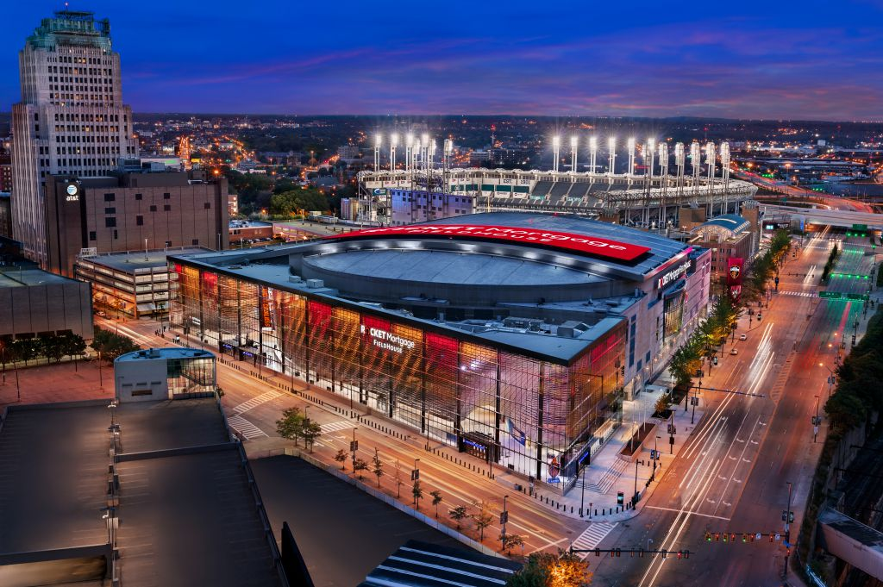

Introduction
NBA league team in Easteren Conference Central Division
Located at Ohio State
Head coach: J.B. Bickerstaff
Stadium: Rocket Mortgage FieldHouse
Owner: Dan Gilbert
General Manager: Koby Altman
Sponsored by The Goodyear Tire & Rubber Company

Slide 3
History
Founded in 1970
Championships 1 time (2016)
Conference titles 5 times (2007,2015,2016,2017,2018)
Division titles 7 times (1976,2009,2010,2015,2016,2017,2018)
2010-11 season 26-game losing steak(longest in NBA history)
Lost Lebron James and some other great players with many fans

Slide 4
Marketing Strategy
The Cleveland Cavaliers will bring back many fans by winning the games. In order to achieve this, we will make a whole new different team then before. Our organization will continue to draft young and exciting players that will benefit the team immediately. We will change the playstyle of our team then before. Also we have a renovated arena that will put fans first. Using this arena, we will make many basketball fans to come and like this arena.
We will make the people feel pride in living in Cleveland and being a fan of Cavs.

Slide 5
Marketing Objectives
Increase ticket sales
The Cavs’ attendance is down 7.1%, and ranks 17th in the league. By making more fans to come to the game, we need to Increase ticket sales.
More fan service using the new arena
To collect more fans, the players should meet with the fans especially little children, and familys to get involved in the community in Cleveland.
Adjusting the team to a new play style
The team has almost whole new starting members, and they need to play as a team to win because there are no big stars that could win by 1 on 1.
Bring a Big win home!
If we bring a big win home like the championship title in 2016, there will be more fans in other states too.

Slide 6
Target Marketing
The target of this marketing is the population in Ohio State.
We want everyone to feel at home watching the game
Our main objective is family's and children
Children can be the newest and longest fan in the future
We want everyone to be excited to come to the arena and attend the game
We want to sell out the renovated arena
The more people we bring to the arena the more people will recognize the change of the team
Then this will increase more people to be one of a fan for this team
Those people will buy and wear jerseys and then more people will know about the team

Slide 7
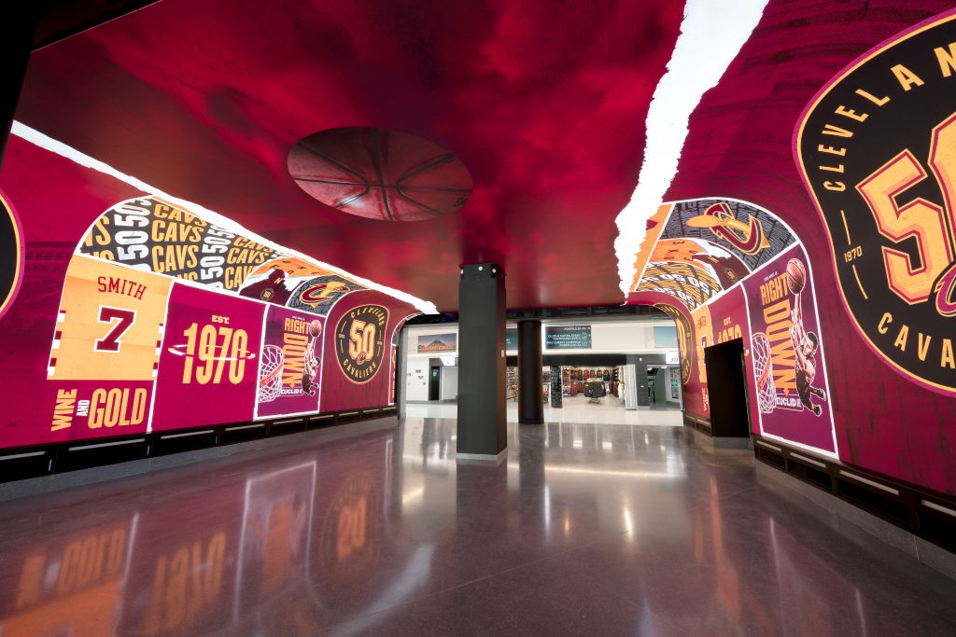
Strengths
Renovated arena
Rocket Mortgage FieldHouse
Many three point shooters
J.R. Smith (43.1%), Kyle Korver(43.1%), George Hill (38.3%), Kevin Love (37.0%), Rodney Hood(43.1%)
Rookies
Collin Sexton, Kevin Porter Jr., Dylan Windler

Slide 8
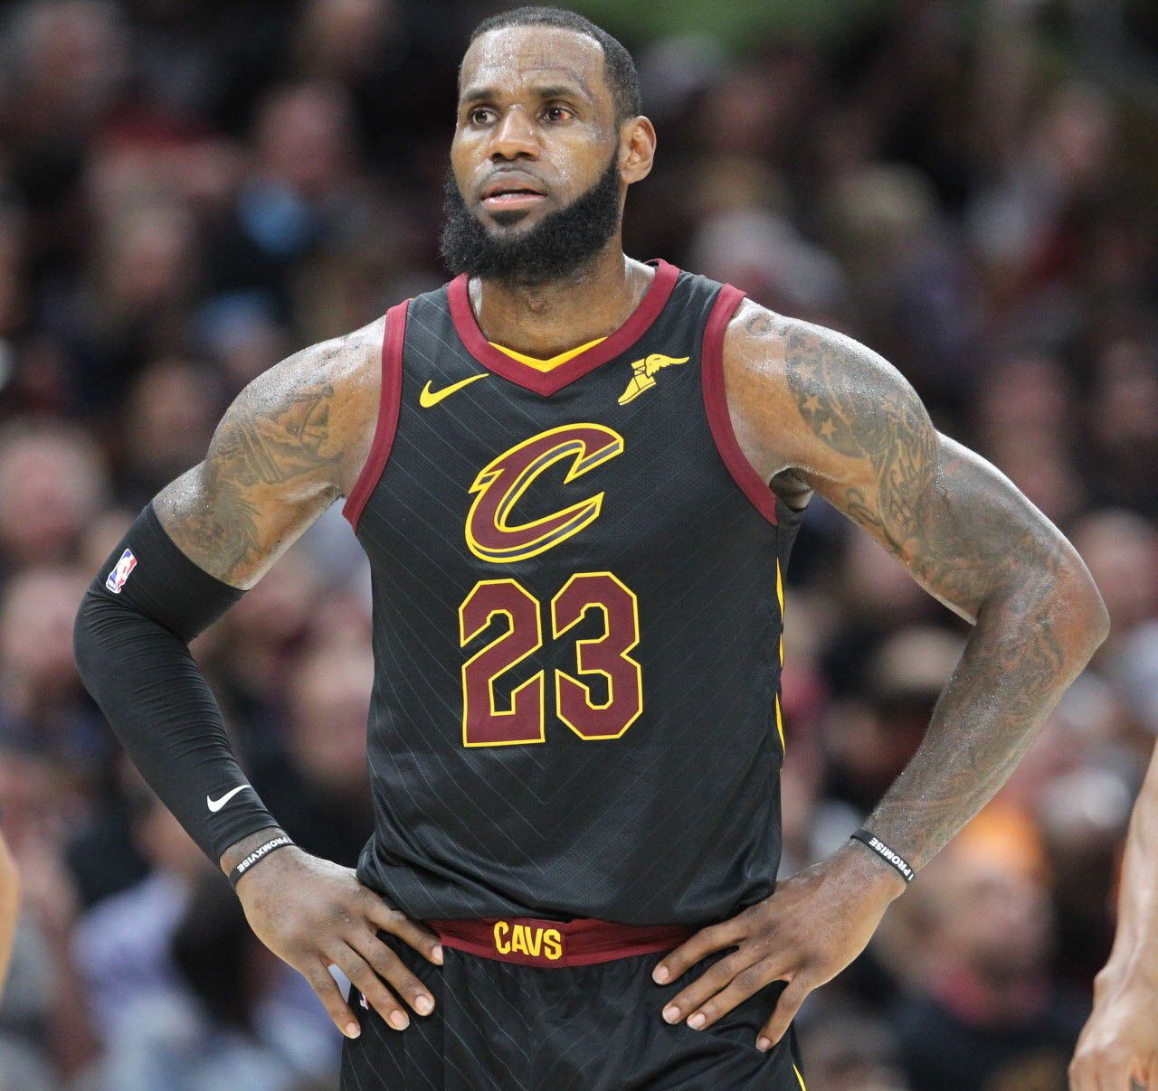
Weakness
Lose of LeBron James
No player that can control the ball and plays during the game
Many players that are not famous in NBA

Slide 9
Opportunities
Renovated Arena with more space
The new arena built has more space for fans to watch and the are opportunities for anyone to buy it.
Kevin Love is one of the All Star members
Kevin Love is an All Star player so there are many fans for him. We could make those fans to look at the rookies and tell them how great they are. Then they will be able to make fans in Cleveland to watch the game.
LeBron is gone so the wealth will spread
To play as a team to win, there will be more ball-movement, more shooting, and more scoring for each player.

Slide 10


Threats
Golden State Warriors
Warriors has a whole new arena and has many three point shooters.
Two of then are a big threat because we have almost the same two strength as them
Los Angeles Lakers
LeBron transferred to Lakers so they have LeBron’s fan witch used to come see Cavs’ game.

Slide 11
Marketing Tactics
We will make a family package to watch the game
We will make a ticket that has a big chance to win a signed basketball
We will make a children fan day
A day that children will be able to have fun playing basketball and some equipment's at the arena before the home game
Can have time with the players (Fan service for the kids)
Increase the amount of items
Bobble heads, Jerseys, T-shirts, Caps, Mug cup, souvenir balls, and any others that fans would like to have
Put more selections of food and drinks at the arena so that people could stay there a whole day

Slide 12
Marketing Tactics
Price
We are going to increase ticket sales and let fans purchase the ticket easier.
In the arena we will make them stay for a whole day by having fun. So we will make the money by people purchasing items, food, and drinks.
People
We are making ticket packs for families and children.
So we want fans that are young while we treat the old fans good enough by making a discount if they bring the Cav’s old item (like a jersey).

Slide 13
Marketing Tactics
Promotion
Instagram
Twitter
Facebook
Website
We will use these social network services because they are free and most young people watch them mainly today.

Slide 14
Conclusion
Since LeBron James and some other star players have transferred to an other team, Cavaliers has been suffering to win games and are loosing some fans. Therefore we need to change the team 180 degrees. We are going to change each play on court and , there will be more ball-movement, more shooting, and more scoring for each player. Also the arena has renovated, we will make more people know that the Cavs have changed by watching it at the arena. We will let more people come to the arena easier by increasing ticket sales. At the arena there will be more items and others, more fan services, making a place that children will have fun so that their parents can have a nice arena date.
This will hopefully have more fan attendance and build up the team again to win a title. Our overall goal is to bring the Championship title to the Cleveland fans that will always support us.

Slide 15
Sources
https://www.pinterest.ie/pin/116389971604301628/
https://en.wikipedia.org/wiki/Cleveland_Cavaliers
https://en.wikipedia.org/wiki/Goodyear_Tire_and_Rubber_Company#/media/File:Goodyear_logo.svg
https://frntofficesport.com/cleveland-cavaliers/
https://www.cleveland.com/metro/2018/07/lebron_james_departure_wont_st.html
https://www.pinterest.com/pin/145030050475032900/
https://www.nba.com/lakers/releases/180804statement-regarding-lebron-games

