Slide 1
Sport Marketing
Chapter 12
Ketra L. Armstrong, Patrick Walsh, and Windy Dees

Slide 2
Introduction
Marketing is a complex function
Sport marketing defined
Unique characteristics of sport
  Demands unique approach to marketing
  Provides marketers with challenges and opportunities

Slide 3
Unique Characteristics of Sport
Aspects of sport are intangible.
Sport involves emotions.
Sport is subjective and heterogeneous.
Sport is generally socially consumed.
Sport experiences are inconsistent and unpredictable.
Sport is perishable.

Slide 4
Developing a Sport Marketing Plan
Marketing plans
Marketing mix (four Ps)
  Product
  Price
  Place
  Promotion

Slide 5
Four Ps
Central to the sport marketing plan.
Manipulated by sport marketers’ strategic and tactical plans.
Integrated with other elements for optimal success

Slide 6
Process for Developing a Sport Marketing Plan: Steps 1 and 2
Identify the purpose of the sport marketing plan.
Analyze the sport product.
  Dynamic and complex nature of the sport product
  Dimensions of the sport product
  Core product
  Product extensions

Slide 7
Process for Developing a Sport Marketing Plan: Step 3
Analyze market conditions.
  Influence of market conditions
  Assessing the sport climate: examining internal and external factors

Slide 8
SWOT Analysis
Assessing internal strengths and weaknesses
Assessing external opportunities and threats
Marketing plans should
  Maximize strengths and opportunities
  Minimize weaknesses and threats
SWOT Analysis of Women’s Professional Basketball

Slide 9
Process for Developing a Sport Marketing Plan: Step 4
Position the sport product.
  Differentiating the product from competing products
  Creating a distinctive image of the product
  Elements of effective communication practices
    Using honest and inoffensive communication

Slide 10
Branding
Using a name, design, or symbol to differentiate a sport product
  Brand awareness
  Brand image
  Brand equity
  Brand loyalty

Slide 11
Process for Developing a Sport Marketing Plan: Step 5
Segment and target consumer groups.
  Analyzing and targeting consumers: grouping and selecting the right consumers
  Market segmentation
    Used to identify target audiences
    Segmenting consumers into five areas: demographics, geographics, psychographics, product benefits, and purchasing behavior

Slide 12
Process for Developing a Sport Marketing Plan: Step 6
Package the sport product.
  Presenting the product in the best possible manner
  Packaging
    Tangible sport product, core product, product extensions
    Licensed merchandise and sport sponsorship

Slide 13
Process for Developing a Sport Marketing Plan: Step 7
Price the sport product.
  Price is the most visible and flexible element
  Determining the value of the product
  Factors to consider when developing pricing strategy
  Unique aspects and complexity of sport pricing
Four factors to be consider in pricing
  Consumer
  Competitor
  Company
  Climate

Slide 14
Process for Developing a Sport Marketing Plan: Step 8
Promote the sport product.
  Communicating the desired image (see Renaming the Washington Bullets)
  Educating and informing target audiences
  Persuading target audiences to purchase

Slide 15
Elements of Promotion Strategy
Advertising
Publicity
Sales promotions
Public relations
(continued)

Slide 16
Elements of Promotion Strategy (continued)
Community relations
Media relations
Personal selling
Sponsorship

Slide 17
Process for Developing a Sport Marketing Plan: Step 9
Distribute the sport product.
  Product location
  Distribution point of origin
  Geographic location of target markets
  Other channels

Slide 18
Process for Developing a Sport Marketing Plan: Step 10
Evaluate the sport marketing plan.
  Evaluating the extent to which the marketing plan met its objectives to help achieve the sport organization’s mission
  Obtaining and analyzing feedback from internal and external sources

Slide 19
Market Research
Information needed to develop a marketing plan
  The product
  Targeted consumers
  Social, cultural, and economic trends
  Direct and indirect competitors

Slide 20
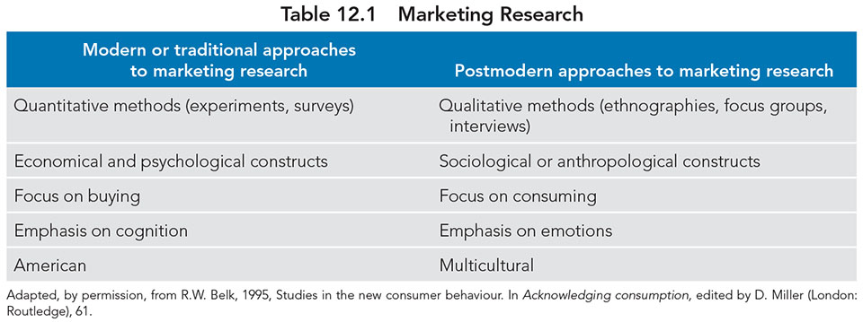
Table 12.1

Slide 21
Practical Application
Technology, social media, and sport marketing
Critical thinking in sport marketing
  Infusion of hip-hop nuances into marketing plans
Ethics in sport marketing
  Communicating honesty in images and integrity in messages
  Increasing consumer diversity
  Effects of technology on sport marketing practices

Slide 22
Review Questions
Identify the elements of a SWOT and discuss how they may inform marketing plans?
What are the methods used to segment a market to identify viable target audiences for a sport product?
What are some things to consider when pricing sport?

