Slide 1
DR. SUNGICK MIN Associate Professor The State University of New York at Fredonia University of Northern Colorado Doctor of Philosophy Degree, Sport Administration (2009) Doctoral Minor, Applied statistics and research methods (2009) Dissertation : An analysis of sport reporters’ perceptions of the effectiveness of sport public relations practitioners’ influence practices in South Korea

Slide 2
Practical / Research Experience
Florida Marlins (MLB/Miami Marlins)
Miami Dolphins (NFL)
Miami Heat (NBA)
Orange Bowl Committee
Dolphins Stadium
American Airline Arena
World Baseball Classic
Ford Championship (PGA)
Grand Prix Americas
Colorado Rockies
Denver Nuggets
Colorado Avalanche (NHL)
USOC

Slide 3
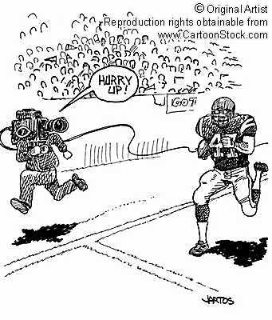
Sports & the Media:
The State University of New York
Dr. Sungick Min

Slide 4
What is Mass Media?
“Means of public communication reaching a large audience”
American Heritage Dictionary, 4th ed.
“Newspapers, motion pictures, radio, television, and magazines, all of which have the technical capacity to deliver information to millions of people.”
American Heritage Dictionary of Cultural Literacy, 3rd ed.

Slide 5
The purpose of the Media
Primary purpose of the Media
- to transmit information of interest to its
specific target audience
The media business is essential to give the editorial staff the freedom and funding needed to pursue their journalistic responsibilities.

Slide 6
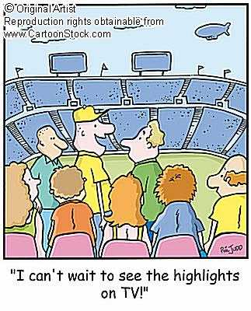
Mass Media Structures
Print
Newspapers
Magazines
Electronic
Radio
Television
Internet

Slide 7
Table 13.1

Slide 8
Positive Effects of Sport Media
Create excitement leading up to sporting events by describing the action during the event.
https://www.youtube.com/watch?v=nySProefTHc&t=7s
Affect the popularity of sport,
Provide free publicity
Present player personalities and build fan allegiance to teams and individual players.
=>To attract an audience and participants

Slide 9
Negative Effects of Sport Media
Rule Changes – MLB strike zone & DH (Designated Hitter)
Attendance Declines Due to Televised Sport
Gambling

Slide 10
Delivering the announcement
By holding press conferences
https://www.youtube.com/watch?v=vk6jYT7PB0Y
By sending press releases through the mail, via e-mail, or by fax

Slide 11
Press Conferences
Valid reasons for calling a press conference
- A major change in personnel including
players, coach, owners, or management
**A.J. Burnett press conference**
http://www.youtube.com/watch?v=ucziOp19i7k&feature=PlayList&p=39929FFDD4AAA4B0&playnext=1&playnext_from=PL&index=17

Slide 12
Press Conferences
- Scheduling of an important event
- A change in facility location or name
- Introduction of a new or revised product
such as new uniforms or logo
- Presentation or display of award
- Announcement of a new rule or policy

Slide 13
Press Conferences
- Announcement of a major sponsor/
partnership agreement
- Announcement of an infraction or rule violation
***A-Rod Press Conference***
http://www.youtube.com/watch?v=kwLszCGc8Vg
http://www.youtube.com/watch?v=FA7ty2LQwc0&feature=fvw

Slide 14
Press releases
Standard press release criteria
- Double-space content on 8.5-by-11-inch
paper using only one side of each sheet
- Side margins should be 1 inch/bottom 2
inches
- The supplier’s name, address, and contact
information

Slide 15
- Arrange the material in descending order of
importance
- Include the 5Ws (Who, What, When, Where,
and Why)
- Utilize quotes from key personalities
- Brevity is key; Sentences not exceed 17 words
and paragraphs 2-3 sentences
- Mark the release’s conclusion with a series of
circled “###” or “End”

Slide 16
Servicing the Media at the Event Site
Media Guides
- Typically developed as a preseason or
pre-event content supply tool
- a team media guide includes basic profiles and
photographs of each player, coach, and
selected members of the administration

Slide 17
Servicing the Media at the Event Site (Continued)
Accreditation
- Maintaining a safe, exclusive, and professional work
environment for the media and to maintain a
reasonable level of security for the athletes and
others working in nonpublic areas
- includes the design and distribution to authorized
personnel passes that visually identify the
bearers/affiliation and permit them access to
restricted areas

Slide 18
Media Center Facilities
Media workroom
- seating with tabletops/multiple power outlets and surge
protectors/telephones/high-speed data lines/workspace
lightning/television monitors/fax machine/rosters and
line-ups/press releases/media guides/
http://www.youtube.com/watch?v=BYrUZfNbieg

Slide 19
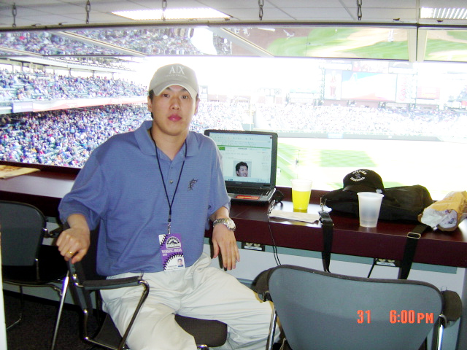

Slide 20
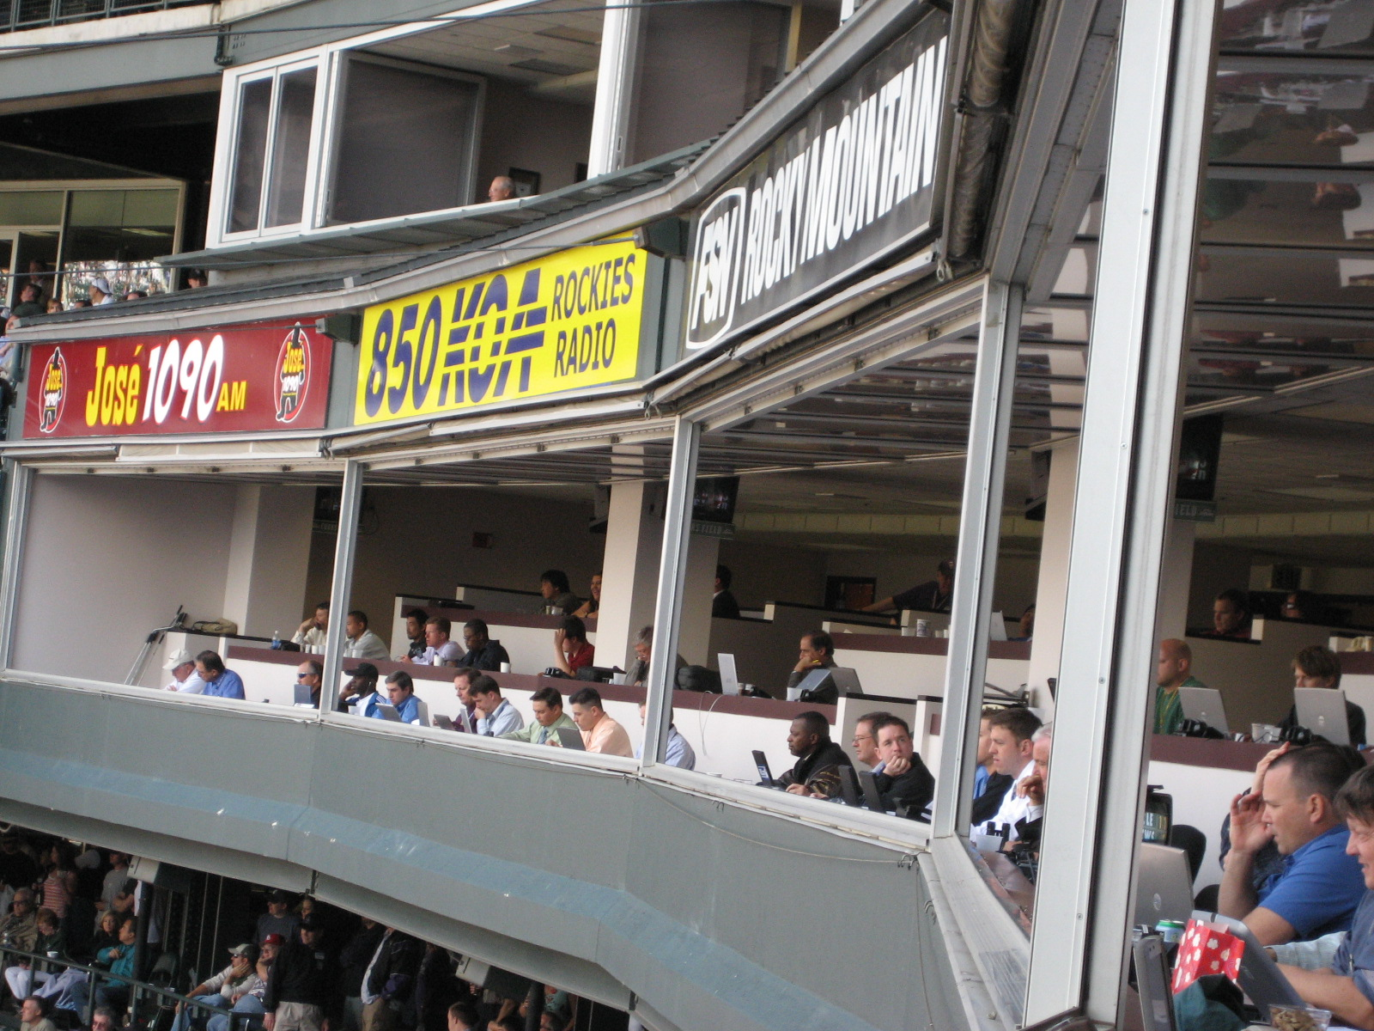

Slide 21
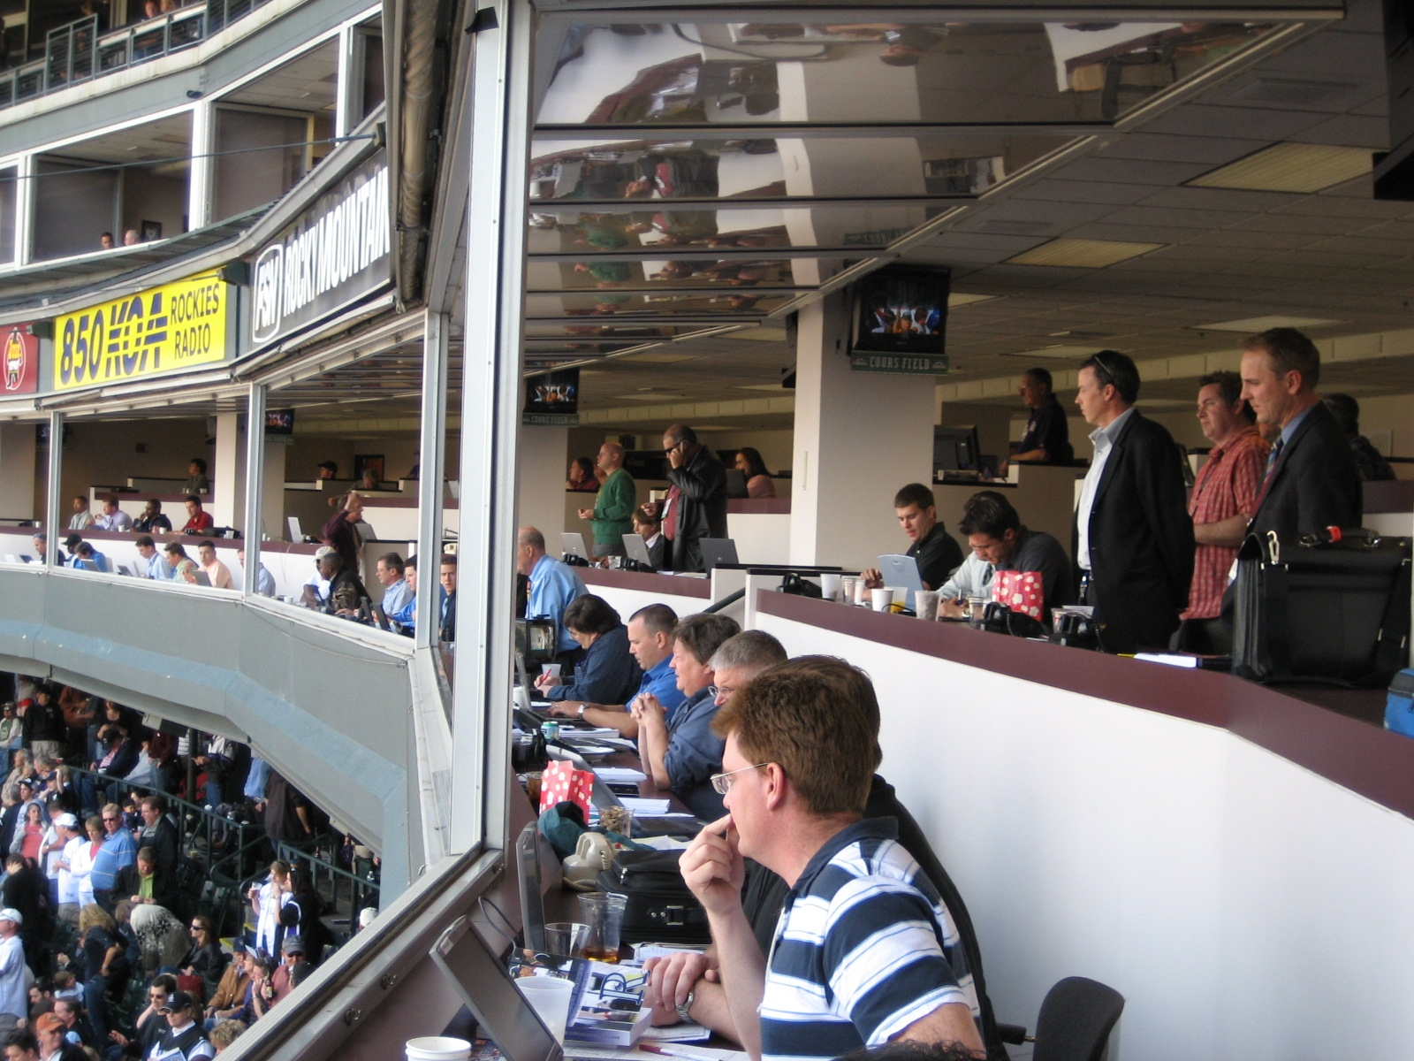

Slide 22
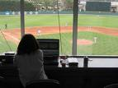
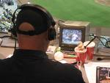

Slide 23
Media Center Facilities
Media Lounge or Hospitality Area
Media relations office
- located within close proximity of the media
workroom
- the office should be staffed at all times

Slide 24
Media Center Facilities
Press conference and interview facilities
- quiet/limited access space
- media seating
- table microphones with flashes for interviewees
- wireless microphones for moderator and
interviewer questions
- camera/photographer riser
- lightning for stage and podium

